Slide 1
An Algorithm for the Steiner Problem in Graphs
M. L. Shore, L. R. Foulds, P. B. Gibbons
Networks, Vol. 12, 1982, pp. 323-333.
Speaker: Chuang-Chieh Lin
Advisor: Professor Maw-Shang Chang
Dept. of CSIE, National Chung-Cheng University
November 16, 2005

Slide 2
Outline
Introduction
Branch-and-bound strategy
  General concept of the algorithm
  The branching method
  The bounding method
Numerical example
Conclusions
References

Slide 3
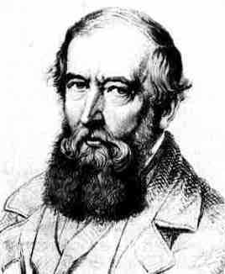
Introduction
Steiner’s problem (SP)
  SP is concerned with connecting a given set of points in an Euclidean plane by lines in the sense that there is a path of lines between every pair in the set.
Steiner problem in graphs (SPG)
  SPG is a graph-theoretic version of the SP.
Jakob Steiner

Slide 4
SPG (contd.)
  Let w : E→R be a weight function, such that each edge e in E has a weight w (e), where R is the set of real numbers. For each edge e_{ij} = {v_{i} , v_{j}} in E, we denote its weight w (e_{ij}) by w_{ij} .
  A path between point v_{i} and v_{j} in G is a sequence of the form:
  where v_{αk} , k = 1, 2, …, p, are distinct points in G and the pairs are edges in G.

Slide 5
SPG (contd.)
SPG is then defined as follows:
Given a weighted graph G = (V, E) and a nonempty subset V ' of V, the SPG requires the identification of a subset E* of E such that:
  The edges in E* connect the points in V' in the sense that between every pair of points in V', there exists a path comprising only edges in E*.
  The sum of weights of the edges in E* is a minimum.

Slide 6
SPG (contd.)
To discuss this article more conveniently, we call the vertices in V ' terminals, and vertices in V \ V' Steiner points from now on.
Throughout our discussion, we assume that all edges of a graph G = (V, E) under consideration have non-negative weights.

Slide 7
This restriction means that among the optimal solutions, there will exist a tree.
Thus we shall solve the SPG by finding a tree containing V ' which is a subgraph of G and is of minimum total weight.
Let us see some examples.

Slide 8
5
A Steiner tree
6
5
2
2
2
3
3
4
2
4
2
13
: E \ E*
: E*
: V'
; terminals
: V \ V'
; Steiner points
The sum of weights of this Steiner tree is 2 + 2 + 2 + 2 + 4 = 12.

Slide 9
5
Another Steiner tree
6
5
2
2
2
3
3
4
2
4
2
13
: E \ E*
: E*
: V'
; terminals
: V \ V'
; Steiner points
The sum of weights of this Steiner tree is 4 + 2 + 2+ 3 + 4 = 15.

Slide 10
Special cases:
  | V ' | = 1:
  single point
  => The optimal solution has no edges and zero total weight.
  | V ' | = 2:
  SPG can be reduced to finding the shortest path in G between the nodes in V '.
  | V ' | = | V |:
  SPG can be reduced to the minimal spanning tree problem.

Slide 11
Outline
Introduction
Branch-and-bound strategy
  General concept of the algorithm
  The branching method
  The bounding method
Numerical example
Conclusions
References

Slide 12
Branch-and-bound strategy
The general ideas:
  Each edge e_{ij} can be temporarily excluded from consideration.
  The set of included edges for a partial solution will form a set of connected components; those components that contain points in V ' are called essential components.
  The criterion for a solution to be feasible is that there is only one essential component. (All points in V ' are connected by the set of includes edges.)
include
exclude
Notes:
Some edges may be temporarily excluded from consideration. => 要加在後面的slides

Slide 13
  As an edge e_{ij} is added to the set of included edges, the components containing v_{i} an v_{j} will be combined to form one component.
  When a further edge is excluded, the component structure remains unaltered.

Slide 14
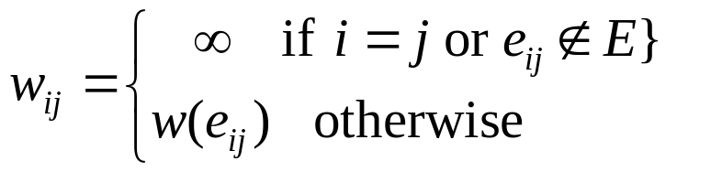
Other preliminaries of the algorithm:
  Let |V | = n and |V' | = m. Relabel the points in V' as v₁, v₂, … , v_{m} and those in V \ V' as v_{m+1}, v_{m+2}, … , v_{n}.
  Construct a matrix W = [w_{ij}]_{n×n} , where

Slide 15
  Calculate the lower bound and the upper bound at the current visited node in the branch-and-bound tree.
    (Fathomed) If the lower bound is equal to the upper bound, return the feasible solution.
    (Fathomed) If the lower bound is greater than the presently found lowest upper bound, discard this node.
    (Fathomed) If the node itself represents an infeasible solution, discard this node.

Slide 16
    (Unfathomed) Else, branch on each node to two nodes. One node is generated by excluding an edge from consideration and the other one is generated by including it in the partial solution. The latter node is always selected first. (This leads to an initial examination of successive partial solutions of accepted edges.) < depth-first; quickest-feasible-solution strategy >
Next, let us proceed to the branching method.

Slide 17
Outline
Introduction
Branch-and-bound strategy
  General concept of the algorithm
  The branching method
  The bounding method
Numerical example
Conclusions
References

Slide 18
The branching method
Assume that we are branching on an unfathomed node N.
We associate with each edge a penalty for not adding it to the set of included edges.
The edge with the largest penalty will be selected for branching.
How do we calculate a penalty?
  penalty vector

Slide 19
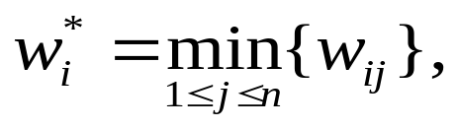
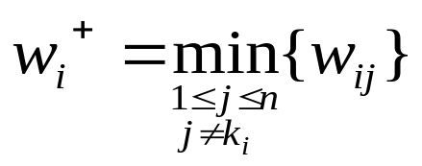
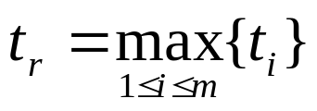
A penalty vector T = {t_{i}: i = 1, 2, … , m} is calculated as follows:
  Compute k_{i} = the value of j producing w_{i}*.
  Compute .
  Compute t_{i} = w_{i}⁺ − w_{i}*
  At last,
Then the edge e_{r, kr} is the edge to branch.
Two nodes emanating from N are created.
Notes:
每次都選擇terminals來看(since i=1, 2, …m)
後面有例子

Slide 20
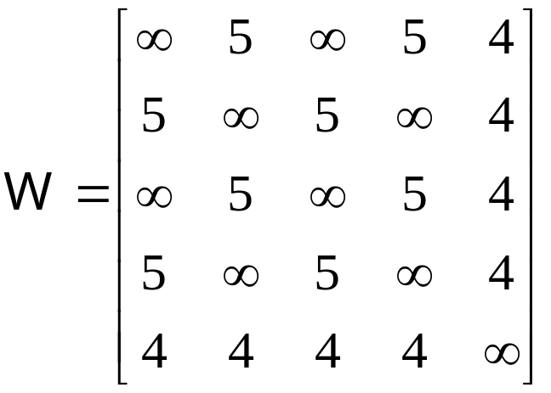
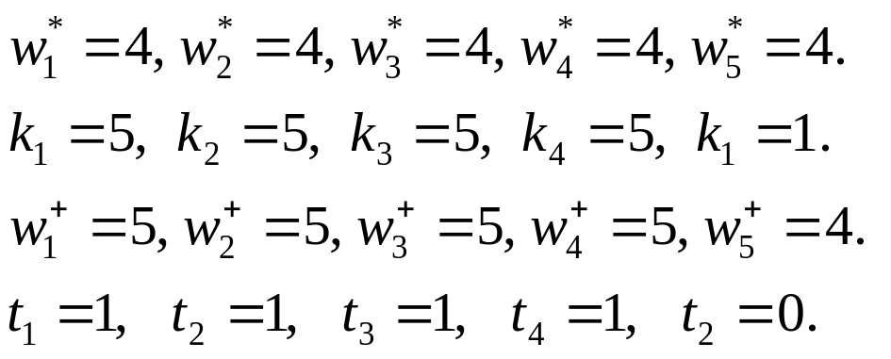
For example, let us see the following graph:
v₁
v₃
(v₁, v₂, v₃, v₄ are terminals and v₅ is a Steiner point.)
5
5
v₂
5
4
5
4
4
v₅
4
v₄
∴t_{r} = 1 and the edge to branch can be e_{1, 5}

Slide 21
v₁
v₃
v₂
Node 0
v₄
v₅
v₁
v₁
v₃
v₃
v₂
v₂
4
or
v₅
v₄
v₅
v₄
Node 1
Node 2

Slide 22
In order to produce a bound for a new partial solution, we must temporarily adjust the weight matrix W.
If the new partial solution was produced by adding e_{xy} to the set of excluded edges, then we temporarily set w_{xy} = w_{yx} = ∞.
If the new partial solution was produced by adding e_{xy} to the set of included edges, then components, c_{x} and c_{y} , where v_{x} and v_{y} belong are combined. W is then transformed to W ' with one less row in each row and one less column in each column.

Slide 23
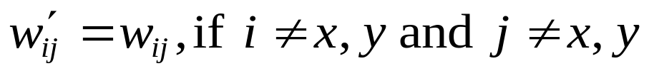
Thus if we let W ' =[w'_{ij}],
  If 1 ≤ x ≤ m,
  Otherwise,
<for included edges>
(i.e., x is a terminal)
(i.e., x is a Steiner point)

Slide 24
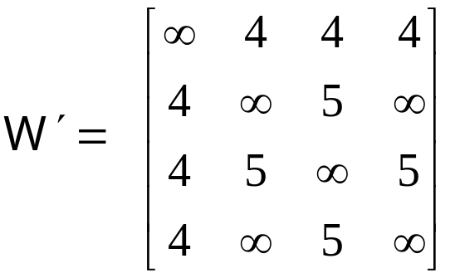
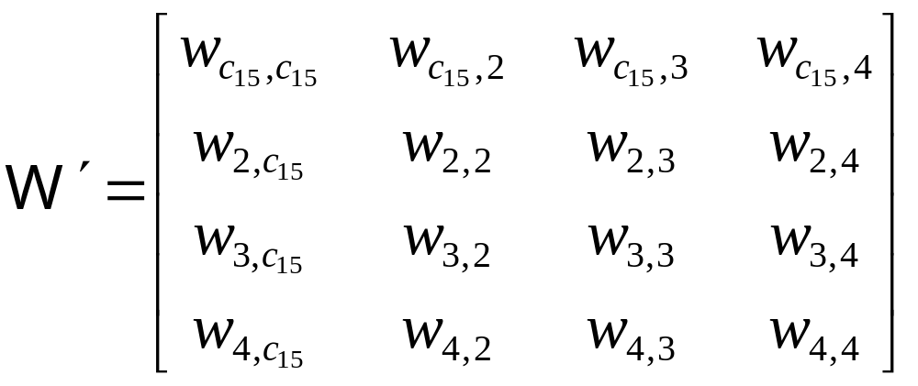
For example, in the previous example,
At node 1, W will be temporarily changed to
v₁ and v₅ are combined

Slide 25
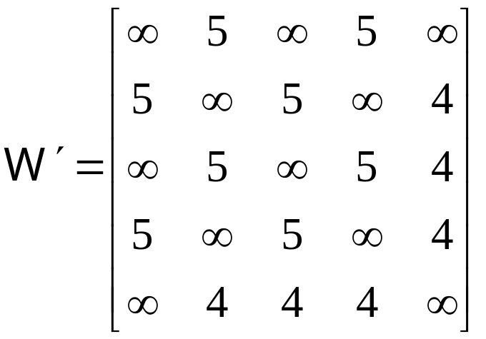
At node 2, W will be temporarily changed to

Slide 26
Outline
Introduction
Branch-and-bound strategy
  General concept of the algorithm
  The branching method
  The bounding method
Numerical example
Conclusions
References

Slide 27
The bounding method
Upper bound:
  At each branching node N, finding the minimal spanning tree from the current node. Then the sum of weights of this tree is an upper bound for N. (Actually, The authors didn’t calculate the upper bounds, so we omit the proof here.)
Lower bound:
  The Lower bound is calculated for a node with weight matrix W by using the following theorem.

Slide 28
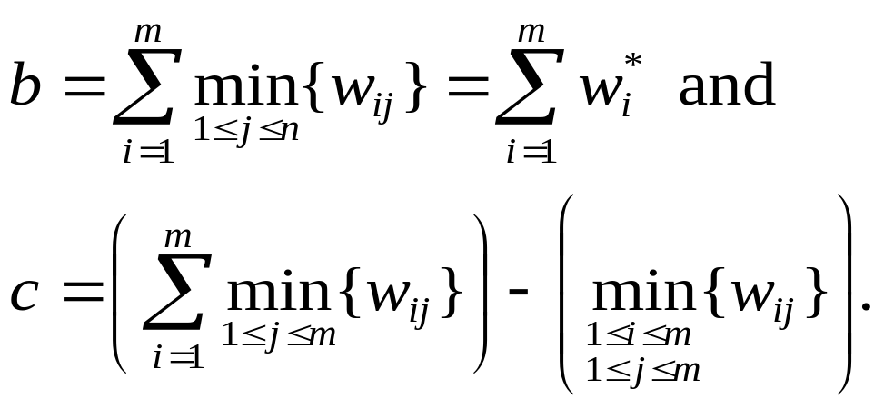
The bounding method (contd.)
Theorem.
Consider an SPG on graph G = (V, E) with the optimal solution z*. Then we have z* ≥ min [b, c], where

Slide 29
Proof:
Consider a minimal tree T * with length z* spanning V'.
Suppose T * = (V *, E *), where V' ⊆ V *⊆ V and E *⊆ E.
T * can be represented as the ordered triple (V_{t} , E*, v_{t}), where V_{t} ∪ {v_{t}} = V *, and there is a one-to-one correspondence h: V_{t} → E * such that v_{i} is incident with h(v_{i}), for all v_{i}∈V_{t} .
Now, let us discuss about the following two cases:
  Case I: V *\ V ' ≠ φ
  Case II: V *= V '

Slide 30
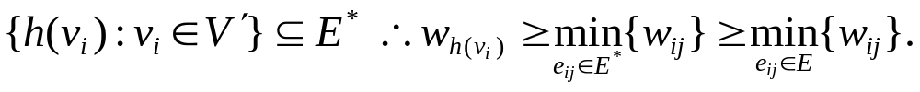
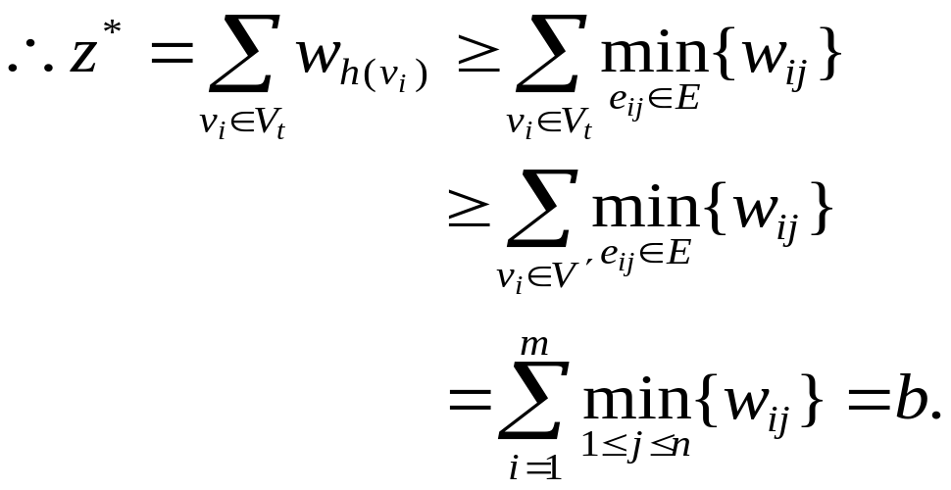
Case I. V *\ V ' ≠ φ, i.e., ∃k, m < k ≤ n s.t. v_{k}∈ V *\ V '.
  Let v_{t} = v_{k} . Therefore V' ⊆ V_{t} since v_{k}∉ V'.
  Thus,
since E*⊆ E.
Since V ' ⊆ V_{t}

Slide 31
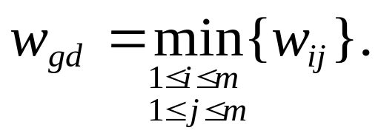
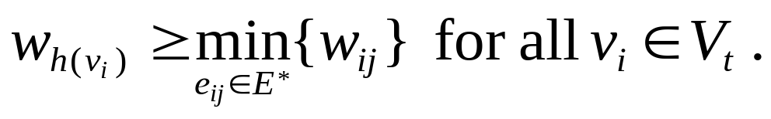
V * contains only terminals, T * becomes the minimal spanning tree of V *, that is, V'.
Case II. V *= V ' .
  Given any v_{t}∈V *, {h(v_{i}): v_{i}∈V_{t}} = E*.
  Let
  Let v_{t} = v_{g} . Now,
v_{d}
v_{g} = v_{t}
Since h(v_{i}) ∈ E *

Slide 32
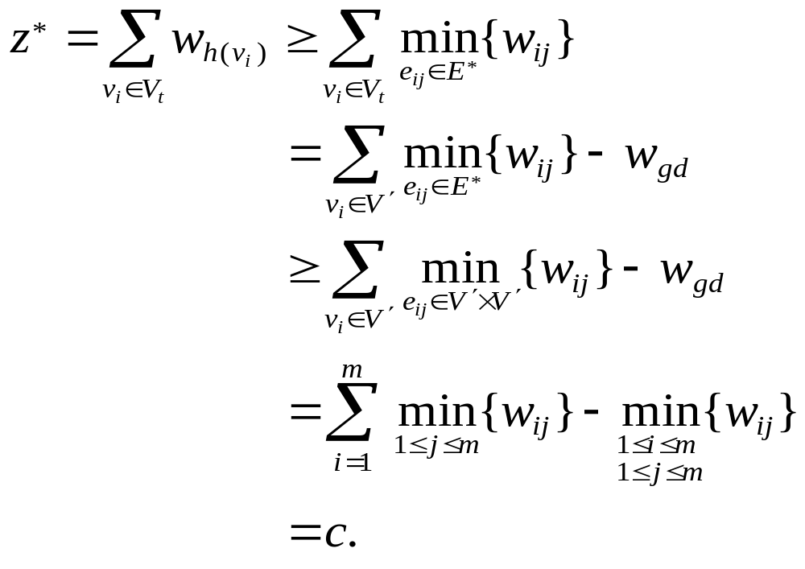
(Note that {h(v_{i}): v_{i}∈V_{t}} = E*.)
since V_{t}∪{v_{t}} = V * = V ' and v_{t} = v_{g}
since E* ⊆ V *×V * = V '× V '
Therefore, we have shown that z* ≥ b or z* ≥ c. ■

Slide 33
Outline
Introduction
Branch-and-bound strategy
  General concept of the algorithm
  The branching method
  The bounding method
Numerical example
Conclusions
References

Slide 34
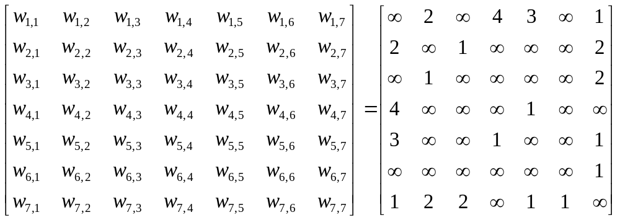
Numerical example
Now, let us see an example.
6
4
1
7
5
m = 4
3
2

Slide 35
Node 1
(4)
~ e_{4, 5}
e_{4, 5}
The authors’ branch-and-bound tree nodes
Node 17
(7)
Node 2
(4)
~ e_{5, 7}
e_{5, 7}
discard
Node i
(lower bound)
Node16
(7)
Node 3
(5)
~ e_{1, 7}
e_{1, 7}
discard
Node15
(7)
Node 4
(6)
node
~ e_{6, 7}
e_{6, 7}
discard
Node 5
(7)
Node 10
(6)
~ e_{3, 7}
e_{3, 7}
~ e_{2, 3}
Node 9
(7)
Node 6
(7)
Node 14
(7)
e_{2, 3}
discard
~ e_{2, 3}
e_{2, 3}
discard
Node 11
(6)
Node 8
(∞)
Node 7
(7)
~ e_{3, 7}
e_{3, 7}
discard
solution
Node 13
(∞)
Node 12
(6)
discard
solution

Slide 36
Node 1
(4, 7)
My branch-and-bound tree nodes
~ e_{4, 5}
e_{4, 5}
Node 7
(7, 6)
Node 2
(5, 7)
Node i
(lower bound, upper bound)
discard
~ e_{5, 7}
e_{5, 7}
Node 6
(7, 6)
Node 3
(5, 6)
node
discard
~ e_{1, 7}
e_{1, 7}
Node 5
(7, 6)
Node 4
(6, 6)
discard
solution
Next, we will concentrate on this bounding procedure.

Slide 37
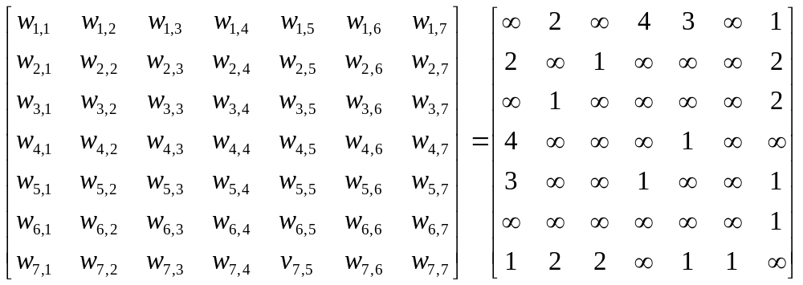
Node 1: < φ >
b = 1 + 1 + 1 + 1 = 4; c = (2 + 1 + 1 + 4) −(1) = 7
lower bound = min [b, c] = 4
upper bound = 7 ⇒ global upper bound (by finding a minimal spanning tree of v₁, v₂, v₃ and v₄)
pick?

Slide 38
Node 1
(4, 7)
~ e_{4, 5}
e_{4, 5}
Node 7
(?, ?)
Node 2
(?, ?)

Slide 39
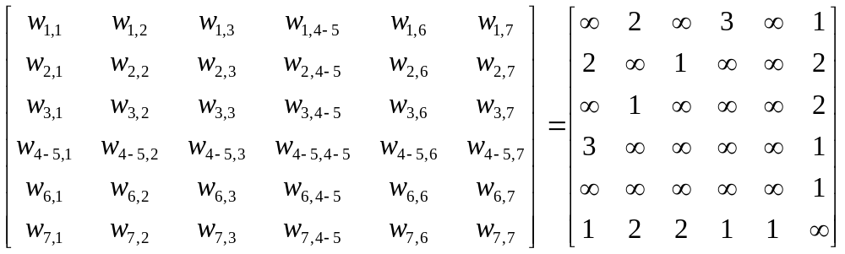
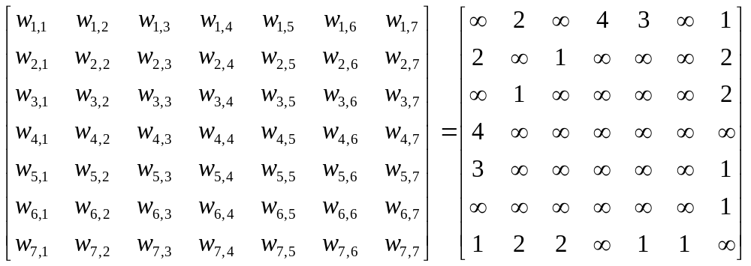
For node 2: (pick e_{4, 5})
For node 7: (don’t pick e_{4, 5})

Slide 40
Node 2: < e_{4, 5} >
b =1 + 1 + 1 + 1 = 4; c = (2+1+1+1) − (1) = 4
lower bound = 1 + min [b, c] = 5
upper bound = |e_{4, 5}| + | e_{5, 1}| + |e_{1, 2}| + |e_{2, 3}| = 1 + 3 + 2 + 1 = 7 ⇒ global upper bound (by finding a minimal spanning tree of v₁, v₂, v₃ and v₄₋₅)
pick?

Slide 41
Node 1
(4, 7)
~ e_{4, 5}
e_{4, 5}
Node 7
(?, ?)
Node 2
(5, 7)
~ e_{5, 7}
e_{5, 7}
Node 6
(?, ?)
Node 3
(?, ?)

Slide 42
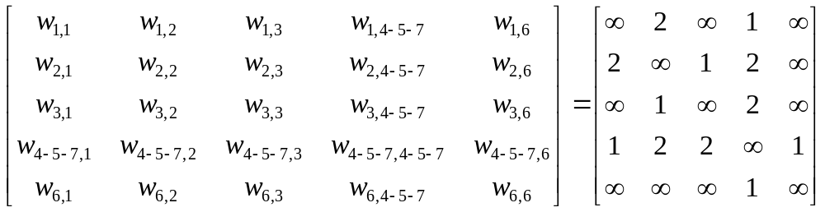
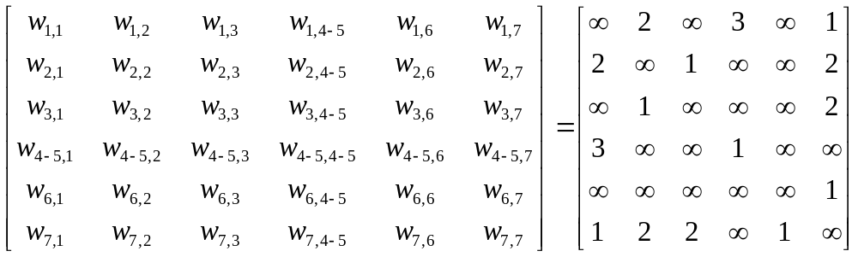
For node 3: (pick e_{5,} ₇)
For node 6: (don’t pick e_{5, 7})

Slide 43
Node 3: < e_{4, 5} , e_{5, 7} >
b =1 + 1 + 1 + 1 = 4; c = (1+1+1+1) − (1) = 3
lower bound = 2 + min [b, c] = 5
upper bound = |e_{4, 5}| + | e_{5, 7}| + |e_{7, 1}| + |e_{1, 2}| + |e_{2, 3}| = 1 + 1 + 1 + 2 + 1 = 6 ⇒ global upper bound (by finding a minimal spanning tree of v₁, v₂, v₃ and v₄₋₅₋₇)
pick?

Slide 44
Node 1
(4, 7)
~ e_{4, 5}
e_{4, 5}
Node 7
(?, ?)
Node 2
(5, 7)
~ e_{5, 7}
e_{5, 7}
Node 6
(?, ?)
Node 3
(5, 6)
~ e_{1, 7}
e_{1, 7}
Node 5
(?, ?)
Node 4
(?, ?)

Slide 45
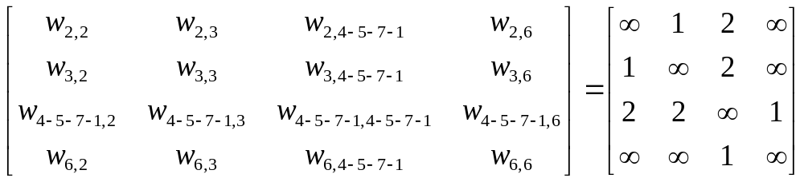
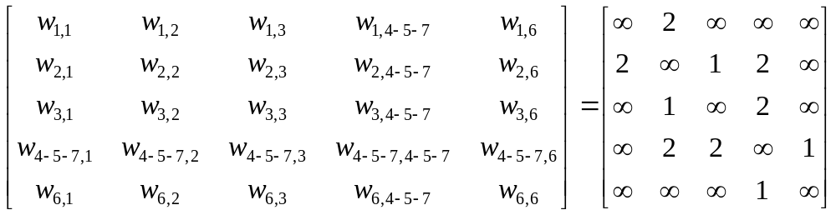
For node 4: (pick e_{1,} ₇)
For node 5: (don’t pick e_{1, 7})

Slide 46
Node 4: < e_{4, 5} , e_{5, 7} , e_{1, 7} >
b =1 + 1 + 1 + 1 = 4; c = (1+1+1+1) − (1) = 3
lower bound = 3 + min [b, c] = 6
upper bound = |e_{4, 5}| + |e_{5, 7}| + |e_{7, 1}| + |e_{1, 2}| + |e_{2, 3}| = 1 + 1 + 1 + 2 + 1 = 6 = global upper bound (by finding a minimal spanning tree of v₂, v₃ and v₄₋₅₋₇₋₁)
A feasible solution is here since its lower bound = its upper bound.

Slide 47
Node 1
(4, 7)
~ e_{4, 5}
e_{4, 5}
Node 7
(?, ?)
Node 2
(5, 7)
~ e_{5, 7}
e_{5, 7}
Node 6
(?, ?)
Node 3
(5, 6)
~ e_{1, 7}
e_{1, 7}
Node 5
(?, ?)
Node 4
(6, 6)
solution

Slide 48
Node 5: < e_{4, 5} , e_{5, 7} , ~e_{1, 7} >
b =2 + 1 + 1 + 1 = 5; c = (2+1+1+2) − (1) = 5
lower bound = 2 + min [b, c] = 7
upper bound = |e_{4, 5}| + |e_{5, 7}| + |e_{7, 2}| + |e_{2, 3}| + |e_{2, 1}| = 1 + 1 + 2 + 1 + 2 = 7 > global upper bound = 6 (by finding a minimal spanning tree of v₁, v₂, v₃ and v₄₋₅₋₇)
Discard this node since its lower bound is higher than global upper bound

Slide 49
Node 1
(4, 7)
~ e_{4, 5}
e_{4, 5}
Node 7
(?, ?)
Node 2
(5, 7)
~ e_{5, 7}
e_{5, 7}
Node 6
(?, ?)
Node 3
(5, 6)
~ e_{1, 7}
e_{1, 7}
Node 5
(7, 6)
Node 4
(6, 6)
discard
solution

Slide 50

Node 6: < e_{4, 5} , ~ e_{5, 7} >
b = 1 + 1 + 1 + 3 = 6; c = (2 + 1 + 1 + 3) − (1) = 6
lower bound = 1 + min [b, c] = 7
upper bound = |e_{4, 5}| + |e_{5, 1}| + |e_{1, 2}| + |e_{2, 3}| = 1 + 3 + 2 + 1 = 7 > global upper bound = 6 (by finding a minimal spanning tree of v₁, v₂, v₃ and v₄₋₅)
Discard this node since its lower bound is higher than global upper bound

Slide 51
Node 1
(4, 7)
~ e_{4, 5}
e_{4, 5}
Node 7
(7, 6)
Node 2
(5, 7)
~ e_{5, 7}
e_{5, 7}
Node 6
(7, 6)
Node 3
(5, 6)
discard
~ e_{1, 7}
e_{1, 7}
Node 5
(7, 6)
Node 4
(6, 6)
discard
solution

Slide 52
Node 7: < ~e_{4, 5} >
b = 1 + 1 + 1 + 4 = 7; c = (2 + 1 + 1 + 4) − (1) = 7
lower bound = min [b, c] = 7
upper bound = |e_{1, 2}| + |e_{2, 3}| + |e_{1, 4}| + |e_{2, 3}| = 2 + 1 + 4 = 7 > global upper bound = 6 (by finding a minimal spanning tree of v₁, v₂, v₃ and v₄)
Discard this node since its lower bound is higher than global upper bound

Slide 53
Node 1
(4, 7)
~ e_{4, 5}
e_{4, 5}
Node 7
(7, 6)
Node 2
(5, 7)
discard
~ e_{5, 7}
e_{5, 7}
Node 6
(7, 6)
Node 3
(5, 6)
discard
~ e_{1, 7}
e_{1, 7}
Node 5
(7, 6)
Node 4
(6, 6)
discard
solution

Slide 54
Node 1
(4, 7)
~ e_{4, 5}
e_{4, 5}
Node 7
(7, 6)
Node 2
(5, 7)
discard
~ e_{5, 7}
e_{5, 7}
Node 6
(7, 6)
Node 3
(5, 6)
discard
~ e_{1, 7}
e_{1, 7}
Node 5
(7, 6)
Node 4
(6, 6)
discard
solution
Procedure terminated.

Slide 55
Outline
Introduction
Branch-and-bound strategy
  General concept of the algorithm
  The branching method
  The bounding method
Numerical example
Conclusions
References

Slide 56
Conclusions
This article is related to our project but the Steiner points in our project are much more and unknown.
It is related to constructing phylogeny or phylogenetic trees.
Any question?

Slide 57
This slides are available at
http://www.cs.ccu.edu.tw/~lincc/paper/An_Algorithm_for_the_Steiner_Problem_in_Graphs_20051116.ppt

Slide 58
The End
Thank you

Slide 59
References
[B62] On a Routing Problem, Bellman, R. E., Quarterly of Applied Mathematics, Vol. 16, 1962, pp. 349.
[C72a] The Generation of Minimal Trees with Steiner Topology, Chang, S. K., Journal of the ACM, Vol. 19, 1972, pp. 699.
[C72b] Graph Theory : An Algorithm Approach, Christofides, N., Academic Press, London, 1975, pp. 145.
[C70] On the Efficiency of the Algorithm for Steiner Minimal Trees, Cockayne, E. J., SIAM Journal on Applied Mathematics, Vol. 18, 1970, pp. 150.
[D59] A Note on Two Problems in Connection with Graphs, Dijkstra, E. W., Numerische Mathematik, Vol. 1, 1959, pp. 269.
[DW72] The Steiner Problem in Graphs, Dreyfus, S. E. and Wagner, R. A., Networks, Vol. 1, 1972, pp. 195-207.
[F58] Algorithm 97, Shortest Path, Floyd, R. W., Communications of the ACM, Vol. 16, 1958, pp. 87-90.
[F56] Network Flow Theory, Ford, L. R., The Rand Corporation, July, 1956.
[FG78] A Branch and Bound Approach to the Steiner Problem in Graphs, Ford, L. R. and Gibbons, P. B., 14th Ann. Conf. O.R.S.N.Z., Christchurch, New Zealand, May, 1978.

Slide 60
[FHP78] Solving a Problem Concerning Molecular Evolution Using the O.R. Approach, Foulds, L. R., Hendy, M. D. and Penny E. D., N.Z. Operational Research, Vol. 6, 1978, pp. 21-33.
[H71] Steiner’s Problem in Graphs and Its Implications, Hakimi, S. L., Networks, Vol. 1, 1971, pp. 113-133.
[KW72] Algorithm 422-minimal Spanning Tree, Kevin, V. and Whitney, M., Communications of the ACM, Vol. 15, 1972.
[K56] On the Shortest Spanning Subtree of a Graph and the Traveling Salesman Problem, Kruskal, J. B., Jr., Proceedings of Am. Math Soc., Vol. 7, 1956, pp. 48.
[M61] On the Problem of Steiner, Melzak, Z. A., Canadian Mathematical Bulletin, Vol. 4, 1961, pp. 355.
[M57] The Shortest Path through a Maze, Moore, E. F., Proc. Int. Symp. on the Theory of Switching, Part II, 1957, pp. 285.
[P57] Shortest Connection Networks and Some Generalizatons, Prim, R. C., Bell Syst. Tech. J., Vol. 36, 1957, pp. 1389.
[S71] Combinatorial Programming, Spatial Analysis, and planning, Scott, A., Methuen, London, 1971.
[TM80] An Approximation Solution for the Steiner Problem in Graphs, Takahashi, H. and Matsuyama, A., Math. Japonica, Vol. 24, 1980, pp. 573-577.

Slide 61

中正大學計算理論實驗室

Slide 62
v_{t}
V' ⊆ V* ⊆ V
all points : V
: V \ V *
Steiner points
: V *\ V'
: V'
terminals

Slide 63
<Case I>
v_{t}
h(v₄)
v₄
h(v₁)
v₁
h(v₂)
h(v₃)
V' ⊆ V* ⊆ V
v₂
v₃
all points : V
: V \ V *
Steiner points
: V *\ V'
: V'
terminals
V *

Slide 64
<Case II>
v_{t} = v_{g}
V' = V* ⊆ V
all points : V
: V \ V *
Steiner points
: V *= V'
terminals

