Slide 1
Approximate Matching of Polygonal Shapes
Speaker: Chuang-Chieh Lin
Advisor: Professor R. C. T. Lee
National Chi-Nan University

Slide 2
Outline
Introduction
Determine the Hausdorff-distance
On a fixed translation & Davenport-Schinzel sequences
Pseudo-optimal solutions
References

Slide 3
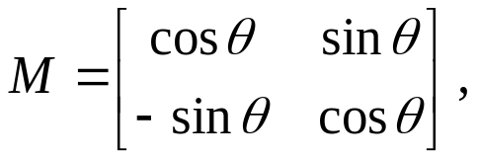


Introduction
Problem:
For two given simple polygons P and Q, the problem is to determine a rigid motion I of Q giving the best possible match between P and Q, i.e. minimizing the Hausdorff-distance between P and I(Q)
Input: Two polygons P and Q
Output: An isometry I such that the Hausdorff-distance between P and I(Q)
Generally, + t, where
t = <t_{x}, t_{y}> is a translation vector.

Slide 4

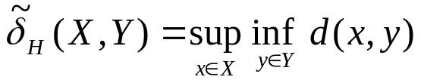

Determine the Hausdorff-distance (1/4)
The Hausdorff-distance between P and I(Q) is defined as:
, where , d(x, y) is the Euclidean distance in the plane.
How can we determine the Hausdorff-distance between two polygons?
        By Voronoi diagrams [A83]
X
Y
x₁
y₁
9
x₂
7
y₂

Slide 5
Determine the Hausdorff-distance (2/4)
Examples: [F87] & [Y87]

Slide 6
Determine the Hausdorff-distance (3/4)
Note that the Voronoi edge can be a parabolic edge when a point meets a line segment. [F87] & [Y87]
x
L
parabolic edge

Slide 7

Determine the Hausdorff-distance (4/4)
Why do we adopt Voronoi diagrams?
Lemma:
is either at some vertex of Q or at some intersection point of Q with some Voronoi-edge e of P having either the smallest or largest x-coordinate among the intersection points of Q with e. [ABB91]
P
Q

Slide 8
On a fixed translation & Davenport-Schinzel sequences (1/3)
Suppose the isometry I_{t} = t for t = (t, 0), A is a point or a line segment of P, e/ is a Voronoi-edge of P bounding the Voronoi-cell C, and e is an edge of Q.
When we move polygon Q through a vector t, we need to analyze the Hausdorff-distances. These distances are “dynamic” and can be formed as distance functions. From the previous lemma, we know that is the maximum of these function above at some t. [ABB91] & [A85]
e/
A
e
C
t

Slide 9
On a fixed translation & Davenport-Schinzel sequences (2/3)
In order to determine , we have to apply the theory of Davenport-Schinzel sequence to find the upper envelope of these functions. [AS95]
As the figure above, the upper envelope of these functions is the function drawn red. We define (1, 3, 2, 4) to be the upper-envelope sequence of these functions.
f₄
f₁
f₂
f₃
t
1 3 2 4

Slide 10

On a fixed translation & Davenport-Schinzel sequences (3/3)
Why do we use the concept of Davenport-Schinzel sequence (We denote it as DS(n, s)-sequence)?
From a theorem (see [AS95]), we can obtain that the complexity of finding upper-envelope of univariate functions can be viewed as the maximum length of possible DS(n, s)-sequences.
The complexity in this case is , where p is the number of vertices of P and q is the number of vertices of Q. [ASS89]
In addition, Davenport-Schinzel sequences have many geometric applications which relate to computing envelopes.

Slide 11

Pseudo-optimal solutions (1/4)
What is a Pseudo-optimal solution?
An algorithm is said to produce a pseudo-optimal solution, if and only if there is a constant c > 0 such that on input P, Q the algorithm finds a translation (isometry) I with where δ is the minimal Hausdorff-distance determined by the optimal solution.

Slide 12





Pseudo-optimal solutions (2/4) – Without rotations
Let where x_{P} (y_{P}) is the smallest x-coordinate (y-coordinate) of all points in P (Q).
Y
Let , We can easily obtain
C
P
D
I(Q)
F
.
Since we will get .
r_{I (Q)}
A
Therefore, if maps r_{I(Q)} onto r_{P} , we will obtain a pseudo-optimal solution, i.e. .
y_{P}
B
X
r_{P}
E
x_{P}

Slide 13



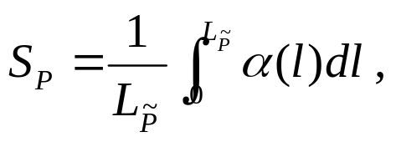


Pseudo-optimal solutions (3/4) – Allowing rotations
For another idea, we may transform polygons P and Q into convex hulls and respectively, and find the centroids S_{P} and S_{Q} of the edges of and respectively.
Why? A centroid of a polygon never changes under rotations.
S_{P} can be calculated as
where is a natural parameterization of such that the length from point α(0) to α(l ) equals l, and is the length of .

Slide 14






Pseudo-optimal solutions (4/4)
Lemma:
If an isometry gives a minimal among the ones mapping S_{Q} onto S_{P}, we can obtain that
The angle of rotation, which gives the pseudo-optimal solution , can be determined by a technique analogous to the dynamic distance functions. The time complexity is still [ABB91] & [A85] & [ASS89]
However, has been improved to
  for any c > 1. [S88]

Slide 15
References
[A83] A Linear Time Algorithm for the Hausdorff-distance between Convex Polygons, Atallah, M. J., Information Processing Letters, Vol. 17, 1983, pp. 207-209.
[A85] Some Dynamic Computational Geometry Problems, Atallah, M. J., Comput. Math. Appl., Vol. 11, 1985, pp. 1171-1181.
[ABB91] Approximate Matching of Polygonal Shapes, Alt, H. Behrends, B. and Blömer, J., In proceedings of 7th Annual ACM Symp. on Computational Geometry, 1991, pp. 186-193.
[AS95] Davenport-Schinzel Sequences and Their Geometric Applications, Agarwal, P. K. and Sharir, M., Department of Computer Science, Duke University, Durham, North Carolina, 27708-0129, September 1, 1995.
[ASS89] Sharp Upper bound and Lower Bound on the Length of General Davenport-Schinzel Sequences, Agarwal, P. K., Sharir, M. and Shor, P., Journal of Combinatorial Theory Series A, Vol. 52, 1989, pp. 228-274.
[F87] A Sweepline Algorithm for Voronoi Diagrams, Forrune, S., Algorithmica, Vol. 2, 1987, pp. 153-174.
[S88] Űber die Bitkomplexität der ε- Kongruenz, Diplomarbeit, Fachbereich Informatik, Universität des Saarlandes, 1988.
[Y87] An O(n log n) Algorithm for the Voronoi diagram of a Set of Simple Curve Segments, Yap, C. K., Discrete Computaional Geometry, Vol. 2, 1987, pp. 365-393.
Thank you.

