Slide 1

Approximating the Minimum Spanning Tree Weight in Sublinear Time
Bernard Chazelle, Ronitt Rubinfeld and Luca Trevisan
SIAM Journal on Computing, Vol. 34, No. 6, July, 2005, pp. 1370-1379.
Speaker: Chuang-Chieh Lin
Advisor: Professor Maw-Shang Chang
Computation Theory Laboratory
National Chung Cheng University

Slide 2



Bernard Chazelle, Department of Computer Science, Princeton University
Department of Electrical Engineering and Computer Science, MIT
Computer Science Division, University of California-Berkeley

Slide 3
Outline
Introduction
Related works
An overview of the algorithm in this paper
Approximating the average degree
Estimating the number of connected components
Approximating the weight of an MST
Conclusions

Slide 4
Introduction
Traditionally, a linear time algorithm has been held as the gold standard of efficiency.
In a wide variety of settings, large data sets have become increasingly common.
It is often desirable and sometimes necessary to find very fast algorithms which can assert nontrivial properties of the data in sublinear time.

Slide 5
Introduction (contd.)
One direction of research that has been suggested is that of property testing. [RS96, GG98]
Property testing algorithms distinguish between inputs that have a certain property and those are far from having the property.
Property testing can be viewed as a natural type of approximation problem.

Slide 6
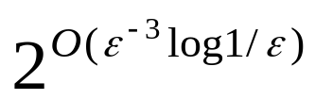
Introduction (contd.)
Many of the property testers have led to very fast, even constant time, approximation schemes for associated problem. [GG98, FK99, FKV04, ADPR03]
For example, one can approximate the value of a maximum cut in a dense graph in time , with relative error at most ε , by looking at only O(ε ^{–7} log 1/ε) locations in the adjacency matrix. [GG98]

Slide 7
Outline
Introduction
Related works
An overview of the algorithm in this paper
Approximating the average degree
Estimating the number of connected components
Approximating the weight of an MST
Conclusions

Slide 8
Related works
Finding the minimum spanning tree (MST) of a graph has a long, distinguished history [C00b, GH85, N97].
Currently the best known deterministic algorithm was proposed by Chazelle [C00a].
Chazelle’s algorithm runs in O(mα(m, n)) time, where n (resp., m) is the number of vertices (resp., edges) and αis inverse-Ackermann.

Slide 9
Related works (contd.)
Karger, Klein and Tarjan [KKT95] gave a randomized algorithm which runs in linear expected time.
In this paper, we consider the problem of finding the weight of the minimum spanning tree (MST) of a graph.
There are conditions under which it is possible to approximate the weight of the MST of a connected graph in sublinear time in the number of edges.

Slide 10
Outline
Introduction
Related works
An overview of the algorithm in this paper
Approximating the average degree
Estimating the number of connected components
Approximating the weight of an MST
Conclusions

Slide 11
An overview of the algorithm in this paper
Let G^{(i)} denote the subgraph of G that contains only edges of weight at most i.
First, we estimate the number of connected components in each G^{(i)}.
  Sample uniformly at random O(1/ε ²) vertices in each G^{(i)}.
  Estimate the size of the component that contains each sampled vertex by constructing “local trees” of some appropriate size defined by a random process.
(Note that 0 < ε < ½ )

Slide 12
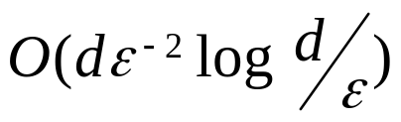
An overview of the algorithm in this paper (contd.)
Second, we can in turn produce a good approximation for the weight of the MST of G.
Estimating the number of connected components in a graph runs in time within an additive error of ε n of the true count.
  d is the average degree of the graph.
  We can ensure that d can be approximated in O(d/ε) expected time and that at most ε n/4 vertices having degree greater than the estimate of d.

Slide 13
An overview of the algorithm in this paper (contd.)
The method for estimating the number of connected components in a graph is based on a similar principle as the property tester for graph connectivity given by Goldreich and Ron [GR02].
The total running time is O(dwε ^{–2} log ^{dw}/ε). It does NOT depend on the number of vertices in G.

Slide 14
Outline
Introduction
Related works
An overview of the algorithm in this paper
Approximating the average degree
Estimating the number of connected components
Approximating the weight of an MST
Conclusions

Slide 15
Approximating the average degree
Pick C/ε vertices of G at random, for some large constant C and set d * to be the maximum degree among them.
  To find the degree of any one of them takes O(d) time on average, so the expected running time is O(Cd/ε) = O(d/ε).
(Imagine the vertex degrees sorted in nonincreasing order…☺) Let ρ be the rank of d *.
  With high probability, ρ=Θ(ε n)
  Why?

Slide 16
Approximating the average degree (contd.)
In my opinion, we can assume that C ≥ 1.
Pr({ρ > ε n}) = (1– ε)^{C/ε} ≤ e^{–C}
  Since (1 + ε)^{1/ε} e, when ε 0.
Pr({ρ > ε n/C²}) = (1– ε /C²)^{C/ε} ≥ e^{–2/C (…☺…)} > 1 – 2/C.
  Try to prove that f (x) = x + e ^{–x} > 1
0
ε/C²
ρ
ε
1

Slide 17
Approximating the average degree (contd.)
Lemma 1: In O(d/ε) expected time, we can compute a vertex degree d * that, with high probability, is the kth largest vertex degree for some k =Θ(ε n).
  Note: k = Ω(ε n) alone implies that d * = O(d/ε).
  Why?

Slide 18
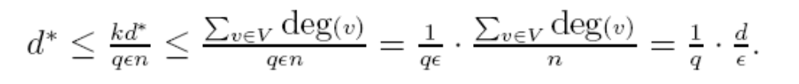
Approximating the average degree (contd.)
By C. M. Lee:
  Since k = Ω(ε n), we can assume that k ≥ qε n for some positive constant q.
  Consider the fact that kd *≤ Σ_{v∈V} deg(v).
    Why?
    Thus d * = O(d/ε).
0
k
My weekly report…
1

Slide 19
Approximating the average degree (contd.)
If we scale ε by the proper constant, we can ensure that at most ε n/4 vertices have degree higher than d *.
Lemma 1: In O(d/ε) expected time, we can compute a vertex degree d * that, with high probability, is the kth largest vertex degree for some k = Θ(ε n).
0
k
1

Slide 20
Outline
Introduction
Related works
An overview of the algorithm in this paper
Approximating the average degree
Estimating the number of connected components
Approximating the weight of an MST
Conclusions

Slide 21
Other preliminaries and notations
Let d denote the average degree of the graph.
Edge weights are in the set {1, …, w}.
Let c denote the number of connected components of the graph.
The algorithm requires no prior information about the graph besides w and n. (n is the number of vertices)

Slide 22
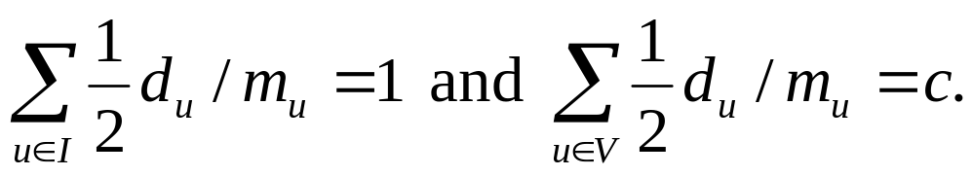
Estimating the number of connected components
Let d_{u} be the number of edges incident upon it (including self-loops).
Let m_{u} be the number of edges in u’s component in G.
Consider the following fact.
FACT: Given a graph with vertex set V, for every component I ⊆ V,
This is concerned with a problem in the algorithm course ...
Besides, we let d_{u}/m_{u} = 2 for an isolated vertex u. (m_{u}= 0 here)

Slide 23
The algorithm is as follows:

Slide 24
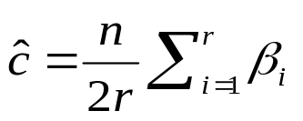
approx-number-connected-components(G, ε, W, d*)
Uniformly choose r = O(1/ε ²) vertices u₁,…,u_{r}
For each vertex u_{i} ,
  Set β_{i} = 0
  Take the first step of a BFS from u_{i}
  (*) Flip a coin!!
  If (heads) & (# vertices visited in BFS < W)
  & (no visited vertex has degree > d *)
  then { Resume BFS to double number of visited edges
  If this allows BFS to complete
  then { If m_{ui} = 0 set β_{i} = 2;
  else set β_{i} = d_{ui}2^{#coin flips}/#edges visited in BFS }
  else go to (*) }
  Output
Visit the single vertex u_{i} and all its d_{ui} incident edges
⎡log(m_{ui} /d_{ui})⎤
At least 1?

Slide 25
Illustration 1 for BFS with coin flips
A
B
C
D
A
E
F
G
d_{A} = 0
m_{A} = 0

Slide 26
First step of a BFS from A
A
Resume BFS to double number of visited edges
B
C
D
D
C
H
B
E
F
G
d_{A} = 3
m_{A} = 3

Slide 27
A
F
B
C
D
E
D
C
E
F
G
d_{A} = 3
m_{A} = 5

Slide 28
A
G
B
C
D
F
E
D
E
F
G
d_{A} = 3
m_{A} = 6

Slide 29
A
B
C
D
G
F
E
E
F
G
d_{A} = 3
m_{A} = 6

Slide 30
A
B
C
D
G
F
E
F
G
d_{A} = 3
m_{A} = 6

Slide 31
A
B
C
D
G
E
F
G
d_{A} = 3
m_{A} = 6

Slide 32
A
B
C
D
E
F
G
d_{A} = 3
β_{A} = d_{A}×2¹ / m_{A} = 1
m_{A} = 6

Slide 33
Illustration 2 for BFS with coin flips
A
B
C
D
A
E
d_{A} = 0
m_{A} = 0

Slide 34
First step of a BFS from A
A
Resume BFS to double number of visited edges
B
C
D
D
C
H
B
E
d_{A} = 3
m_{A} = 3

Slide 35
A
B
C
D
E
D
C
E
d_{A} = 3
m_{A} = 4

Slide 36
A
B
C
D
E
D
E
d_{A} = 3
m_{A} = 4

Slide 37
A
B
C
D
E
E
d_{A} = 3
m_{A} = 4

Slide 38
A
B
C
D
E
d_{A} = 3
β_{A} = d_{A}×2¹ / m_{A} = 1.5
m_{A} = 4

Slide 39
Illustration 3 for BFS with coin flips
A
B
C
D
F
E
A
G
d_{A} = 0
m_{A} = 0

Slide 40
First step of a BFS from A
A
F
Resume BFS to double number of visited edges
E
B
C
D
F
D
E
C
H
B
G
d_{A} = 5
m_{A} = 5

Slide 41
A
G
F
B
E
C
D
E
F
D
C
G
d_{A} = 5
m_{A} = 6

Slide 42
A
G
B
F
C
D
E
F
E
D
G
d_{A} = 5
m_{A} = 6

Slide 43
A
B
G
C
D
E
F
F
E
G
d_{A} = 5
m_{A} = 6

Slide 44
A
B
C
D
F
E
G
F
G
d_{A} = 5
m_{A} = 6

Slide 45
A
B
C
D
F
E
G
G
d_{A} = 5
m_{A} = 6

Slide 46
A
B
C
D
F
E
G
d_{A} = 5
β_{A} = d_{A}×2¹ / m_{A} = 5/3
m_{A} = 6

Slide 47
Illustration 4 for BFS with coin flips
A
B
C
D
A
d_{A} = 0
m_{A} = 0

Slide 48
First step of a BFS from A
A
Resume BFS to double number of visited edges
B
C
D
D
C
H
B
d_{A} = 3
m_{A} = 3

Slide 49
A
B
C
D
D
C
d_{A} = 3
m_{A} = 3

Slide 50
A
B
C
D
D
d_{A} = 3
m_{A} = 3

Slide 51
A
B
C
D
d_{A} = 3
m_{A} = 3

Slide 52
A
B
C
D
d_{A} = 3
β_{A} = d_{A}×2¹ / m_{A} = 2
m_{A} = 3

Slide 53
Estimating the number of connected components (contd.)
Notice that W is a threshold value which is set to 4/ε for counting connected components.
Note that if the BFS from u_{i} completes, the number of coin flips associated with it is ⎡log(m_{ui} /d_{ui})⎤ (at least 1).
  Think about it!

Slide 54
Estimating the number of connected components (contd.)
Let S denote the set of vertices that lie in components with fewer than W vertices all of which are of degree at most d *.
If u_{i} ∈ S, then β_{i} is 2^{⎡lg(mui} ^{/dui)⎤}d_{ui} /m_{ui} with probability 2^{–⎡lg(mui} ^{/dui)⎤} (and 2 if m_{ui} = 0);
If u_{i} ∉ S, then β_{i} = 0.
1 ≤ β_{i} ≤ 2

Slide 55
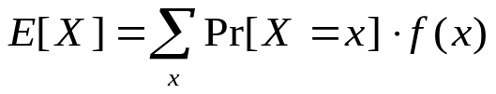
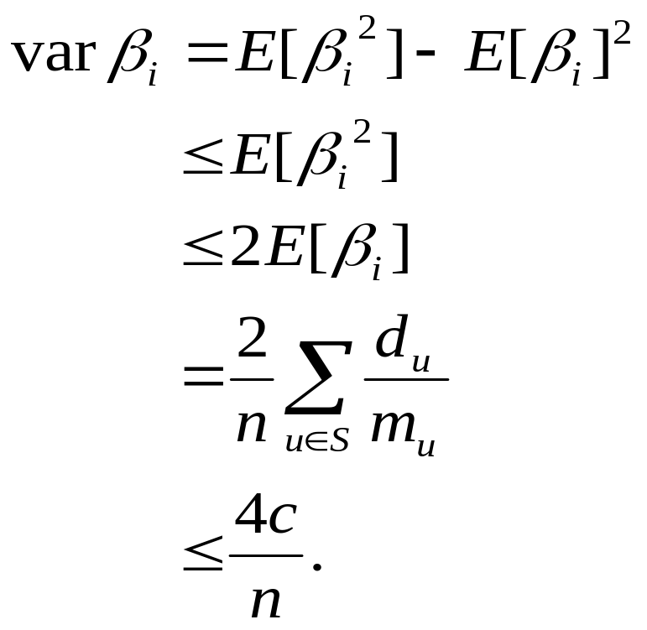
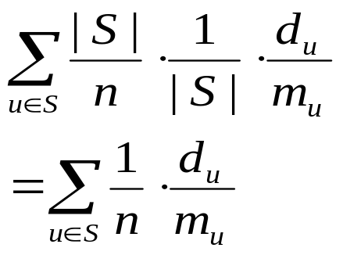
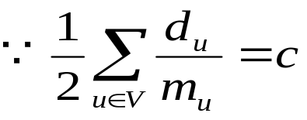
Estimating the number of connected components (contd.)
Since β_{i} ≤ 2, we have

Slide 56
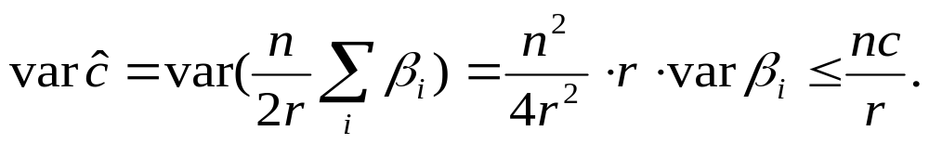
Estimating the number of connected components (contd.)
Thus the variance of ĉ is bounded by

Slide 57
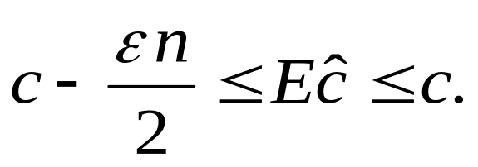
Estimating the number of connected components (contd.)
By our choice of W = 4/ε and d *, there are at most ε n/2 components NOT in S, so:
Components: n/(4/ε) = ε n/4
There are at most ε n/4 vertices having degree greater than d*
The number of connected components in S.

Slide 58
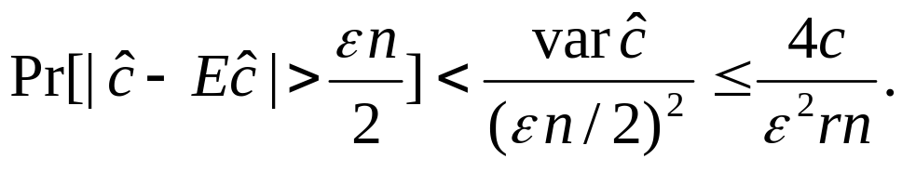
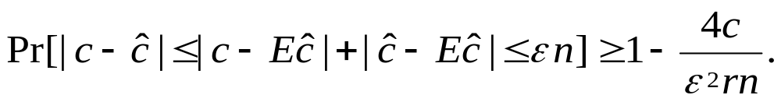
Estimating the number of connected components (contd.)
Furthermore, by Chebyshev’s Inequality,
Choosing r = O(1/ε ²) ensures that, with constant probability arbitrary close to 1, our estimate ĉ of the number of connected components deviates from the actual value by at most ε n.

Slide 59
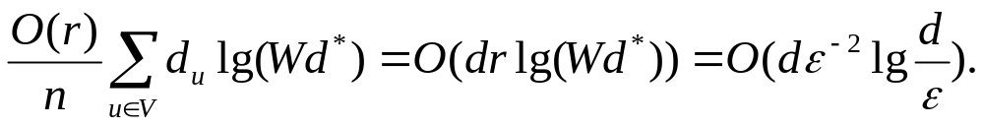
Estimating the number of connected components (contd.)
The expected number of edges visited in a given iteration of the “for-loop” is O(d_{ui} log M).
M is the maximum number of edges visited, which is at most Wd * = O(d/ε ²).
Therefore, the expected running time of the entire algorithm is (not counting the time needed for computing d * )
There are at most W vertices in the component (found by the algorithm) and the maximum vertex degree among them is d *

Slide 60
Estimating the number of connected components (contd.)
The algorithm’s running time is randomized.
However, if d is known, we can get a deterministic running time bounded by stopping the algorithm after Cdε ^{–2} log(d/ε) steps and output 0 if the algorithm has not yet terminated.
This event occurs with probability at most O(1/C).
Therefore we obtain the following theorem.

Slide 61
Estimating the number of connected components (contd.)
Theorem 1. Let c be the number of components in a graph with n vertices. Then Algorithm approx-number-connected-components runs in time O(dε ^{–2} log d/ε) and with probability at least ¾ outputs ĉ such that |c – ĉ| ≤ ε n.

Slide 62
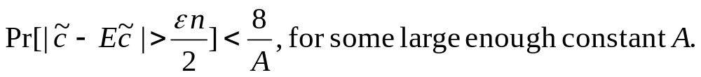
Estimating the number of connected components (contd.)
Actually,
can be fine-tuned to be
We omit the details here, OK?

Slide 63
Outline
Introduction
Related works
An overview of the algorithm in this paper
Approximating the average degree
Estimating the number of connected components
Approximating the weight of an MST
Conclusions

Slide 64
Approximating the weight of an MST
Now we are going to present an algorithm for approximating the value of the MST in bounded weight graphs.
We are given a connected graph G with average degree d and with each edge assigned an integer weight between 1 and w.
We assume that G is represented by adjacency lists.

Slide 65
Approximating the weight of an MST (contd.)
Let G^{(p)} be the subgraph of G consisting of all the edges of weight at most p.
Let c^{(p)} be the number of connected components in G^{(p)}.
  Then what is c⁽⁰⁾? What is c^{(w)} ?
Let M(G) denote the weight of the MST of G.
0 ≤ p ≤ w
c⁽⁰⁾ = n and c^{(w)}= 1

Slide 66
Approximating the weight of an MST (contd.)
Consider the case that G has only edges of weight 1 or 2 (i.e., w = 2).
c⁽¹⁾ is the number of connected components in G⁽¹⁾.
Then any MST of G must contain exactly c⁽¹⁾ – 1 edges of weight 2 (Why?) with the others being of weight 1.
Thus the weight of the MST is exactly 2(c⁽¹⁾ – 1) + [(n – 1) – (c⁽¹⁾ – 1)] × 1 = n – 2 + c⁽¹⁾.

Slide 67
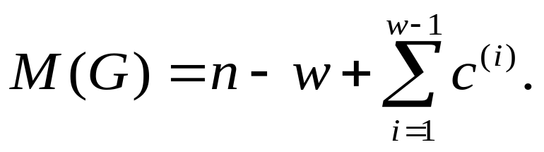
Approximating the weight of an MST (contd.)
Then we can generalize the previous derivation to any w.
CLAIM: For integer w ≥ 2,

Slide 68
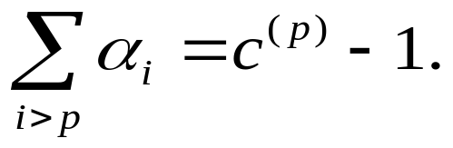
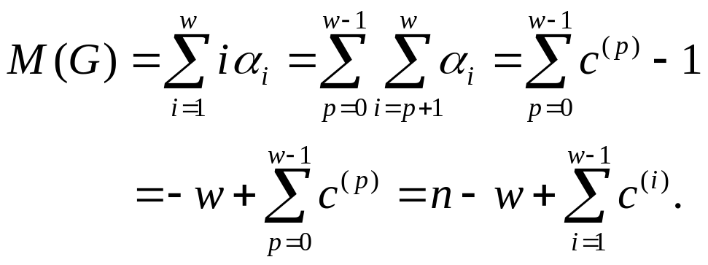
Approximating the weight of an MST (contd.)
Proof of the CLAIM:
  Let α_{i} be the number of edges of weight i in an MST of G.
    Note that α_{i} is independent of which MST we choose. [G68]
  For all 0 ≤ p ≤ w – 1,
  Therefore,

Slide 69
Approximating the weight of an MST (contd.)
Therefore, we can find that computing the number of connected components allows us to compute the weight of the MST of G.

Slide 70
Approximating the weight of an MST (contd.)
Now let us proceed with the main algorithm approximating the value of the MST.
It approximates the value of the MST by estimating each of the c^{(p)}’s.
Due to the analysis of the complexity, W is set to 4w/ε here, not 4/ε.
(Imagine that ε is substituted to be ε /w)

Slide 71
Approximating the weight of an MST (contd.)
For the same reason, we need a different estimate of d *.
  In O(dw/ε) time, an estimate d * = O(dw/ε) such that at most ε n/4w vertices have degree higher than d *.

Slide 72
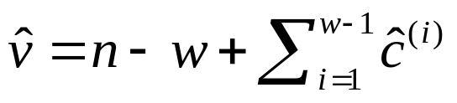
approx-MST-weight (G, ε)
For i = 1,…, w–1
ĉ^{(i)} = approx-number-connected-components(G^{(i)}, ε, 4w/ε, d *)
output

Slide 73

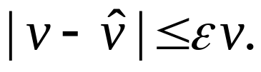
Approximating the weight of an MST (contd.)
Theorem 2. Let w/n < ½. Let v be the weight of the MST of G. Algorithm approx-MST-weight (G, ε) runs in time O(dwε ^{–2} log ^{dw}/_{ε}) and outputs a value that, with high probability at least ¾ , differs from v by at most ε n.
We have to show that

Slide 74
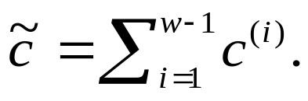
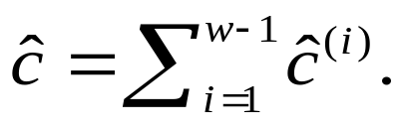
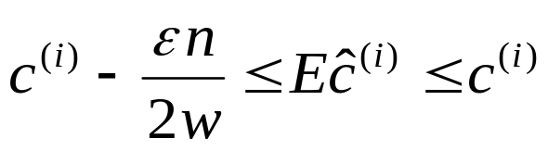
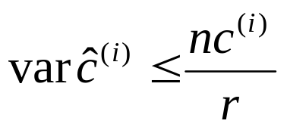
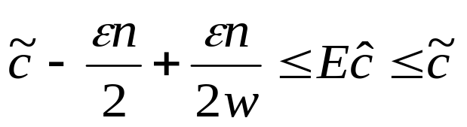
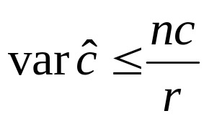
Approximating the weight of an MST (contd.)
Proof:
  Let Note that
  From the previous results, we have
  By summing over all i’s, it follows that
and
and

Slide 75
Dear Chuang-Chieh
Thanks for your interest in the article.
I think we're both correct.
You say:
"By summing over $i$, it follows that $\sum_{i=1}^{w-1}c^{(i)} -
(w-1)(\epsilon n/2w) = c-\epsilon n/2 + \epsilon n/2w \leq E\hat{c}\leq
c$ and ...."
which is true.
but this implies that
c- \epsilon n/2 \leq E\hat{c}
which is what we write. In other words, we simply leave out
the intermediate step to make the math shorter.
but it's still entirely correct.
Hope this helps.
Bernard Chazelle

Slide 76
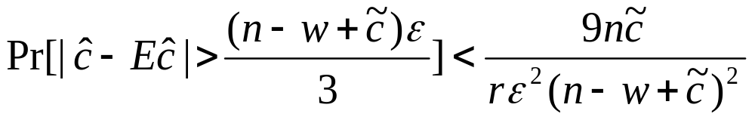
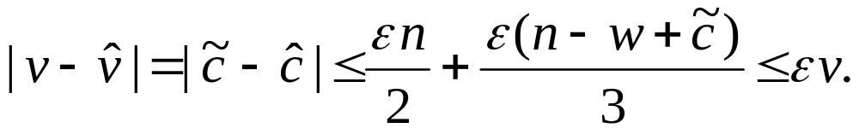
Approximating the weight of an MST (contd.)
Choosing rε ² large enough, by Chebyshev’s Inequality, we have
which can be arbitrary small.
Then with high probability,
v
= v ≥ n – 1

Slide 77
Approximating the weight of an MST (contd.)
Time complexity?
Each call to approx-number-connected-components is O(dε ^{–2} log ^{dw}/_{ε}).
Therefore the total expected running time is O(dwε ^{–2} log ^{dw}/_{ε}).

Slide 78
Outline
Introduction
Related works
An overview of the algorithm in this paper
Approximating the average degree
Estimating the number of connected components
Approximating the weight of an MST
Conclusions

Slide 79
Conclusions
This paper is difficult to be understood, isn’t it?
There are now a small number of examples of approximation problems that can be solved in sublinear time.
Can we find other problems that lend themselves to sublinear time approximation schemes?
What problems can and what problems cannot be approximated in sublinear time?

Slide 80
Thank you.

Slide 81

Merry Christmas!

Slide 82
References
[ADPR03] Testing of Clustering, N. Alon, S. Dar, M. Parnas and D. Ron, SIAM Journal on Discrete Mathematics, Vol. 16, (2003), pp. 393-417.
[C00a] A Minimum Spanning Tree Algorithm with Inverse-Ackermann Type Complexity, B. Chazelle, Journal of the ACM, Vol. 47 (2000), pp. 1028-1047.
[C00b] The Discrepancy Method: Randomness and Complexity, B. Chazelle, Cambridge University Press, Cambridge, UK, 2000.
[FK99] Quick Approximation to Matrices and Applications, A. Frieze and R. Kannan, Combinatorica, Vol. 19 (1999), pp. 175-220.
[FKV04] Fast Monte-Carlo Algorithms for Finding Low-Rank Approximaitons, A. Frieze, R. Kannan and S. Vempala, Journal of the ACM, Vol. 51 (2004), pp. 1025-1041.
[FW94] Trans-dichotomous Algorithms for Minimum Spanning Tree and Shortest Paths, M. L. Fredman and D. E. Willard, Journal of Computers and System Sciences, Vol. 48 (1994), pp. 533-551.
[G68] Optimal Assignment in an Ordered Set: An Application of Matroid Theory, D. Gale, Journal of Combinatorial Theory, Vol. 4 (1968), pp. 176-180.

Slide 83
[GGR98] Property Testing and Its Connection to Learning and Approximations, O. Goldreigh, S. Goldwasser and D. Ron, Journal of the ACM, Vol. 45 (1998), pp. 653-750.
[GH85] On the History of the Minimum Spanning Tree Problem, R. L. Graham and P. Hell, IEEE Annals of the History of Computing, Vol. 7 (1985), pp. 43-57.
[GR02] Property Testing in Bounded Degree Graphs, O. Goldreigh and D. Ron, Algorithmica, Vol. 32 (2002), pp. 302-343.
[KKT95] A Randomized Linear-Time Algorithm to Find Minimum Spanning Trees, D. R. Karger, P. N. Klein and R. E. Tarjan, Journal of the ACM, Vol. 42 (1995), pp. 321-328.
[MOP01] Sublinear Time Approximate Clustering, N. Mishra, D. Oblinger and L. Pitt, in Proceedings of the Twelfth Annual ACM-SIAM Symposium on Discrete Algorithms, ACM, New York, SIAM, Philadelphia, 2001, pp. 439-447.
[N97] A Few Remarks on the History of MST-Problem, J. Nešetřil, Arch. Math. (Brno), Vol. 33 (1997), pp. 15-22.
[PR00] An Optimal Minimum Spanning Tree Algorithm, S. Pettie and V, Ramachandran, in Automata, Languages and Programming (Geneva, 2000), Lectures Notes in Computer Sciences, Vol. 1853, Springer-Verlag, Berlin, 2000, pp. 49-60.

Slide 84
[R01] Property Testing, D. Ron, in Handbook of Randomized Computing, Vol. II, S. Rajasekaran, P. M. Pardalos, J. H. Reif and J. D. P. Rolim, eds., Kluwer Academic Publishers, Dordrecht The Netherlands, 2001, pp. 597-649.
[RS96] Robust Characterization of Polynomials with Applications to Program Testing, R. Rubinfeld and M. Sudan, SIAM Journal on Computing, Vol. 25 (1996), pp. 252-271.
The End

Slide 85
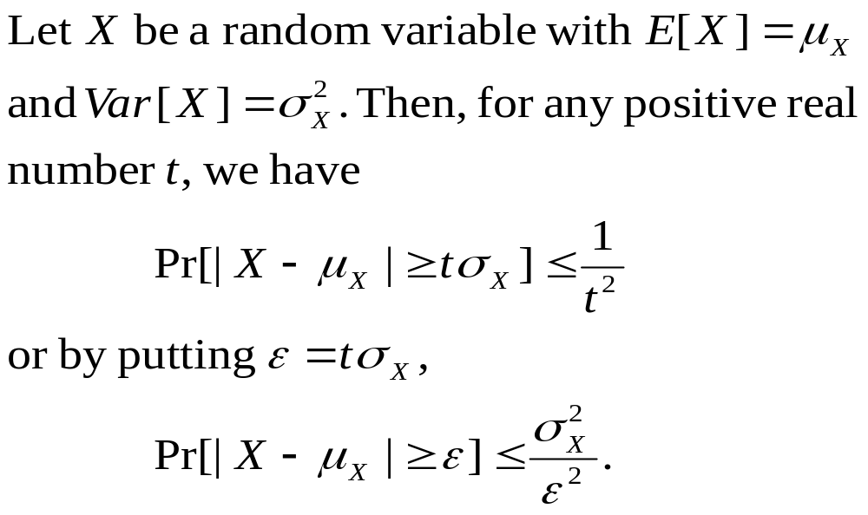
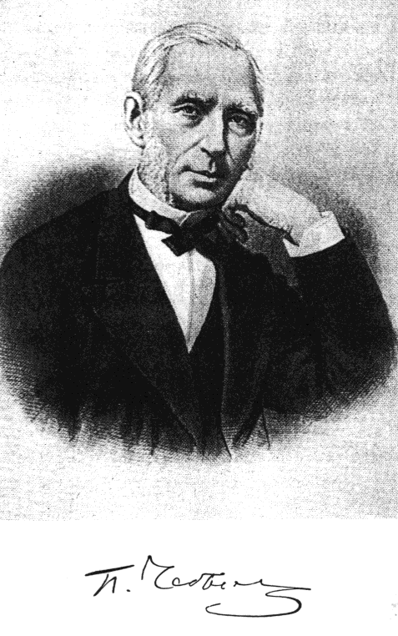
Chebyshev’s Inequality

