Slide 1

The Evolution Trees (Part I)
Speaker: Fang-Ling Lin
Advisor: R. C. T. Lee
National Chi-Nan University

Slide 2

Evolution Trees
To describe the relationship among species.
  The length of each edge (a, b) represents the time needed to evolve from a to b.
Root Extinct Ancestor
a
Internal Node Extinct Ancestor
b
Extant Species

Slide 3
Rooted Evolution Tree
The degree of each internal node is 3, except the root node.
S₁ S₂ S₃ S₄
S₁ S₃ S₂ S₄
S₁ S₄ S₂ S₃

Slide 4
Unrooted Evolution Trees
The degree of each internal node is 3.
S₁
S₃
S₁
S₂
S₂
S₄
S₃
S₄
S₁
S₃
S₄
S₂

Slide 5
Number of Unrooted Evolution Trees
 | Number of Trees | Structe of Trees | Number of Edges
n = 2 | 1 |  | 1
n = 3 | 1 |  | 3
n = 4 | 3 |  | 5
S₁
S₂
S₁
S₂
S₃
S₁
S₃
S₂
S₄
S₁
S₂
S₃
S₄
S₁
S₂
S₄
S₃

Slide 6
Number of Unrooted Evolution Trees
Inserting a new species to an unrooted evolution tree
The number of edges of the tree is increased by 2.
NE(n): number of edges of a unrooted tree with n species.
By induction, we have NE(n) = 2n – 3.
S₁
S₂
S₁
S₂
S₁
S₂
S₄
S₄
S₄
S₃
S₃
S₃

Slide 7
Number of Unrooted Evolution Trees
TU(n): number of unrooted trees for n species
Since NE(n)= 2n – 3, we have
TU(n + 1)= (2n – 3)TU(n)
→TU(n) = (2(n – 1) – 3)TU(n – 1) = (2n – 5) TU(n – 1)
→TU(n)= (2n – 5)(2n – 7)… 1

Slide 8
Changing Unrooted into Rooted
n = 2
unrooted evolution trees rooted evolution trees
root
S₁
S₂
S₁
S₂

Slide 9
Changing Unrooted into Rooted
n = 3
S₁
S₂
S₁
S₂
S₁
S₂
root
root
root
S₃
S₃
S₃
S₁
S₂
S₃
S₂
S₁
S₃
S₃
S₁
S₂

Slide 10
Number of Rooted Trees
TR(n): the number of rooted trees for n species.
Since there are 2n – 3 edges in every unrooted tree for n species, we have
  TR(n)= (2n – 3)TU(n)
  = (2n – 3)(2n – 5)(2n – 7)…1
  = TU(n + 1)

Slide 11
The number of rooted trees is much higher than that of the unrooted trees.
When n is very large, it will be desirable to consider unrooted evolution trees.
But, we can not explain an unrooted tree.
What we can do is to add a species which is exceedingly different from the species which we are analyzing.

Slide 12
An Unrooted Tree with an Outlier Species
We can use the outlier species to identify a root.
S₁
root
S₆
S₄
S₇
S₂
S₃
S₈
S₉
S₅
S₁ S₄ S₂ S₃ S₈ S₉ S₆ S₇

Slide 13
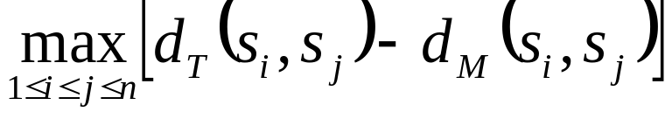
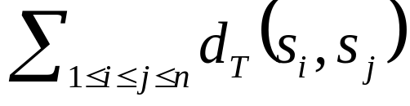
Specification of Evolution Tree
Minimax Evolution Tree
  is minimized.
Minisum Evolution Tree
  is minimized.
Minisize Evolution Tree
  The total length of the tree is minimized.

Slide 14
The Complexities of Evolution Tree
 | Minimax | Minisum | Minisize
Unrooted | NP-complete | NP-complete | Unknown
Rooted | O(n²) | NP-complete | NP-complete

Slide 15
Basic principle of Minimax Evolution Tree
A minimal evolution tree is based upon the minimal spanning tree concept.
That the edge (b, e) is the longest.
d f
a
b
e
g
c
h

Slide 16
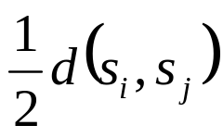
Basic priciple of Minimax Evolution Tree
Let s_{i} and s_{j} be the two species which have the longest distance in the distance matrix.
The longest distance is exactly preserved.
T_{i} T_{j}
s_{i} s_{j}

Slide 17
A Rooted Minimax Evolution Tree Algorithm
Input:
A Distance Matrix of a Set S of n Species S₁, S₂, …, S_{n}.
Output:
A Rooted Minimax Evolution Tree for S.

Slide 18
A Rooted Minimax Evolution Tree Algorithm
Step 1: If S contains only one species x, returen node x as the tree.
Step 2: Find the longest d(s_{i} , s_{j}) in the distance matrix. Find a minimal spanning tree of S.
Step 3: Find the longest edge e in the path linking s_{i} and s_{j} in the minimal spanning tree. Let S_{i} and S_{j} be the two sets of species obtained by breaking edge e.
Step 4: Use this algorithm recursively to find subtrees T_{i} and T_{j} for S_{i} and S_{j} respectively
Step 5: Construct a rooted tree with T_{i} and T_{j} as subtrees. Let the distance from the root r of this tree to the root of T_{i}(T_{j}) be h_{i}(h_{j}). Set h_{i}(h_{j}) so that dt(r, s_{i}) = dt(r,s_{j}) = 1/2 d(s_{i}, s_{j}).

Slide 19
An Example for Rooted Minimax Evolution Tree
Input: A distance Matrix
Construct a minimal spanning tree
 | S₁ | S₂ | S₃ | S₄
S₁ | 0 | 2 | 3 | 3.1
S₂ |  | 0 | 3.6 | 5
S₃ |  |  | 0 | 1
S₄ |  |  |  | 0
s₂
2
s₃
3
s₁
1
s₄

Slide 20
An Example for Rooted Minimax Evolution Tree
The distance between s₂ and s₄ is the longest.
The path linking s₂ and s₄ in T in which (s₁, s₃) is the longest edge.
s₂
 | S₁ | S₂ | S₃ | S₄
S₁ | 0 | 2 | 3 | 3.1
S₂ |  | 0 | 3.6 | 5
S₃ |  |  | 0 | 1
S₄ |  |  |  | 0
2
s₃
3
s₁
1
s₄

Slide 21
An Example for Rooted Minimax Evolution Tree
Break (s₁, s₃) obtains two subsets of species
Construct subtrees for T₂ and T₄ for s₁ and s₃ respectively
s₂
2
1 1 0.5 0.5
s₃
s₁
1
s₁ s₂ s₃ s₄
s₄

Slide 22
An Example for Rooted Minimax Evolution Tree
Combine T₁ and T₂ by making sure that dt (s₂, s₄) = d (s₂, s₄) = 5
1.5 2
1 1 0.5 0.5
s₁ s₂ s₃ s₄

Slide 23
Determination of edge weights
A possible unrooted evolution tree for four species.
s₁ s₃
x₁ x₄
x₃
x₂ x₅
s₂ s₄

Slide 24
Determination of edge weights
Determine x_{i} by linear programming
Minimize x₁+x₂+x₃+x₄+x₅
x₁+x₂ ≧d₁₂
x₁+x₃+x₄ ≧d₁₃
Subject to x₁+x₃+x₅ ≧d₁₄
x₂+x₃+x₄ ≧d₂₃
x₂+x₃+x₅ ≧d₂₄
x₄+x₅ ≧d₃₄
s₃ s₄
x₄ x₅
x₃
x₁ x₂
s₁ s₂
Unrooted Tree

Slide 25
Determination of edge weights
Minimize x₁+x₂+x₃+x₄+x₅+x₆
Subject to
x₁+x₂ ≧d₁₂
x₁+x₅+x₆+x₃ ≧d₁₃
x₁+x₅+x₆+x₄ ≧d₁₄
x₂+x₅+x₆+x₃ ≧d₂₃
x₂+x₅+x₆+x₄ ≧d₂₄
x₃+x₄ ≧d₃₄
x₅+x₁ = x₅+x₂ = x₆+x₃ = x₆+x₄
x₅ x₆
x₁ x₂ x₃ x₄
s₁ s₂ s₃ s₄
Rooted Tree

Slide 26
Evolution Trees (Part II)
Speaker: Chuang-Chieh Lin
Advisor: R. C. T. Lee
National Chi-Nan University

Slide 27
Outline
The Unweighted Pair Group Method with Arithmetic Mean (UPGMA)
Neighbor Joining Method
An Approximation Algorithm for an Unrooted Minisize Evolution Tree
The Minimal Spanning Tree Preservation Approach for Evolution Tree Construction

Slide 28
Outline
The Unweighted Pair Group Method with Arithmetic Mean (UPGMA)
Neighbor Joining Method
An Approximation Algorithm for an Unrooted Minisize Evolution Tree
The Minimal Spanning Tree Preservation Approach for Evolution Tree Construction

Slide 29
UPGMA
The unweighted pair group method with arithmetic mean (UPGMA) is a method to produce a good rooted evolution tree after a distance matrix is given.
This method is used for rooted evolution trees.
Our method is in the spirit of the greedy method.

Slide 30
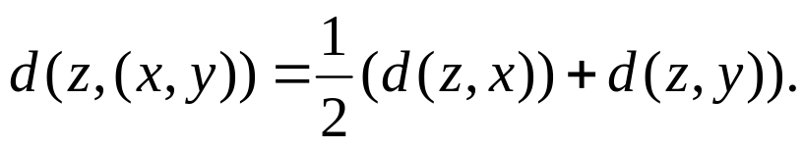
Algorithm: The Unweighted Pair Group Method with Arithmetic Mean Algorithm.
Input: A set S of n species and its distance matrix.
Output: A rooted evolutionary tree structure for S.
Step 1: Find two species x and y such that d(x, y) is the smallest element of the distance matrix.
Step 2: Create a new species, denoted as (x, y). Construct a tree using (x, y) as the root and subtrees rooted at x and y respectively as the descendants of the root. Delete x and y from the distance matrix.
Step 3: If all species have been deleted, return the tree rooted at (x, y) and exit. Otherwise update the distance to a new distance matrix. The distance d(z, (x, y)) is calculated as:

Slide 31

Let’s see an example to understand UPGMA:
Consider the distance matrix.
Step 1: Select the pair of species with the smallest distance between them. s₃ and s₄ are selected.

Slide 32
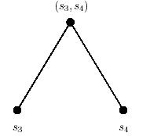
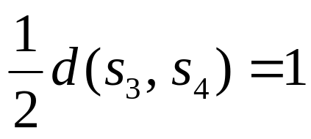
Construct a rooted evolution tree with s₃ and s₄ as leaf nodes.

Slide 33

Step 2: Consider (s₃, s₄) as a new specie. The new distances are updated as follows:

Slide 34

Then we got a new distance matrix as follows:

Slide 35
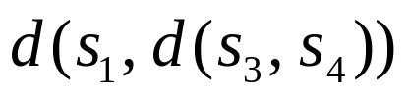
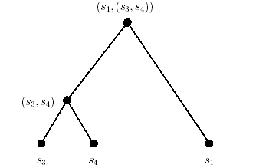
Since is the smallest, we select s₁ and (s₃, s₄). Construct a rooted evolution tree as follows:

Slide 36
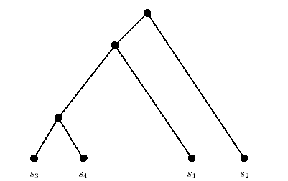
Step 3: Since s₄ is the only specie left, the final tree will look like as follows:

Slide 37
After obtaining this structure, we can use the linear programming technique to produce an evolution tree for given criteria.

Slide 38
Outline
The Unweighted Pair Group Method with Arithmetic Mean (UPGMA)
Neighbor Joining Method
An Approximation Algorithm for an Unrooted Minisize Evolution Tree
The Minimal Spanning Tree Preservation Approach for Evolution Tree Construction

Slide 39
Neighbor Joining Method
This is a method to produce a good unrooted evolution tree.
This method is used for rooted evolution trees.
The algorithm for neighbor joining method is presented as follows:

Slide 40
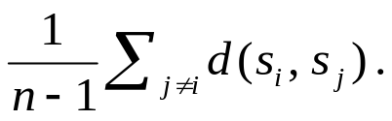
Algorithm: Neighbor Joining Method
Input: A set S of n species and its distance matrix.
Output: An unrooted evolution tree structure for S.
Step 1: Construct a 1-star tree T with x as center node and species as leaf nodes.
Calculate average (s_{i}) =
Step 2: If the degree of x is greater than 3, find two species s_{i} and s_{j} such that (average (s_{i}) + average (s_{j}) – d(s_{i} , s_{j})) is maximized.
Step 3: Insert an internal node x_{k} with degree 3 into T, such that x_{k} is connected to x, s_{i} and s_{j} .
Step 4: If the degree of x is equal to 3, return T and exit; otherwise k = k + 1 and go to Step 2.

Slide 41
Let’s go to see an example.
Consider the distance matrix:
4
4
6
3
5
5
average (s₁) = 3.67 ; average (s₂) = 5
average (s₃) = 4 ; average (s₄) = 3.33

Slide 42
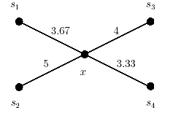
Step 1: Construct a 1-star tree
The distance from the unique internal node to a leaf node is the mean of the distances from this specie to all other species. (For instance )

Slide 43
Step 2: Let us now imagine that s₁ and s₂ are chosen to be paired.
Step 3: Insert an internal node x₁ with degree 3.
s₁
3.67
4
x
s₂
5
s₁
3.67
4
x
x₁
s₂
5

Slide 44
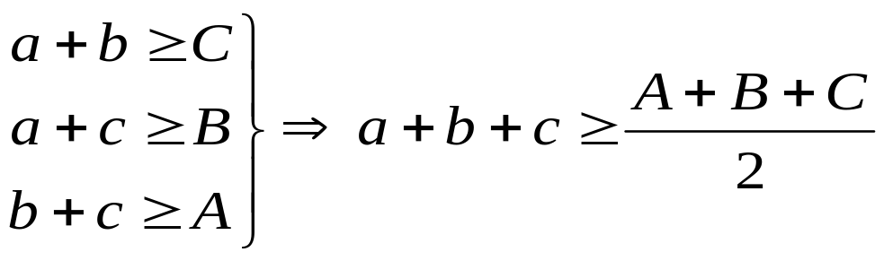
We may set x₁ as the geometrical center of triangle Δs₁-s₂-x .
A + B + C = 12.67
s₁
A = 3.67
b
C = 4
a
x
x₁
c
B = 5
s₂

Slide 45
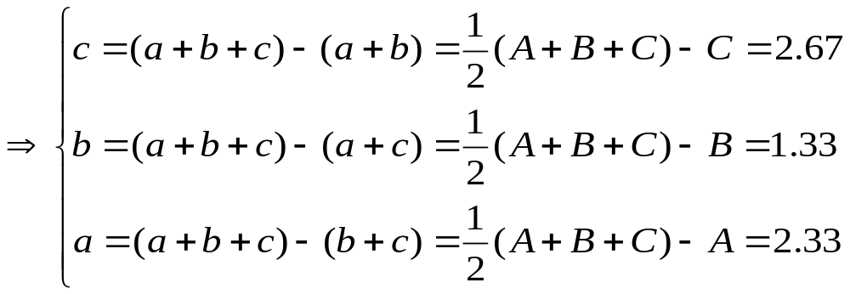
To fit the equality relation, we set that:
s₁
C = 3.67
b
A = 4
a
x
x₁
c
B = 5
s₂

Slide 46
s₁
C = 3.67
b = 1.33
A = 4
a = 2.33
x
x₁
c = 2.67
B = 5
s₂

Slide 47
s₁
1.33
2.33
x
x₁
2.67
s₂

Slide 48
The old cost
= 3.67 + 5
= 8.67 .
The new cost
= 2.33 + 1.33 + 2.67
= 6.33 .
s₁
s₁
3.67
1.33
2.33
4
x
x
x₁
2.67
s₂
5
s₂
The saved cost is 8.67 - 6.33 = 2.34 .

Slide 49
By the way, dt (s₁, s₂) = 4 = d (s₁, s₂).
The most important thing is that the distance between s₁ and s₂ is exactly preserved.
s₁
1.33
2.33
x
x₁
2.67
s₂

Slide 50
The degree of x is equal to 3, so we finally get an unrooted evolution tree T.
s₁
s₃
4
1.33
2.33
x
x₁
2.67
3.33
s₂
T
s₄

Slide 51
Outline
The Unweighted Pair Group Method with Arithmetic Mean (UPGMA)
Neighbor Joining Method
An Approximation Algorithm for an Unrooted Minisize Evolution Tree
The Minimal Spanning Tree Preservation Approach for Evolution Tree Construction

Slide 52
An Approximation Algorithm for an Unrooted Minisize Evolution Tree
We haven’t found any polynomial algorithm for the minisize unrooted evolution tree problem.
We’ll introduce a 2-approximation algorithm for this problem.
This algorithm is based upon the minimal spanning tree strategy.

Slide 53
Algorithm: A 2-approximation Algorithm for an Unrooted Minisize Evolution Tree
Input: A set S of n species and its distance matrix.
Output: An unrooted minisize evolution tree structure for S.
Step 1: Construct a minimal spanning tree based upon the given distance matrix.
Step 2: Conduct a breadth first search on this minimal spanning tree. Without losing generality, we may say that the nodes are ordered as s₁, s₂, ……, s_{n} .
Step 3: Add species one by one to form an unrooted evolution tree. The rules of adding species are as follows:
(a) If there is only one species in the partially constructed evolution tree, link the new specie directly to it.
(b) If the partially constructed evolution tree contains more than one specie and our procedure requires us to link s_{i+1} to s_{i}. Create a new internal node x in the edge emanating from s_{i}. Link s_{i+1} to x. Let the weight of (x, s_{i}) be 0 and the weight of (s_{i}, s_{i-1}) be the weight of in the minimal spanning tree. Let the weight of (x, s_{i+1}) be the weight of (s_{i}, s_{i+1}) in the minimal spanning tree.

Slide 54
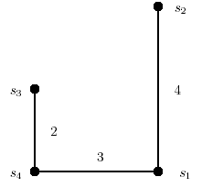
For example,
Given a distance matrix.
Construct a minimal spanning tree out of this distance matrix.

Slide 55
If we order the nodes through a breadth first search, we can get the following order:
s₄ → s₃ → s₁ → s₂

Slide 56
We first start by linking s₃ to s₄ . The weight of the edge linking s₄ and s₃ will be the same as that in the minimal spanning tree.
Then we link s₁ with s₄. We can’t link these two nodes directly, because this will cause s₄ to be an internal node with degree 2.
s₃
s₃
2
2
s₄
s₄
3
s₁

Slide 57
In stead, we create a new node x₁ on the edge emanating from s₄.
s₃
2
3
x₁
s₁
0
s₄

Slide 58
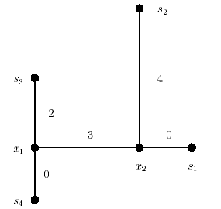
The other species are added to the partially constructed unrooted evolution tree one by one with the same procedure.
Finally, we get:

Slide 59
The distance between any two species on the evolution tree is exactly the same as that on the minimal spanning tree .
Yet the distance between any two species on the minimal spanning tree must be larger or equal to the distance between them in the distance matrix because of the triangular inequality.

Slide 60
From above facts, we can obtain that dt (s_{i}, s_{j}) ≥ d (s_{i}, s_{j}), where dt (s_{i}, s_{j}) denotes the distance between s_{i} and s_{j} on the evolution tree, and d (s_{i}, s_{j}) denotes the distance between s_{i} and s_{j} on the distance matrix.

Slide 61
In the following part, we’ll prove that | APP | ≤ 2| OPT |, where APP denotes the tree constructed by proceeding the algorithm and OPT denotes the optimal unrooted minisize evolution tree.
We first introduce two very important concepts:
(i) Hamiltonian cycle
(ii) Traveling salesperson problem

Slide 62
Given a graph G = (V, E), a Hamiltonian cycle is a cycle visiting all of the nodes exactly once, except for the starting node.
The traveling salesperson problem (TSP) is to find a Hamiltonian cycle with smallest length.

Slide 63
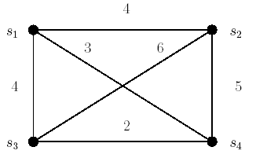
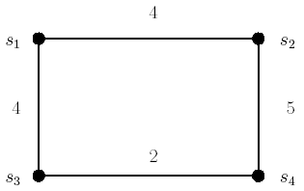
For instance, consider the right-hand side graph G:
We can easily find a optimal solution P of TSP.
G
P

Slide 64
If we delete any edge of P, we’ll get a spanning tree T_{P} of G.
Let MST denote the minimal spanning tree of the graph.
So we get | MST | ≤ | T_{P} |< | TSP |

Slide 65
Note that our constructed unrooted evolution tree has the same length as that of the minimal spanning tree.
Therefore,
| APP | = | MST |
| APP | = | MST | ≤ | T_{P} |< | TSP |

Slide 66
In the following, we’ll prove that the length of TSP, i.e., | P |, is never large than twice of the length of an optimal unrooted minisize evolution tree.
To do this, we have to introduce an important term, which is called Euler tour.

Slide 67
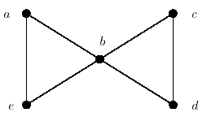
Given a graph, an Euler tour is a cycle which traverses each edge exactly once (however, some nodes may be traversed several times).
For instance,
G
a – b – c – d – b – e – a is an Euler tour of graph G.

Slide 68
Note that not every graph has an Euler tour.
For instance,
T doesn’t have any Euler tour.
It can be easily seen that there is no Euler tour in any tree.
(A tree must not have any loops or cycles.)
s₃
s₂
x₁
x₂
T
s₄
s₁

Slide 69
Yet, if we duplicate every edge of a tree, there is an Euler tour in this resulting graph.
For instance,
s₄ – x₁– s₃ – x₁ – x₂ – s₂– x₂ – s₁ – x₂ – x₁ – s₄
The cycle above is an Euler cycle of T.
s₃
s₂
x₁
x₂
s₄
T
s₁

Slide 70
Let OPT denote an optimal unrooted minisize evolution tree T.
Let ET denote any Euler tour of the graph obtained by duplicating every edge of T.
Let CET denote the cycle of species corresponding to the Euler tour of the duplicated tree.
Obviously, we can find that | ET | = 2| OPT | and | CET | ≤ | ET |.

Slide 71
Note that CET is also a Hamiltonian cycle of the complete graph out of the distance matrix, so |TSP| ≤ |CET|. (This is because that TSP is the shortest Hamiltonian cycle of the graph.)
Therefore,
| APP | = | MST | < | TSP | ≤ | CET | ≤ | ET | = 2 | OPT | .
| APP | < 2 | OPT | .

Slide 72
Outline
The Unweighted Pair Group Method with Arithmetic Mean (UPGMA)
Neighbor Joining Method
An Approximation Algorithm for an Unrooted Minisize Evolution Tree
The Minimal Spanning Tree Preservation Approach for Evolution Tree Construction

Slide 73
The Minimal Spanning Tree Preservation Approach for Evolution Tree Construction
Let D and D_{t} denote the original input distance matrix and the distance matrix based upon the evolution tree respectively.
The condition for this approach for the evolution tree construction problem is that MST(D) = MST(D_{t}) .

Slide 74
Algorithm: A Minimal Spanning Tree Preservation Approach for the Evolution Tree Construction
Input: A distance matrix D(n, n) for a set S of n species.
Output: A rooted evolution tree for S such that MST(D) is equal to one of MST(D_{t}).
Step 1: Find a minimal spanning tree MST(D) of D.
Step 2: Sort the edges of the spanning tree by their weights in the ascending order.
Let the result be e₁, e₂, …, e_{n-1}where | e_{i} | < | e_{j} |, if i < j.
Step 3: Create a leaf node for each species.
Notes:
使得Evolution tree依然保持住原來的MST。

Slide 75


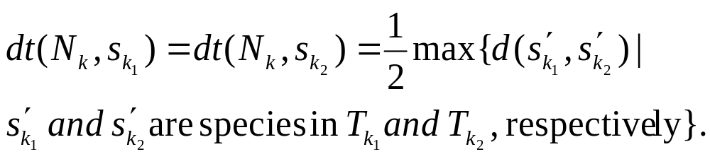
Step 4: for k = 1 to n – 1 do
Let the two species connected by e_{k} be and .
Construct a new internal N_{k} with descendants (the subtree containing) and (the subtree containing) such that:
end for
Step 5: Output the evolution tree.

Slide 76
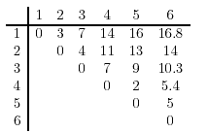
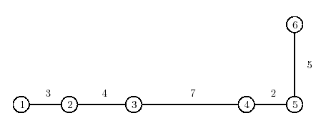
For example, consider the distance matrix D:
MST(D) is illustrated as the graph below:

Slide 77
Then we sort the edge sequence in the ascending order:
e( 4 , 5 ), e( 1 , 2 ), e( 2 , 3 ), e( 5 , 6 ), e( 3 , 4 )
2
3
4
5
7

Slide 78
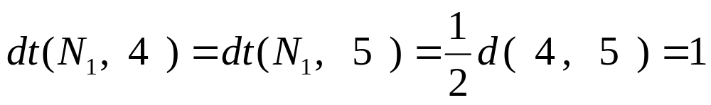
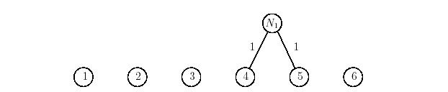
We add a new internal node N₁ with descendants 4 and 5 as below.
Note that:

Slide 79
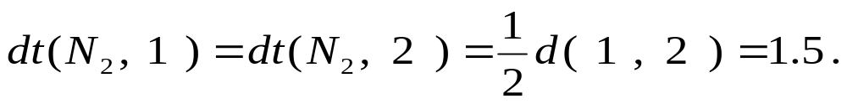
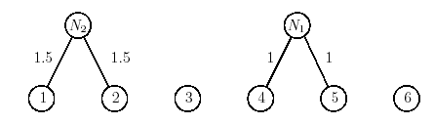
For the second smallest edge, a new internal node N₂ with descendants 1 and 2 are constructed as below with

Slide 80
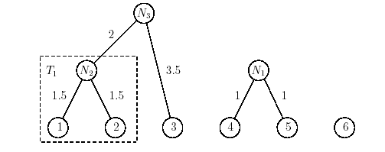
For the third smallest edge , a new internal node N₃ with descendants 3 and the subtree which contains species 2 is constructed as below with
The MST(D) of species 1 , 2 and 3 will be an MST(D_{t}) of species 1 , 2 and 3 .

Slide 81
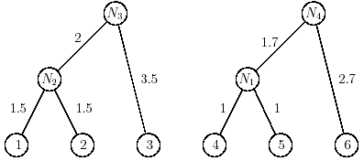
Likewise, for the fourth smallest edge , we construct a new internal node N₄ as below with

Slide 82
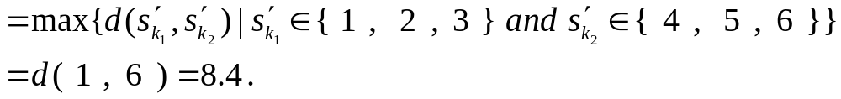
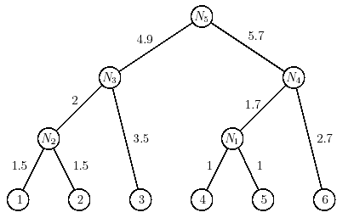
For the last edge e( 3 , 4 ), a new internal node N₅ is constructed with dt(N₅ , 3 ) = dt(N₅ , 4 )

Slide 83
At last, we obtain the final evolution tree.

Slide 84
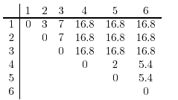
And then, we can derive the dt-matrix from the evolution tree. This dt-matrix is shown as follows:

Slide 85
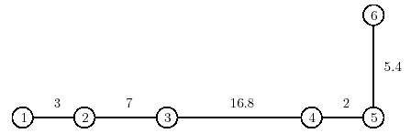
We can obtain the other minimal spanning tree from the dt-matrix:

Slide 86
We can find that the original minimal spanning tree is the same as the new minimal spanning tree except the weights of the edges are not the same any more .

Slide 87
Thank you.

Slide 88
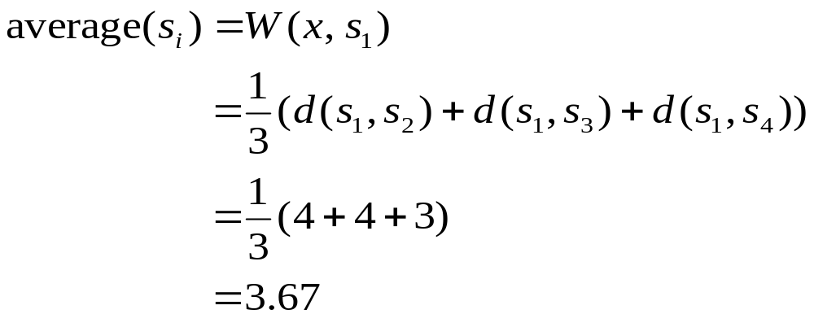
Notes:
Appendix

Slide 89
s₃
s₂
x₁
x₂
ET
s₁
s₄
Given a cycle: s₄ – x₁– s₃ – x₁ – x₂ – s₂– x₂ – s₁ – x₂ – x₁ – s₄,
then the corresponding CET is s₄ – s₃ – s₂ – s₁ – s₄ .
s₃
s₂
x₁
x₂
T = OPT
s₁
s₄

