Slide 1
Randomized Algorithms
Evaluation algorithms for NOR circuits
and
Min-Max Principle
Speaker: Chuang-Chieh Lin
Advisor: Professor Maw-Shang Chang
National Chung Cheng University
March 30, 2006

Slide 2
References:
  Professor Hsueh-I Lu’ s slides for Randomized Algorithms
  Randomized algorithms, Rajeev Motwani and Prabhakar Raghavan

Slide 3

Outline
Lower bound on deterministic evaluation algorithms for NOR circuits
Yao’s Principle for proving lower bounds

Slide 4
Part 1
Randomized evaluation for a logic function

Slide 5
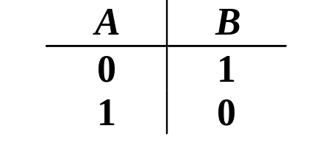
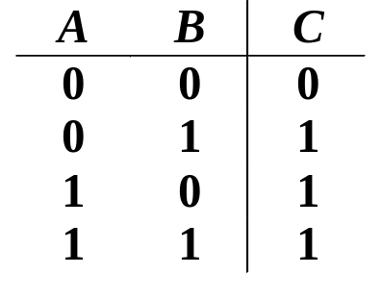
Some logic gates
NOT gate (inverter)
If A = 0 then B = 1
If A = 1 then B = 0
A
B
OR gate
A
B
If A = 1 OR B = 1,
then C = 1 otherwise C = 0
C = A + B

Slide 6
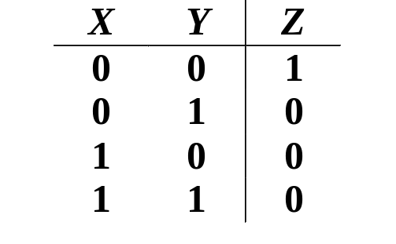
NOR gates
NOR gate
X
Y
Z
≡
X
Y
Z

Slide 7
A one-level complete NOR circuit
X₁
X₂
Y

Slide 8
A two-level complete NOR circuit
X₁
X₂
Y
X₃
X₄

Slide 9
A three-level complete NOR circuit
X₁
X₂
X₃
X₄
Y
X₅
X₆
X₇
X₈

Slide 10
A Circuit evaluation problem
Let F_{k} (x₁, x₂, … , x_{2k}) denote the value of the level-k complete NOR circuit on input x₁, x₂, … , x_{2k} .
The NOR circuit evaluation problem:
  Input: x₁, x₂, … , x_{2k}
  Output: F_{k} (x₁, x₂, … , x_{2k})

Slide 11
Take a closer look at NOR
x₁
x₂
To determine y = F₁(x₁, x₂), there are two cases:
  Case 1: y = 0. At least one of x₁ and x₂ is 1, so we only have to read one of x₁ and x₂ if we are lucky.
  Case 2: y = 1. Both of x₁ and x₂ are 0, so we have to read both x₁ and x₂ to ensure y = 1.
y = F₁(x₁, x₂)

Slide 12
Question: Can a correct evaluation algorithm avoid reading all inputs?
X₁
X₂
X₃
X₄
X₅
X₆
Y
X₇
X₈

Slide 13
Perhaps not for F₁(x₁,x₂)
x₁
x₂
To determine y = F₁(x₁, x₂), there are two cases:
  Case 1: y = 0. At least one of x₁ and x₂ is 1, so we only have to read one of x₁ and x₂ if we are lucky.
  Case 2: y = 1. Both of x₁ and x₂ are 0, so we have to read both x₁ and x₂ to ensure y = 1.
y = F₁(x₁, x₂)

Slide 14
How about F₂(x₁,x₂,x₃,x₄)?
X₁
X₂
Y
X₃
X₄
When y = 1, both input of the rightmost NOR gate has to be 0. Therefore, for the two gates at the left, the algorithm, if lucky enough, doesn’t have to read all of x₁, x₂, x₃, and x₄.

Slide 15
Wanna change your answer? ☺

Slide 16
The answer is:
It’s impossible for any deterministic algorithm to correctly evaluate F_{k} in sublinear (i.e., o(2^{k})) time for any input x₁,x₂,…,x_{2k}.
It’s possible for a randomized algorithm to correctly evaluate F_{k} in expected sublinear (i.e., o(2^{k})) time for any input x₁,x₂,…,x_{2k}.

Slide 17
Theorem 1
For any deterministic algorithm A that always correctly evaluate F_{k} for any k ≥ 1, there exists an input instance x₁, x₂,…, x_{2k} such that A has to read all 2^{k} numbers to determine F_{k} (x₁, x₂, … , x_{2k}).

Slide 18
Proof strategy
Construct two sets of inputs that differ only at the last value read by algorithm A.
Show that the value of F_{k} (x₁,x₂,…, x_{2k}) does depend on the very last bit.

Slide 19
Observations
Since A is a deterministic algorithm, it reads the input x₁,x₂,…, x_{2k} in a fixed order for each k ≥ 1.
Each NOR gate in the circuit of F_{k} has two legs. The leg that contains the last leaf to be read by algorithm A is called its back leg. The other leg is called its front leg.

Slide 20
Mark the front leg in red
1
X₁
X₂
3
6
X₃
X₄
2
Y
5
X₅
X₆
8
7
X₇
X₈
4
Notes:
就像已經決定好線路的邏輯元件一樣

Slide 21
Let all front legs to be 0, then each back leg has to be the complement of its parent.
1
0
X₁
X₂
3
0
6
X₃
X₄
2
0
0
Y
5
0
X₅
X₆
8
7
X₇
X₈
0
4
0

Slide 22
The two possible values of y determine two sets of inputs that differ only at the last variable read by algorithm A.
1
0
X₁
X₂
3
1
0
6
1
X₃
X₄
1
2
0
0
1
Y
5
0
X₅
X₆
0
8
0
1
7
1
X₇
X₈
0
4
0

Slide 23
The two possible values of y determine two sets of inputs that differ only at the last variable read by algorithm A.
1
0
X₁
X₂
3
1
0
6
1
X₃
X₄
1
2
0
0
Y
0
5
0
X₅
X₆
1
8
1
0
7
1
X₇
X₈
0
4
0

Slide 24
Therefore, any deterministic algorithm takes Ω(2^{k}) time to correctly evaluate F_{k} in the worst case!

Slide 25

Randomization can be very helpful for this problem!

Slide 26
Algorithm RandEval
Boolean function RandEval (x₁, … , x_{2t} ) {
if (2t == 1) return x₁;
throw a fair coin;
if (the head appears) {
if (RandEval (x₁, … , x_{t} ) == 1) return 0;
else return (!RandEval (x_{t+1}, … , x_{2t} ));
} else {
if (RandEval (x_{t+1}, … , x_{2t}) == 1) return 0;
else return (!RandEval (x₁, … , x_{t} ));
}
}

Slide 27
Theorem 2
For each integer λ ≥ 1, algorithm RandEval correctly evaluates F_{2λ} in expected O(3^{λ}) time.

Slide 28
Proving the theorem by induction on λ
Basis: two levels. Try for yourselves to show that the expected number of variables to be read by RandEval at most 3. ☺
X₁
X₂
Y
X₃
X₄

Slide 29
X₁
X₂
1
Y
0
X₃
X₄
Expected legs read by RandEval is at most 1.5.
X₁
X₂
0
Y
1
X₃
X₄
0
Expected legs read by RandEval is 2.

Slide 30
X₁
X₂
1
Y
0
X₃
X₄
Expected number of read variables ≤ 1.5 × 2 = 3
Expected legs read by RandEval is 2.
X₁
X₂
0
Y
1
X₃
X₄
0
Expected number of read variables ≤ 2 × 1.5 = 3
Expected legs read by RandEval is at most 1.5.
Notes:
令一個r.v. Z 為讀取legs個數，所以所求為1 * Pr[Z = 1] + 2 * Pr[Z = 2]，而 Pr[Z = 1] = Pr[Z = 1 | y = 0] * Pr[y = 0] + Pr[Z = 1 | y = 1] * Pr[y = 1], similarly, Pr[Z = 2] = Pr[Z = 2 | y = 0] * Pr[y = 0] + Pr[Z = 2 | y = 1] * Pr[y = 1]
Note: Pr[y = 0] 和 Pr[y = 1] 並不知道，但是可以先算出 Pr[Z = 1 | y = 0] 、 Pr[Z = 2 | y = 1] ……等之值，最後再調整。

Slide 31
The induction step: λ → λ + 1
Case 1: The output is 0. At least one leg has to be 1. So, the expected number of legs to be evaluated rightmost level is at most 1.5, each takes O(2 ⋅ 3^{λ}) time by the inductive hypothesis. The expected time is thus O(3^{λ+1}).
1
0
Notes:
想法1: “…each takes O(2 ⋅ 3^{λ}) time…“ 是因為induction hypothesis在 λ 時為藍色橢圓的部分 (Ex: λ = 1 => F₂; λ = 2 => F₄)
想法2: 在右邊數來第二層因為output為1，所以必須讀兩個接腳，故有O(2 ⋅ 3^{λ}) time這一項

Slide 32
The induction step: λ → λ + 1 (contd.)
Case 2: The output is 1. Both legs have to be 0. So, the expected number of legs to be evaluated at the second-to-rightmost level is 3, each takes O(3^{λ}) time by the inductive hypothesis. The expected time is thus O(3^{λ+1}).
0
1
0
Notes:
“…the expected number of legs to be evaluated at the second-to-rightmost level is 3…” 由No. 28 投影片得到

Slide 33
Theorem 2
For each integer λ ≥ 1, algorithm RandEval correctly evaluates F_{2λ} in expected O(3^{λ}) time.
Corollary 3
The expected running time of RandEval on evaluating F_{lg n} is O(3^{log4n}) = O(n^{0.793}).

Slide 34
Revisit the Theorem 1
For any deterministic algorithm A that always correctly evaluate F_{k} for any k ≥ 1, there exists an input instance x₁, x₂,…, x_{2k} such that A has to read all 2^{k} numbers to determine F_{k} (x₁, x₂, … , x_{2k}).

Slide 35
Another proof strategy
Without loss of generality, we may assume that a deterministic algorithm works in a depth-first manner.
Prove by induction on k that any deter-ministic depth-first algorithm has two “trouble” instances, one for output 0 and the other for output 1.
Notes:
“trouble” instances: 不同的 output 只在 algorithm 最後讀的那個 leaf 之值不一樣。

Slide 36
Depth-first evaluation
Definition: does not read any leaf beneath the second leg until the value of the first leg is determined
For example, RandEval is an depth-first evaluation algorithm.
Observation: Without loss of generality, we can focus only depth-first evaluation algorithms. Why?

Slide 37
The reason
Lemma. Let D’ be a deterministic algorithm that correctly evaluates any NOR circuit. Then, there is a deterministic depth-first evaluation algorithm D such that
  The outputs of D and D’ coincide on any input.
  The number of leaves read by D is always no more than that by D’.
Proof: a simple exercise.
So, it suffices to focus on depth-first algorithms.

Slide 38
For example,
1
X₁
X₂
0
1
X₃
X₄
0
1
Y
0
0
X₅
X₆
0
1
0
X₇
X₈
0
Notes:
D’ 讀過的leaves => D 就去讀 (必有自root至這些leaves的depth-first evaluation 路徑)
D’ 未讀的leaves => 表示可以不用讀這些leaves就能判斷結果 => D 就不用去讀 (當成back leg，因為front leg之結果而能略過不讀)
Note: 一條至leaf的路徑即可視為一條depth-first traversal的路徑

Slide 39
1
X₁
X₂
0
1
X₃
X₄
0
1
Y
0
0
X₅
X₆
0
1
0
X₇
X₈
0

Slide 40
Another example,
X₁
X₂
X₃
X₄
Y
0
1
X₅
X₆
0
1
X₇
X₈
0
1
Notes:
D’ 讀過的leaves => D 就去讀
D’ 未讀的leaves => 表示可以不用讀這些leaves就能判斷結果 => D 就不用去讀
Note: 一條至leaf的路徑即可視為一條depth-first traversal的路徑

Slide 41
X₁
X₂
X₃
X₄
Y
0
1
X₅
X₆
0
1
X₇
X₈
0
1

Slide 42
Proof by induction on k
CLAIM: The following statement holds for any positive integer k and any deterministic depth-first evaluation algorithm A.
  There is an input X_{k,1} (respectively, X_{k,0}) such that A has to read all numbers in the input to correctly compute F_{k}(X_{k,1}) = 1 (respectively, F_{k}(X_{k,0}) = 0).
Notes:
略

Slide 43
Basis: k =1.
X_{k,1}
0
0
1
0
1
if A reads the first leg first
X_{k,0}
0
1
0
if A reads the second leg first
X_{k,0}
0

Slide 44
Induction step: k → k+1.
X_{k+1,1}
X_{k,0}
0
1
X_{k,0}
0

Slide 45
Induction step: k → k+1. (contd.)
X_{k+1,0}
First leg to be evaluated by A.
X_{k,0}
0
0
X_{k,1}
1

Slide 46
Induction step: k → k+1. (contd.)
X_{k+1,0}
X_{k,1}
1
0
X_{k,0}
0
First leg to be evaluated by A.

Slide 47
Therefore, any deterministic algorithm takes Ω(2^{k}) time to correctly evaluate F_{k} in the worst case!

Slide 48
Comments (by Prof. Lu)
Throwing coins does the magic:
  For any input, including X_{k,0} and X_{k,1}, RandEval runs in expected O(n^{0.793}) time.
  By Snir [TCS’85].
Snir’s algorithm RandEval is an optimal Las Vegas algorithm for evaluating NOR circuits.
  That is, any Las Vegas algorithm requires Ω(n^{0.793}) time to evaluate NOR circuits.
  Proved by Saks and Wigderson [FOCS’86].

Slide 49
Part 2
Yao’s Principle for Proving Lower Bounds [FOCS’77]

Slide 50
Yao’s Inequality
Let Π be a problem. Let D consist of all deterministic algorithms for solving Π. Let I consist of all possible input instances for Π. Let I_{p} be denote the input instance of Π with probability distribution p. Then the following inequality holds for any probability distribution p and any Las Vegas randomized algorithm R.
min expected time of A running on I_{p}
≤ max expected time of R running on I
A ∈D
I ∈ I

Slide 51
An alternative viewpoint
Let I be an input instance for the problem Π. Let D consist of all deterministic algorithms that correctly solve Π on I.
Then each Las Vegas algorithm for Π is actually a probabilistic distribution over D.

Slide 52
For example,
Such an instance has 8 deterministic depth-first evaluation algorithms.
u v w
↑ ↑ ↑
↑ ↑ ↓
↑ ↓ ↑
↑ ↓ ↓
⋅ ⋅ ⋅
⋅ ⋅ ⋅
⋅ ⋅ ⋅
↓ ↓ ↓
x₁
x₂
v
u
y
x₃
x₄
w
Notes:
箭號代表讀上面的接腳或下面的接腳。

Slide 53
Algorithm RandEval
Boolean function RandEval (x₁, … , x_{2t} ) {
if (2t == 1) return x₁;
throw a fair coin;
if (the head appears) {
if (RandEval (x₁, … , x_{t} ) == 1) return 0;
else return (!RandEval (x_{t+1}, … , x_{2t} ));
} else {
if (RandEval (x_{t+1}, … , x_{2t}) == 1) return 0;
else return (!RandEval (x₁, … , x_{t} ));
}
}

Slide 54
The alternative view
RandEval is the uniform distribution over the eight deterministic depth-first evaluation algorithms.

Slide 55
We shall explain Yao’s Inequality through game-theoretic techniques as follows.

Slide 56
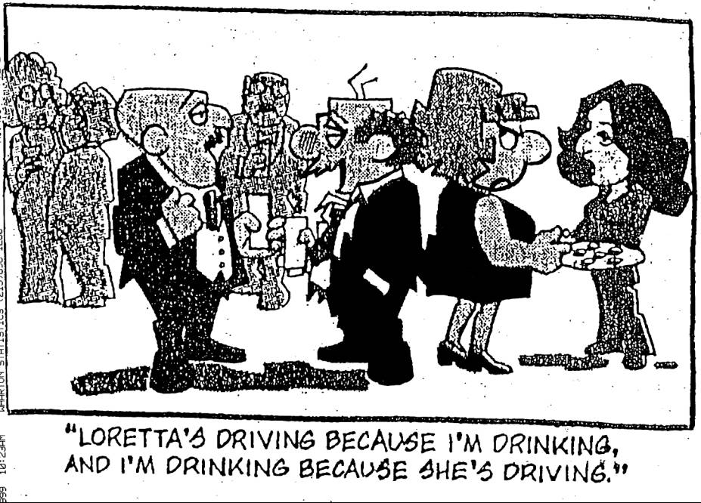

Slide 57
Strategic Interactions
Players: Reynolds and Philip Morris
Strategies: { Advertise , Do Not Advertise }
Payoffs: Companies’ Profits
Each firm earns $5 million from its customers
Advertising costs a firm $2 million
Advertising captures $3 million from competitor
How to represent this game?

Slide 58
Stategic Normal Form
PLAYERS
 |  | Philip Morris
 |  | No Ad | Ad
Reynolds | No Ad | 5 , 5 | 2 , 6
 | Ad | 6 , 2 | 3 , 3
STRATEGIES
PAYOFFS

Slide 59
Nash Equilibrium
 |  | Philip Morris
 |  | No Ad | Ad
Reynolds | No Ad | 5 , 5 | 2 , 6
 | Ad | 6 , 2 | 3 , 3
Best reply for Reynolds:
    If Philip Morris advertises: advertise
    If Philip Morris does not advertise: advertise
Regardless of what you think Philip Morris will do
Advertise!

Slide 60
Nash Equilibrium
j
When the row player uses the i-th strategy, the best strategy for the column player is strategy j.
When the column player uses the j-th strategy, the best strategy for the row player is strategy i.
i

Slide 61
Another example:
Prisoner’s Dilemma

Slide 62
The scenario
In the Prisoner’s Dilemma, A and B are picked up by the police and interrogated in separate cells without the chance to communicate with each other.

Slide 63
Both are told:
• If you both confess, you will both get 4 years in prison.
• If neither of you confesses, the police will be able to pin part of the crime on you, and you’ll both get 2 years.
• If one of you confesses but the other doesn’t, the confessor will make a deal with the police and will go free while the other one goes to jail for 5 years.

Slide 64
Payoff Table
 | B does not confess | B confesses
A does not confess
A confesses
2, 2
5, 0
0, 5
4, 4
Notes:
如果B認罪，那麼A一定要認罪

Slide 65
Question:
Does each game have a unique equilibrium?

Slide 66
Matching Pennies
No Nash equilibrium
 | Head | Tail
Head | 1, −1 | − 1, 1
Tail | − 1, 1 | 1, − 1
Notes:
因為當 A 的結果一出來，B 最好的策略就是跟 A 唱反調

Slide 67
Go to movie together, but action or romance?
 | Action | Romance
Action | 2, 1 | 0, 0
Romance | 0, 0 | 1, 2
Two Nash equilibriums occurs!!

Slide 68
Focus
2-person 0-sum games –
the sum of payoffs of two players is zero in each cell of the table

Slide 69
2-person 0-sum games
c
It suffices to list the payoffs for the row-player.
r
M
(
r
c
)
;

Slide 70
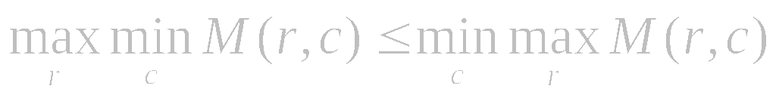
An observation
Try to prove it yourself as a simple exercise.
LHS = the maximum payoff that the row-player can guarantee for himself.
RHS = the minimum loss that the column-player can guarantee for himself.

Slide 71
: minimum of the row
: greater than
: maximum of the column
Proof by contradiction:
Min-max
Max-min

Slide 72
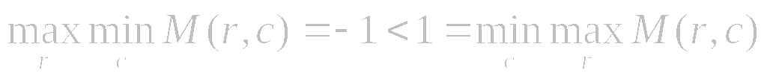
For example,
 | 剪刀 | 石頭 | 布
剪刀 | 0 | − 1 | 1
石頭 | 1 | 0 | − 1
布 | − 1 | 1 | 0

Slide 73
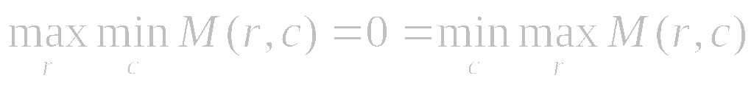
Another example
Saddle point
 | 剪刀 | 饅頭 | 布
剪刀 | 0 | 1 | 2
饅頭 | − 1 | 0 | 1
布 | − 2 | − 1 | 0

Slide 74
Not every 2-person 0-sum game has a saddle point
However, with respect to “mixed strategies”, von Neumann showed that each 2-person 0-sum game has a saddle point.

Slide 75
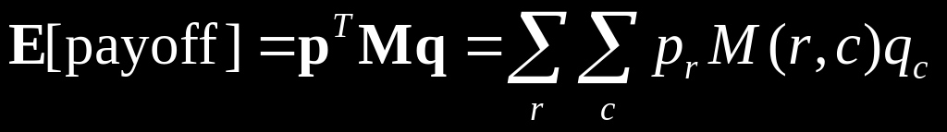
Pure strategies versus mixed strategies
A mixed strategy is a probability distribution over the set of all pure strategies. Let p be a mixed strategy for the row player and q be a mixed strategy for the column player. That is, p_{r} is the probability for the row player to use his r-th strategy, and q_{c} is the probability for the column player to use his c-th strategy. Then the expected payoff with respect to p and q is
Notes:
M(r, c) 那個欄位的機率即為 p_{r} * q_{c}

Slide 76
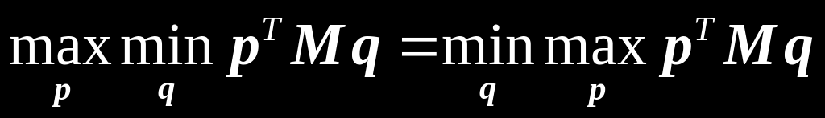
von Neumann’s
Minimax Theorem
For any two-person 0-sum game, we have
That is, each two-person 0-sum game has a saddle point with respect to mixed strategies.

Slide 77
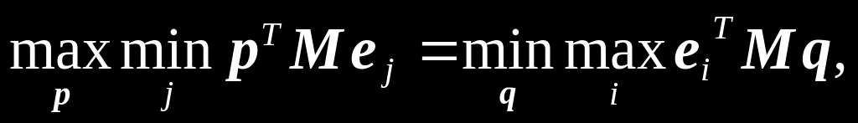
Loomis’ Theorem
For any two-person 0-sum game, we have
where e_{i} means running the i-th strategy with probability 1.
To see this theorem, just observe that when p is known, the column player has an optimal strategy that is a pure strategy. A similar observation holds for the row player, too.
Notes:
倒數第2-3行所指的pure strategy, 原因是因為它的probability為1。

Slide 78
Yao’s interpretation
The row player = the maximizer = the adversary responsible for designing malicious inputs.
The column player = the minimizer = the algorithm designer responsible for designing efficient algorithms.

Slide 79
Pure strategies
For the column player (minimizer)
  Each pure strategy corresponds to a deterministic algorithm.
For the row player (maximizer)
  Each pure strategy corresponds to a particular input instance.

Slide 80
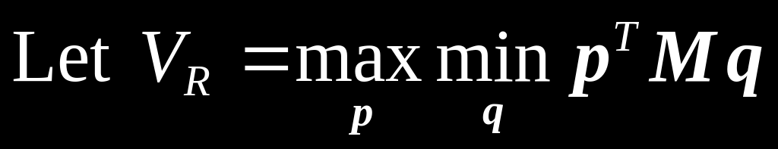
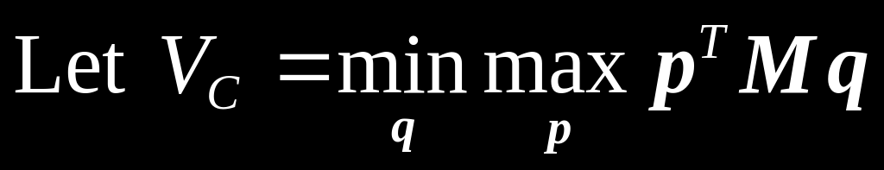
It is related to the non-deterministic complexity of the problem
It stands for the worst-case running time of any deterministic algorithm for the problem.
Notes:
上半部：先固定一組input，再從各種方法中挑最好的running time，最後再從這些最好的running time中挑最大的當成 worst-case running time (for non-deterministic complexity)
下半部：先固定一個演算法，從各種input中挑選worst-case running time，再從這些演算法的worst-case running time中
挑出最小的，即為”解決此問題的最好的演算法的worse-case running time”

Slide 81
Mixed strategies
For the column player (minimizer)
  Each mixed strategy corresponds to a randomized algorithm.
For the row player (maximizer)
  Each mixed strategy corresponds to a probability distribution over all the input instances.

Slide 82
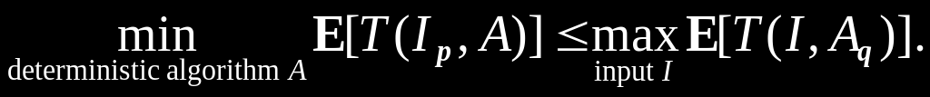
Yao’s interpretation for Loomis’ Theorem
Let T(I, A) denote the time required for algorithm A to run on input I. Then by Loomis’ theorem, we have
Therefore, the following inequality holds for any prob-bility distribution p and q:

Slide 83
Yao’s Inequality
Let Π be a problem. Let D consist of all deterministic algorithms for solving Π. Let I consist of all possible input instances for Π. Let I_{p} be denote the input instance of Π with probability distribution p. Then the following inequality holds for any probability distribution p and any Las Vegas randomized algorithm R.
min expected time of A running on I_{p}
≤ max expected time of R running on I
A ∈D
I ∈ I

Slide 84
A comment
The two different topics “probabilistic analysis for deterministic algorithms” and “randomized algorithms” interact by Yao’s Principle.

Slide 85
How to use Yao’s Lemma?
Task 1:
  Design a probability distribution p for the input instance.
Task 2:
  Obtain a lower bound on the expected running for any deterministic algorithm running on I_{p}.

Slide 86
牛刀小試 on Yao’s Principle
A lower bound Ω(n^{0.694}) on the expected running time of any Las Vegas algorithms for evaluating NOR circuits

Slide 87
Task 1: designing I_{p}
x₁
x₂
x₃
x₄
y
x₅
x₆
x₇
x₈

Slide 88
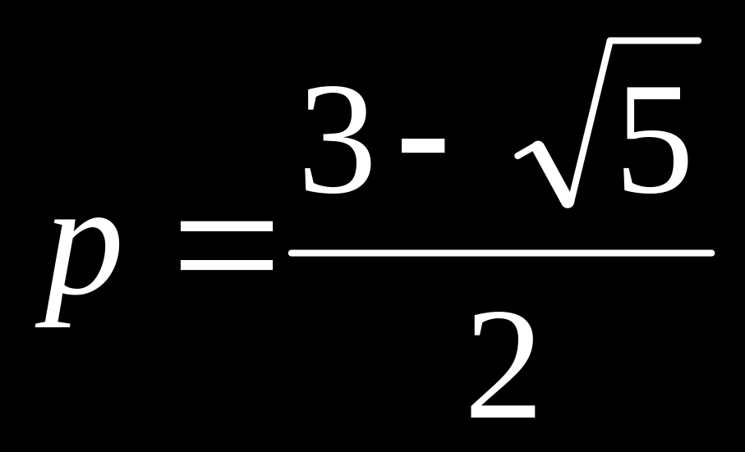
An I_{p}
Let each leaf of the NOR circuit be independently assigned value 1 with probability
and value 0 with probability 1 – p.

Slide 89
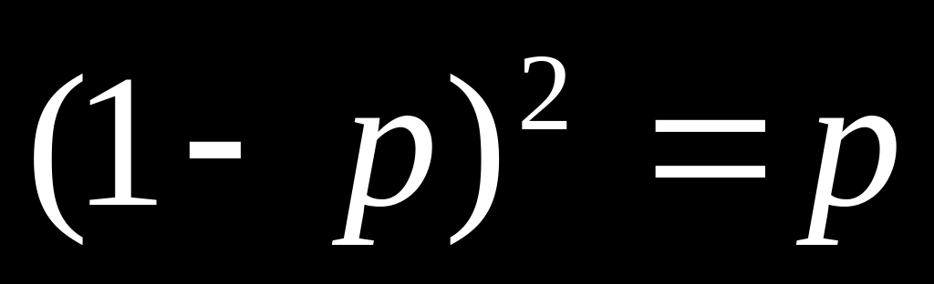
Interestingly,
The output of each NOR gate also has value 1 with probability
(As a matter of fact, the above equation is how we obtain the value of p in the first place.)

Slide 90
Depth-first evaluation
Recall that we can focus on deterministic depth-first evaluation algorithms.
Let A be an arbitrary algorithm of this kind. Let W(k) be the time required for A to evaluate the circuit on I_{p} with 2^{k} numbers.
So, W(k) = W(k – 1) + (1 – p) W(k – 1), implying W(k) = Θ((2 – p)^{k}) = Ω(n^{0.694}).
Notes:
A is deterministic
((2 – p)^{k} = ((\sqrt{5}+1)/2)lgn ≥ n ^{lg1.618} ≈ n ^{0.694}

Slide 91
A comment
Saks and Wigderson proved that RandEval is optimal by designing a much complicated I_{p}.
  The values of the inputs are chosen at random but not independently.

Slide 92
向左走 ←→ 向右走
The two different topics “probabilistic analysis for deterministic algorithms” and “randomized algorithms” meet at Yao’s Principle.

Slide 93
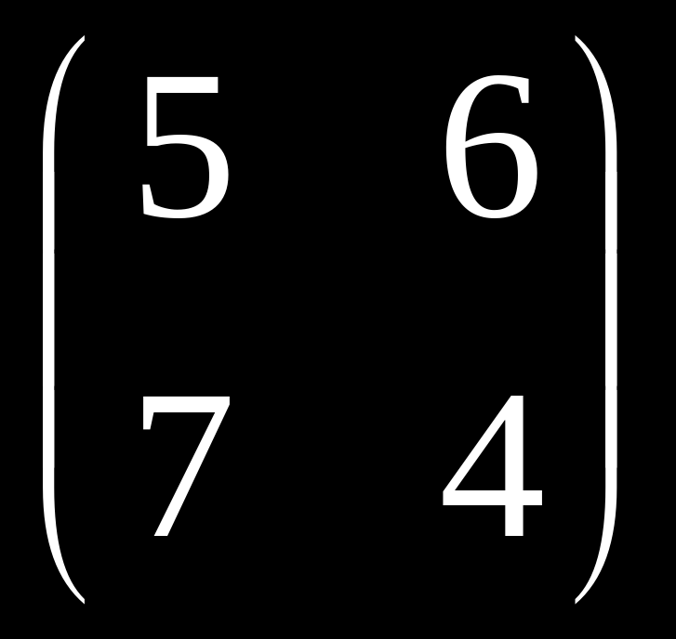
Exercises
Use Yao’s Minmax Principle to prove a lower bound on the expected running time of any Las Vegas algorithm for sorting n numbers.
Determine the value V_{R} of the following 2×2 matrix game and give optimal mixed strategies for the two players.

Slide 94
Consider a Monte Carlo algorithm A for a problem Π whose expected running time is at most T(n) on any instance of size n and that produces a correct solution with probability γ(n). Suppose further that given a solution to Π, we can verify its correctness in time t(n). Show how to obtain a Las Vegas algorithm that always gives a correct answer to Π and runs in expected running time at most (T(n) + t(n)) / γ(n).
  Hint: Consider the geometric random variable.

Slide 95
Thank you.

