Slide 1
On Finding Minimal Length Superstrings
John Gallant, David Maier and James A. Storer
Journal of Computer and System Science Vol. 20, 1980, pp. 50-58
Speaker: Chuang-Chieh Lin
Advisor: R. C. T. Lee
National Chi-Nan University

Slide 2
Outline
Introduction and Definitions
Unbounded Size Alphabets
Bounded Size Alphabets
Conclusions
References

Slide 3
Outline
Introduction and Definitions
Unbounded Size Alphabets
Bounded Size Alphabets
Conclusions
References

Slide 4
Introduction
What does this paper propose?
Show the NP-completeness results of the superstring problem dealing with sets of strings over both finite and infinite alphabets.
(2) Give a linear time algorithm for a restricted version of the superstring problem.

Slide 5
Superstring
A superstring of a set of strings S = {s₁,…, s_{n}} is a string s containing each s_{i}, 1≤ i ≤ n , as a substring.

Slide 6
For example:
S = { ab, bcd, de, abc }, K = 5
then abcde is a superstring of length K of S
Notes:
是“superstring”不是“supersequence”所以不可分離

Slide 7
Superstring Problem
Given a set of strings S and a positive integer K, does S have a superstring of length K?
Notes:
The problem for the compiler is to arrange strings so that they may be “overlapped” as much as possible.
=> 盡可能overlap最好

Slide 8

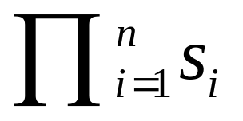
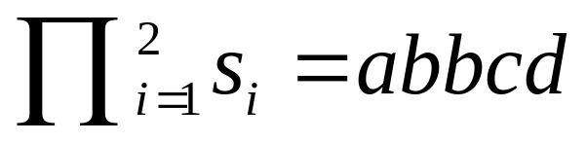
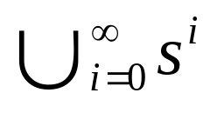
Definitions
If s and s_{i} denote strings and n N, s₁s₂ denotes the concatenation of s₁ with s₂
denotes s₁s₂…s_{n}
s₁ = ab, s₂ = bcd,
s ⁰ denotes empty string
s* denotes

Slide 9
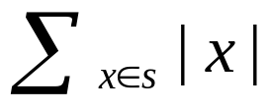
Two strings x and y have an overlap of length k if there exists strings u, v, and w with | v | = k, such that x = uv and y = vw
If s is a string, | s | denotes the length (in characters) of s
If s is a set, | s | denotes the cardinality of s and || s || =

Slide 10
LEN₂(n) denotes the number of bits necessary to write n in binary.
A string is primitive if no character appears more than once.

Slide 11
For example,
aabc and bccd are not primitive.
abcd is primitive.
x = {abc, bcd, cde}, then | x | = 3, || x || = 9
LEN₂(5) = 3 since 5 = 101₂
If y = abcde, | y | = 5.
If z = 01, z*= {ε, 01, 0101, 010101,…… }

Slide 12
IN(v) means indegree of vertex v
i.e. the number of incoming edges to v
OUT(v) means outdegree of vertex v
i.e. the number of outgoing edges from v

Slide 13
Outline
Introduction and Definitions
Unbounded Size Alphabets
Bounded Size Alphabets
Conclusion
References

Slide 14
Concepts
We consider superstring problems S, K where no bound is assumed on the size of the alphabet over which S is written.
For H ≥ 3, and we make a restriction that all strings in the set must be primitive and of length H:
The Hamilton path problem
The superstring problem
Notes:
H大於等於3而且集合中所有的strings都必須primitive且長度為H
然後我們可以用Hamilton path problem reduce 到它, superstring problem

Slide 15
For H ≥ 8,
The node cover problem
The superstring problem
(See [MS77] )
Notes:
此法本篇不提

Slide 16
Theorem 1
The superstring problem is NP-complete.
This problem is NP-complete even if for any integer H ≥ 3, the restriction is made that all strings in the set be primitive and of length H.
Before understanding Theorem 1, let’s see some definitions and a lemma first.

Slide 17
Directed Hamilton Path (Circuit) Problem
Given a directed graph G, is there a path (cycle) that goes through each node of G exactly once?
This problem is shown NP-complete by Karp (1972). (See [K72] in references )

Slide 18
Restricted Directed Hamilton Path Problem
The restricted directed Hamilton path problem is the directed Hamilton path problem with the following restrictions:
(a) There is a designated start node s and a designated end t, with IN(s) = OUT(t) = 0.
(b) Except for the end node t, all nodes have out-degree greater than 1.
Notes:
(1) 一定要有起始點和終點
(2) 除了終點t以外，所有的點的out-degree都必須大於1

Slide 19
For example:
a
b
s
t
c
d
s →c →b →d →a →t is a Hamilton path of this graph.

Slide 20
Lemma 1
The restricted directed Hamilton path problem is NP-complete.
Proof:
Let G be an instance of the directed Hamilton circuit problem and assume G is connected.
And then we form a graph G / as follows:

Slide 21
Choose a vertex in G and split it into two nodes s and t, with s having all the outgoing edges and t having all the incoming edges.
(This is for restriction (a) )
s
u
t

Slide 22
Add the new nodes a, b, and t / and let t / be the new end node.
Add an edge from all nodes with out-degree < 2 to t /, and add the edges (t, a), (t, b), (a, b), (b, a), (a, t /) and (b, t /).
(This is for restriction (b) )

Slide 23
x, y, and z are the nodes with out-degree < 2
x
y
t
z
s
a
b
t /
New end
Now we can check that G has a Hamilton circuit if and only if G/ has a Hamilton path starting at s and end at t/.

Slide 24
Now, let’s go back to Theorem 1.

Slide 25
Theorem 1
The superstring problem is NP-complete.
This problem is NP-complete even if for any integer H ≥ 3, the restriction is made that all strings in the set be primitive and of length H.

Slide 26
Proof of Theorem 1
First, we prove the theorem for nonprimitive strings of length 3.
Second, we show how to modify the construction to make all strings primitive and of length H, for H ≥ 3
Notes:
Nonprimitive strings of length 3
Modify the construction.

Slide 27
First part,

Slide 28
Claim
G has a directed Hamilton path if and only if S has a superstring of length 2m + 3n.
Notes:
2m + 3n 可當成某個K

Slide 29

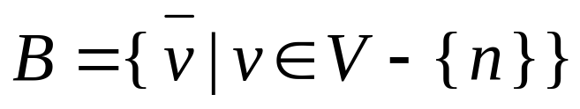
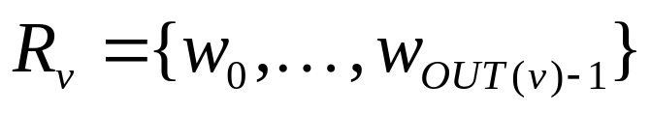
Let G = (V, E) be a instance of the restricted directed Hamilton path problem, V = {1, …, n}, | E | = m.
We construct strings for G over , where and S = { ¢, #, $ }
Let be the set of nodes adjacent to v.
Notes:
B: barred symbols: local to a node;
unbarred symbols: global to whole G
S: special symbols 故意給來湊的
R_{v}: nodes adjacent to v (有它的out-degree這麼多個)

Slide 30
For example:
v
w₁
w₂
w₃
Here, R_{v} = {w₁, w₂, w₃}

Slide 31
For each node v V– {n}, we create a set
∴ | A_{v} | = 2*OUT(v).
B: barred symbols: local to a node
unbarred symbols: global to whole G
Notes:
說明A_{v}剛好有2*OUT(v) strings 因為R_{v}有OUT(v)個nodes
故意創造出length = 3的字串, 連起始點1與終點n都變成length = 3
扣掉n是因為node n沒有out-degree，還有告訴大家A_{v}的feeling

Slide 32
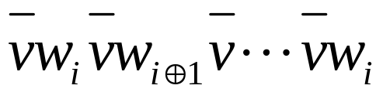
For example,
v
w₁
w₂
w₃
Therefore, we can obtain that
A_{v} = .
And we call the standard w_{i}-superstring for A_{v,} denote it as STD(v, w_{j})
Notes:
A_{v}是v開頭, w_{i} 結尾

Slide 33
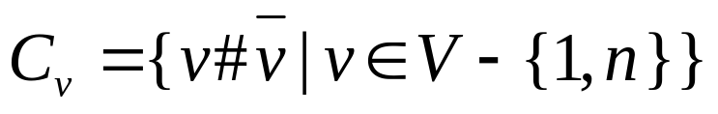


Let be a set of connectors.
Let T = {¢# , n#$} be terminal strings.
Let S be the union of A_{j}, C_{i}, and T.
means modulo OUT(v)

Slide 34
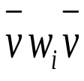
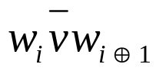
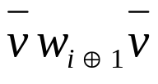
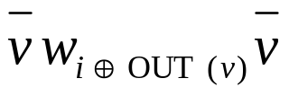
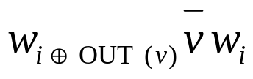
Claim: G has a directed Hamilton path if and only if S has a superstring of length 2m + 3n.
( ) First, we create a standard w_{i}-superstring of length 2(OUT(v) + 1) for A_{v}:
This is form by overlapping the following strings:
……
Notes:
Overlapping 的長度為2

Slide 35
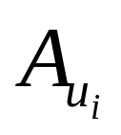
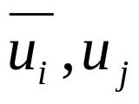
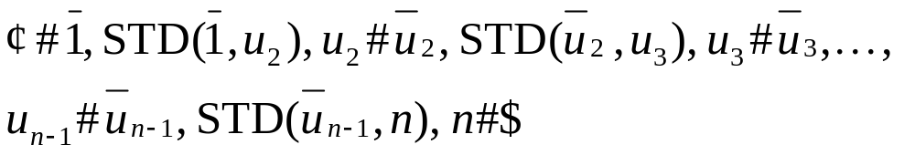
Let (u₁ , u₂ ,…, u_{n}) denote the directed Hamilton path and let u₁ = 1 and u_{n} = n
Abbreviate the u_{j}-standard superstrings for as STD( )
Therefore we can form a superstring for S by overlapping the standard superstrings:
terminal node
Notes:
STD(u_{i}, u_{j}) 都是u_{i}開頭, u_{j} 結尾

Slide 36
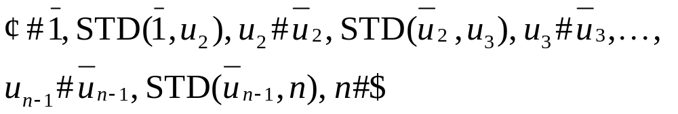
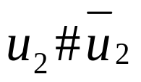
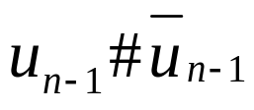

The superstring has length:
Note:
∵ ,…, are (n – 2) items (#)
“4“ comes from , #, #, and $.
Notes:
足標n-1變成n是因為degree of n-th node is entirely “indegree”.
2|E|的部分是因為每個點都有out-degree除了node n

Slide 37
The sum of OUT(v) is just the same as | E |

Slide 38


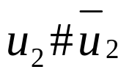
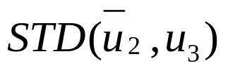
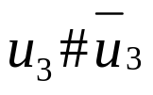



( ) We can show that 2m + 3n is a lower bound on the size of a superstring for S.
And then we can show that this lower bound can only be achieved if the superstring encodes a directed Hamilton path.
Notes:
此處證明細節不講

Slide 39

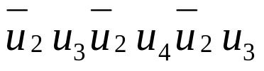



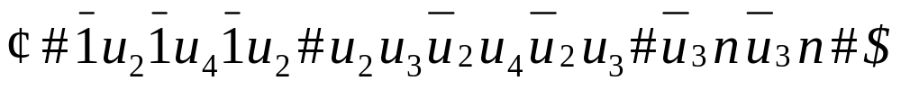
Example of reducing
u₁= 1
G
A Hamilton path for graph G (m = 5, n = 4) : u₁→u₂→ u₃→ u₄
u₂
Transferring:
u₃
=
u₄= n
The superstring:
Length = 22 = 2m + 3n

Slide 40
Second part,

Slide 41
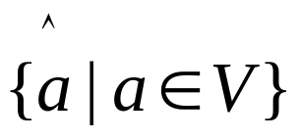
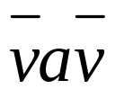
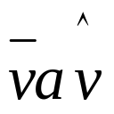
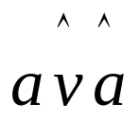
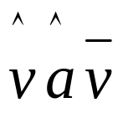
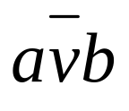
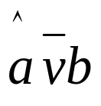
Now we come back to modify the restriction that all strings be primitive and of length exactly H for H ≥ 3.
For H = 3:
(1) We augment Σ to include
(2)
(3)
Notes:
就是把它們變成primitive而且長度保持成H
(3)的a^是為了跟(2)配合

Slide 42
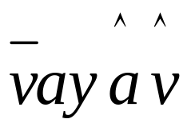
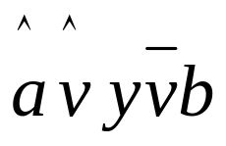
For H ≥ 4:
(1) Let y and y / be primitive strings over an alphabet disjoint from Σ.
| y | = H – 4 , | y / | = H – 2
(2)
(3)
The superstring problem is in NP (easy to check) and the reductions can be done in polynomial time. So the proof is done.
Notes:
說明長度剛好都湊到H
就是把它們變成primitive而且長度保持成H

Slide 43
Theorem 2
For a set of strings S = {s₁ ,…, s_{n}} and an integer K, if | s_{i} | ≤ 2 for each i, then there is a linear time and space algorithm (on a RAM) to decide if S has a superstring of length K.
Before understanding this this theorem, let’s see some definitions and lemmas first.

Slide 44
Loosely Connected
If G = (V, E) denotes a directed graph G with vertex set V and edge set E, then we say that G is loosely connected if the corresponding undirected graph is connected.
Notes:
鬆連通

Slide 45
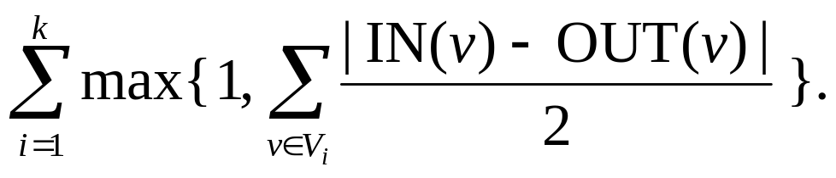
PATH(G)
For a directed graph G = (V, E), if G₁ = (V₁, E₁),…, G_{k} = (V_{k} , E_{k}) are the loosely connected components of G , then:
PATH(G) =

Slide 46
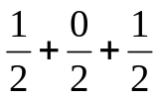
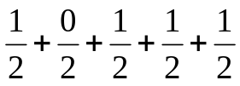
PATH(G) =
For example:
e
a
d
f
b
g
c
h
G₁
G₂
PATH(G) = max{1, }+ max{1, }= 3
G
Notes:
畫一個圖G包含了個鬆連通子圖G₁, G₂，算出PATH(G)值

Slide 47
Path-decomposition
A path decomposition of a directed graph G = (V, E) is a partition of E into edge disjoint paths.
For example:
e
a
d
f
b
g
c
h
G₁
G₂
Notes:
分的原則：
找出out-degree> in-degree的點開始跑
走到不能走為止
再講一下minimal path-decomposition

Slide 48
Minimal Path-decomposition
A minimal path-decomposition is a path-decomposition of G with least paths.
Notes:
此path非彼PATH

Slide 49
For example,
e
ab → bc , hf → fe → ed, gf is a minimal path-decomposition
a
d
f
ab → bc, gf → fe, ed, hf is a path-decomposition, NOT a minimal path-decomposition.
b
g
c
h
G₁
G₂

Slide 50
Now, an algorithm for finding a minimal path-decomposition is given:

Slide 51
Algorithm 1
WHILE there exists a node v in G with IN(v) < OUT(v) DO
Starting at v, traverse edges at random until a node with no outgoing edges is reached, delete the edges traversed from G, and add this path to P.
WHILE G is not empty DO
IF there exists a cycle c which intersects a path p in P.
THEN Delete c from G and “splice” it into p.
ELSE Delete a cycle from G and add it to P.

Slide 52
For example,
e
a
d
f
b
g
c
h
G₁
G₂

Slide 53
Starting node
e
a
d
f
b
g
c
h
G₁
G₂

Slide 54
e
a
d
f
b
g
c
h
G₁
G₂

Slide 55
e
a
d
f
b
g
c
h
G₁
G₂

Slide 56
e
a
d
f
b
g
c
h
Starting node
G₁
G₂

Slide 57
e
a
d
f
b
g
c
h
G₁
G₂

Slide 58
e
a
d
f
b
g
c
h
G₁
G₂

Slide 59
e
a
d
f
b
g
c
h
G₁
G₂

Slide 60
e
a
d
f
b
g
c
h
G₁
G₂

Slide 61
e
a
d
f
b
g
c
Starting node
h
G₁
G₂

Slide 62
e
a
d
f
b
g
c
h
G₁
G₂

Slide 63
e
a
d
f
b
g
c
h
G₁
G₂

Slide 64
Lemma 2.
The number of paths in a minimal path-decomposition of a directed graph G is given by PATH(G).

Slide 65
Let’s go back to see Theorem 2.

Slide 66
Theorem 2
For a set of strings S = {s₁ ,…, s_{n}} and an integer K, if | s_{i} | ≤ 2 for each i, then there is a linear time and space algorithm (on a RAM) to decide if S has a superstring of length K.

Slide 67
Proof of Theorem 2
Σ: the alphabet; S is written over Σ.
Assume that all strings in S have length exactly 2 .
Assume that all strings in S to be primitive.

Slide 68
Since for a nonprimitive string s_{i} = aa in S,
(1) If a doesn’t appear anywhere else in S, then S has a superstring of length K if and only if S – {s_{i}}has a superstring of length K – 2.
(2) Otherwise, S has a superstring of length K if and only if S – {s_{i}}has a superstring of length K – 1.

Slide 69
For example:
Let s_{i}= aa for some i
K – 2
S – {s_{i}}
(1) aa
aaxy……
(2) aa ……ax
aaxz……
S – {s_{i}}
K – 1
Notes:
(2)去掉的aa相當於只去掉一個，所以還剩下K - 1

Slide 70
Let G = (V, E) by letting V = Σ and (a, b) E when ab S.
S has a superstring of length K if and only if PATH(G) ≤ K – | S |. (i.e. K ≥ PATH(G) + | S |)
Since PATH(G) can be computed in linear time and space, the proof is done.
Notes:
下一頁有example

Slide 71
  PATH(G) = 3, | S | = 6, there is a superstring x = abchfedgf, | x | = K = 9 x is the superstring of abc, hfed, gf
e
a
d
f
b
g
G₁
c
G₂
G
h

Slide 72
We can find that PATH(G) ≤ K – | S |. (i.e. K ≥ PATH(G) + | S |), but we can’t find a superstring of length less than 9 (= K) here.
e
a
PATH(G) = 3,
| S | = 6,
d
f
| x | = K = 9
b
g
G₁
c
G₂
h

Slide 73
Corollary 2.1
There is a linear time and space algorithm to find a minimal length superstring for a set of strings of length less than or equal to 2.

Slide 74
Corollary 2.2
For a multiset of strings S over alphabet Σ, we can find algorithms to find a minimal length superstring for S which use the following amounts of time and space:
(1) Linear expected time and linear space.
(2) o(|| S || LEN₂ | S |) time and linear space.
(3) Linear time and o(| S | + |Σ |²) space.
Notes:
Use hashing techniques
Use dictionary techniques
Strings of length 1: Can be dealt with as in Corollary 2.1
Strings of length 2: May be tabulated in linear time by using an o(|Σ| × |Σ|) matrix.

Slide 75
Multiset
For example:
{A, A, B} and { A, B, B, B, C, D, E, E}
Notes:
String可以重複出現

Slide 76
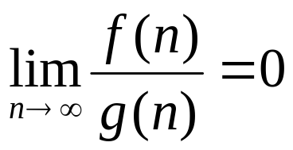
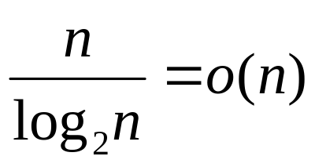
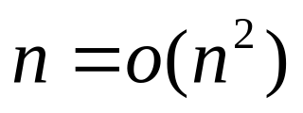
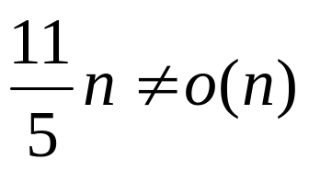
About o-notation
It is pronounced “little Oh”
f (n) = o(g(n)) if .
For example,
But,

Slide 77
Outline
Introduction and Definitions
Unbounded Size Alphabets
Bounded Size Alphabets
Conclusions
References

Slide 78
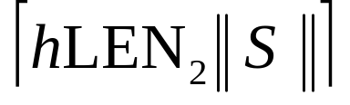
Theorem 3
The superstring problem is NP-complete even if for any real number h > 1, the problem is restricted to instances S, K where S is written over the alphabet {0, 1} and all strings in S have length .

Slide 79
Outline
Introduction and Definitions
Unbounded Size Alphabets
Bounded Size Alphabets
Conclusions
References

Slide 80
Conclusions
The superstring problem is an NP-complete problem.
We should provide the impetus for studying approximation algorithms and heuristics for finding a minimal length superstring.
Notes:
Impetus: 動力

Slide 81
Outline
Introduction and Definitions
Unbounded Size Alphabets
Bounded Size Alphabets
Conclusions
References

Slide 82
Reference
[AHU76] The Design and Analysis of Computer Algorithms, Aho A. V., Hopcroft J. E. and Ullman J. D., 2nd printing, Addison-Wesley, Reading, Mass, 1976.
[C71] The complexity of Theorem Proving Procedures, Cook S. A., Proceedings, Third Annual ACM Symposium on Theory of Computing, Shaker Height, Ohio, 1971, pp. 151-158.
[GJS76] Some Simplified NP-complete Problems, Garey M. R., Johson D. S. and Stockmeyer L., Theor. Comp. Sci., Vol. 1, pp. 237-267.
[H72] Graph Theory, Harary F., Addison-Wesley, Reading, Mass, 1972.

Slide 83
[H52] A method for the Construction of Minimum- Redundancy Codes, Huffman D. A., Proc. IRE, Vol. 40, 1952, pp. 1098-1101.
[K72] Reducibility among Combinatorial Problems, Karp R. M., Complexity of Computer Computations, Plenum, New York, 1972, pp. 85- 103.
[MS77] A Note on the Complexity of the Superstring Problem, Maier D. and Storer J. A., Technical Report 233, Dept. of Electrical Engineering and Computer Science, Princeton University, Princeton, N. J., 1977.

Slide 84
[S77] NP-completeness Results Concerning Data Compression, Storer J. A., Technical Report 233, Dept. of Electrical Engineering and Computer Science, Princeton University, Princeton, N. J., 1977.
[SS77] The Macro Model for Data Compression, Storer J. A. and Szymanski T. G., Technical Report 233, Dept. of Electrical Engineering and Computer Science, Princeton University, Princeton, N. J., 1977

Slide 85
Thank you.

