Slide 1
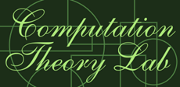
國立中正大學資訊工程所
計算理論實驗室

Slide 2
Probabilistic Coloring of Bipartite and Split Graphs
Federico Della Croce, Bruno Escoffier, Cécile Murat and Vangelis Th. Paschos
Lecture Notes in Computer Science, Vol. 3483, 2005, pp. 152-168.
Cahier du LAMSADE 218, LAMSADE, University Paris-Dauphine, pp. 1-20, 2004.
Speaker: Chuang-Chieh Lin
Advisor: Professor Maw-Shang Chang
Computation Theory Laboratory
National Chung-Cheng University

Slide 3

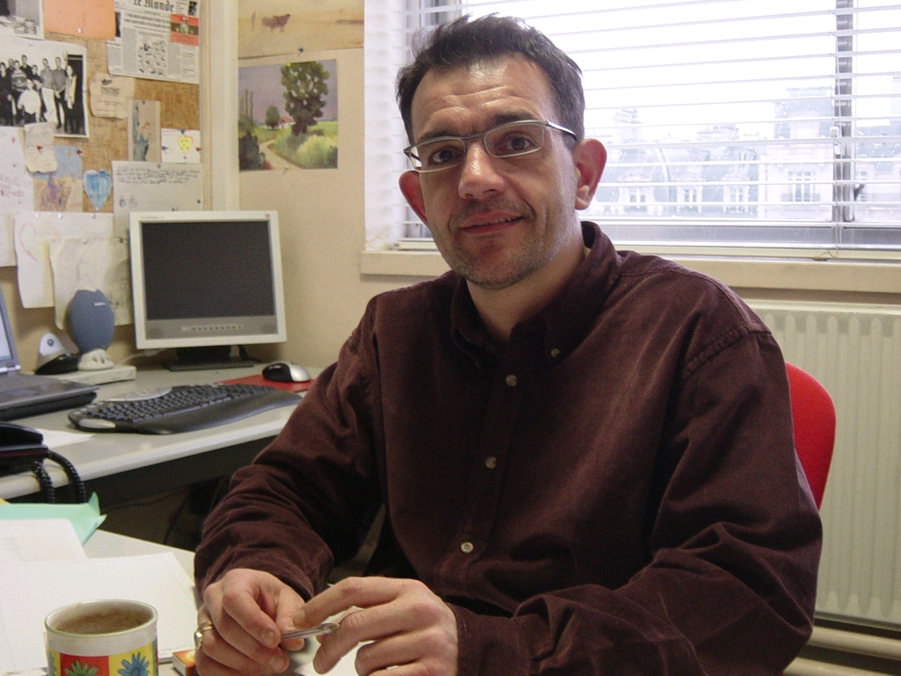
Federico Della Croce (From Italy)
Bruno Escoffier (from France)
Cécile Murat (from France)
Vangelis Th. Paschos (from France)

Slide 4
Outline
Preliminaries
Properties
On General Bipartite Graphs
  2-approximation under any system of vertex-probabilities
  8/7-approximation algorithm for identical vertex-probabilities
Conclusions
References

Slide 5
Preliminaries
In minimum coloring problem, the objective is to color the vertex-set V of a graph G(V, E) with as few colors as possible so that no two adjacent vertices receive the same color.
An infeasible coloring
A feasible and minimum coloring

Slide 6
A feasible coloring can be seen as a partition of V into independent sets.
A partition:
{1, 4, 6}, {2, 5}, {3}
1
2
6
Let S₁ = {1, 4, 6},
S₂ = {2, 5},
S₃ = {3},
then C = (S₁, S₂, S₃) is called a coloring, or 3-coloring, of a graph G.
3
5
4
G(V, E)

Slide 7
Before introducing the definition of the probabilistic coloring problem, let us consider a real problem concerning the real world.

Slide 8
Suppose that there are 4 more classes in Dept. CSIE of CCU decided to be opened. Students have to choose a subset of these classes.
If each of these course is not chosen by more than 10 students, it won’t be opened.
Thus there exists concepts of probabilities in this problem.
No. | Course name | Teacher | Time
A | Approximation Algorithms | Prof. M. S. Chang | 14:45-16:00, Tuesday 14:45-16:00, Thursday
B | Advanced Compilers | Prof. N. W. Lin | 14:45-16:00, Wednesday 14:45-16:00, Thursday
C | Life and Algorithms | Prof. M. S. Chang | 14:45-16:00, Wednesday 10:45-12:00, Friday
D | Elementary Graph Theory | Prof. C. L. Tsai | 14:10-17:00, Tuesday

Slide 9
No. | Course name | Teacher | Time
A | Approximation Algorithms | Prof. M. S. Chang | 14:45-16:00, Tuesday 14:45-16:00, Thursday
B | Advanced Compilers | Prof. N. W. Lin | 14:45-16:00, Wednesday 14:45-16:00, Thursday
C | Life and Algorithms | Prof. M. S. Chang | 14:45-16:00, Wednesday 10:45-12:00, Friday
D | Elementary Graph Theory | Prof. C. L. Tsai | 14:10-17:00, Tuesday
C
Courses can be considered as vertices and two vertices have an edge if the corresponding classes cannot have place in the same room.
1
0.6
D
A
0.7
Each vertex is assigned a probability on the fact that such corresponding class will really take place.
B
0.5

Slide 10
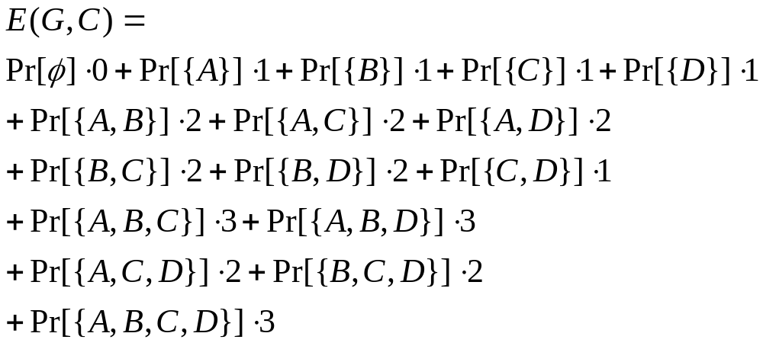
The problem is: “How many rooms are needed probably?”
| rooms | can be regarded as | needed “colors”|.
Suppose that we have a coloring as follows.
Consider the expected number of colors by the following calculations:
C
1
0.6
D
A
0.7
B
0.5

Slide 11
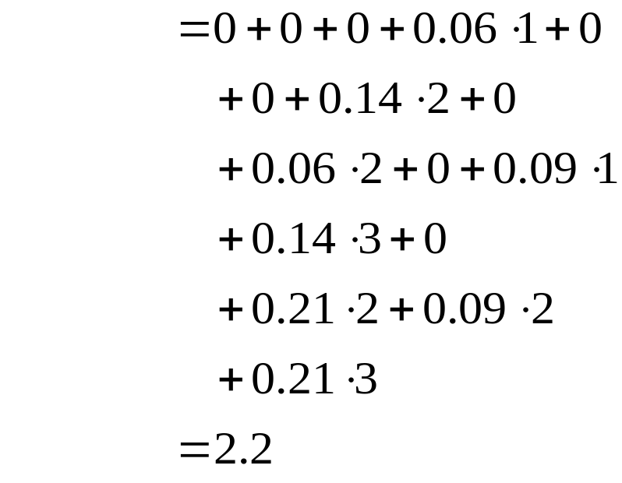
Another application: Satellites Shots Planning. [GMMP97]
Now let us consider the definition of the probabilistic coloring problem.

Slide 12
PROBABILISTIC COLORING (PROBLEM) is the probabilistic version of minimum coloring problem, defined as follows:
Given a graph G(V, E), |V | = n, an n-vector Pr = (p₁, …, p_{n}) of vertex-probabilities and a modification strategy M, the object is to determine a coloring C* (a priori solution) of G minimizing E(G, C, M) = ∑_{V ′⊆V} Pr[V ′] . |C(V ′, M)|.
A modification strategy M is an algorithm that when receiving a coloring C = (S₁, …, S_{k}) for V, called a priori solution, and a subgraph G ′= G[V ′] of G induced by a subset V ′ ⊆ V as inputs, it modifies C in order to produce a coloring C ′ for G ′.
C(V ′, M) is the solution computed by M(C, V ′).
Pr[V ′] = ∏_{i∈V ′} p_{i} . ∏_{i∈V \V ′} (1− p_{i}).

Slide 13
In this paper, we apply the following modification strategy M:
  Given an a priori solution C, take the set C∩ V ′ as a solution for G[V ′]. (i.e., remove the absent vertices from C.)
Thus we simply notations by using E(G, C) instead of E(G, C, M) and C(V ′) instead of C(V ′, M).

Slide 14
We should notice that
the function
may need exponential steps to be computed.
However, …
“E(G, C) = ∑_{V ′⊆V} Pr[V ′] . |C(V ′)|”

Slide 15
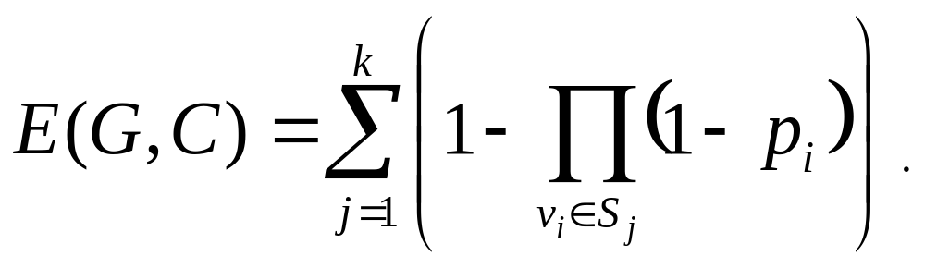
In [MP03a], it is shown that
This can be performed in at most O(n²) steps.

Slide 16
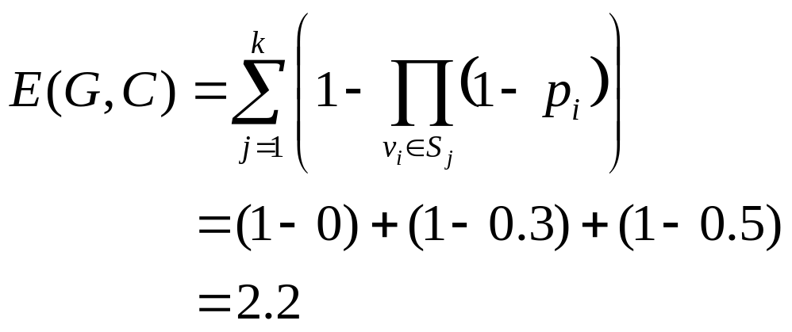
Look!
C
1
0.6
D
A
0.7
B
0.5
Thus mathematics is very important, isn’t it?

Slide 17
Outline
Preliminaries
Properties
On General Bipartite Graphs
  2-approximation under any system of vertex-probabilities
  8/7-approximation algorithm for identical vertex-probabilities
Conclusions
References

Slide 18
Properties
We will give some general properties about probabilistic colorings, upon which we will be based later in order to achieve our results.
In what follows, given an a priori k-coloring C = (S₁, …,S_{k}), we will set f (C) = E(G, C), and for i = 1,…,k, f (S_{i}) = 1 − ∏_{vj∈Si}(1− p_{j}).

Slide 19
Properties under non-identical vertex-probabilities.

Slide 20
Property 1
Let C = (S₁, …, S_{k}) be a k-coloring and assume that colors are numbered so that f (S_{i}) ≤ f (S_{i+1}), i = 1,…, k−1. Consider a vertex x (of probability p_{x}) colored with S_{i} and a vertex y (of probability p_{y}) colored with S_{j}, j > i, such that p_{x} ≥ p_{y}. If swapping colors of x and y leads to a new feasible coloring C′, then f (C′) ≤ f (C).
x
x
y
y
S_{i}
S_{j}

Slide 21
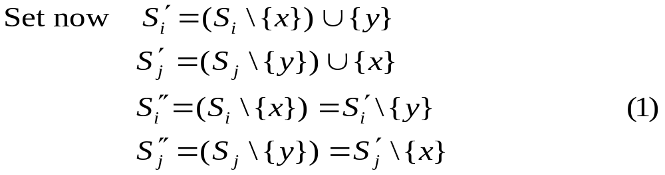
Proof of Property 1 [CEMP04]
Between coloring C and C′, the only colors changed are S_{i} and S_{j}. Then:

Slide 22
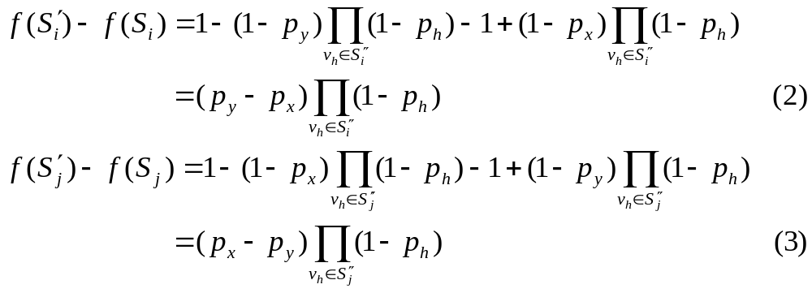
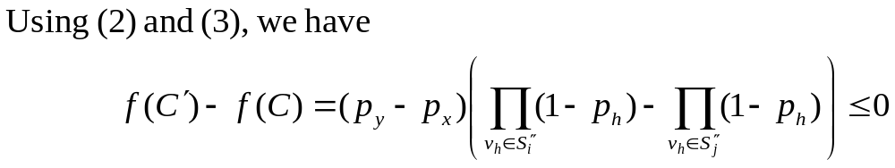
By (1), we have

Slide 23
Property 2
Let C = (S₁, …,S_{k}) be a k-coloring and assume that colors are numbered so that f (S_{i}) ≤ f (S_{i+1}), i = 1,…, k−1. Consider a vertex x (of probability p_{x}) colored with S_{i}. If it is feasible to color x with another color S_{j} , j > i, (by keeping colors of the other vertices unchanged), then the new feasible coloring C ′ verifies f (C ′) ≤ f (C).
Proof:
  A good EXERCISE for you. ☺

Slide 24
Property 3
In any graph of maximum degree Δ, the optimal solution of PROBABILISTIC COLORING contains at most Δ + 1 colors.
Proof:
  If an optimal coloring uses Δ + k colors, k > 0, then, by emptying the lowest-value color (thing always possible as there are at least Δ + 1 colors) and due to Property 2, we achieve a (Δ + 1)-coloring feasible for G with value better smaller (better) than the one of C.
WHY? ☺
Notes:
I figured out the proof when riding on the way to tutoring.

Slide 25
Properties under identical vertex-probabilities.

Slide 26
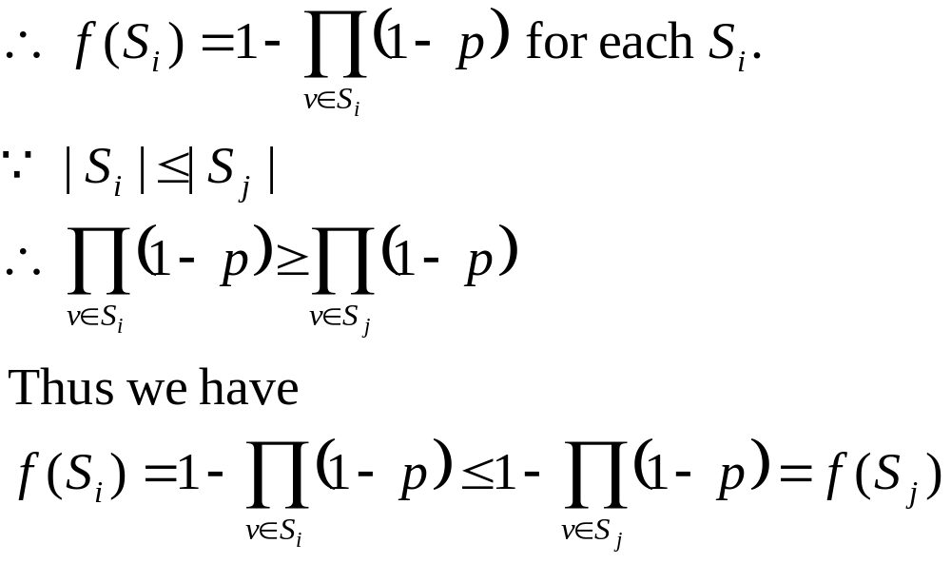
My Lemma 1 (proved in a Toilet)
If |S_{i}| ≤ |S_{j}|, then f (S_{i}) ≤ f (S_{j}).
Proof:
Assume that the identical vertex-probability is p.

Slide 27
Property 4
Let C = (S₁, …,S_{k}) be a k-coloring and assume that colors are numbered so that |S_{i}| ≤ |S_{i+1}|, i = 1,…, k−1. If it is feasible to inflate a color S_{j} by “emptying” another color S_{i} with i < j, then the new coloring C ′, so created, verifies f (C ′) ≤ f (C).
Proof:
  By applying My Lemma 1 and Property 1 we can easily prove this property.
  EXERCISE? ☺

Slide 28
Property 5
Let C = (S₁, …, S_{k}) be a k-coloring and assume that colors are numbered so that |S_{i}| ≤ |S_{i+1}|, i = 1,…, k−1. Consider two colors S_{i} and S_{j} , i < j , and a vertex-set X ⊂ S_{j} such that, |S_{i}| + | X | ≥ |S_{j}|. Consider (possibly unfeasible) coloring C ′ = (S₁,…, S_{i}∪X,…, S_{j} \ X,…, S_{k}). Then, f (C ′) ≤ f (C).
Proof: Omitted here.

Slide 29
We define those colorings C such that Properties 1, 2 or 4 hold, as balanced colorings. On the other hand, colorings for which transformations of properties above cannot apply will be called unbalanced colorings.
In other words, for a balanced coloring C, there exists a coloring C′ better than C, obtained as described in Properties 1, 2 or 4.
From the above definitions, the following Proposition immediately holds.

Slide 30
Proposition 1
For any balanced coloring, there exists an unbalanced one dominating it.

Slide 31
Let us further restrict ourselves to bipartite graphs.
  We will not discuss the cases that all the vertex-probabilities are 0 or all the vertex-probabilities are 1. They are trivial.
  In any bipartite graph, the bipartition (2-coloring) of its vertices is unique. [MP03a]
My explanation:
Based upon the previous properties and Proposition 1, one can always improve a 2-coloring C of a bipartite graph B to an unbalanced coloring C*, where E(B, C*) is the lowest. And we regard C* as the unique coloring of B.
Notes:
I have discussed this with senior C. M. Lee. The explanation is thought out when eating.

Slide 32
α(B) for a Bipartite Graph B(U ∪D, E)
For a bipartite graph B(U∪D, E), and without loss of generality, assume | U | ≥ | D |, we denote by α(B) the cardinality of a maximum independent set of B.
1
1
2
2
3
3
4
U = {1, 2, 3, 4}
D = {5, 6, 7}
5
5
6
6
7
α(B) = 5
B(U, D, E)

Slide 33
Property 6
If α(B) = | U |, then 2-coloring C = (U, D) is optimal.
Proof:
  Suppose a contradiction that C is not optimal, then the optimal coloring C′ uses exactly k ≥ 3 colors and its largest cardinality color S₁′ has cardinality β. Consider the following cases that α(B) = | U | or α(B) > | U |.
  Why don’t we discuss k = 2? ☺
  Why don’t we discuss α(B) < | U |?
. .
−
Notes:
By Property 2 we can know that when k = 2, C = (U,D) is optimal. => I think it out when eating.

Slide 34
Proof:
α(B) = | β |:
α(B) > | β |:
  Assume adding to color S₁′ exactly α(B) − β vertices from the other colors neglecting possible infeasibilities. Hence consider the case α(B) = | β |, the proof is done.
(Note: |S₁′| = β )
≥ f (C)
S₁′
S₁′
S₂′
S₂″
S₃′

Slide 35
My Explanation
The unique 2-coloring of a bipartite graph B(U∪D, E) is C = (U, D), where α(B) = | U |.
While, the natural 2-coloring of a bipartite graph B(U∪D, E) is C = (U, D), where α(B) ≥ | U |.
I think that the authors should give more clearly explanations here.

Slide 36
Outline
Preliminaries
Properties
On General Bipartite Graphs
  2-approximation under any system of vertex-probabilities
  8/7-approximation algorithm for identical vertex-probabilities
Conclusions
References

Slide 37
Under Any System of Vertex-Probabilities
We first give an easy result showing that the hard cases for PROBABILISTIC COLORING are the ones where vertex-probabilities are “small”.
Consider a bipartite graph B(U∪D, E) and denote by p_{min} its smallest vertex-probability.

Slide 38
Proposition 2
If p_{min} ≥ 0.5, then the unique 2-coloring C = (U, D) is optimal for the bipartite graph B.
Proof:
  Since p_{min} ≥ 0.5, for any color S_{i} of any coloring C′ of B, 1 > f (S_{i}) ≥ 0.5. (since f (S_{i}) = 1 − ∏_{vj∈Si}(1− p_{j}))
  Hence f (C′) ≥ 0.5|C′| > 0.5
  On the other hand, f (C) < 2. ☺
  Thus an optimal coloring of B uses either 2, or 3 colors. (Why not use 4 or more than 4 colors? ☺)
Notes:
f (C′) ≥ 0.5|C′| is because f (C′) ≥ Σ_{k} 0.5, where Σ_{k} is size of C′
4 more colors is impossible since f (C′) ≥ 0.5|C′| ≥ 0.5*4 = 2, which is NOT better than C

Slide 39
Consider any 3-coloring C′ = (S₁′, S₂′, S₃′) of B.
The best 3-coloring ever reachable is coloring C″ = (S₁″, S₂″, S₃″), assigning color S₁″ to a vertex v of B with lowest probability, color S₂″ to a vertex v′ with the second lowest probability, and color S₃″ to all the other vertices of B. (by Property 1 and 2)
It is easy to see that f (S₃″) > f (S₂″) ≥ f (S₁″).
The other vertices of B
v
v′

Slide 40

By some applying some easy algebra and the techniques of factoring polynomials, we have
Thus the proof is done.

Slide 41
You may wonder that “what if p_{min} < 0.5” ?
Suppose each vertex-probability is equal to 0.1.
1
1
WINNER!!
8
8
5
6
7
5
6
7
2
3
4
2
3
4
coloring C
coloring C ′
E(B, C) = 2(1−(0.1)⁴)
= 1.9998
E(B, C ′) = 2(1−(0.1)) +(1 − (1 −0.1)²)
= 1.81
Notes:
I made this example when I was at toilet

Slide 42
Proposition 3
In any bipartite graph B(U∪D, E), its unique 2-coloring C = (U, D) achieves approximation ratio bounded by 2. This bound is tight.
Proof:
  Consider a bipartite graph B(U∪D, E). There is a trivial lower bound on the optimal solution cost: infeasible 1-coloring U∪D with all vertices having the same color.
  Hence:
  (It is NOT trivial indeed. I made a proof by mathematical induction for one hour. It is a good EXERCISE for you. ☺)
Notes:
The previous bound is 2.773

Slide 43
  f (U∪D) ≤ f (C*), where C* is denoted an optimal coloring of B.
  Assume that f (D) ≤ f (U).
  Then, since U ⊆ U∪D, f (U) ≤ f (U∪D).
  Therefore, f (C) = f (U) + f (D) ≤ 2 f (U) ≤ 2f (U∪D) ≤ 2f (C*).
Notes:
The previous bound is 2.773

Slide 44
Tightness
Consider the following bipartite graph:
1−ε
ε
1−ε
ε
1
2
1
2
3
4
3
4
ε
1−ε
ε
1−ε
2-coloring:
f₂ = 2[1−ε(1−ε)]
= 2 − 2ε + 2ε²
3-coloring:
f₃ = 1(1−ε²) + 2[1−(1−ε)]
= 1 + 2ε − ε²

Slide 45
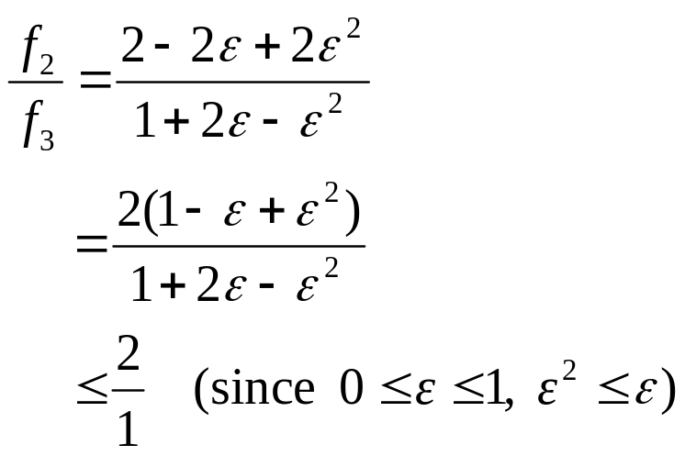
Tightness
When ε → 0, the 3-coloring is the optimal solution, thus the approximation ratio of the two coloring tends to 2.

Slide 46
Corollary 1
The natural 2-coloring is not always optimal under distinct vertex probabilities. Yet this coloring constitutes a tight 2-approximation for all bipartite graphs..

Slide 47
Outline
Preliminaries
Properties
On General Bipartite Graphs
  2-approximation under any system of vertex-probabilities
  8/7-approximation algorithm for identical vertex-probabilities
Conclusion
References

Slide 48
We now restrict our discussion to the case of identical vertex-probabilities.

Slide 49
Algorithm: 3-COLOR
Step 1: Compute and store the natural 2-coloring C₀ = (U, D).
Step 2: Compute a maximum independent set S of B.
Step 3: Output the best coloring among C₀ and C₁ = (S, U \ S, D \ S).
It is polynomial since computation of a maximum independent set can be performed in polynomial time in bipartite graphs. [GJ79]

Slide 50
U
…
…
S
D

Slide 51
Proposition 4
Algorithm 3-COLOR achieves approximation ratio bounded above by 8/7 in bipartite graphs with identical vertex-probabilities. This bound is asymptotically tight.

Slide 52
Proof
We omit the proof here due to the matter of time.
However, everyone can comprehend the proof easily if you can solve the following problems:

Slide 53
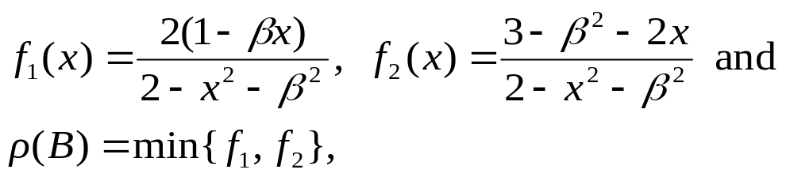
Problem 1
Suppose that n₂ ≤ n₁, 0 ≤ β ≤ x < 1, and we are given
What is the maximum value of ρ (B)?
  The idea to solve it is very similar to one proof in senior W. H. Wu’s thesis.
  Only some simple calculus techniques are needed.

Slide 54
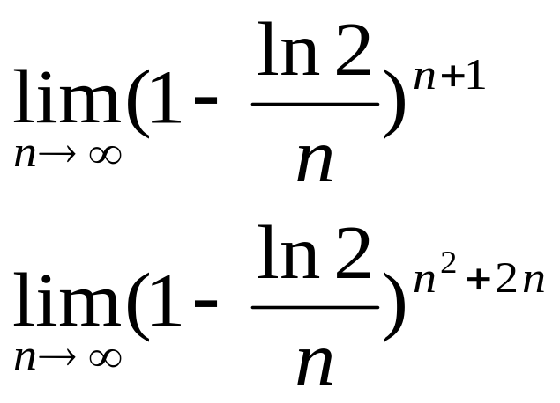
Problem 2
Solve
I thought out the method solving these when leaving a toilet.
A quite good EXERCISE for you. ☺

Slide 55
Outline
Preliminaries
Properties
On General Bipartite Graphs
  2-approximation under any system of vertex-probabilities
  8/7-approximation algorithm for identical vertex-probabilities
Conclusions
References

Slide 56
Conclusions
This is the best paper (except our boss’ papers) I have ever seen. (Maybe I haven’t studied extensively enough.)
Some of the authors’ errors in the papers have been corrected by me and some proofs are given by myself.
There are still several problems needed to be solved or improved as follows.

Slide 57
Summary of the main results of the papers.
Graph-classes | Complexity | Approximation ratio
Bipartite | ? | 2
Bipartite, p_{i} ≥ 0.5 | Polynomial
Bipartite, p_{i} identical | ? | 8/7
Trees | ?
Trees, bounded degree, k distinct probabilities | Polynomial
Trees, all leaves exclusively at even or odd level, identical p_{i}’s | Polynomial
Stars | Polynomial
Paths | ?
Cycles | ?
Even or odd cycles, p_{i} identical | Polynomial
Split graphs | NP-complete | 2
Split graphs, p_{i} identical | NP-complete | 1 + ε, for any ε > 0

Slide 58
Outline
Preliminaries
Properties
On General Bipartite Graphs
  2-approximation under any system of vertex-probabilities
  8/7-approximation algorithm for identical vertex-probabilities
Conclusions
References

Slide 59
[ABSL94] Probabilistic a Priori Routing-location Problems, Averbakh, I., Berman, O. and Simchi-Levi, D., Naval Research Logistics, Vol. 41, 1994, pp. 973-989.
[B89] On Probabilistic Traveling Salesman Facility Location Problems, Bertsimas, D. J., Transportation Science, Vol. 3, 1989, pp. 184-191. [SCI]
[B90] The Probabilistic Minimum Spanning Tree Problem, Bertsimas, D. J., Networks, Vol. 20, 1990, pp. 245-275. [SCI]
[BJO90] A Priori Optimization, Bertsimas, D. J., Jaillet, P. and Odoni, A., Operations Research, Vol. 38, 1990, pp. 1019-1033. [SCI]
[CEMP04] Probabilistic Coloring of Bipartite and Split Graphs, Croce, D. F., Escoffier, B., Murat, C. and Paschos, V. Th., Cahier du LAMSADE 218, LAMSADE, Université Paris-Dauphine, 2004.
[CEMP05] Probabilistic Coloring of Bipartite and Split Graphs (Extend Abstract), Croce, D. F., Escoffier, B., Murat, C. and Paschos, V. Th., Computational Science and Its Applications, 2005, (ICCSA 2005); Lecture Notes in Computer Science, Vol. 3483, 2005, pp. 202-211. [SCIE]
[GJ79] Computers and Intractability: A Guide to the Theory of NP-completeness, Garey, M. R. and Johson, D. S., W. H. Freeman, San Francisco, 1979.
[GMMP97] A New Model and Derived Algorithms for the Satellite Shot Planning Problem Using Graph Theory Concepts, Gabrel, V., Moulet, A., Murat, C. and Paschos, V. Th., Annals of Operations Research, Vol. 69, 1997, pp. 115-134. [SCI]
[J85] Probabilistic Traveling Salesman Problem, Jaillet, P., Technical Report 185, Operations Research Center, MIT, Cambridge Mass., USA, 1985.

Slide 60
[J88] A Priori Solution of a Traveling Salesman Problem in Which a Random Subset of the Customers Are Visited, Jaillet, P., Operations Research, Vol. 36, 1988, pp. 929-936. [SCI]
[J92] Shortest Path Problems with Node Failures, Jaillet, P., Networks, Vol. 22, 1992, pp. 589-605. [SCI]
[JO88] The Probabilistic Vehicle Routing Problem, Jaillet, P. and Odoni, A., In Golden, B. L., Assad, A. A. eds.: Vehicle Routing: Methods and Studies, North Holland, Amsterdam, 1988.
[MP99] The Probabilistic Longest Path Problem, Murat, C. and Paschos, V. Th., Networks, Vol. 33, 1999, pp. 207-219.[SCI]
[MP02a] The Probabilistic Minimum Vertex-coloring Problem, Murat, C. and Paschos, V. Th., International Transactions in Operational Research, Vol. 9, 2002, pp. 19-32.
[MP02b] A Priori Optimization for the Probabilistic Maximum Independent Set Problem, Murat, C. and Paschos, V. Th., Theoretical Computer Science, Vol. 270, 2002, pp. 561-590. [SCI]
[MP03a] The Probabilistic Minimum Coloring Problem, Murat, C. and Paschos, V. Th., Annales du LAMSADE 1, LAMSADE, Université Paris-Dauphine, 2003. (Available on line.) (submitted); Workshop on Graph-Theoretic Concepts in Computer Science, 2003.(WG2003)
[MP03b] The Probabilistic Minimum Coloring Problem, Murat, C. and Paschos, V. Th., Lecture Notes in Computer Science, Vol. 2880, 2003, pp. 346-357. [SCIE]

Slide 61
The End
Thank you

