Slide 1
Three Theorems Regarding Testing Graph Properties:
The first theorem: there exists a monotone graph property which is hard to test
Oded Goldreich and Luca Trevisan
Random Structures and Algorithms, Vol. 23, 2003, pp. 23−57.
Speaker: Chuang-Chieh Lin
National Chung Cheng University

Slide 2
Outline
Graph properties
Testers for graph properties
Monotone graph properties
The first theorem
Tools used for the first theorem
Idea of the lower bound construction
References

Slide 3
For any natural number n, we define [n] = {1, …, n}.
We consider finite, undirected, labeled graphs without parallel edges.
WLOG, all N-vertex graphs have [N] as their vertex set, and their edges are unordered pairs over [N].

Slide 4
Graph property
A graph property Π is a predicate defined over graphs that is preserved under graph isomorphism.
That is, if G has property Π and G′ is isomorphic to G then G′ has property Π.

Slide 5
Graph property (contd.)
We say that G = ([N], E) is ε-close to having property Π if there exists a graph G′ = ([N], E′) having property Π such that the symmetric difference between E and E′ is at most
We say that a graph G is ε-far from having property Π if it is NOT ε-close to having property Π.
¡
N
¢
²
2
.
Notes:
A ΔB = (A−B)∪(B−A)

Slide 6
Symmetric difference between two graphs
A
B
A
B
C
D
C
D
G₁
G₂
The symmetric difference between G₁ and G₂ is 3.

Slide 7
Testers for graph properties
Testers are oracle machines that are given as input a pair (N, ε).
  N is a size parameter
  ε > 0 is a distance parameter,
  oracle access to the adjacency matrix of an N-vertex graph.
Notes:
Oracle: It can be visualized as a Turing machine with a black box, called an oracle,
which is able to decide certain decision problems in a single step.

Slide 8
Testers for graph properties (contd.)
An oracle machine T is called a tester for property Π if for every graph G = ([N], E) and every ε, the following two conditions hold:
1
I
f
G
h
a
s
p
r
o
p
e
r
t
y
Q
t
h
e
n
P
r
[
T
G
(
N
²
)
=
1
]
¸
2
.
,
;
3
.
2
I
f
G
i
s
²
-
f
a
r
f
r
o
m
h
a
v
i
n
g
p
r
o
p
e
r
t
y
Q
t
h
e
n
.
G
1
,
P
r
[
T
(
N
²
)
=
1
]
·
;
3
.

Slide 9
Testers for graph properties (contd.)
A typical query (u, v) to oracle G is answer 1 iff the edge (u, v) is in the graph G.
The tester T (for Π) is said to be one-sided error if it always accepts graphs having the property Π.

Slide 10
Testers for graph properties (contd.)
The query complexity of a tester T is a function q: N × [0,1] → N such that q(N, ε) is an upper bound on the number of queries made by T on input (N, ε) and oracle access to the adjacency predicate of any N-vertex graph.
The query complexity of a property Π is the minimum query complexity of testers for Π.

Slide 11
Monotone graph properties
In this paper, the monotone graph property is defined as follows.
A graph property Π is called monotone if adding any edge to any graph that has property Π results in a graph that has property Π.
  Connectivity, Clique,, … are monotone.
  Triangle-free, Chordality, bipartiteness, … are NOT monotone.

Slide 12
By saying that a graph property Π is in NP, we mean that the problem of deciding whether a given graph has property Π is in NP.

Slide 13
The first theorem
There exists a monotone graph property Π in NP for which every tester requires Ω(N²) queries (even when invoked with constant distance parameter).

Slide 14
Tools used for the first theorem
We use efficient constructions of small-bias probability spaces.
An ε-biased sample space over {0, 1}^{n}, is a multiset S such that, for every nonempty set I ⊆ [n], if s = s₁ …s_{n} is selected uniformly in S, then
¯
P
[
©
1
]
¡
1
¯
·
¯
r
i
2
I
s
i
=
2
¯
²
.

Slide 15
ε-biased sample space
Such sample spaces can be constructed in time poly(n/ε); specifically, |S| = (n/ε)² suffices.

Slide 16
a 0,1 string s of length 5:
0 | 1 | 1 | 0 | 1
Let A_{i} be an event such that s has i 1’s.
Assume that |s| = 5. We have the probability that s has odd 1’s is
P
r
[
A
1
[
A
3
[
A
5
]
µ
5
¶
µ
5
¶
µ
5
¶
=
(
1
=
2
)
1
(
1
=
2
)
4
+
(
1
=
2
)
3
(
1
=
2
)
2
+
(
1
=
2
)
5
(
1
=
2
)
0
1
3
5
=
(
5
+
1
0
+
1
)
¢
(
1
=
2
)
5
=
1
=
2
:

Slide 17
a 0,1 string s of length 6:
0 | 1 | 1 | 0 | 0 | 1
Assume that |s| = 6. The probability that s has odd 1’s is still
P
r
[
A
1
[
A
3
[
A
5
]
µ
6
¶
µ
6
¶
µ
6
¶
=
(
1
=
2
)
1
(
1
=
2
)
5
+
(
1
=
2
)
3
(
1
=
2
)
3
+
(
1
=
2
)
5
(
1
=
2
)
1
1
3
5
=
(
6
+
2
0
+
6
)
¢
(
1
=
2
)
6
=
1
=
2
:

Slide 18
Actually, we can easily show by induction that the probability of having odd 1’s in a 0,1-string is ½, so is the case for even 1’s.

Slide 19
Fact 1
L
e
t
²
¸
0
t
2
[
n
]
a
n
d
S
b
e
a
n
²
-
b
i
a
s
e
d
s
a
m
p
l
e
s
p
a
c
e
,
,
o
v
e
r
f
0
1
g
n
T
h
e
n
f
o
r
e
v
e
r
y
t
-
s
u
b
s
e
t
I
2
[
n
]
a
n
d
;
.
,
e
v
e
r
y
®
=
®
®
2
f
0
1
g
t
i
f
s
=
s
s
s
e
l
e
c
t
e
d
1
:
:
:
t
;
,
1
:
:
:
n
u
n
i
f
o
r
m
l
y
i
n
S
t
h
e
n
i
t
h
o
l
d
s
t
h
a
t
,
¯
P
r
[
(
8
i
2
I
)
s
®
]
¡
2
¡
t
¯
·
²
¯
i
=
i
¯
:
Notes:
很像”不公平”的”樂透”

Slide 20
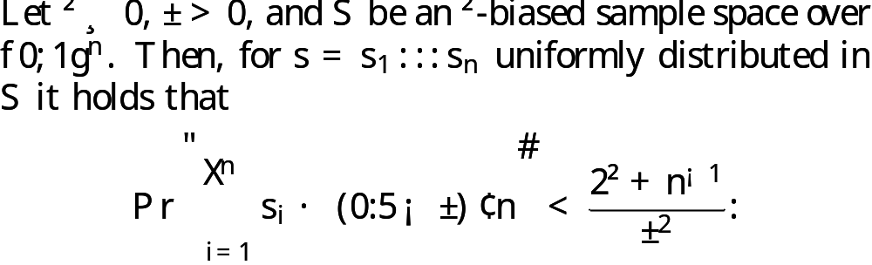
Fact 2
Notes:
可用 Chebyshev’s inequality 證明

Slide 21
Idea of the lower-bound construction

Slide 22
A
Constructing a 0.1 ⋅2^{-t}-biased sample space over -bit long strings, where t = N²/200.
S
u
c
h
s
a
m
p
l
e
s
p
a
c
e
o
f
s
i
z
e
¡
N
¢
O
(
(
¡
N
¢
=
(
0
1
2
¡
t
)
)
2
)
2
2
t
+
o
(
t
)
2
2
:
¢
=
d
o
e
x
i
s
t
.
B
Omit from the sample space any sample that has less than on third of one-entries.
C
For each sample s in the residual space, we define a graph G_{s} = ([N], E_{s}) by letting (i, j) ∈ E_{s} iff (i, j)th bit of s equals 1.
We call these 2^{2t+o(t)} graphs the basic graphs.
Notes:
關鍵在A的 t 值，使得 bias 很小，讓 testers 花\Omega(N^2)才能 test

Slide 23
(1,2)
(1,3)
(1,4)
(1,5)
(2,3)
(2,4)
(2,5)
(3,4)
(3,5)
(4,5)
¡
5
¢
b
i
t
1 | 0 | 1 | 1 | 0 | 1 | 0 | 1 | 0 | 1
2
s
1
3
2
4
5

Slide 24
C
For each sample s in the residual space, we define a graph G_{s} = ([N], E_{s}) by letting (i, j) ∈ E_{s} iff (i, j)th bit of s equals 1.
We call these 2^{2t+o(t)} graphs the basic graphs.
D
For every s in the sample space (equivalently, every basic graph G_{s}) and every permutation π over [N], we consider the secondary graph G_{s,π} = ([N], E_{s,π}) that is defined so that (π(u), π(v)) ∈ E_{s,π} iff (u, v) ∈ E_{s}.
By construction, the set of secondary graphs are closed under graph isomorphism, and so this collection does constitute a graph property.

Slide 25
D
For every s in the sample space (equivalently, every basic graph G_{s}) and every permutation π over [N], we consider the secondary graph G_{s,π} = ([N], E_{s,π}) that is defined so that (π(u), π(v)) ∈ E_{s,π} iff (u, v) ∈ E_{s}.
By construction, the set of secondary graphs are closed under graph isomorphism, and so this collection does constitute a graph property.
E
For every secondary graph G′= ([N], E′), and every E′′⊇ E′, we introduce the final graph G′′= ([N], E′′)

Slide 26
B
Omit from the sample space any sample that has less than on third of one-entries.
At this point, the reason for the modification in the initial sample space may be clear.
  If, for example, the sample space had contained the all-zero string, then the set of final graphs would have contained all graphs, and testing membership in it would have been trivial.

Slide 27
A simple observation
Question:
How many different simple graphs of N vertices?
Another similar question:
How many Boolean functions with n variables?
(
N
)
(
)
=
2
2
n
n
¡
1
2
2
=
2
2
n

Slide 28
: final graphs
: a random graph

Slide 29
The aim of the proof
Our aim is to show that, although a random graph is far from the set of final graphs, no algorithm that make o(N²) queries can distinguish a random graph from a graph selected among the final graphs (with some distribution that is not necessarily uniform).
Since a tester for the set of final graphs must accept any final graph (with high probability), we conclude that such tester must make Ω(N²) queries.

Slide 30
The aim of the proof (contd.)
Specifically, throughout the rest of the analysis, we refer to testers of N-vertex graphs that should :
  accept with probability at least 2/3 every graph that has the property, and
  reject with probability at least 2/3 every graph that is 0.1-far from having the property.
Thus, we omit (fix) the distance parameter ε (to be 0.1).

Slide 31
Claim 1
The probability that a random graph is 0.1-close to some final graph is at most 0.1.

Slide 32
Claim 2
Let M be a probabilistic oracle machine that makes at most t queries. Let R_{N} denote a random graph, and B_{N} denote a graph uniformly selected among the basic graphs. Then,
¯
P
[
M
R
N
(
N
)
1
]
¡
P
[
M
B
N
(
N
)
1
]
¯
<
0
2
¯
r
=
r
=
¯
:

Slide 33
The first theorem
There exists a monotone graph property Π in NP such that the query complexity of Π, denoted by q_{Π}, satisfies q_{Π} (N, 0.1) = Ω(N²).

Slide 34
Proof of Theorem 1
Consider the graph property, denoted by Π, corresponding to the set of final graphs denoted above.
Suppose that M is a tester for this property and that M makes less than N²/200 queries (invoked with distance parameter 0.1)
Then by Claim 2, we have
(*)
¯
P
r
[
M
R
N
(
N
)
1
]
¡
P
r
[
M
B
N
(
N
)
1
]
¯
<
0
2
¯
=
=
¯
:
.

Slide 35
Proof of Theorem 1 (contd.)
Since each graph in the support of B_{N} (i.e., each basic graph) has property Π, the tester must accept such graph with probability at least 2/3.
The tester may accept with probability at most 1/3 each graph that is 0.1-far from having property Π is at least 0.9 (denote it by y). By Claim 1, we have
B
2
(**)
P
r
[
M
N
(
N
)
=
1
]
¸
>
0
6
3
:
.
P
r
[
M
R
N
(
N
)
1
]
·
¢
1
=
3
+
(
1
¡
)
¢
1
=
y
y
(***)
·
0
9
¢
1
=
3
+
0
1
¢
1
=
0
4
:
:
:
:

Slide 36
Proof of Theorem 1 (contd.)
(**) − (***) contradicts to (*). Hence the theorem follows.

Slide 37
Recall to Claim 1:
The probability that a random graph is 0.1-close to some final graph is at most 0.1.

Slide 38
Proof of Claim 1
The key observation is that the set of final graphs is very sparse.
Each basic graph gives rise to at most N! secondary graphs.
Each secondary graph gives rise to at most final graphs.
2
=
3
(
N
)
2
2
2
N
2
=
3
<

Slide 39
Proof of Claim 1 (contd.)
Thus, the number of final graphs is at most
where the above holds for all sufficiently large N.
My idea:
  For each final graph G′′, we have at most graphs which are 0.1-close to G′′.
2
t
+
(
t
)
(
)
N
2
=
3
0
7
¢
(
N
)
2
o
¢
N
!
¢
2
<
2
:
2
0
1
(
N
)
2
:
2

Slide 40
Proof of Claim 1 (contd.)
Thus for all sufficiently large N, we can show that less than 10% of the graphs are 0.1-close to some final graph.

Slide 41
Recall to Claim 2:
Let M be a probabilistic oracle machine that makes at most t queries. Let R_{N} denote a random graph, and B_{N} denote a graph uniformly selected among the basic graphs. Then,
¯
P
[
M
R
N
(
N
)
1
]
¡
P
[
M
B
N
(
N
)
1
]
¯
<
0
2
¯
r
=
r
=
¯
:

Slide 42
Proof of Claim 2
We identify -bit long strings with N-vertex graphs.
  They are obtained as in the first stage of the construction.
Let G_{N} denote a graph uniformly selected among all graphs in the sample space without discarding from the space those samples having less than on third of one-entries (i.e., less than edges)
Thus, B_{N} is obtained from G_{N} by conditioning that G_{N} has at least edges.
¡
N
¢
2
1
¡
N
¢
3
2
1
¡
N
¢
3
2

Slide 43
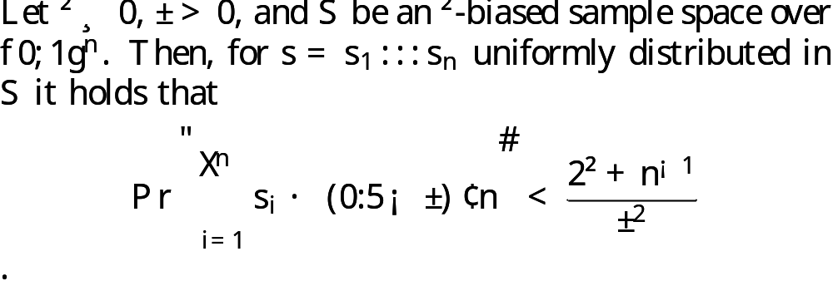
Proof of Claim 2 (contd.)
By Fact 2:
The probability that an element in it has less than one third of one-entries is very small (e.g., tends to 0 when N → ∞)

Slide 44
Proof of Claim 2 (contd.)
It follows that
¯
G
B
¯
(i)
P
r
[
M
N
(
N
)
=
1
]
¡
P
r
[
M
N
(
N
)
=
1
]
<
0
1
¯
¯
:
.

Slide 45
Proof of Claim 2 (contd.)
The sample space underlying the construction of G_{N} has bias at most 0.1 ⋅ 2^{−t}.
It follows by Fact 1 that, for every t distinct unordered pairs (u₁, v₁), ... , (u_{t} , v_{t}) ∈ [N]×[N] and every α₁α₂ …α_{t} ∈{0.1}^{t}, the probability that for every i query (u_{i},v_{i}) to G_{N} is answered by α_{i} with probability within 2^{−t} ± 0.1 ⋅ 2^{−t}.

Slide 46
Proof of Claim 2 (contd.)
Observe that the internal coins of M together with the oracle answers to M determine oracle queries of M.
For any fixed sequent of coins for M, any fixed sequence of t answers occurs with probability within 2^{−t} ± 0.1 ⋅ 2^{−t} under G_{N} (rather than with probability 2^{−t} under R_{N}).
  Thus, for any fixed sequence of coins for M, the observed deviation of the t answers of G_{N} from the t answers of R_{N} is at most 0.1.
Notes:
The internal coins of M here are fair.

Slide 47
Proof of Claim 2 (contd.)
Thus we have
Combing the result of (i):
the claim follows (by triangular inequality).
¯
G
R
¯
(ii)
P
r
[
M
N
(
N
)
=
1
]
¡
P
r
[
M
N
(
N
)
=
1
]
<
0
1
¯
¯
:
.
¯
G
B
¯
(i)
P
r
[
M
N
(
N
)
=
1
]
¡
P
r
[
M
N
(
N
)
=
1
]
<
0
1
¯
¯
:
.

Slide 48
Thank you.

Slide 49
References
[AS05] N. Alon and A. Shapira: Every monotone graph property is testable. STOC’05.
[AGHP92] N. Alon, O. Goldreich, J. Hastad, and R. Peralta: Simple constructions of almost k-wise independent random variables. J. Random Struct. Alg., 3(3) (1992), pp. 289−304.
[AK02] N. Alon and M. Krivelevich. Testing k-colorability. SIAM J. Discrete Math., 15(2) (2002), pp. 211−227.
[GGR98] O. Goldreich, S. Goldwasser, and D. Ron: Property testing and its connection to learning and approximation. J. ACM, 45(4) (1998), pp. 653−750.
[GT03] O. Goldreich and L. Trevisan: Three theorems regarding testing graph properties. Random Strut. Alg., 23 (2003), pp. 23−57.
[NN93] J. Naor and M. Naor: Small-bias probability spaces: Efficient constructions and applications. SIAM J. Comput., 22 (1993), pp. 838−856.

