Slide 1
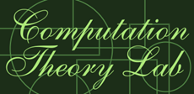
國立中正大學資訊工程所
計算理論實驗室
榮譽出品

Slide 2
The Church-Turing Thesis: Breaking the Myth
Dina Goldin and Peter Wegner
Lecture Notes in Computer Science, Vol. 3526, 2005, pp. 152-168.
Speaker: Chuang-Chieh Lin
Advisor: Professor Maw-Shang Chang
Computation Theory Laboratory,
National Chung Cheng University, Taiwan

Slide 3

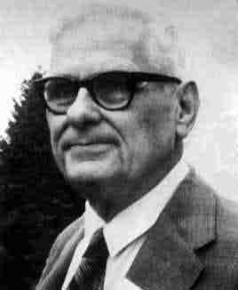
Alan Turing (1912 – 1954)
Alonzo Church (1903-1995)

Slide 4
It is not Alan Turing’s fault.
Really.

Slide 5
Outline
Introduction
Turing Machines
The Turing Thesis Myth
Algorithms and Computability
Persistent Turing Machines (PTMs)
Turing Thesis Myth Corrected
Conclusion

Slide 6
Outline
Introduction
Turing Machines
The Turing Thesis Myth
Algorithms and Computability
Persistent Turing Machines (PTMs)
Turing Thesis Myth Corrected
Conclusion

Slide 7
What Is Computation?
The theory of computation views computation as a closed box transformation of inputs to outputs, completely captured by Turing machines, which will be introduced later.
input
output

Slide 8
Turing’s Thesis
Turing’s thesis:
  LCMs can do anything that could be described as “rule of thumb” or “purely mechanical” (1948)
In the above sentence, LCMs means "logical computing machines", that are Turing's expressions for Turing machines.
Let us see the myth first.

Slide 9
The Turing Thesis Myth
Claim 1. All computable problems are function-based.
Clam 2. All computable problems can be described by an algorithm.
Claim 3. Algorithms are what computers do.
Claim 4. Turing machines serve as a general model for computers.
Claim 5. Turing machines can simulate any computer.

Slide 10
Outline
Introduction
Turing Machines
The Turing Thesis Myth
Algorithms and Computability
Persistent Turing Machines (PTMs)
Turing Thesis Myth Corrected
Conclusion

Slide 11
Turing Machines
I will make use of Prof. Tsai’s lectures to introduce Turing machines as follows.

Slide 12
Tape
......
......
Read-Write head
Control Unit

Slide 13
No boundaries -- infinite length
......
......
OR
The tape
Read-Write head
The head moves Left or Right

Slide 14
......
......
Read-Write head
The head at each time step:
1. Reads a symbol
2. Writes a symbol
3. Moves Left or Right

Slide 15




Example:
Time 0
......
......
Time 1
......
......
1. Reads a
2. Writes k
3. Moves Left

Slide 16

Time 1
......
......
Time 2
......
......
1. Reads b
2. Writes f
3. Moves Right

Slide 17

The Input String
Input string
Blank symbol
......
......
head
Head starts at the leftmost position
of the input string

Slide 18




States & Transitions
Read
Write
Move Left
Move Right

Slide 19
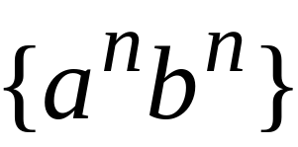







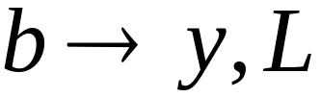



Turing machine for the language

Slide 20
Time 0

Slide 21

Time 1

Slide 22
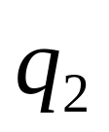
Time 2

Slide 23

Time 3

Slide 24
Time 4

Slide 25
Time 5

Slide 26
Time 6

Slide 27
Time 7

Slide 28
Time 8

Slide 29
Time 9

Slide 30
Time 10

Slide 31
Time 11

Slide 32
Time 12

Slide 33
Time 13
Halt & Accept

Slide 34
Turing machines with stay option, semi-infinite tape, multitape, nondeterministic have the same power as the standard Turing machine which is we just introduced.
That is, they can recognize the same class of languages. (i.e., they can solve the same problems.)
To simplify our discussion, we use “TM ” to stand for the noun “Turing machine”.

Slide 35
Here we introduce the concept of the universal TM.
  We regard TMs as “hardwired” components, each of which execute only one program.
  An universal TM is a reprogrammable machine that can simulate any other TM, say M.
  Input of a universal TM M:
    Description of transitions of M
    Initial tape contents of M
For example:

Slide 36

Three tapes
Tape 1
Description of
TM₁
TM₂
Tape 2
TM₃
Tape Contents of
Universal Turing Machine M
Tape 3
State of

Slide 37
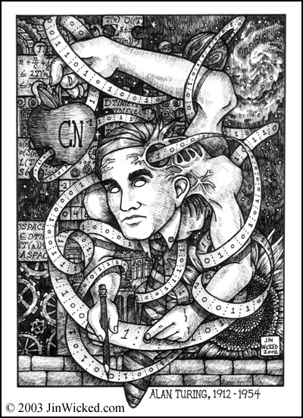
The Universal Turing Machine
This picture looks awful, doesn’t it?

Slide 38
Yet, are TMs so wonderful that they can solve all computational problems in the computer science?
Professor Tsai and many theoreticians didn’t find any problem that can be solved by an algorithm but can’t be solved by any Turing machine.
We were taught that TMs can simulates any computer.
Many computer theoreticians believe that.

Slide 39
Outline
Introduction
Turing Machines
The Turing Thesis Myth
Algorithms and Computability
Persistent Turing Machines (PTMs)
Turing Thesis Myth Corrected
Conclusion

Slide 40
Church-Turing Thesis
Whenever there is an effective method (algorithm) for obtaining the values of a mathematical function, the function can be computed by a TM.

Slide 41
Strong Church-Turing Thesis
A TM can do (compute) anything that a computer can do.

Slide 42
The Turing Thesis Myth
Claim 1. All computable problems are function-based.
Clam 2. All computable problems can be described by an algorithm.
Claim 3. Algorithms are what computers do.
Claim 4. TMs serve as a general model for computers.
Claim 5. TMs can simulate any computer.

Slide 43
To break the myth, we have to investigate the role of algorithms.

Slide 44
Outline
Introduction
Turing Machines
The Turing Thesis Myth
Algorithms and Computability
Persistent Turing Machines (PTMs)
Turing Thesis Myth Corrected
Conclusion

Slide 45
The Original Role of algorithms
Algorithms are “recipes” for carrying out function-based computation, that can be followed mechanically.
Given some finite input x, an algorithm describes the steps for effectively transforming it to an output y, where y is f (x) for some (recursive) function f .

Slide 46
The Original Role of algorithms (contd.)
The notion of an algorithm is a mathematical concept much older than TMs.
For example
  the Euclid’s algorithm for finding common divisors.

Slide 47
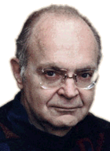
The Original Role of algorithms (contd.)
Donald E. Knuth explicitly specified that algorithms are closed; no new input is accepted once the computation has begun.
  “An algorithm has zero or more inputs, i.e., quantities which are given to it initially before the algorithm begins”. [K68]

Slide 48
The Original Role of algorithms (contd.)
Knuth distinguished algorithms from arbitrary computation that may involve I/O.
Thus Knuth’s careful discussion of algorithmic computation remains definitive to this day.
His discussion of algorithms ensures their function-based behavior and guarantees their equivalence with TMs. [K68]

Slide 49
The Original Role of algorithms (contd.)
Knuth said:
  “There are many other essentially equivalent ways to formulate the concept of an effective computational method (for example, using TMs).”

Slide 50
The Original Role of algorithms (contd.)
The coexistence of the informal (algorithms-based) and the formal (TM-based) approaches to defining solvable problems can be found in all modern textbook on algorithms or computability.
This has proved tremendously convenient for computer scientists, by allowing us to describe function-based computation informally using “pseudocode”, with the knowledge that an equivalent Turing machine can be constructed.

Slide 51
The Original Role of algorithms (contd.)
As we will see, these inconsistencies in the various definitions of an algorithm greatly contributed to the Turing Thesis myth.

Slide 52
The Original Role of algorithms (contd.)
“A procedure is a finite sequence of instructions that can be mechanically carried out, such as a computer program … A procedure which always terminates is called an algorithm.” - Hopcroft, J. E. and Ullman, J. D. [HU69]
“An algorithm is a recipe, a set of instructions or the specifications of a process for doing something. That something is usually solving a problem of some sort”
- Rice J. K. and Rice J. N. [RR69]

Slide 53
The Original Role of algorithms (contd.)
“A TM can do anything that a computer can do.”
- Sipser, M. [S97]
ANYTHING??

Slide 54
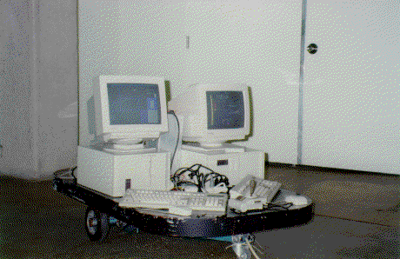
Let us see some counterexamples…
Driving Home From Work [EGW04]
  Create a car that is capable of driving us home from work, where the locations of both work and home are provided as input parameters.
Operating Systems
  They never terminate, if they are fine.
Online algorithms
  Inputs are given dynamically or ongoingly.

Slide 55
According to the interactive view of computation, communication happens during the computation, not before or after it.
It’s time for NEW MODELS.
Wegner has conjectured that interactive models of computation are more expressive than “algorithmic” ones such as Turing machines. [W97, W98]

Slide 56
It would therefore be interesting to find out what minimal extensions are necessary to TMs to capture the salient aspects of interactive computing.
Motivated by these goals, Goldin et al. [GSAS04] proposed a new way of interpreting TM computation, one that is both interactive and persistent:
  persistent Turing machines

Slide 57
Outline
Introduction
Turing Machines
The Turing Thesis Myth
Algorithms and Computability
Persistent Turing Machines (PTMs)
Turing Thesis Myth Corrected
Conclusion

Slide 58
Persistent Turing Machines (PTMs)
An N3TM is a nondeterministic 3-tape TM that has three semi-infinite tapes.
A persistent Turing machine (PTM) is an N3TM having a read-only input tape, a read/write work tape and a write-only output tape. Moreover, a PTM is allowed to “remember” its previous work-tape contents upon commencing a new computation.

Slide 59

Three-tape Turing Machines (N3TM)
input
s - current state
w₁ - contents of input tape
w₂ - contents of work tape
w₃ - contents of output tape
n₁ , n₂ , n₃ - tape head positions
work
S
output
Configurations:
Computation = a sequence of transitions between
configurations, from initial to halting.

Slide 60

N3TM macrosteps
< s₀, w_{in}, w, ε, 1, 1, 1 >
|
→
< s_{h}, w_{in}, w', w_{out}, 1, 1, 1 >
w_{in}
w_{in}
w
w'
s₀
ε
s_{h}
w_{out}
Notation:
< w_{in}, w >
⇒
< w', w_{out} >
M

Slide 61
Extending N3TM Computations
in₁
in₁
in₂
in₂
ε
w₁
w₁
w₂
...
S₀
ε
S_{h}
out₁
S₀
ε
S_{h}
out₂
Dynamic stream semantics
  - Inputs are streams of dynamically generated tokens (strings).
  - For each input token, there is an N3TM macrostep generating the corresponding output token.
Persistence (memory)
  - The contents w of the work tape at the beginning of each macrostep is the same as at the end of the previous one.

Slide 62
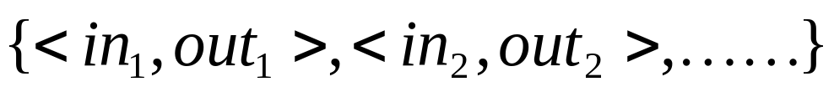
Persistent Turing Machine (PTM)
Interaction Stream
stream of inputs
stream of outputs
PTM
memory
Environment
...
Persistent Stream Language (PSL) of a PTM: set of streams:

Slide 63
Examples of the PTMs
Answering Machine (AM)
  PSL(AM) contains:
  Sequential objects as PTMs
  f_{AM} (record Y, X) = (ok, XY)
  f_{AM} (erase, X) = (done, ε)
  f_{AM} (playback, X) = (X, X)
work tape
Chieh
See
Chuang
(record See, ok),
(erase, done),
(record Chuang, ok),
(record Chieh, ok),
(playback, Chuang Chieh), …

Slide 64
Another example: Latch
At each step, output first bit of
previous step.
  inputs in₁; outputs 1
  inputs in₂; outputs 1st bit of in₁
  inputs in₃; outputs 1st bit of in₂
  ...
PSL(Latch) contains:
Latch is a PTM working as a Labeled Transition System
  Latch has 3 states, meaning “contents of the work tape”
  The labels are input/output pairs, as in the interaction stream.
Latch
(1*,1)
(1*,1)
1
#
(0*,1)
(1*,0)
(0*,1)
0
(0*,0)

Slide 65
To simplify our discussion, we omit the other properties, language classes and the equivalence hierarchy concerning to PTMs.
However, we can find abundant information in the following two journal papers. (about 65 pages)
  [W98] appeared in Theoretical Computer Science (Vol. 192, 1998)
  [GSAS04] appeared in Information and Computation (Vol. 194, 2004)
and

Slide 66
Outline
Introduction
Turing Machines
The Turing Thesis Myth
Algorithms and Computability
Persistent Turing Machines (PTMs)
Turing Thesis Myth Corrected
Conclusion

Slide 67
Corrected Turing Thesis
Claim 1.
  All algorithmic problems are function-based.
Clam 2.
  All function-based problems can be described by an algorithm.
Claim 3.
  Algorithms are what early computers do.

Slide 68
Claim 4.
  TMs serve as a general model for early computers.
Claim 5.
  TMs can simulate any algorithmic computing device.
Claim 6.
  TMs cannot compute all problems, nor can they do everything that real computers can do.

Slide 69
Outline
Introduction
Turing Machines
The Turing Thesis Myth
Algorithms and Computability
Persistent Turing Machines (PTMs)
Turing Thesis Myth Corrected
Conclusion

Slide 70

Any question?

Slide 71
T
o
u
h
n
y
a
k

Slide 72
References
[65] An Undergraduate Program in Computer Science-Preliminary Recommendations, A Report from the ACM Curriculum Committee on Computer Science, Communications of the ACM, Vol. 8, No. 9, September 1965, pp. 543-552.
[68] Curriculum 68: Recommendations for Academic Programs in Computer Science, A Report of the ACM Curriculum Committee on Computer Science, Communications of the ACM, Vol. 11, No. 3, March 1968, pp. 151-197.
[04] SIGACT News, ACM Press, March 2004, p. 49.
[B91] Intelligence Without Reason, Brooks, R., MIT AI Lab Technical Report 1293, 1991.
[D58] Computability & Unsolvability, Davis, M., McGraw-Hill, 1958.
[D04] The Field of Programmers Myth, Denning, P., Communications of the ACM, July, 2004.
[EGW04] Turing’s Ideas and Models of Computation. In Alan Turing: Life and Legacy of a Great Thinker, ed. Christof Teuscher, Springer, 2004.
[GMR89] The Knowledge Complexity of Interactive Proof Systems, Goldwasser, S., Micali, S. and Rackoff, C., SIAM Journal on Computing, Vol. 18, No. 1, 1989, pp. 186-208.

Slide 73
[GSAS04] Turing Machines, Transition Systems, and Interaction, Goldin, D. Q., Smolka, S. A., Attie, P. C. and Sonderegger, E. L., Information and Computation, Vol. 194, Issue 2, November 2004, pp. 101-128.
[HU69] Formal Languages and Their Relation to Automata, Hopcroft, J. E. and Ullman, J. D., Addison-Wesley, 1969.
[K68] The Art of Computer Programming, Vol. 1: Fundamental Algorithms, Knuth, D. E., 1968.
[LT89] An Introduction to Input/Output Automata, Lynch, N. and Tuttle, M., CWI Quarterly, Vol. 2, No. 3, September 1989, pp. 219-246.
[RR69] Computer Science: Problems, Algorithms, Languages, Information and Computers, Rice, J. K. and Rice J. N., Holt, Rinehart and Winston, 1969.
[RN94] Artificial Intelligence: A Modern Approach, Russel S. and Norveig, P., Addison-Wesley, 1994.
[R67] Theory of Recursive Functions and Effective Computability, Rogers, H. Jr., McGraw-Hill, 1967.
[S92] Recursive Functions, Sanchis, L., North Holland, 1992.

Slide 74
[S97] Introduction to the Theory of Computation, Sipser, M., PWS Publishing Company, 1997.
[T37] On Computable Numbers, with an Application to the Entscheidungsproblem, Proceedings of the London Mathematical Society, Turing, A., Vol. 42, No. 2, 1936, pp. 230-265; A correction: ibid, Vol. 43, 1937, pp. 544-546.
[LW00] The Turing Machine Paradigm in Contemporary Computing, Leeuwen J. v., Wiedermann, J., Mathematics Unlimited – 2001 and Beyond, eds., Enquist, B. and Schmidt, W., Springer-Verlag, 2000.
[W68] Programming Languages, Information Structures and Machine Organization, Wegner, P., McGraw-Hill, 1968.
[W97] Why Interaction is More Powerful Than Algorithms, Wegner, P., Communications of the ACM, Vol. 40, No. 5, May 1997.
[W98] Interactive Foundations of Computing, Wegner, P., Theoretical Computer Science, Vol. 192, Issue 2, 1998, pp. 315-351.
[WG03] Computation Beyond Turing Machines, Wegner, P. and Goldin, D., Communications of the ACM, Vol. 46, Issue 4, April 2003.

Slide 75
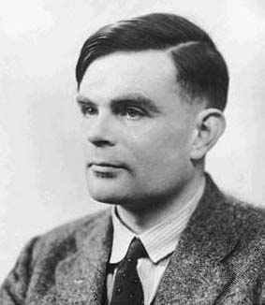

NonDeterministic Turing Machines
Let’s go back!
Non Deterministic Choice

