Slide 1
The Full Steiner Tree Problem
Chin-Lung Lu, Chuan-Yi Tang, Richard, Chia-Tung Lee
Theoretical Computer Science, Vol. 306, 2003, pp.55-67.
Speaker: Chuang-Chieh Lin
Advisor: Professor Maw-Shang Chang
Dept. of CSIE, National Chung-Cheng University
October 1, 2004

Slide 2

Outline
Introduction
Preliminaries
Hardness results
An -approximation algorithm
Conclusion
References

Slide 3
Introduction
Given a graph G = (V, E), a subset R ⊆ V of vertices, and a length function d: E→ℜ⁺ on the edges, a Steiner tree is a connected and acyclic subgraph of G which spans all vertices of R.
The vertices in R are usually referred to as terminals and the vertices in V \ R as Steiner (or optional) vertices.
Note that a Steiner tree might contain the Steiner vertices.

Slide 4
The length of a Steiner tree is defined to be the sum of the lengths of all its edges.
The so-called Steiner tree problem is to find a Steiner minimum tree. (i.e., a Steiner tree of minimum length) in the given graph G.
For example,

Slide 5
5
6
5
2
2
2
3
3
4
2
4
2
13
: terminals
: Steiner vertices
The length of this Steiner tree is 2 + 2 + 2 + 2 + 4 = 12.

Slide 6
Another Steiner tree
5
6
5
2
2
2
3
3
4
2
4
2
13
: terminals
: Steiner vertices
The length of this Steiner tree is 4 + 2 + 2+ 3 + 4 = 15.

Slide 7
Applications: ([CD2001], [DSR2000], [FG82], [HRW92])
  VLSI design
  Network routing
  Wireless communications
  Computational biology
This problem has been proved to be NP-complete, even in the Euclidean metric or rectilinear metric. [K72]

Slide 8
Motivated by the reconstruction of phylogenetic (or evolutionary) tree in biology, we study a variant of the Steiner tree problem, called the full Steiner tree problem (FSTP).
A Steiner tree is full if all terminals are leaves of the tree.
FSTP is to find a full Steiner tree with minimum length.
For example,

Slide 9
5
6
5
2
2
2
3
3
4
2
4
2
13
The Steiner tree shown above is right a full Steiner tree with minimum length 12.

Slide 10
5
6
5
2
2
2
3
3
4
2
4
2
13
The Steiner tree shown above is also a full Steiner tree with minimum length 12.

Slide 11
From the viewpoints of biologists, the terminals of a full Steiner tree T can be regarded as the extant taxa (or species, morphological features, biomolecular sequences), the internal vertices of T as the extinct ancestral taxa, and the length of each edge in T as the evolutionary time along it.
According to the principle of parsimony, T corresponds to an evolutionary tree of the extant species, which trends to minimize the tree length.
The principle of parsimony:
Nature always finds the paths that require a minimum evolution.
Notes:
Morphological型態上的
extant taxa:
The taxa whose sequences/other genetic information/morphological characters, etc. are being used
in order to do a phylogenetic analysis, are known as the extant taxa,
irrespective of whether the individuals/species to whom the sequences/other information belong to, are extant(存活) or extinct(消滅).
taxa:
animal or plant group having natural relations

Slide 12
If we restrict the lengths of edges to be either 1 or 2, then the problem is called the (1, 2)-full Steiner tree problem (FSTP(1, 2)).
Little work has been done on the FSTP.

Slide 13

In this paper, FSTP(1, 2) will be shown to be NP-complete and MAX SNP-hard. Therefore FSTP is surely NP-complete and MAX SNP-hard.
However, an -approximation algorithm for the FSTP(1, 2) is shown in this paper. (Its running time is polynomial but it is NOT a PTAS)

Slide 14
Preliminaries
To make sure that a full Steiner tree exists, we restrict the given graph G = (V, E) to be complete and R to be a proper subset of V (i.e., R ⊂ V )
We assume that the length function d is a metric.

Slide 15
The length function d is called a metric if it satisfies the following three conditions:
  d (x, y) ≥ 0 for any x, y in V, where equality holds
  iff x = y
  d (x, y) = d (y, x) for any x, y in V
  d (x, y) ≤ d (x, z) + d (z, y) for any x, y, z in V
  (triangular inequality)

Slide 16
Let us see the problems again.

Slide 17
FSTP:
  Given a complete graph G = (V, E), a length function d: E→ℜ⁺ on the edges, a proper subset R ⊂ V, and a positive integer bound B. Is there a full Steiner tree T in G such that the length of T is less than or equal to B?
MIN-FSTP:
  Given a complete graph G = (V, E), a length function d: E→ℜ⁺ on the edges and a proper subset R ⊂ V of terminals, find a full Steiner tree of minimum length in G.
MIN-FSTP(1, 2):
  Given a complete graph G = (V, E), a length function d: E→{1, 2} on the edges and a proper subset R ⊂ V of terminals, find a full Steiner tree of minimum length in G.

Slide 18
In order to proceed to the proof the hardness results, we have to be familiar with the following concepts:
  L-reduction
  Performance ratio
  Polynomial time approximation scheme (PTAS)
  MAX SNP-hard

Slide 19
L-reduction
Given two optimization problems Π₁ and Π₂, we say that Π₁ L-reduces to Π₂ if there are polynomial-time algorithms f and g and positive constants αandβ such that for any instance I of Π₁, the following conditions are satisfied:
  Algorithm f produces an instance f (I) of Π₂ such that OPT(f (I)) ≤ αOPT(I), where OPT(I) and OPT(f (I)) stand for the optimal solutions of I and f (I), respectively.
  Given any solution of f (I) with cost (size) c₂, algorithm g produces a solution of I with cost (size) c₁ in polynomial time such that |c₁−OPT(I)| ≤β|c₂−OPT(f (I))|.

Slide 20
I : an instance of Π₁
f (I) : an instance of Π₂
s_{I} : a solution of I
s_{f (I)} : a solution of f (I)
f
g
I
f (I)
s_{I}
s_{f (I)}
size c₁
size c₂
OPT(f (I)) ≤ αOPT(I)
|c₁−OPT(I)| ≤β|c₂−OPT(f (I))|.

Slide 21
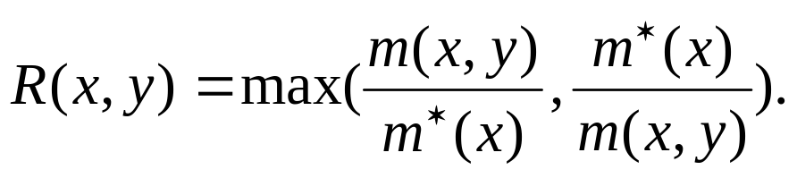
Performance ratio
Given an optimization problem P, for any instance x of P and for any feasible solution y of x, the performance ratio of y with respect to x is defined as
where m*(x) denotes the measure of an optimal solution of instance x and m (x, y) denote the measure of solution y.

Slide 22
PTAS
Let P be an optimization problem. An algorithm A is said to be a polynomial-time approximation scheme (PTAS) for P if, for any instance x of P and any rational value r > 1, A, when applied to input (x, r), returns an r-approximate solution of x in time polynomial in |x|. (r is the performance ratio)
A problem has a PTAS if for any fixed r > 1, the problem can be approximated within a factor of r in polynomial time (polynomial in | x |; r is the performance ratio).

Slide 23
MAX SNP-hard
Here we omit the precise definition.
A problem is said to be MAX SNP-hard if a MAX SNP-hard problem can be L-reduced to it.
Note:
  If P ≠ NP, then there doesn’t exist any PTAS for any MAX-SNP-hard problem.
  If there were a PTAS for one of the MAX SNP-hard problems, there were a PTAS for all of them.

Slide 24
Hardness results
We will show that the optimization problem MIN-FSTP(1, 2) is MAX SNP-hard by an L-reduction from the vertex cover-B problem (VC-B for short), which was shown to be MAX SNP-hard by Papadimitriou and Yannakais in 1991. [PY91]
VC-B: Given a graph G = (V, E) with degree bounded by a constant B, find a vertex cover of minimum cardinality in G.

Slide 25
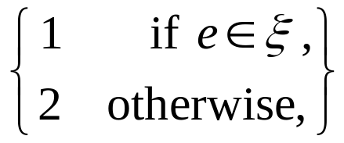
Let G₁ = (V₁, E₁) and B be an instance I₁ of VC-B with V₁ = {v₁, v₂, …, v_{n}} (WLOG, we assume that G₁ is connected and n ≥ 3.) Then we transform I₁ into an instance I₂ of MIN-FSTP(1, 2), say G₂ and R, as follows.
  A complete graph G₂ = (V₂ , E₂) with V₂ = V₁∪ {z_{i, j} | (v_{i} , v_{j}) ∈ E₁}, and R = V₂ \ V₁ = {z_{i, j} | (v_{i} , v_{j}) ∈ E₁}.
  For each edge e ∈ E₂ , d (e) =
  where ξ = {(v_{i} , v_{j}) | 1 ≤ i < j ≤ n} ∪ {(v_{i.}, z_{i, j}), (z_{i, j} , v_{j}) | (v_{i} , v_{j}) ∈ E₁}.
(This is right the polynomial-time transformation algorithm f which will be mentioned later.)
Notes:
zeta

Slide 26
Let us see an example.

Slide 27
: terminal
v₁
z_{1,2}
v₁
z_{1,5}
v₂
v₅
v₂
v₅
z_{4,5}
z_{2,3}
v₃
v₄
v₃
v₄
z_{3,4}
G₁
G₂
An L-reduction from VC-B to MIN-FSTP(1, 2). Note that only edges of length 1 in G₂ are shown for simplicity.

Slide 28
Lemma 1
Let T be a solution of length c to MIN-FSTP(1, 2) on the instance I₂ which is obtained from a reduction of an instance I₁ of VC-B. Then in polynomial time, we can find another solution T ' of length no more than c to MIN-FSTP(1, 2) on instance I₂ such that T ' contains no edge of length 2.

Slide 29
Proof
In the following proof, we only show how to replace an edge of length 2 from T with some edges of length 1 in polynomial time without increasing the length of the resulting T .
By repeatedly applying this procedure to T , we will finally obtain T ' in polynomial time.

Slide 30
y
z_{1,2}
v₁
z_{1,5}
v₂
v₅
z_{4,5}
z_{2,3}
x
v₃
v₄
z_{3,4}
Let (x, y) be an edge of length 2 in T .
One of x and y must be a terminal and the other must be a Steiner vertex. WLOG, we assume that x is a terminal and y is a Steiner vertex.

Slide 31
Since G₁ is connected and n ≥ 3, x must be connected to some one terminal z with a path of two edges of length 1, say (x, v) and (v, z).
Let u be the Steiner vertex of which is adjacent to z. Then we consider the following two possibilities.
Case 1: u = v
d (x, y) = 2
d (x, v) = 1
v₁ = y
v₁ = y
z_{1,2}
z_{1,5}
z_{1,2}
z_{1,5}
v₂
v₅
v₂
v₅
z_{4,5}= x
z_{4,5}= x
z_{2,3}
z_{2,3}
v₃
v₄ = u = v
v₃
v₄ = u = v
z_{3,4} = z
z_{3,4} = z
Notes:
因為G₁連通且n ≥ 3，所以對於任一個Steiner vertex u，必存在一個與之相連的Steiner vertex v
u, v之間必存在一個terminal。所以每兩個距離最近的terminal必存在一個經過一個Steiner vertex的path

Slide 32
Case 2: u ≠ v
d (x, y) = 2
d (x, v) + d (v, u) = 1+1= 2
v₁ = y
v₁ = y
z_{1,2}
z_{1,5}
z_{1,2}
z_{1,5}
v₂
v₅
v₂
v₅
z_{4,5} = x
z_{4,5} = x
z_{2,3}
z_{2,3}
v₃ = u
v₄ = v
v₃ = u
v₄ = v
z_{3,4} = z
z_{3,4} = z

Slide 33
Theorem 1
MIN-FSTP(1, 2) is a MAX SNP-hard problem.
Proof:
  Let f denote the polynomial-time algorithm to transform an instance I₁ of VC-B to the instance I₂ of MIN-FSTP(1, 2).
  We design another polynomial-time algorithm g as follows.

Slide 34
Given a full Steiner tree in T in G₂ of length c, we transform it into another full Steiner tree T ' using the method described in the proof of Lemma 1.
Collect the internal vertices of T ' which are adjacent to the leaves of T ' .

Slide 35
Clearly, T ' contains no edge of length 2 and its length is no more than c.
Then we know that the number of vertices in T ' is less than or equal to c + 1 since T ' is a tree.
The collection of those internal vertices of T ', which are adjacent to the leaves of T ', corresponds to a vertex cover of G₁ whose size is less than or equal to c − | E₁| + 1.
Notes:
Length會小於c是因為當初的c可能有length為2的edge求出。
T‘ 能夠span到terminals理論上就一定能span到原來G₁的所有vertices
c −|E₁|+1中要減去|E₁|是因為每個邊都會插入一個terminal, 而c+1是最多可能的vertices數目

Slide 36
z_{1,2}
v₁
z_{1,5}
v₂
v₅
z_{4,5}
z_{2,3}
v₃
v₄
z_{3,4}
A Steiner tree is shown by red edges of the graph above.
The corresponding vertex cover of G₁ is {v₂, v₃, v₅}.
Notes:
因為terminals只會被Steiner vertex經由length為1的edge所cover(這是因為我們已經把length為2的edge替換掉了)
所以若是z_{i,j}會被v_{i} 給cover, 則v_{i} 就等於cover了v_{i}它自己以及v_{j}
因為每個zij都會被cover，所以每個v_{i} 和v_{j} 都會被cover了

Slide 37
Next, we will show that algorithms f and g are an L-reduction from VC-B to MIN-FSTP(1, 2).
(1) OPT(f (I₁)) ≤ αOPT(I₁), where α= 2B:
  B ⋅ OPT(I₁) ≥ |E₁| since each vertex in G₁ covers at most B edges.
  Let u be a vertex in G₁ whose degree is B. Then let us build a “star”Ψ with u as its center and R as its leaves. Clearly, Ψ is a feasible solution of MIN-FSTP(1, 2) on f (I₁).

Slide 38
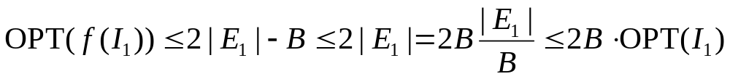
  The length of Ψ is B + 2(|E₁| − B) = 2|E₁| − B.
  Hence,
z_{1,2}
v₁
z_{1,5}
v₂
v₅
B = 2
z_{4,5}
z_{2,3}
v₃
v₄
z_{3,4}
Since B⋅ OPT(I₁) ≥ |E₁|

Slide 39
(2) |c₁−OPT(I₁)| ≤β|c₂−OPT(f (I₁))|, where β= 1:
  Given a vertex cover VC in G₁ of size c, we can create a full Steiner tree in G₂ of length c + |E₁| − 1 in the following way.
  Step 1: Connect each edge of E₁ (corresponding to a terminal in G₂) to an arbitrary vertex in VC (corresponding to a Steiner vertex in G₂)
  Step 2: Connect all vertices of VC by c −1 edges of length 1 in G₂.

Slide 40
z_{1,2}
v₁
z_{1,5}
: vertex cover VC
v₂
v₅
c = 3
z_{2,3}
z_{4,5}
v₃
v₄
Step 2
z_{3,4}
Step 1
Hence, OPT(f (I₁)) ≤ OPT(I₁) + |E₁| − 1 since the right part of this inequality formula is the length of a Steiner tree of f (I₁), while OPT(f (I₁)) stands for the length of the “optimal ” Steiner tree of f (I₁).
Don’t forget that OPT(I₁) + |E₁| − 1 ≤ c + |E₁| − 1

Slide 41
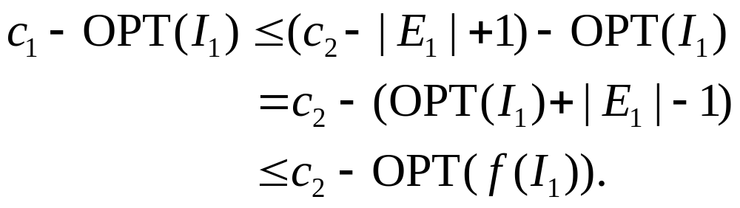
By algorithm g, a full Steiner tree of G₂ with length c₂ can be transformed into a vertex cover of G₁ of size c₁, where c₁ ≤ c₂ − |E₁| + 1.
Then, we obtain that
Hence,

Slide 42
Now, we have shown that MIN-FTSP(1, 2) is MAX SNP-hard.
MIN-FSTP is certainly MAX SNP-hard.

Slide 43

An -approximation algorithm
Any star with an arbitrary Steiner vertex as its center and all terminals as its leaves is an approximate solution with performance ratio within 2 of the optimal one. (We can consider that |E₁| ≤ OPT(f (I₁)) ≤ 2B⋅ OPT(I₁) and |E₁| ≤ B⋅ OPT(I₁))
Instead, we will give an -approximation algorithm for MIN-FSTP(1, 2) using the so-called average length heuristics. [BP89, RS83]
Notes:
|E₁|在之前的例子裡，就等於是Steiner vertices的個數

Slide 44
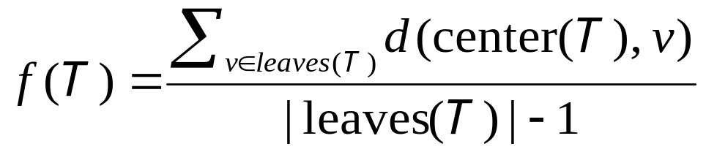
Steiner star:
  A star T with Steiner vertex as its center and the terminals as its leaves
X_{k}-star:
  A Steiner star T with k leaves and d(center(T ), v) = 1 for each v of leaves(T )
Average length f (T ):
  For a Steiner tree T with |leaves(T )| ≥ 2,
1
1
1

Slide 45
The above definition can be regarded as a kind of scoring function for Steiner stars.
After giving the above definitions, let us proceed to some important lemmas.

Slide 46
Lemma 2:
Let T be a Steiner star with k terminals, where k ≥ 2. If T contains no leaf at distance 1 from center(T ), then f (T ) = 2 + 2/(k−1).
Lemma 3:
Let T be a Steiner star with k terminals, where k ≥ 2. If T contains only one leaf at distance 1 from center(T ), then f (T ) = 2 + 1/(k−1).
Lemma 4:
Let T be a Steiner star with k terminals, where k ≥ 2. If T contains exactly two leaves at distance 1 from the center(T ), then f (T ) = 2.
Lemma 5:
Let T be a X_{k}-star with k ≥ 3. Then f (T ) = 1 + 1/(k−1).
Lemma 6:
Let T ₁ be a X_{k}-star with k ≥ 3 and let T ₂ be the Steiner star obtained from T ₁ by adding a new terminal z with d (center(T ₁), z) = 2. Then f (T ₁) < f (T ₂).

Slide 47
Since it is not hard for us to prove the lemmas, we omit the proofs here.
Now, let us go to see the algorithm directly.

Slide 48
Algorithm APX-FSTP(1,2)
Input: A complete graph G = (V, E) with d: E→{1,2} and a set R ⊂ V of terminals
Output: A full Steiner tree T_{APX} for R in G.
Step 1: Let Φ be an empty set;
Step 2:
/* Choose a Steiner star with the minimum average length */
  if there are two or more remaining Steiner vertices then find a Steiner star T with the minimum average length;
    if f (T ) = 2 then /*Transform T into an X₂-star*/
    Remove from T those leaves at distance 2 from center(T )
    end if
  else
  Let T be the Steiner star with the only Steiner vertex as its center and remaining terminals as its leaves;
Notes:
(1) f(T)=2時需要特別處理，因為the selected minimum Steiner tree 有可能包含了一些距離中心為2的leaves (by Lemma 2, 3, 4)
(2) 盡可能去找X_{k}-star，且k愈大愈好

Slide 49
Step 3:/*Perform a reduction*/
  Let Φ = Φ ∪{(center(T ), v) | v ∈leaves(T )}
  Replace the Steiner star T by a single new terminal, say z;
  Let d (z, u) = d (center(T ),v) for each remaining vertex u;
Step 4:
  if there is still more than one terminal then
  Go to Step 2;
  else
  Let T _{APX} be the full Steiner tree induced by Φ;
  end if

Slide 50
For example, consider the following figure.
2
1
2
2
1
1
1
1
1
2

Slide 51
2
1
2
2
1
1
1
1
1
2

Slide 52
2
1
2
2
1
1
1
1
1
2

Slide 53
1

Slide 54
1

Slide 55
1

Slide 57
The final full Steiner tree by APX-FSTP(1,2) is shown in the following figure.
1
1
1
1

Slide 58
Analysis of the time complexity
Let n and m be the numbers of the terminals and the Steiner vertices in G respectively. (n = R and m = |V \ R|).
The time complexity is dominated by the cost of Step 2.
For each Steiner vertex v, we can find an optimal Steiner star with v as its center in O (n') time, where n' denote the number of resulting terminals.
Suppose that there are m' Steiner vertices in each reduction. Then Step 2 can be done in O (n'm' + m') time.
Notes:
根據Lemma 2~6, 我們只要找距離v為1的terminals就能得到optimal Steiner star
O (n‘m’ + m‘)裡面的m’是由於要從m’個Steiner stars中找到最好的Steiner star.

Slide 59
Since each reduction eliminates one Steiner vertex and at least one terminal, the number of iterations is at most min{m, n}.
Thus the total time complexity of APX-FSTP(1, 2) is polynomial.
In the following, we analyze the performance ratio of this approximation algorithm. O (min{n'm‘m + mm', nn'm' + nm'})
Let the performance ratio of APX-FSTP(1, 2) for instance I be ratio (I) = APX(I)/OPT(I), where OPT(I) denotes the length of an optimal full Steiner tree for I and APX denotes the length of T_{APX}.
Notes:
“at least one terminal”是因為至少殺掉兩個terminal但是又合併成一個新的terminal，所以2−1=1

Slide 60

In the following, we assume that I is a worst-case instance among all instances. That is, ratio(I ') ≤ ratio(I) for each I '≠ I.
About the performance ratio, we will show first case by proving Lemma 7.
Lemma 7:
If instance I contains an X_{k}-star for k ≥ 6, then ratio(I) ≤

Slide 61
Proof of Lemma 7
Let T be an arbitrary X_{k}-star whose k is maximum and let E(T ) be the set of its edges.
By lemma 2~6, the first iteration of APX-FSTP(1, 2) will reduce T first.
Let I ' be the resulting instance of APX-FSTP(1, 2) after T is reduced
Clearly, APX(I ') = APX(I ) − k.

Slide 62
Let T _{OPT} be an optimal full Steiner tree of I, and let H be the resulting graph obtained by adding the k edges of E(T ) to T _{OPT} .
Then by removing from H some edges not in E(T ) and adding one edge if possible, we can build a full Steiner tree T 'of I such that it contains all edges of E(T ).
Let us see the figure showing the worst case as follows.

Slide 63
T_{OPT}
v
T '
center(T )
T
Adding an edge (center(T ), v) is to make H connected and build another Steiner tree T '.

Slide 64
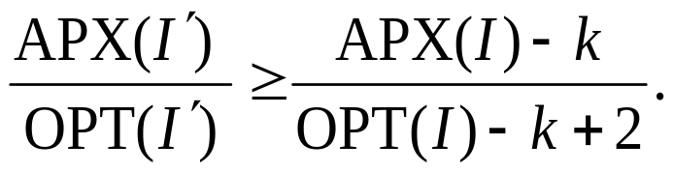
Clearly, the length of T ' is less than or equal to OPT(T ) + 2 since d (center(T ), v) ≤ 2.
Then, if we reduce T in T ', then we obtain a full Steiner tree T '' of instance I ' whose length is less than or equal to OPT(I) − k + 2. That is, OPT(I ') ≤ OPT(I) − k + 2.
Hence, ratio(I) ≥ ratio(I ') =

Slide 65
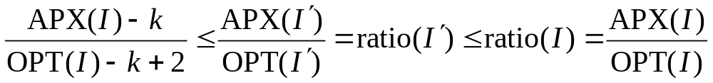
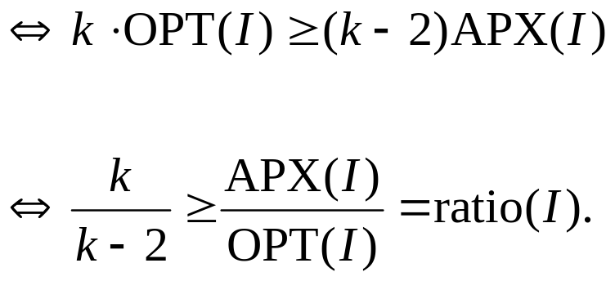
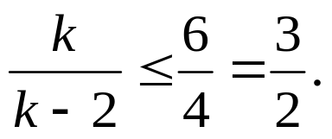

Since k ≥ 6, we have
Therefore we derive that ratio(I) ≤

Slide 66
Before continuing the case of k < 6, we have to know some new definitions and lemmas first.
Given an instance I consisting of G = (V, E) and R ⊂ V, we say that vertex v∈V 1-dominates (or dominates for simplicity) itself and all other vertices at distance 1 from v.
For any D ⊆ V, we call it as 1-dominating set (or dominating set) of R if every terminal in R is dominated by at least one vertex of D.
A dominating set of R with minimum cardinality is called as a minimum dominating set of R.

Slide 67
Lemma 8:
Given an instance I of MIN-FSTP(1, 2), let D be a minimum dominating set of R. Then OPT(I) ≥ n + | D | − 1, where n = | R |.
Proof:
T _{OPT}
R\R '
D'
R '

Slide 68
Let T _{OPT} be an optimal full Steiner tree of I. (OPT(I) = |T _{OPT} |).
D' ⊆ V \ R is the set of Steiner vertices in T _{OPT} .
Let R '⊆ R be the set of terminals that are dominated by the vertices of D'.
T _{OPT} needs to contain at least | D' | − 1 edges to connect them.
Clearly, |T _{OPT} | ≥ |R '| + (| D' | − 1) + 2| R \ R' | = | R '| + | D' | + | R \ R' | − 1.

Slide 69
Since D ' ∪ (R \ R') is a dominating set of R and D ' ∪ (R \ R') = φ , we can easily find that | D | ≤ | D ' ∪ (R \ R') | = | D ' | + | R \ R' |. (Recall that D is the minimum dominating set of R)
By |T _{OPT} | ≥ | R '| + | D' | + | R \ R' | − 1 and | D | ≤ | D ' | + | R \ R' |, we can derive that OPT(I) = |T _{OPT} | ≥ n + | D | − 1.

Slide 70

A kind of actions “partitions” will be performed:
Let D be a minimum dominating set of R. We partition R into many subsets in a way as follows.
Assign each terminal z of R to a member of D which dominates it.
Note: If two or more vertices of D dominate z, then we arbitrarily assign z to one of them.
LetΨ₁,Ψ₂, …Ψ_{q} be the partitions consisting of exactly 5 terminals, clearly, 0 ≤ q ≤ .

Slide 71
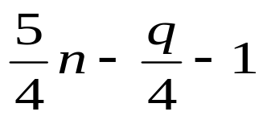
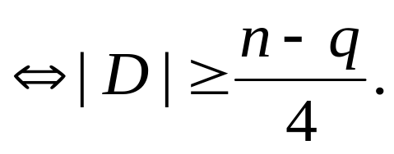
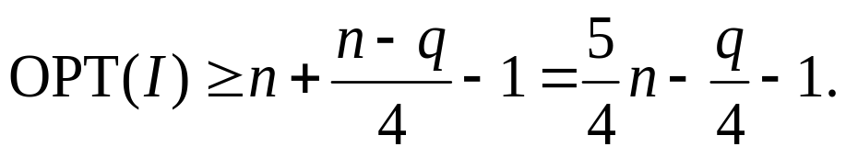
Lemma 9:
OPT(I) ≥
Proof:
According to the partition, we have 5q + 4(|D| − q) ≥ n
Recall that OPT(I) ≥ n + | D | − 1, then we have
Notes:
5q + 4(|D| − q) ≥ n :
假設不滿5個的partitions，每個partition裝的全是4個

Slide 72
Now, we are going to deal with the other case of instances. This case is discussed in the following lemma.
Lemma 10:
If instance I contains no X_{k}-star with k ≥ 6, then ratio(I) ≤
The proof of this lemma is quite complicated. We now prove it as follows.

Slide 73
Assume that FSTP(1, 2) totally reduces j X_{ki}-stars, where 1 ≤ i ≤ j.
Note:
Even though the instance I contains no X_{k}-stars with k ≥ 6, the reduced X_{ki}-stars may be an X₆-star for each i ≥ 2.
However, it’s impossible that an X_{ki}-star is an X_{k}-star with k ≥ 7.
1
1
1
1
1
1
1
1
1
1
1

Slide 74
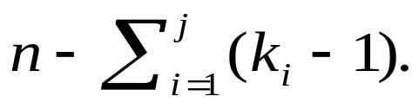
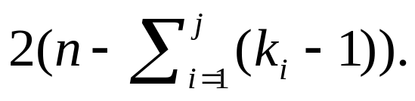
Each X_{ki} is a subtree of the full Steiner tree T _{APX} produced by APX-FSTP(1, 2) and its length is k_{i} .
Since the reduction of X_{ki} merges k_{i} old terminals into a new one, the number of the terminals is decreased by k_{i} − 1.
After reducing jX_{ki}’s , the number of remaining terminals is
To reduce these terminals, APX-FSTP(1,2) creates a Steiner star with length less than or equal to

Slide 75
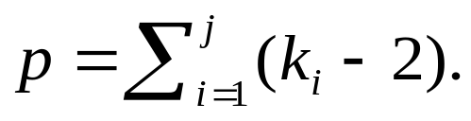
Hence, the total length of T _{APX} is less than or equal to
In other words, we have APX(I) ≤ 2n − p, where we let

Slide 76
Next, we claim that p≥11q/10.
Case 1 is as follows.
The “best” situation is that each partitionΨ_{i} , where 1 ≤ i ≤ q, corresponds to an X_{kl}-star, where 1 ≤ l ≤ j, and k_{l} = 5 or 6, which will be reduced by APX-FSTP(1, 2).
In this case, each such an X_{kl}-star contributes at least 3 to p since k_{l} −2 = 3 or 4. Thus we have p ≥ 3q > 11q/10.

Slide 77
Case 2 talks about the general case with the following five properties.
We assume that q₂ = 0 (mod 2), q₃ = 0 (mod 3), q₄ = 0 (mod 4), q₅ = 0 (mod 5), and q₁+ q₂+…+ q₅= q.
  (1) There are q₁ partitions Ψ_{i1},Ψ_{i2} ,…,Ψ_{iq1}, in which each partition Ψ_{ih},corresponds to an X_{kl}-star reduced by APX-FSTP(1, 2), where 1 ≤ h ≤ q₁.
  (2) There are q₂ partitions Ψ_{iq1+1},Ψ_{iq1+2},…,Ψ_{iq1+q2} , in which every other two consecutive partitionsΨ_{iq1+h+1} and Ψ_{iq1+h+2} corresponds to an X_{kl}-star reduced by APX-FSTP(1, 2), where 1 ≤ h ≤ q₂ − 2 and h = 0 (mod 2).
  …

Slide 78
  (5) There are q₅ partitions Ψ_{iq1+q2+q3+q4+1},Ψ_{iq1+q2+q3+q4+2} ,…,Ψ_{iq1+q2+q3+q4+q5}, in which every other five consecutive partitions Ψ_{iq1+q2+q3+q4+h+1},Ψ_{iq1+q2+q3+q4+h+2} ,…,Ψ_{iq1+q2+q3+q4+h+5} corresponds to an X_{kl}-star reduced by APX-FSTP(1, 2), where 1 ≤ h ≤ q₅ − 5 and h = 0 (mod 5).
The reduction of X_{kl}-stars of property(1) (respectively, (2)-(5)) will contribute at least 3q₁(respectively, 3q₂/2, 3q₃/3, 3q₄/4, 3q₅/5) to p and in the worst case, produce 0 (respectively, q₂/2, 0, q₄/4, and 0) X₃-star and produce 0 (respectively, 0, 2q₃/3, 3q₄/4 and 5q₅/5) X₄-star in the remaining instance.

Slide 79
For example, consider the property (3):
R partitioned by D
Don’t forget that the graph should be a complete graph.

Slide 80
(property 2):
5 = 1 + 4 → remain: (4, 1): (q₂/2) ⋅ 2
= 2 + 3 → remain: (3, 2): (q₂/2) ⋅ 1
(property 3):
5 = 1 + 1 + 3 → remain: (4, 4, 2): (2q₃/3) ⋅ 2
= 1 + 2 + 2 → remain: (4, 3, 3): (q₃/3) ⋅ 2 + (q₃/3) ⋅ 1
(property 4):
5 = 1 + 1 + 1 + 2 → remain: (4, 4, 4, 3): (3q₄/4) ⋅ 2
(property 5):
5 = 1 + 1 + 1 + 1 + 1 → remain: (1, 1, 1, 1): (5q₅/5) ⋅ 2
Both can be chosen

Slide 81
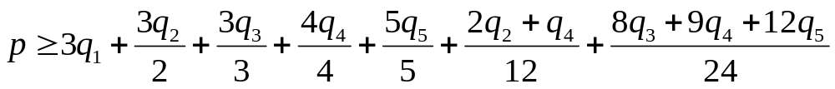
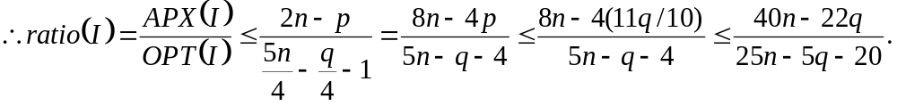
In the worst case, the (0 + q₂/2 + 0 + q₄/4 + 0 = (2q₂+ q₄)/4) produced X₃-stars and the (0 + 0 + 2q₃/3 + 3q₄/4 + 5q₅/5 = (8q₃+ 9q₄+ 12q₅) /12) produced X₄-stars will further contribute 1((2q₂+ q₄)/4)/3 and 2((8q₃+ 9q₄+ 12q₅) /12) /4, respectively to p.
Hence, we have
We will find that p ≥ q₁+ 264q / 240 ≥ 11q / 10
3−2
4−2

Slide 82

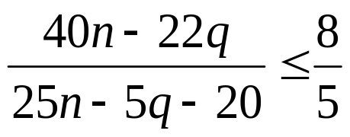
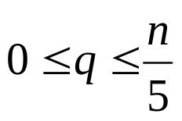
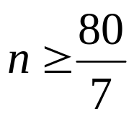

It is easy to verify that if q ≥ ,
Since , ratio(I) ≤ for .
If n < , the optimal solution can be found by an exhaustive search in polynomial time.

Slide 83
Therefore we can obtain the following theorem.
Theorem 2:
APX-FSTP(1, 2) is an - approximation algorithm for MIX-FSTP(1, 2).

Slide 84
Conclusion
We showed that the problem of finding an optimal full Steiner tree is NP-complete and MAX SNP-hard.
If the length of edges are restricted to 1 or 2, we have an -approximation algorithm for this problem.
Maybe we should try to find the properties of the general full Steiner tree problem.

Slide 85
References
[ALMSS98] Proof and Verification and the Hardness of Approximation Problems, Arora, S., Lund, C., Motwani, R., Sudan, M., Szegedy, M., Journal of the ACM, Vol. 45, 1998, pp. 501-555.
[ACGKMSP99] Complexity and Approximation – Combinatorial Optimization Problem and Their Approximability Properties, Springer, Berlin, 1999.
[BP89] The Steiner Problem with edge lengths 1 and 2, Bern, M. and Plassmann, P., Information Processing Letters, Vol. 32, 1989, pp. 171-176.
[BD97] The k-Steiner Ratio in Graphs, SIAM Journal on Computing, Vol. 26, 1997, pp. 857-869.
[CD2001] Steiner Tree in Industry, Cheng, X. and Du, D. Z., Kluwer Academic Publishers, Dordrecht, Netherlands, 2001.
[DSR2000] Advances in Steiner Trees, Du, D. Z., Smith, J. M., Rubinstein, J. H., Kluwer Academic Publishers, Dordrecht, Netherlands, 2000.
[FG82] The Steiner Problem in Phylogeny is NP-complete, Foulds, L. R., Graham, R. L., Advances Applied Mathematics, Vol. 3, 1982, pp. 43-49.

Slide 86
[GGJ77] The Complexity of Computing Steiner Minimal Trees, Garey, M. R., Graham, R. L., Johnson, D. S., SIAM Journal on Applied Mathematics, Vo. 32, 1977, pp. 835-859.
[GJ77] The Rectilinear Steiner Problem is NP-complete, Garey, M. and Johnson, D. S., SIAM Journal on Applied Mathematics, Vol. 32, 1977, pp.826-834.
[GL2000] Fundamentals of Molecular Evolution, Graur, D. and Li, W. H., 2nd Edition, Sinauer Publishers, Sunderland, MA, 2000.
[GHNP2001] Approximation Algorithms for the Steiner Tree Problem in Graphs, Gröpl, C., Hougardy, S., Nierhoff, T., Prömel, H. J., in: Cheng, X., Du, D. Z. (Eds.), Steiner Trees in Industry, Kluwer Academic Publishers, Dordrecht, Netherlands, 2001, pp. 235-279.
[G97] Gusfields, D., Computer Science and Computational Biology, Cambridge, University Press, Cambridge, 1997.
[H86] A Linear Time Algorithm for Full Steiner Trees, Hwang, F. K., Operations Research Letters, Vol. 4, 1986, pp. 235-237.
[HRW92] The Steiner Tree Problem, Hwang, F. K., Richards, D. S. and Winter, P., in: Annals of Discrete Mathematics, Vol. 53, Elsevier, Amsterdam, 1992.

Slide 87
[K72] Reducibility among Combinatorial Problems, Karp, R. M., in Miller, R. E., Thatcher, J. W. (Eds.), Complexity o Computer Computations, Plenum Press, New York, 1972, pp. 85-103.
[KW99] Tutorial on Phylogenetic Tree Estimation, Kim, J. and Warnow, T., Manuscript, Department of Ecology and Evolutionary Biology, Yale University, 1999.
[PY91] Optimization, Approximation and Complexity Classes, Papadimitriou, C. and Yannakakis, M., Journal of Computer and System Sciences, Vol. 43, 1991, pp. 425-440.
[RS83] The Computation of Nearly Minimum Steiner Trees in Graphs, Rayward-Smith, V., International Journal of Mathematical Education in Science and Technology, Vol. 14, 1983, pp. 15-23.
[W95] Introduction to Computational Biology: Maps, Sequences and Genomes, Waterman, M. S., Chapman & Hall, London, 1995.

Slide 88
Thank you.

