Slide 1
Two-point Sampling
Speaker: Chuang-Chieh Lin
Advisor: Professor Maw-Shang Chang
National Chung Cheng University

Slide 2
References
Professor S. C. Tsai’s lecture slides.
Randomized Algorithms, Rajeev Motwani and Prabhakar Raghavan.

Slide 3
Joint probability density function
X, Y: discrete random variables defined over the same probability sample space.
p(x, y) = Pr[{X = x}∩{Y = y}]: the joint probability density function (pdf) of X and Y.
Thus,
and
P
r
[
Y
=
y
]
=
P
p
(
x
y
)
;
x
p
(
x
y
)
P
r
[
X
=
x
j
Y
=
y
]
=
;
P
r
[
Y
=
y
]
.

Slide 4
A sequence of random variables is called pairwise independent if for all i ≠ j, and x, y ∈R, Pr[X_{i} = x | X_{j} = y] = Pr[X_{i} = x].

Slide 5
Randomized Polynomial time (RP)
The class RP (for Randomized Polynomial time) consists of all languages L that have a randomized algorithm A running in worse-case polynomial time such that for any input x in ∑* (∑ is the alphabet set),
F
x
2
L
P
r
[
A
(
x
)
a
c
c
e
p
t
s
]
¸
1
)
2
.
F
=
L
P
[
A
(
)
t
]
0
x
2
)
r
x
a
c
c
e
p
s
=
.

Slide 6
Try to reduce the random bits…
We now consider trying to reduce the number of random bits used by RP algorithms.
Let L be a language and A be a randomized algorithm for deciding whether an input string x belongs to L or not.

Slide 7
Given x, A picks a random number r from the range Z_{n}= {0,1,…, n −1}, with the following property:
If x ∈ L, then A(x, r) = 1 for at least half the possible values of r.
If x ∉ L, then A(x, r) = 0 for all possible choices of r.

Slide 8
Observe that for any x ∈ L, a random choice of r is a witness with probability at least ½.
Goal: We want to increase this probability, i.e., decrease the error probability.

Slide 9
A strategy for error-reduction
There is a strategy as follows:
Pick t > 1 values, r₁,r₂,..r_{t} ∈ Z_{n}.
Compute A(x, r_{i}) for i = 1, …, t.
If for any i, A(x, r_{i}) = 1, then declare x ∈ L.
The error probability of this strategy is at most 2^{−t}.
Yet it still uses Ω(t log n) random bits.
  Why?

Slide 10
Strategy of two point sampling
Actually, we can use fewer random bits.
Choose a, b randomly from Z_{n}.
Let r_{i} = a⋅ i + b mod n, i =1,…, t , then compute A(x, r_{i}).
If for any i, A(x, r_{i}) = 1, then declare x∈L.
Now what is the error probability?

Slide 11
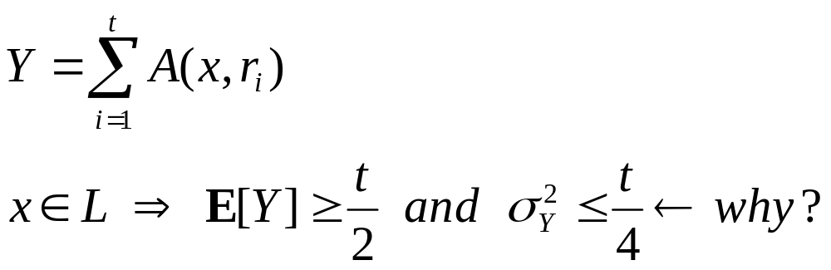
r_{i} = ai + b mod n, i =1,…, t.
r_{i}’s are pairwise independent.
  (See [MR95], Exercise 3.7 in page 52)
Let
Notes:
Suppose E[A(x,r_{i})] = \mu \geq ½, we have Var[A(x,r_{i})] = \mu * (1-mu). By simple calculus analysis, we have Var[A(x,r_{i})] \leq ¼, thus Var[Y] = \sum_{i =1}^{t} Var[A(x,r_{i})] \leq t/4.

Slide 12
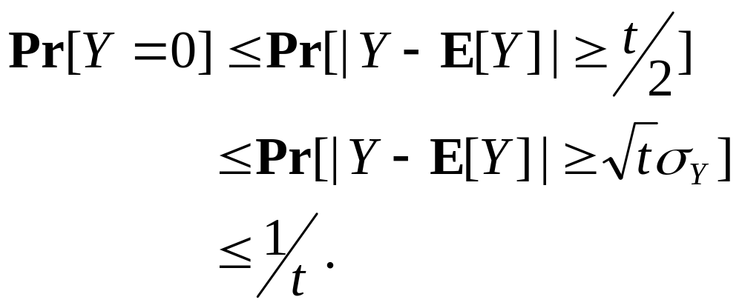
What is the probability of the event {Y = 0}?
Y = 0 ⇒ |Y− E[Y]| ≥ t /2.
Thus
Chebyshev’s Inequality: Pr[|X − μ_{x}|≥ tσ_{X}] ≤ 1/t²

Slide 13
Thank you.

