Slide 1
OS presentation
Group name: Recycle Bin
Joseph Cauvy-Foster, Eimantas

Slide 2
Overall architecture of PintOS

Slide 3
System Call Design and Development
Tokenization
Pushing arguments to the stack
Pulling arguments and system call number off the stack
The system calls

Slide 4
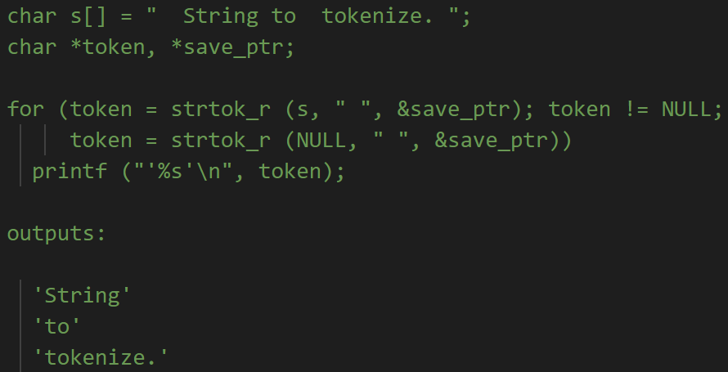
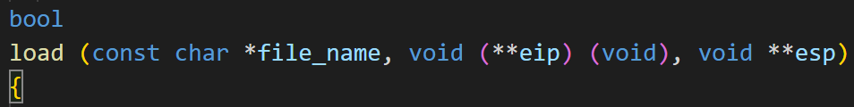
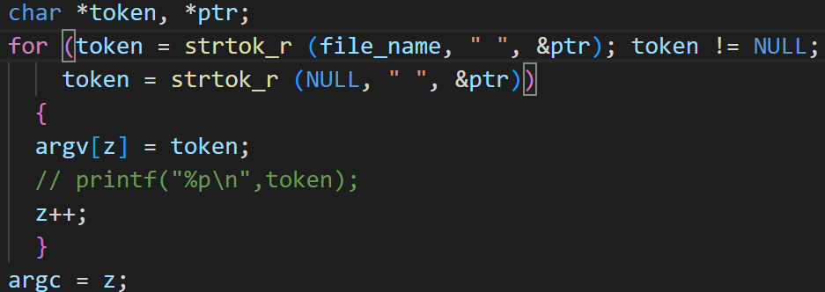
Tokenization
Tokenization is the process of splitting a string into tokens separated by delimiters, in this case filename is being split into arguments separated by spaces. In lib/string.c: in userprog/process.c:

Slide 5
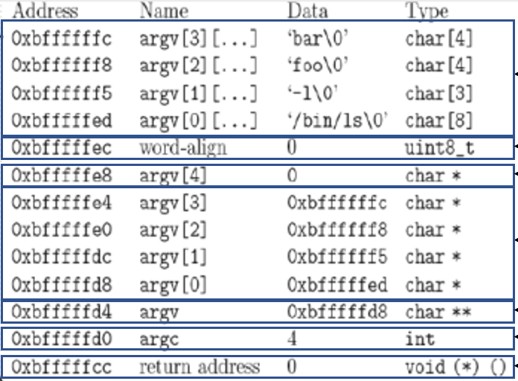
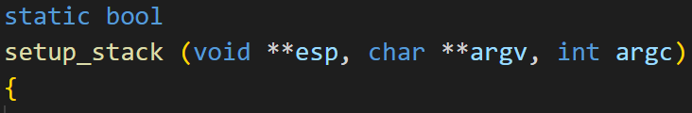
Pushing arguments to stack

Slide 6
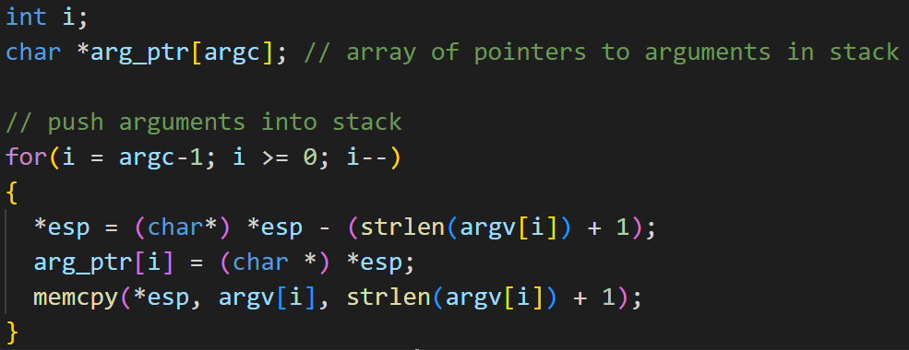




Pushing arguments to stack
Because have to put arguments on in reverse order
For \0

Slide 7
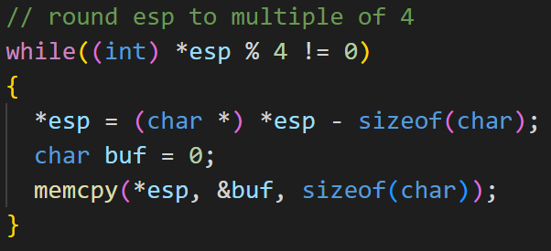
Aligning stack to a multiple of 4 bytes
For example: “Echo x y z” turns into Echo\0 x\0 y\0 z\0 11 total bytes, so need to add one 0 onto the stack to make it a multiple of 4(12).

Slide 8
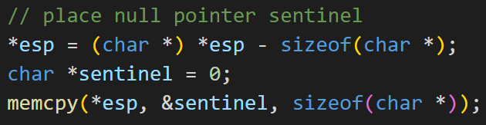
Pushing a null pointer

Slide 9
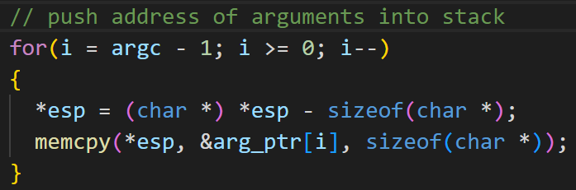




Pushing addresses of arguments
Pushing the addresses of the arguments added that are stored in arg_ptr
Starting at argc – 1 because wanting to put arguments on in reverse order
from

Slide 10
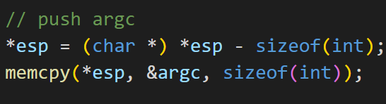
Pushing argc to the stack

Slide 11
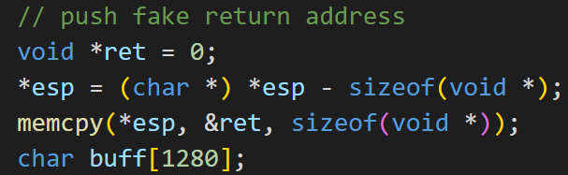

Pushing return address and hex_dump
Using hex_dump() to show the layout of the stack after everything has been pushed
Return address has to be a void pointer

Slide 12
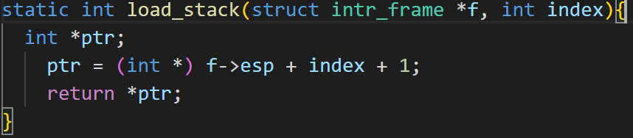

How we pulled the arguments from the stack
In syscall.c:
Pulled the syscall code using:
Pulled the arguments using a load_stack() function:
+ 1 because the syscall code is at esp so need to go up 1 for first argument

