Slide 1
OS presentation
Group name: Recycle Bin
Joseph Cauvy-Foster, Eimantas Miliauskis, krishan singh, bit na yoon, guandong zhang

Slide 2
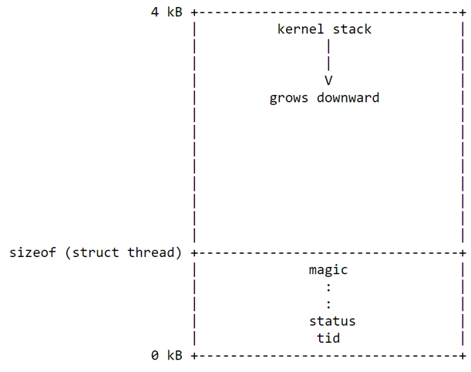
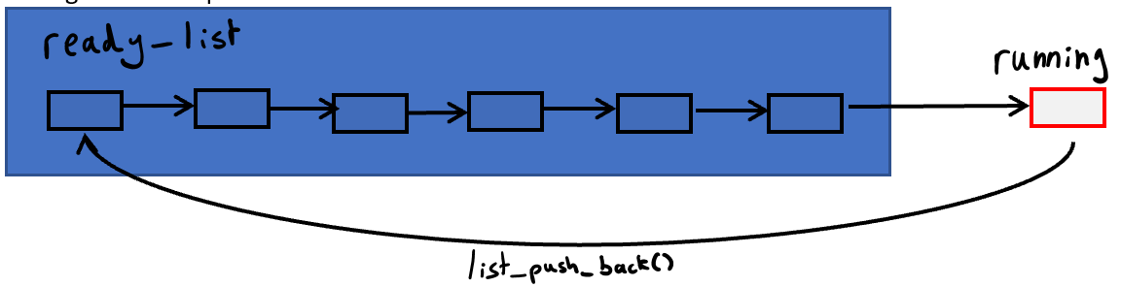

Overall architecture of PintOS - Threads
Threads are defined as a struct thread which
holds all the information on the thread.
Thread switching just has one first in first out list of
threads not being run and when the thread
finishes running it is sent to the back of the queue.

Slide 3
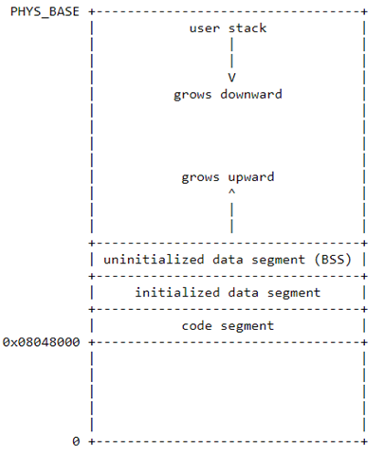
Overall architecture of PintOS - Virtual memory
User virtual memory layout:
PintOS uses 80x86 architecture which does not provide access to memory through physical addresses, but PintOS has a work around for this problem by mapping kernel memory straight onto physical memory. Memory in pintos is split into frames called physical frames or page frames each frame is mapped onto its adjacent kernel virtual memory page e.g. the 1st page of the kernel virtual memory is mapped onto the first frame of the physical memory then the 2nd page of the kernel virtual memory is mapped onto the second frame of the physical memory so on and so forth. Using this method the frames can be accessed through the use of the kernel virtual memory.
Swapping uses virtual memory to swap the location of data from primary memory (RANDOM ACCESS MEMORY/ RAM) to secondary memory (memory that cannot be directly accessed by the CPU e.g. a small section of a HDD/SSD), e.g. saving files for long term. This increases the amount of available memory for a program or the operating system to use. Swapping occurs when a kernel tries to access a page that is stored in swap space (i.e. when is it not stored in the RAM) since it is not in ram and page fault will occur causing the page to be swapped from disk to RAM, this then causes the CPU to be able to access the data.

Slide 4
System Call Design and Development
Tokenization
Pushing arguments to the stack
Pulling arguments and system call number off the stack
The system calls

Slide 5
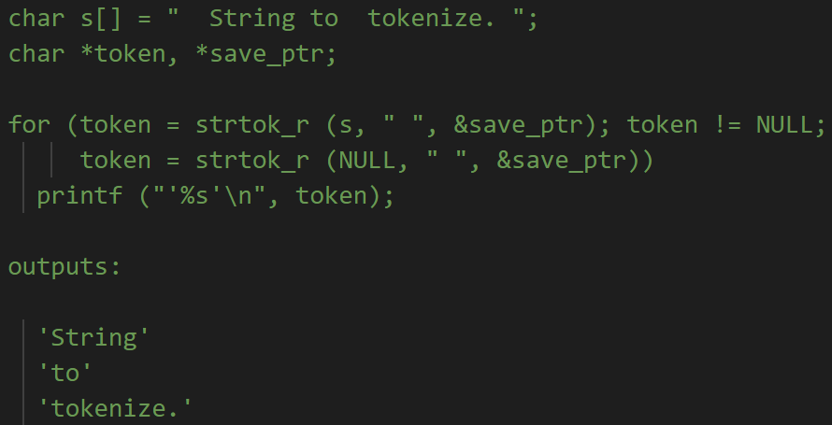
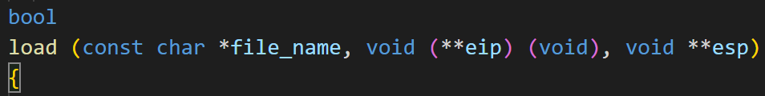
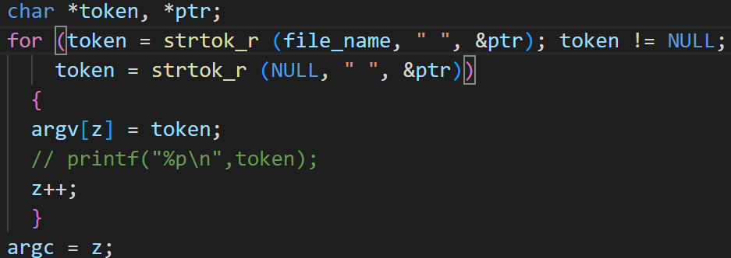
Tokenization
Tokenization is the process of splitting a string into tokens separated by delimiters, in this case filename is being split into arguments separated by spaces. In lib/string.c: in userprog/process.c:

Slide 6
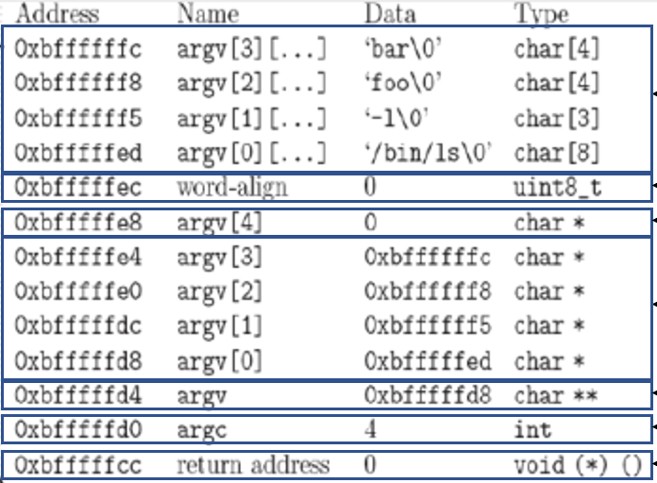
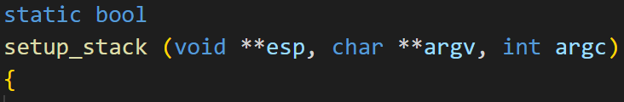
Pushing arguments to stack

Slide 7
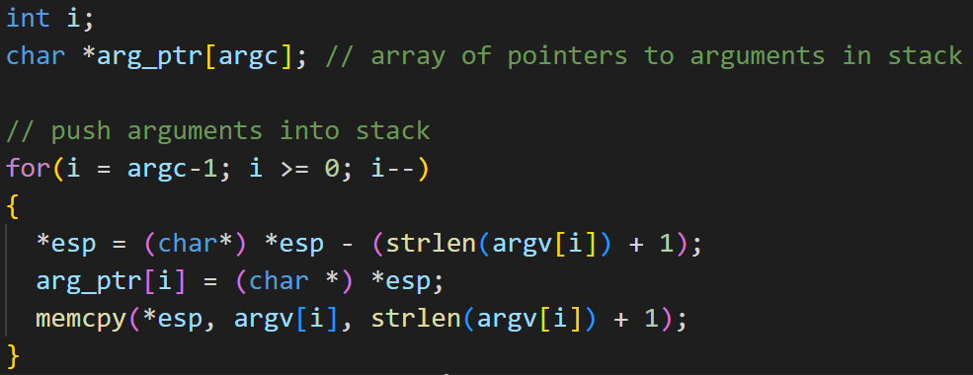


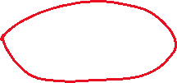

Pushing arguments to stack
Because have to put arguments on in reverse order
For \0

Slide 8
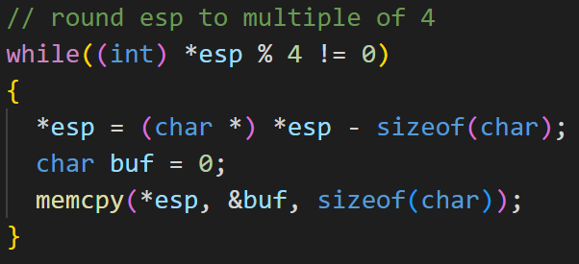
Aligning stack to a multiple of 4 bytes
For example: “Echo x y z” turns into Echo\0 x\0 y\0 z\0 11 total bytes, so need to add one 0 onto the stack to make it a multiple of 4(12).

Slide 9
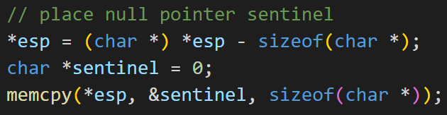
Pushing a null pointer

Slide 10
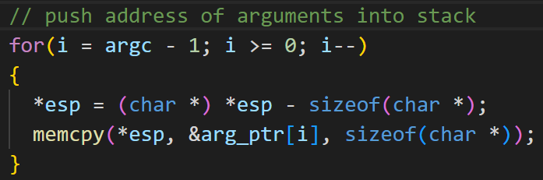




Pushing addresses of arguments
Pushing the addresses of the arguments added that are stored in arg_ptr
Starting at argc – 1 because wanting to put arguments on in reverse order
from

Slide 11
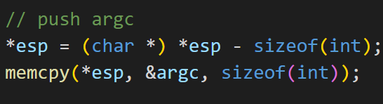
Pushing argc to the stack

Slide 12
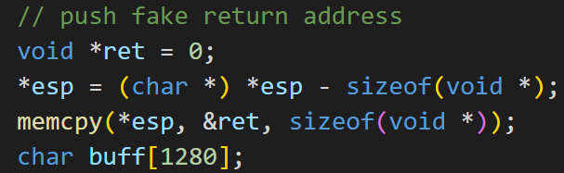

Pushing return address and hex_dump
Using hex_dump() to show the layout of the stack after everything has been pushed
Return address has to be a void pointer

Slide 13
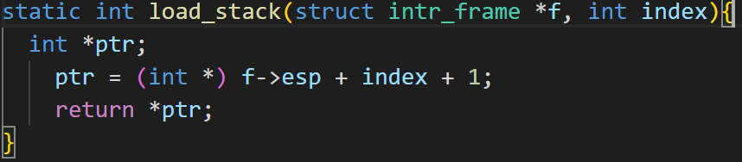

How we pulled the arguments from the stack
In syscall.c:
Pulled the syscall code using:
Pulled the arguments using a load_stack() function:
+ 1 because the syscall code is at esp so need to go up 1 for first argument

Slide 14

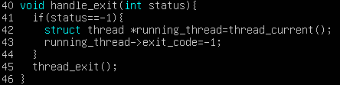





The System Calls:
System calls are invoked using int $0x30 inside of user programs, System calls are also handled in syscall.c within the syscall handler, the system call that is called depends on the number (from 0 -12) given to int $0x30 when it is used, each digit is assigned to its SYSCALL in Lib/syscall-nr.h
From the total of 13 syscalls we completed;
SYS_EXIT
SYS_HALT
SYS_CREATE
SYS_REMOVE
Each of these system call cases call back to the corresponding function handler which then returns the value which is pushed into eax in f with whatever was returned (being if the system call ran correctly which returns a 0 or a -1 if not)
Does not have a function handler as only a single function has to be called which turns off

Slide 15

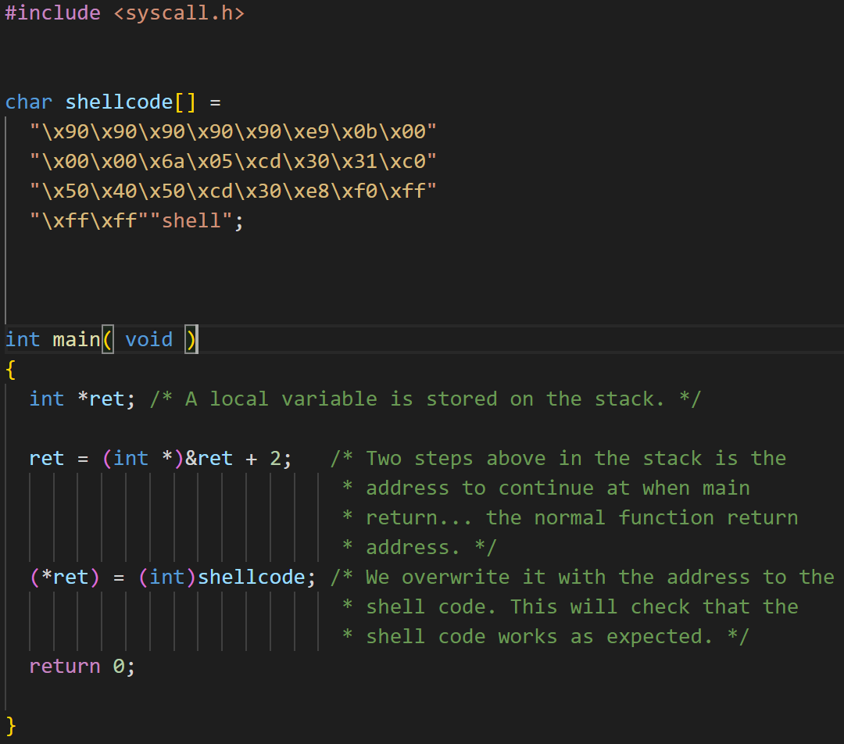

Exploit of sys_remove
Shellcode.c: binary:
\x90 are to fill the buffer
\xe9\x0b\x00\x00\x00 are to jump to x15 which is CALL
\x6a\x05 are to push x05 to stack (remove syscall number)
\xcd\x30 are to make an interrupt with hex 30 (syscall interrupt)
\x31\xc0 are to load 0 into eax
\x50 to push exit_status
\x40\x50 to push exit_status
\xcd\x30 to make syscall interrupt
\xe8\xf0\xff\xff\xff to jump back to call
“shell” name of file that is being removed

