Slide 1

Feedback System for Laser Intensity Stabilization
Joseph Cuzzupoli (Presenter), Jaskaran Randhawa, Gehrig Carlse, Eduardo Ramos, Thomas Vacheresse, Alex Pouliot and A. Kumarakrishnan (Supervisor)
DEPARTMENT OF PHYSICS AND ASTRONOMY, YORK UNIVERSITY

Slide 2
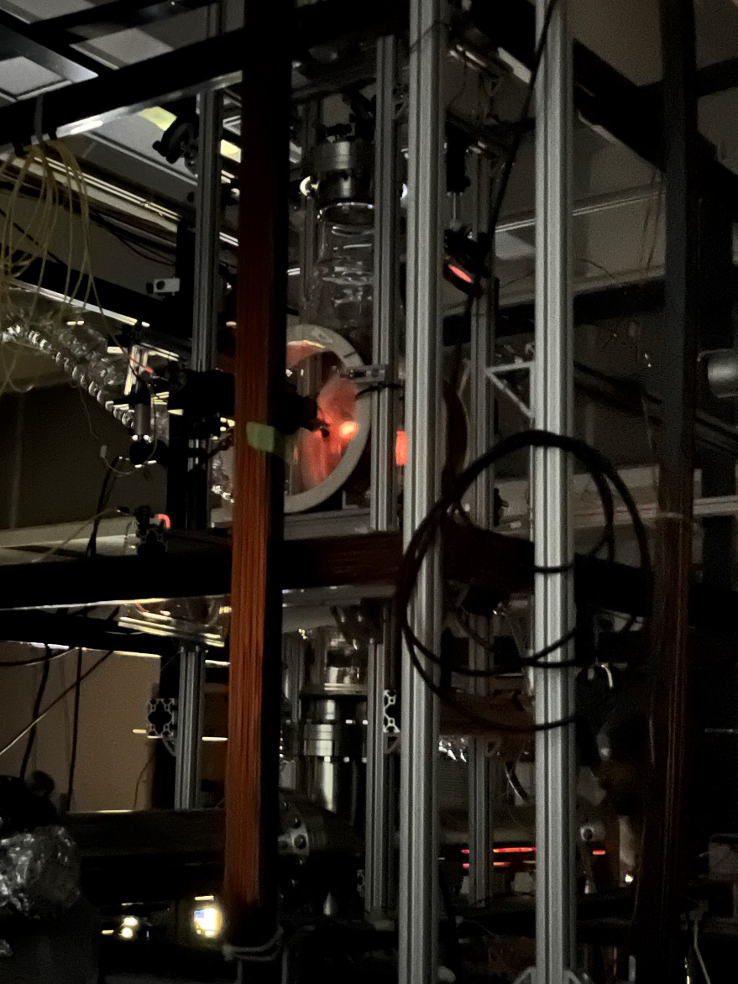
What Is The Problem We Want to Solve?
Experiments involve precision metrology using atom traps
Laser intensity fluctuations cause variations in atom number
Results in unstable fluorescence from the trap
Solution: Acousto-Optic Modulator (AOM)-based Laser Intensity Feedback System
Fluorescing Rb atoms from trap

Slide 3

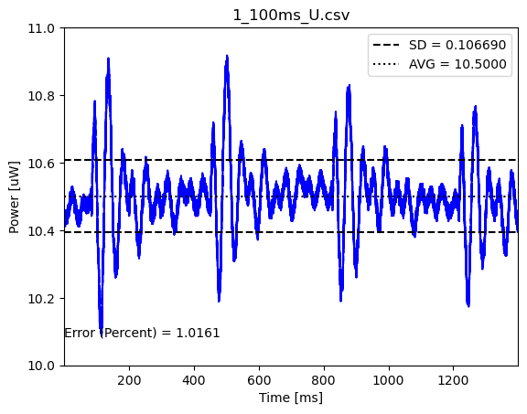
Background
Intensity Modulation - Variances in output laser power
Stabilizing intensity modulations improves experimental outcomes
Electronically adjusting amplitude of an audio signal to achieve constant intensity
Laser Power
SD/AVG ~ 1%

Slide 4
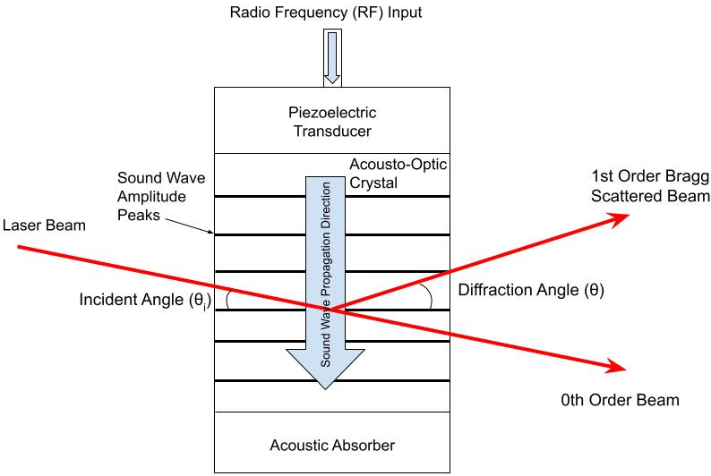
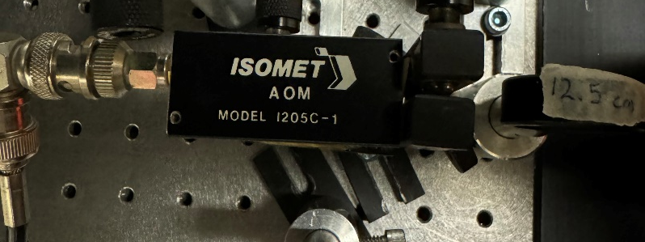
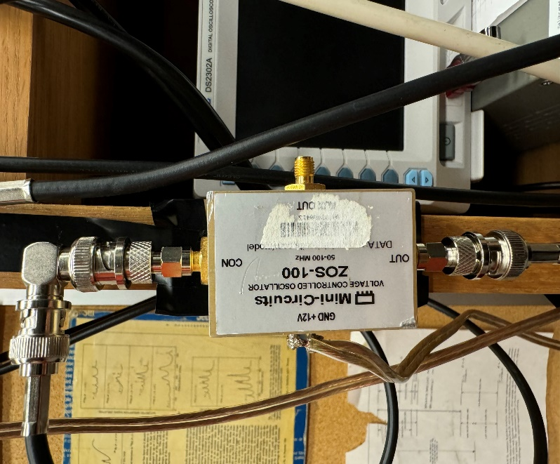

Acousto-Optic Modulator (AOM)
Used to frequency shift and intensity-modulate laser light
Voltage Controlled RF Oscillator (VCO) changes AOM drive frequency in response to a tuning voltage
Amplified RF produces sound waves in crystal to create a diffraction grating
Used as an optical switch for turning light on/off
d
Acousto-Optic Modulator (AOM)
Bragg Scattering Condition:
$$mλ=2ⅆ\sin{θ}$$
Acousto-Optic Modulator (AOM)
Voltage Controlled Oscillator (VCO)
Notes:
Changes in the input RF allow for varying efficiencies of the AOM, permitting more/less light in the diffracted beam

Slide 5
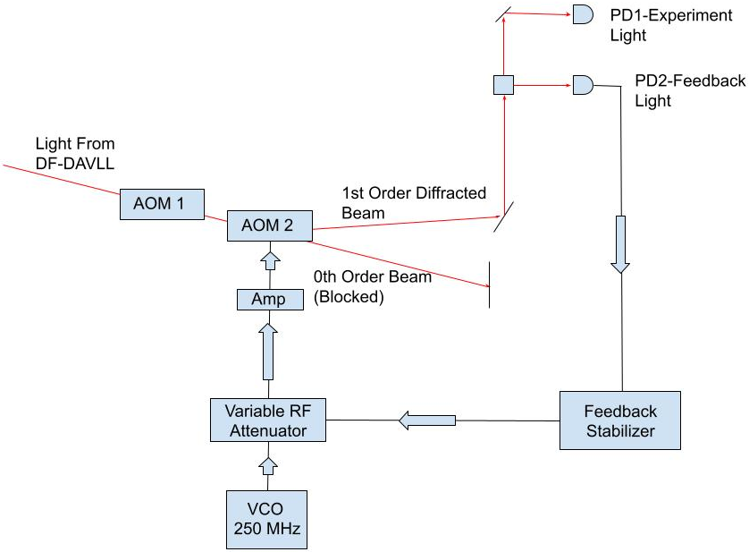
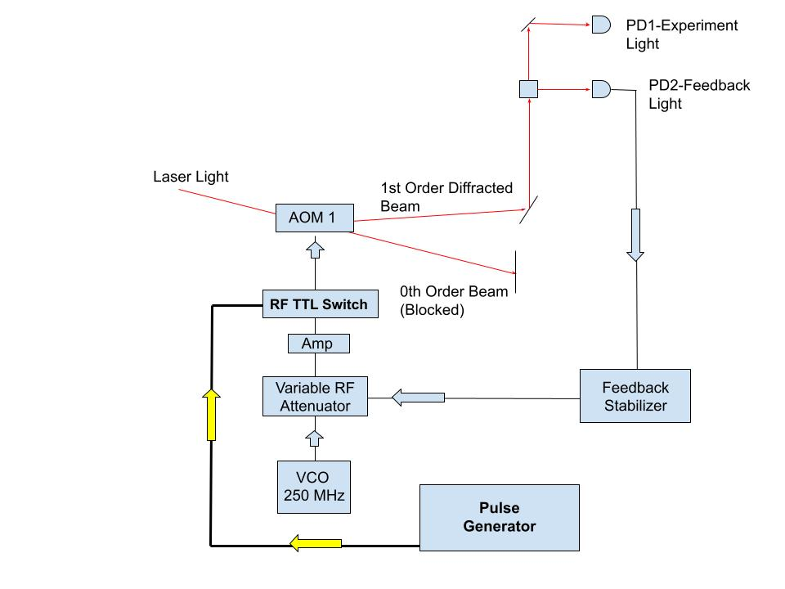
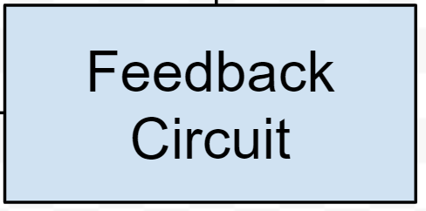
Methodology - The Feedback System
Beam Splitter
Laser Light
Monitoring the laser intensity and obtain feedback signal
Feedback signal sent to a variable RF attenuator
Correction changes the RF power to AOM 1 to cancel intensity variations
Notes:
Show blocks to the particular pieces of the system you are explaining (like in the circuit diagram)
Maybe show the signal at the photodiodes and how they are being stabilized
Aom’s operate on the 80MHz range and are thus sensitive to the noises produced in this range which can be acoustic noise from pumps or electronic noise in the AOM drivers or even walking causing table vibrations

Slide 6
Methodology - The Feedback System
Beam Splitter
Laser Light
Monitoring the laser intensity and obtain feedback signal
Feedback signal sent to a variable RF attenuator
Correction changes the RF power to AOM 1 to cancel intensity variations
Notes:
Show blocks to the particular pieces of the system you are explaining (like in the circuit diagram)
Maybe show the signal at the photodiodes and how they are being stabilized
Aom’s operate on the 80MHz range and are thus sensitive to the noises produced in this range which can be acoustic noise from pumps or electronic noise in the AOM drivers or even walking causing table vibrations

Slide 7
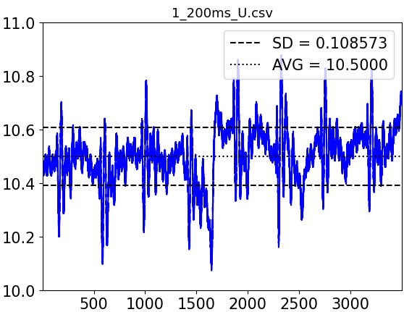
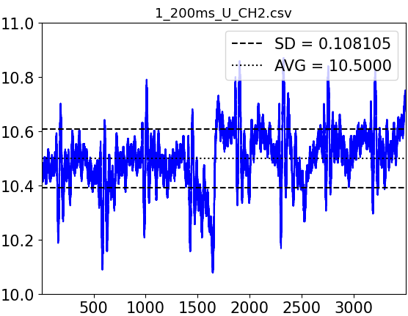
Methodology - The Feedback System
Beam Splitter
Laser Light
Power(μW)
SD/AVG ~ 1%
Time(ms)
Power(μW)
SD/AVG ~ 1%
Time(ms)
Monitoring the laser intensity and obtain feedback signal
Feedback signal sent to a variable RF attenuator
Correction changes the RF power to AOM 1 to cancel intensity variations
Notes:
Show blocks to the particular pieces of the system you are explaining (like in the circuit diagram)
Maybe show the signal at the photodiodes and how they are being stabilized
Aom’s operate on the 80MHz range and are thus sensitive to the noises produced in this range which can be acoustic noise from pumps or electronic noise in the AOM drivers or even walking causing table vibrations

Slide 8
Methodology - The Feedback System
Beam Splitter
Laser Light
Monitoring the laser intensity and obtain feedback signal
Feedback signal sent to a variable RF attenuator
Correction changes the RF power to AOM 1 to cancel intensity variations
Notes:
Show blocks to the particular pieces of the system you are explaining (like in the circuit diagram)
Maybe show the signal at the photodiodes and how they are being stabilized
Aom’s operate on the 80MHz range and are thus sensitive to the noises produced in this range which can be acoustic noise from pumps or electronic noise in the AOM drivers or even walking causing table vibrations

Slide 9
Methodology - The Feedback System
Beam Splitter
Laser Light
Monitoring the laser intensity and obtain feedback signal
Feedback signal sent to a variable RF attenuator
Correction changes the RF power to AOM 1 to cancel intensity variations
Notes:
Show blocks to the particular pieces of the system you are explaining (like in the circuit diagram)
Maybe show the signal at the photodiodes and how they are being stabilized
Aom’s operate on the 80MHz range and are thus sensitive to the noises produced in this range which can be acoustic noise from pumps or electronic noise in the AOM drivers or even walking causing table vibrations

Slide 10
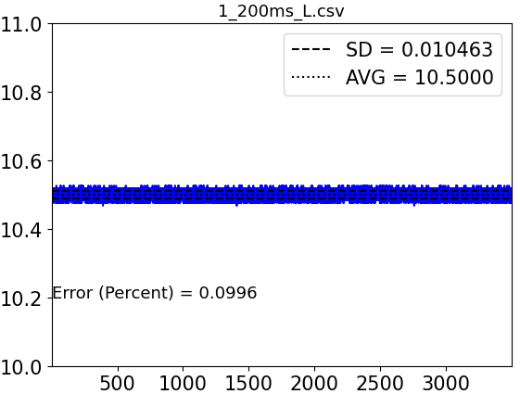
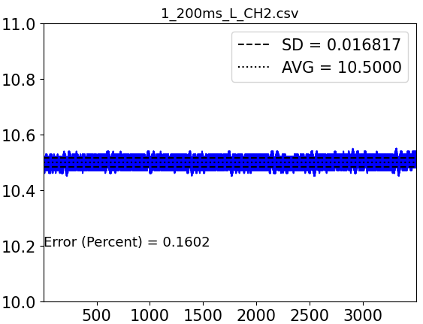
Methodology - The Feedback System
Beam Splitter
Laser Light
SD/AVG ~ 0.1%
Power(μW)
Time(ms)
Power(μW)
SD/AVG ~ 0.1%
Time(ms)
Monitoring the laser intensity and obtain feedback signal
Feedback signal sent to a variable RF attenuator
Correction changes the RF power to AOM 1 to cancel intensity variations
Notes:
Show blocks to the particular pieces of the system you are explaining (like in the circuit diagram)
Maybe show the signal at the photodiodes and how they are being stabilized
Aom’s operate on the 80MHz range and are thus sensitive to the noises produced in this range which can be acoustic noise from pumps or electronic noise in the AOM drivers or even walking causing table vibrations

Slide 11
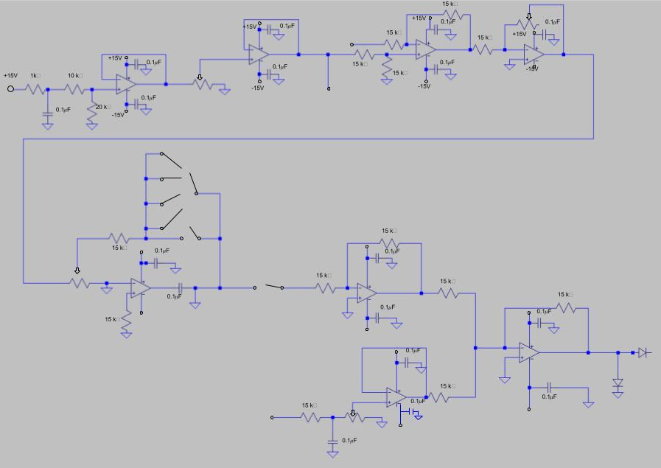
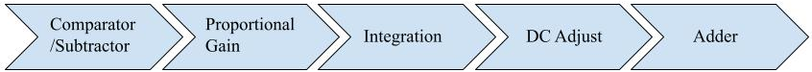
Analog Stabilization Circuit
1 (Comparator): Compares the PD signal to a reference setpoint and subtracts the two values
10pF
100pF
1000pF
10000pF
↑ in control voltage, ↑ RF power, ↑ laser power intensity
↓ in control voltage, ↓ RF power, ↓ laser power intensity
Notes:
Animate each block to enter in as you explain them and find a way to explain the integrator (sort of like a lowpass filter that produces a correction signal at different time constant)
Slide for analog circuit
Slide for AOM background

Slide 12
Analog Stabilization Circuit
1 (Comparator): Compares the PD signal to a reference setpoint and subtracts the two values
2 (Gain): Increases the amplitude of the subtracted signal
3 (Integrator): Integrates the input voltage to provide the correction signal to lock the PD to the setpoint
4 (DC Adjust): Changes the DC level of the signal, allowing more/less light on the PD
5 (Adder): Adds the correction signal to the DC adjust signal and is sent to the RF attenuator
10pF
100pF
1000pF
10000pF
↑ in control voltage, ↑ RF power, ↑ laser power intensity
↓ in control voltage, ↓ RF power, ↓ laser power intensity
Notes:
Animate each block to enter in as you explain them and find a way to explain the integrator (sort of like a lowpass filter that produces a correction signal at different time constant)
Slide for analog circuit
Slide for AOM background

Slide 13
Analog Stabilization Circuit
1 (Comparator): Compares the PD signal to a reference setpoint and subtracts the two values
2 (Gain): Increases the amplitude of the subtracted signal
3 (Integrator): Integrates the input voltage to provide the correction signal to lock the PD to the setpoint
4 (DC Adjust): Changes the DC level of the signal, allowing more/less light on the PD
5 (Adder): Adds the correction signal to the DC adjust signal and is sent to the RF attenuator
10pF
100pF
1000pF
10000pF
↑ in control voltage, ↑ RF power, ↑ laser power intensity
↓ in control voltage, ↓ RF power, ↓ laser power intensity
Notes:
Animate each block to enter in as you explain them and find a way to explain the integrator (sort of like a lowpass filter that produces a correction signal at different time constant)
Slide for analog circuit
Slide for AOM background

Slide 14
Analog Stabilization Circuit
1 (Comparator): Compares the PD signal to a reference setpoint and subtracts the two values
2 (Gain): Increases the amplitude of the subtracted signal
3 (Integrator): Integrates the input voltage to provide the correction signal to lock the PD to the setpoint
4 (DC Adjust): Changes the DC level of the signal
5 (Adder): Adds the correction signal to the DC adjust signal and is sent to the RF attenuator
10pF
100pF
1000pF
10000pF
↑ in control voltage, ↑ RF power, ↑ laser power intensity
↓ in control voltage, ↓ RF power, ↓ laser power intensity
Notes:
Animate each block to enter in as you explain them and find a way to explain the integrator (sort of like a lowpass filter that produces a correction signal at different time constant)
Slide for analog circuit
Slide for AOM background

Slide 15
Analog Stabilization Circuit
1 (Comparator): Compares the PD signal to a reference setpoint and subtracts the two values
2 (Gain): Increases the amplitude of the subtracted signal
3 (Integrator): Integrates the input voltage to provide the correction signal to lock the PD to the setpoint
4 (DC Adjust): Changes the DC level of the signal
5 (Adder): Adds the correction signal to the DC adjust and sends to the variable RF attenuator
10pF
100pF
1000pF
10000pF
↑ in control voltage, ↑ RF power, ↑ laser power intensity
↓ in control voltage, ↓ RF power, ↓ laser power intensity
Notes:
Animate each block to enter in as you explain them and find a way to explain the integrator (sort of like a lowpass filter that produces a correction signal at different time constant)
Slide for analog circuit
Slide for AOM background

Slide 16
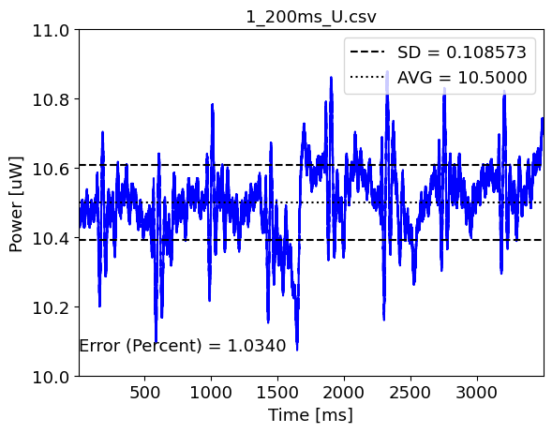
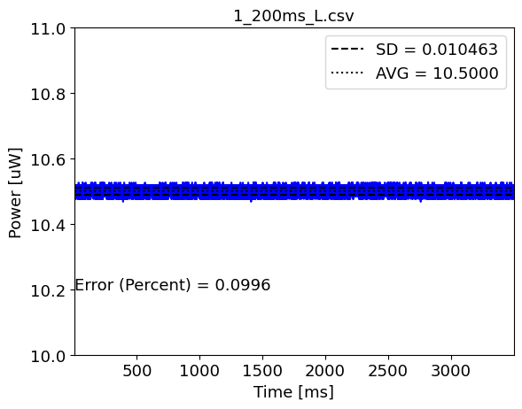
Intensity Stabilization
Feedback Signal-Unlocked
Feedback Signal-Locked
SD/AVG ~ 0.1%
SD/AVG ~ 1%
200ms/div
PD1 Signal
Both the feedback detector (PD1) and experiments detector (PD2) measure the same trends
Notes:
Maybe don’t need both PD’s being show and simply assert them to be the same

Slide 17
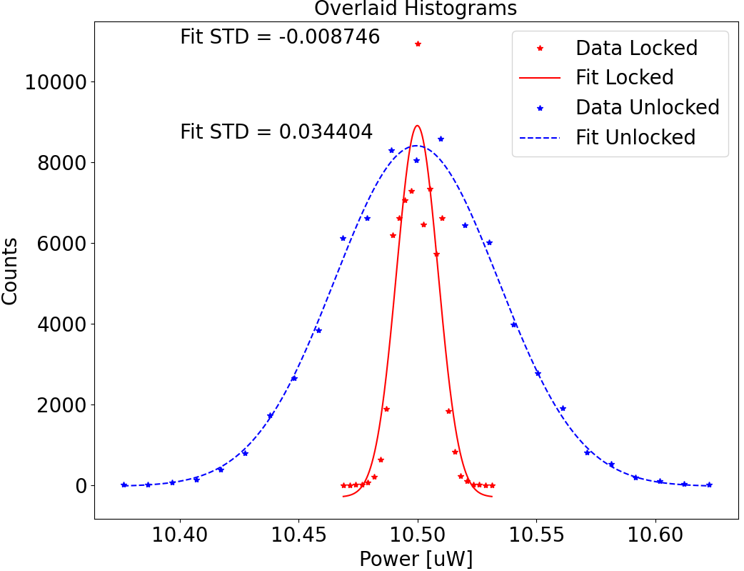


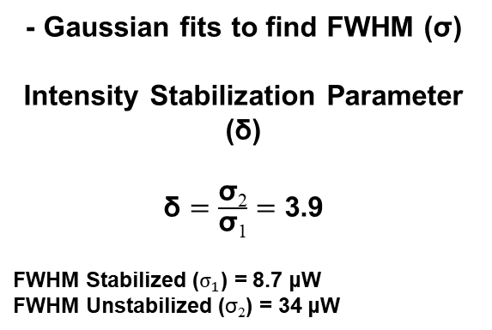
Intensity Histograms
$$σ_{1}$$
μW
- Gaussian fits to find FWHM (σ)
Intensity Stabilization Parameter (δ)
$\text{δ}=\frac{\text{σ}\text{2}}{\text{σ}\text{1}}=$ 3.9
FWHM Stabilized ($σ_{1}$) = 8.7 μW
FWHM Unstabilized ($\text{σ}\text{2}$) = 34 μW
$$σ_{2}$$
μW
Notes:
Reference back to the signal plots for the Gaussians and mention the intensity stabilization parameter earlier on
Make labels bigger, legend better and change symbols
Label sig1 and sig2 on curve
Acoustic from pumps and such…

Slide 18
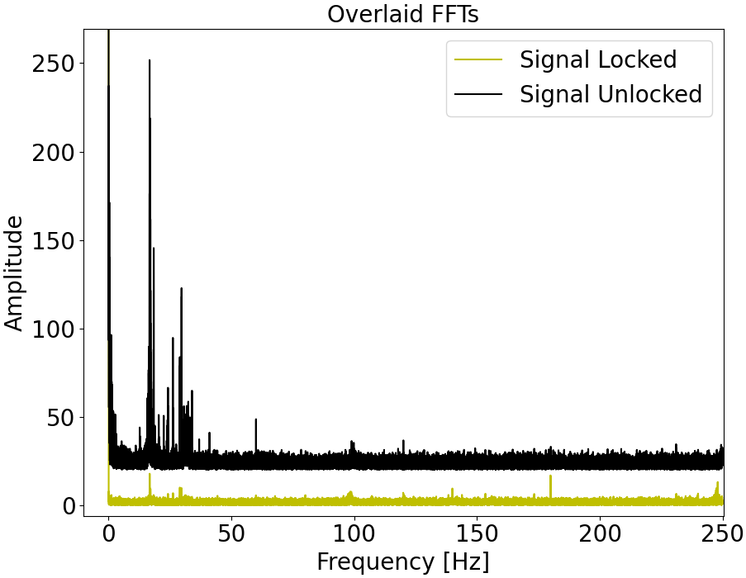
Power Spectrum FFT
- Fourier transform of the unlocked signal shows low-frequency noise (acoustic noise)
Fourier transform of the locked signal shows attenuation of frequency components
Feedback system works in the range of DC to few KHz

Slide 19
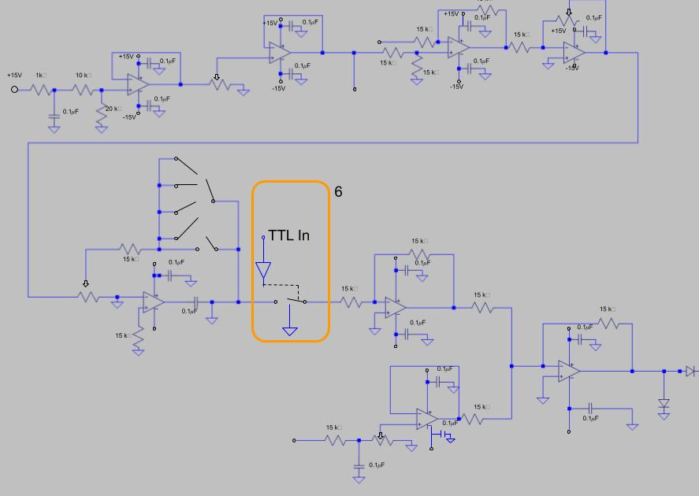
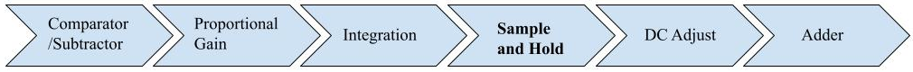
Sample and Hold (S&H) Module
S&H module is developed to accommodate AOM pulsing applications
S&H module can be switched on/off with TTL pulse to engage/disable feedback
Stabilizes laser intensity when TTL is HI
Holds PD signal when TTL is LO
Notes:
Do without the part diagram for the switch and add..WHAT DO I ADD???
Label the pulse and part where fdbk is on/off(hi/low)
Label the TTL input in the circuit diagram

Slide 20
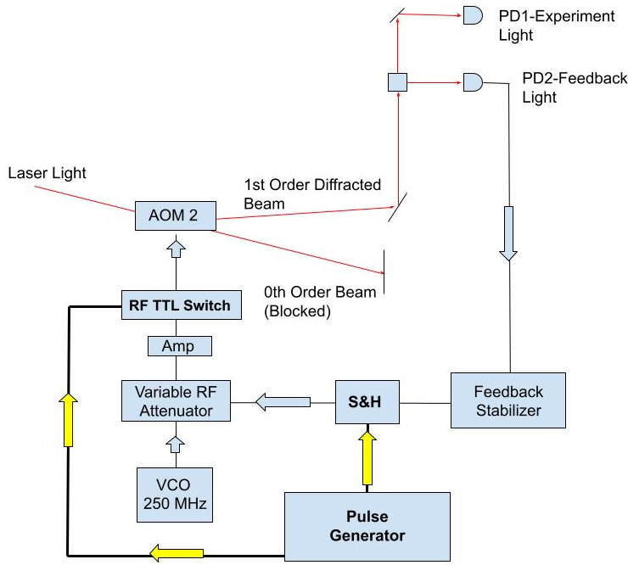
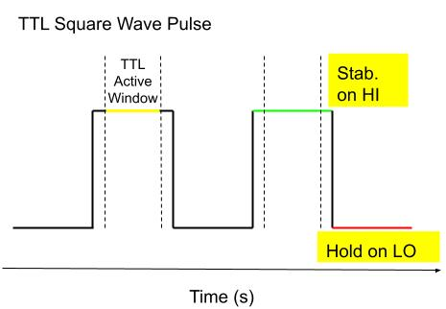
Pulsed Feedback Mode
Pulse generator sends TTL pulse to turn AOM on/off
A delayed TTL pulse is sent to S&H
Delay creates an active window in which the circuit stabilizes (on HI)
When the pulse is LO, the circuit holds the unstabilized DC level
Beam Splitter
Stabilize on HI
Notes:
STABILIZE on HI
When the light turns off, there is no longer intensity noise to stabilize
To avoid voltage spike, a sample and hold can turn on/off feedback coinciding with light/dark phases

Slide 21
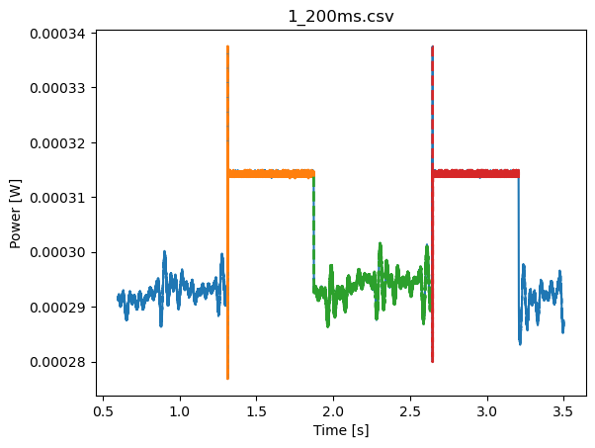
Sample and Hold Signal
Laser Power as a Function of Time
Stabilizing when TTL is high
Holding when TTL is low
Intensity fluctuations are decreased when stabilizing
Repetition rate of 1 Hz
Stabilized
Power(μW)
Unstabilized
Unstabilized Signal ~ 1% SD/AVG
Stabilized Signal ~ 0.3% SD/AVG
Notes:
Eliminate the orange and green

Slide 22
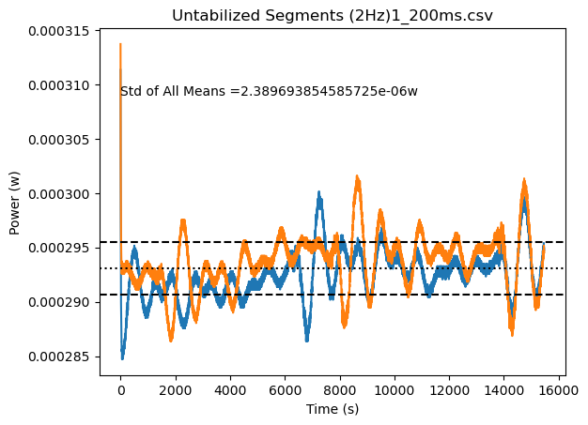
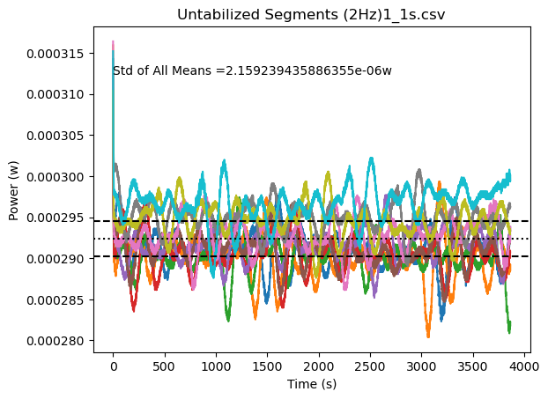
Unstable Segments
Unstable Laser Power as a Function of Time
Analogous to unstable signal in continuous-wave mode
Signal has intensity variations
Standard deviation level of ~ 1%
e-6 W
Power(μW)
1.4
Notes:
Less sig.figs.
Every other measurement point

Slide 23
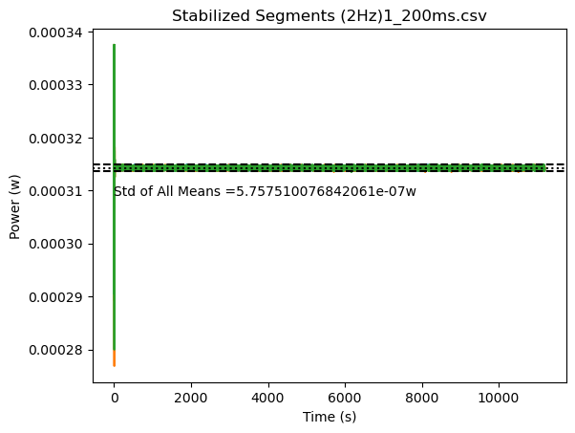
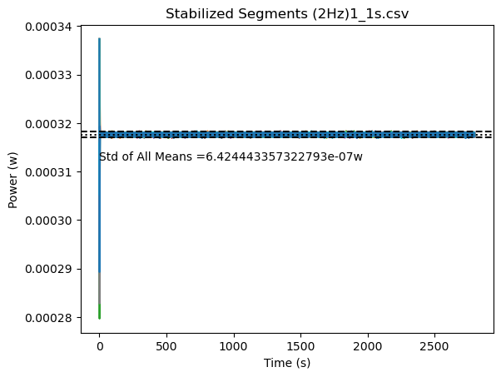
Stabilized Segments
Unstable Laser Power as a Function of Time
Analogous to stable signal in continuous-wave mode
Intensity fluctuations are reduced
Standard deviation on the level of ~ 0.3%
e-7 W
Power(μW)

Slide 24
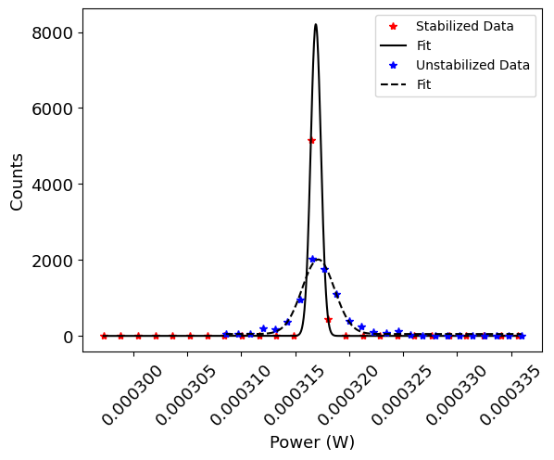
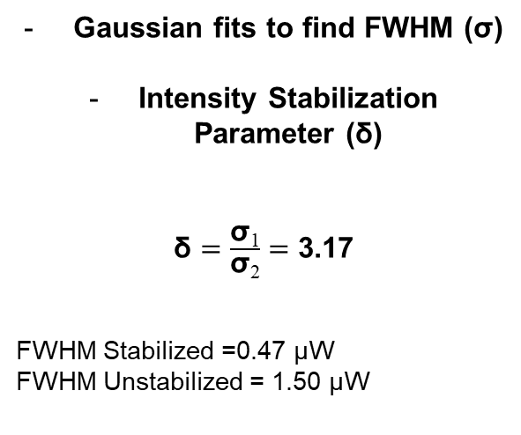
S&H Data Analysis
Laser Intensity Histograms
Gaussian fits to find FWHM (σ)
Intensity Stabilization Parameter (δ)
$\text{δ}=\frac{\text{σ}\text{1}}{\text{σ}\text{2}}=$ 3.17
FWHM Stabilized =0.47 μW
FWHM Unstabilized = 1.50 μW
Stabilized
Unstabilized
Power(μW)
Notes:
Mark the green with sample – mark red with holding
Move legend over
Remove the writing on the plots

Slide 25
Conclusions
Demonstrated laser intensity stabilization in both continuous-waveform and pulsed modes
Accomplished by using an analog circuit that routes a correction signal to a variable RF attenuator that drives an AOM
Cost effective (Circuit budget of $500, electronics, laser and optics budget of $10,000)
Can be used in a broad range of experiments
  In optical tweezers, the spring constant is proportional to laser intensity which improves with active intensity stabilization
  In atom trapping, the number of atoms loaded in the atom trap can be stabilized
  Outputs of high-power tapered wave-guide amplifiers can be stabilized
Notes:
Circuit works in pulsed and Cw modes
Established time constants as small as ___ from stabilized to unstblized
We plan to apply this experiment to atom trapping experiemtns and see results from improved stability
Effect on temperature and number of atoms in the trap

Slide 26

Acknowledgements

Slide 28
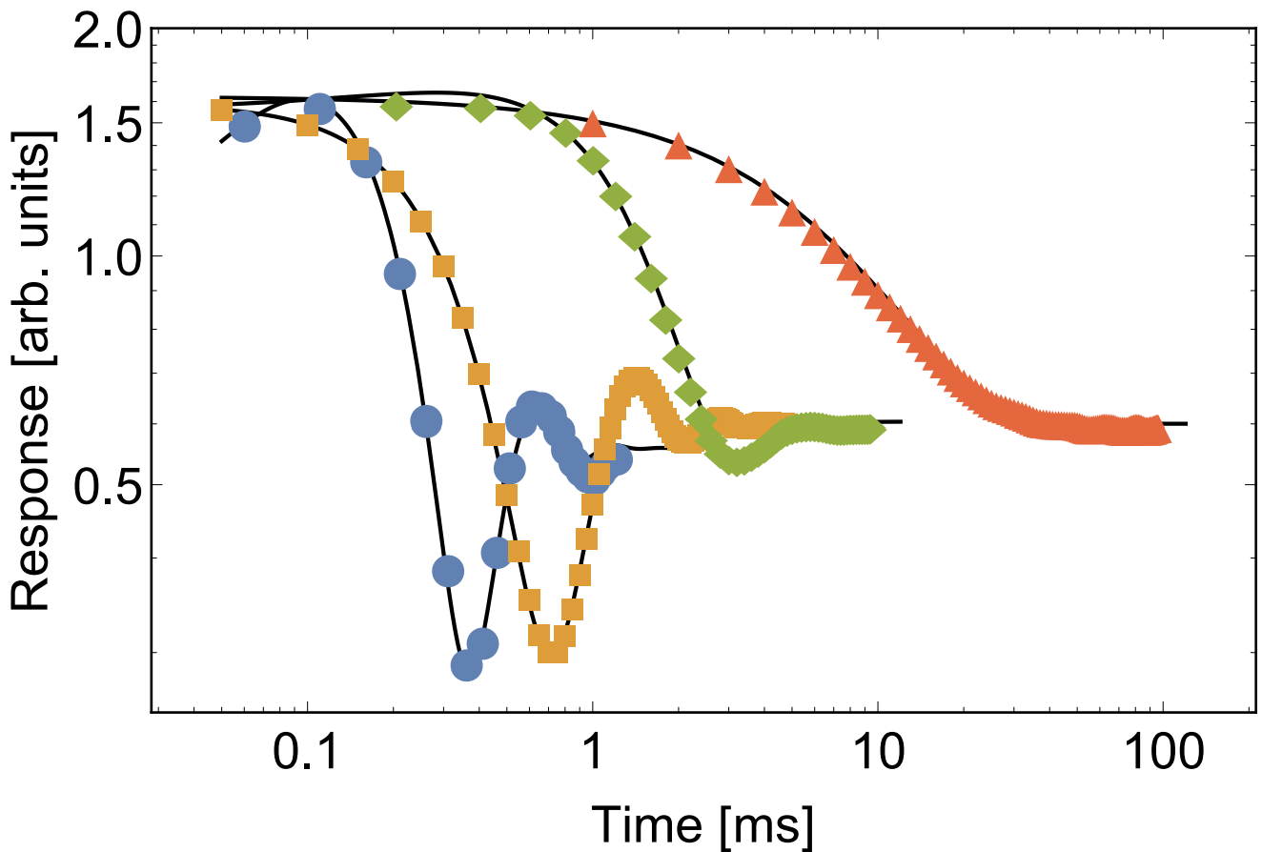
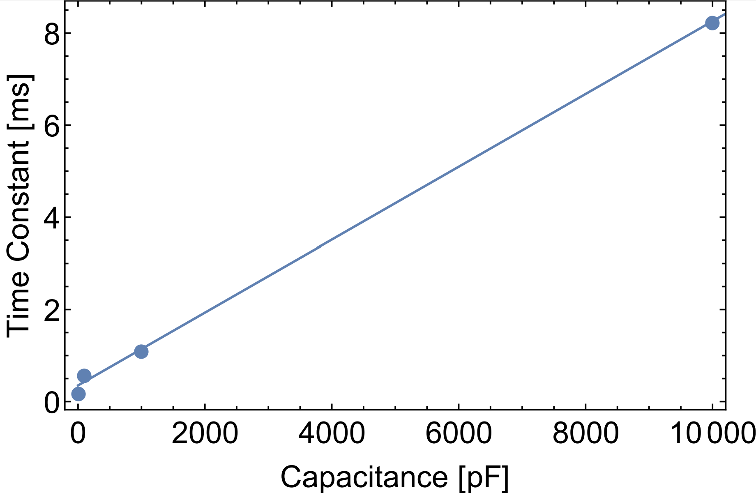
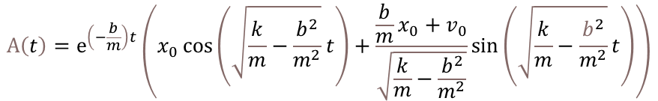
Integrator Time Constants
Normalized Integration Signal Response
Time Constant vs. Capacitor
Unstabilized Level
Stabilized Level
10pF
1000pF
10000pF
100pF
Damped Harmonic Oscillator Fit Equation
Capacitor RC Time Constant
10 pF 0.20 ms
$$A\left(t\right)=ⅇ^{\left(−\frac{b}{m}\right)t}\left(x_{0}\cos\left(\sqrt{\frac{k}{m}−\frac{b^{2}}{m^{2}}}t\right)+\frac{\frac{b}{m}x_{0}+v_{0}}{\sqrt{\frac{k}{m}−\frac{b^{2}}{m^{2}}}}\sin\left(\sqrt{\frac{k}{m}−\frac{b^{2}}{m^{2}}}t\right)\right)$$
100 pF 0.60 ms
1000 pF 1.1 ms
10000 pF 8.2 ms
Notes:
Error bars underneath the point (very small)

Slide 29
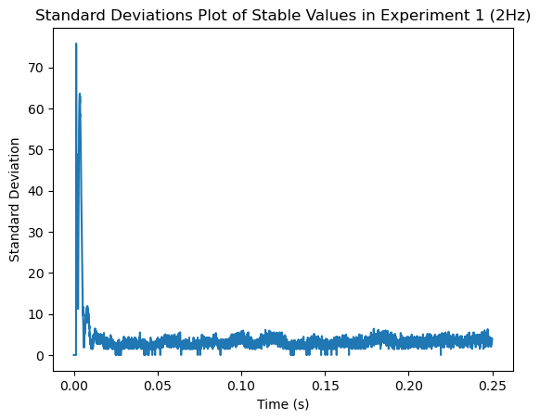
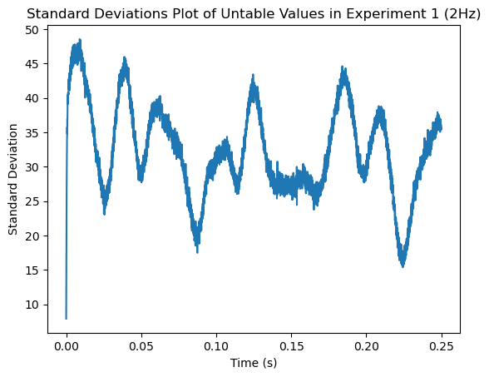
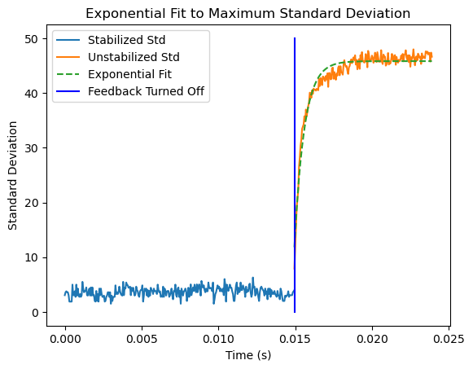
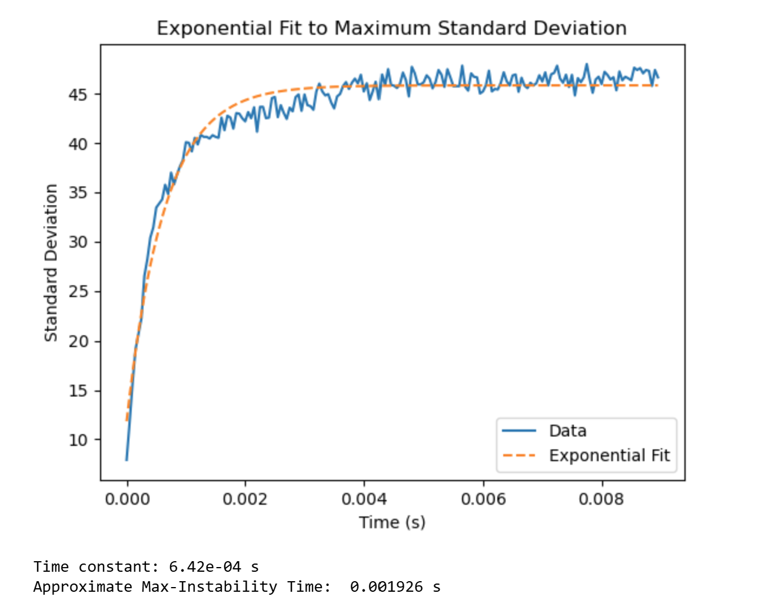
Supplementary: Sample and Hold Data Con’t
(μW)
(μW)
(μW)
(μW)
Time Constant: 6.42E-04s
Approximate Max-Instability Time: 0.001926s
Notes:
Show baseline for the portion that is stabilized (show last bit of the stabilized plot and show it on the time constant plot)
Transition stabble _> unstable
Max Instability time < fastest correction time

Slide 30
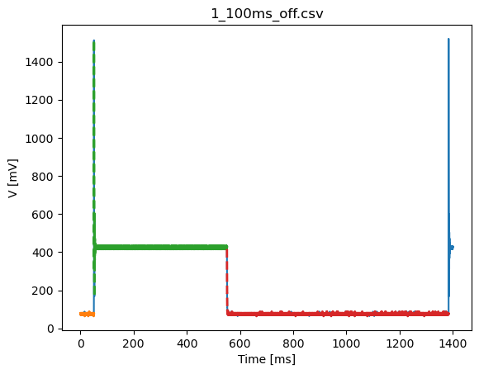
Pulsed Stabilization
AOM is pulsed on/off for some experiments
Using a sample and hold triggered by a TTL pulse, it is possible to engage the feedback for a selected time
The moment the light turns on, the signal transmitted by the circuit shows a spike and rings down
Sample and hold is engaged after the ring down period

Slide 31
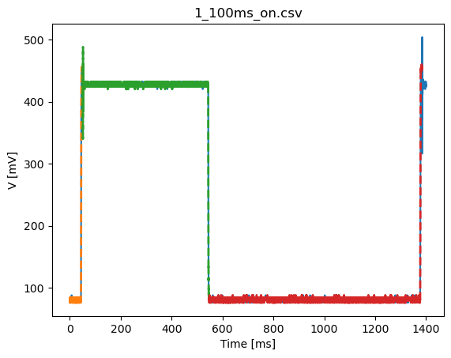
Supplementary: Power Through Vs S&H
Power Through
Sample and Hold
PD input to the circuit is zero when the switch opens since the TTL pulse is synchronous with the RF TTL switch
PD signal experiences a 1V+ rail
TTL signal delay to S&H < TTL switch delay
Stabilized DC level= Unstabilized DC level
Circuit stabilizes active signal and experiences only a small ring
Notes:
Maybe swap this instead of the part picture to motivate the need of the S&H module
Push this
Show ttl pulse, effective window and show the signal in the effective window with and without the feedback
Show whether you are holding on high/low
Axis labels bigger, number on axis bigger, etc.

Slide 32
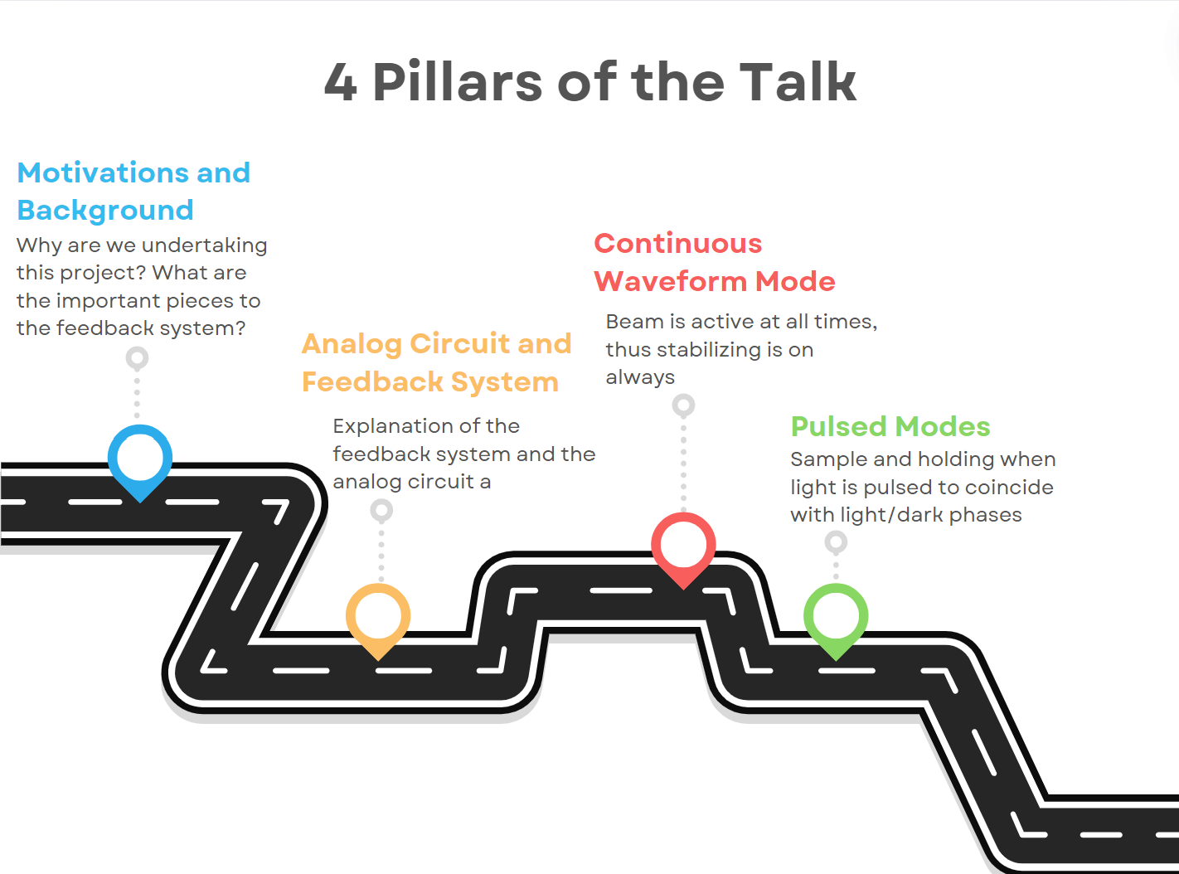
Sign Posts

