Slide 1
Kittyfarm
Mid-Project Review

Slide 2
Highlights
Fetching the data for all 1.6 million kitties via the Cryptokitties API was no easy task. It took quite a bit of trial and error, but I final struck the right balance on the number of parameters to call each time to avoid errors.
The data did not contain the actual gene sequence as I thought it did. This will cause me to pivot from predicting gene outcomes to predicting kitty value directly from cattributes. (Likely gradient boosted trees or random forests approach)

Slide 3
Review Progress
COMPLETED
PLANNED
Setup EC2, S3, RDS
Write script to pull data for all 1.6 million kitties from API
Set up Flask app environment
Configure data model for kitty features
Create working sqlite database for test/development
Create kitty feature table in RDS
Write script to load features from json files in S3 to RDS
Build training, validation, and test sets
Develop CV approach and test potential models (GBM, RF)
Productionize final model
Build continuous training/model deployment pipeline
Build app UI

Slide 4
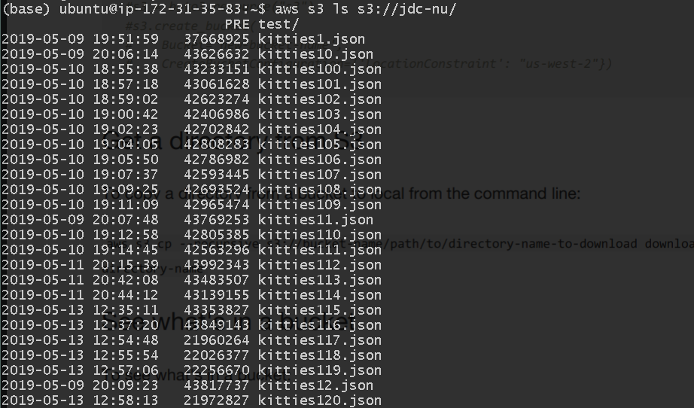
Demo/Analysis
201 json files in S3 bucket (6.36 GB) containing data for 1.6 million cryptokitties

Slide 5
Lessons Learned
This project has been an awesome opportunity to learn more about how Dapps work on the blockchain. Diving into cryptokitties has helped me garner a better understanding of blockchain tech.
Building the framework for a Flask app in Python has been very helpful. At AeroPay, the company I am working for, uses a Flask app to facilitate the back-end of our user and merchant apps.
At an even broader level, the development work in Python has been boosting my Python skills. It is such a versatile language, and I have been needing to build my Python skills to the same level as R.

Slide 6
Recommendations
Load data from S3 to RDS
Build training, testing, and validation sets
Explore GBM and RF models for predicting kitty value
Productionize final predictive model
Build continuous training/deployment pipeline
Finalize app UI

