Slide 1
Debt Calculator

Slide 2
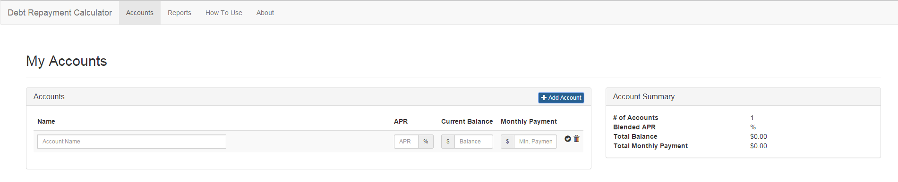
Accounts page
5
1
2
3
4
6, 7, 8
1) Name: Field for name of account
2) APR: Field for APR of account
3) Current Balance: Field for Current balance in account
4) Monthly Payment: Field for Required monthly payment amount
5) +Add Account: Button for adding additional accounts
6) Pencil Icon: Button for editing account
7) Trash Icon: Button to delete account
8) Checkmark Icon: Button to confirm changes to editing a account

Slide 3
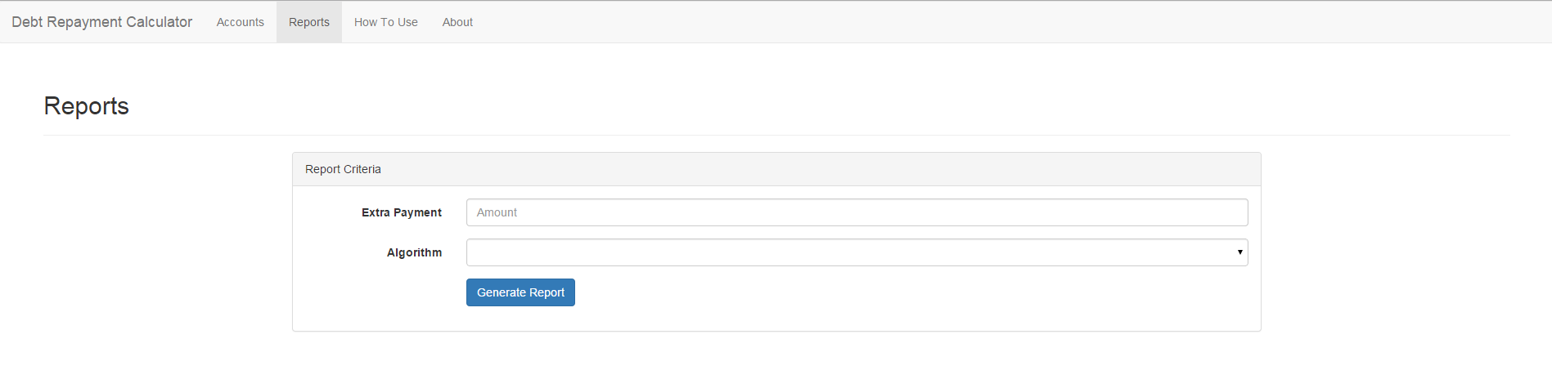
Reports page
1
2
3
1) Extra Payment: Field for entering additional payment
2) Algorithm: Drop-down menu for choosing payment algorithm
3) Generate Report: Button for generating the report

Slide 4
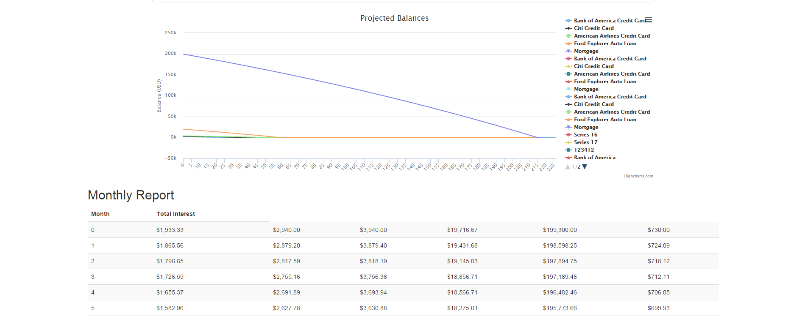
Reports page – Report
1
2
1) Projected Balances: A graphical representation of each account over time
2) Monthly Report: A month by month breakdown of each account over time

