Slide 1
Debt Calculator Tutorial

Slide 2
Overview
The Debt Repayment Calculator consists of four pages, an About page, a How-to page, the Accounts page, and the Reporting page. The latter two will be the focus of the tutorial.
This tutorial will address all the features of the calculator and walk you through how to do certain actions.

Slide 3
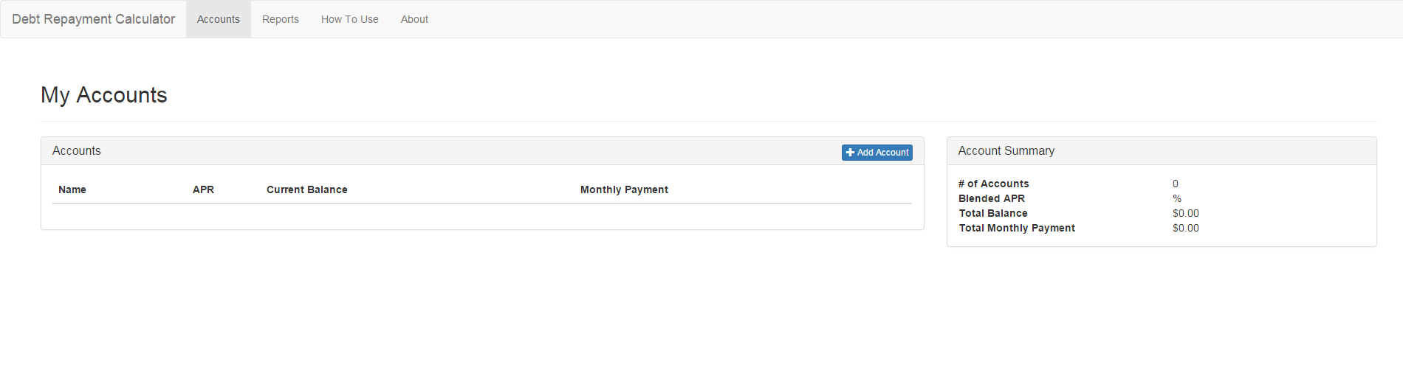
Accounts page
The initial view of the accounts page consists of an empty list of accounts and an account summary, which displays pertinent information about the accounts.

Slide 4
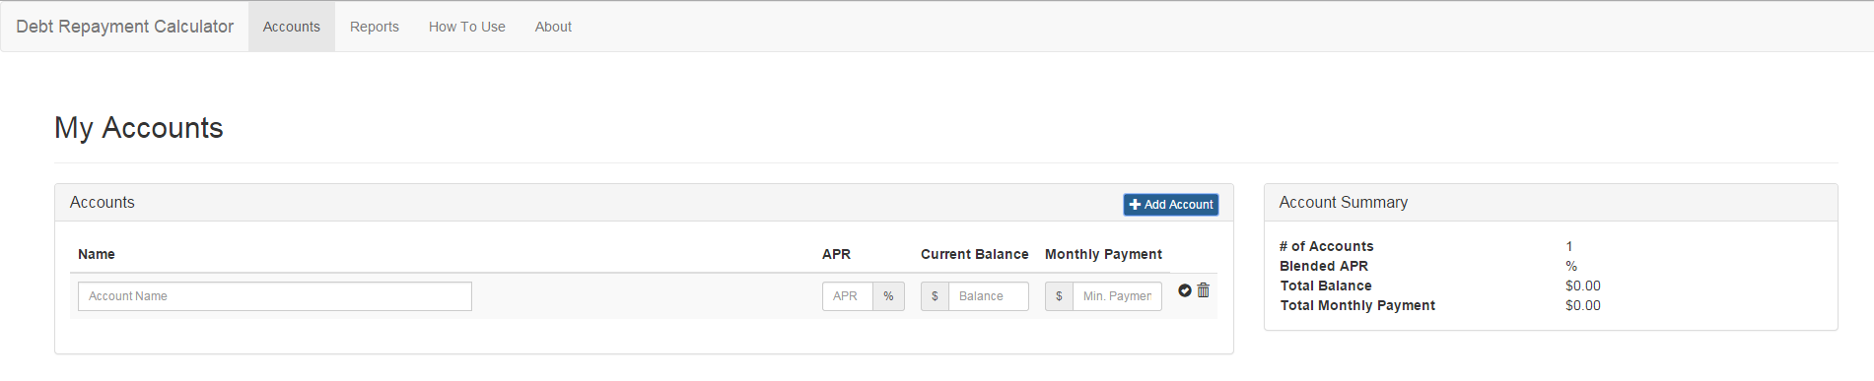
Accounts page – Adding accounts
To add an account, click the blue “Add Account” button. When done, you will be given an entry with four text boxes to fill out: Name, APR, Current Balance, and Monthly Payment.
When all the fields are filled out to your liking, click the check mark to confirm the account.

Slide 5
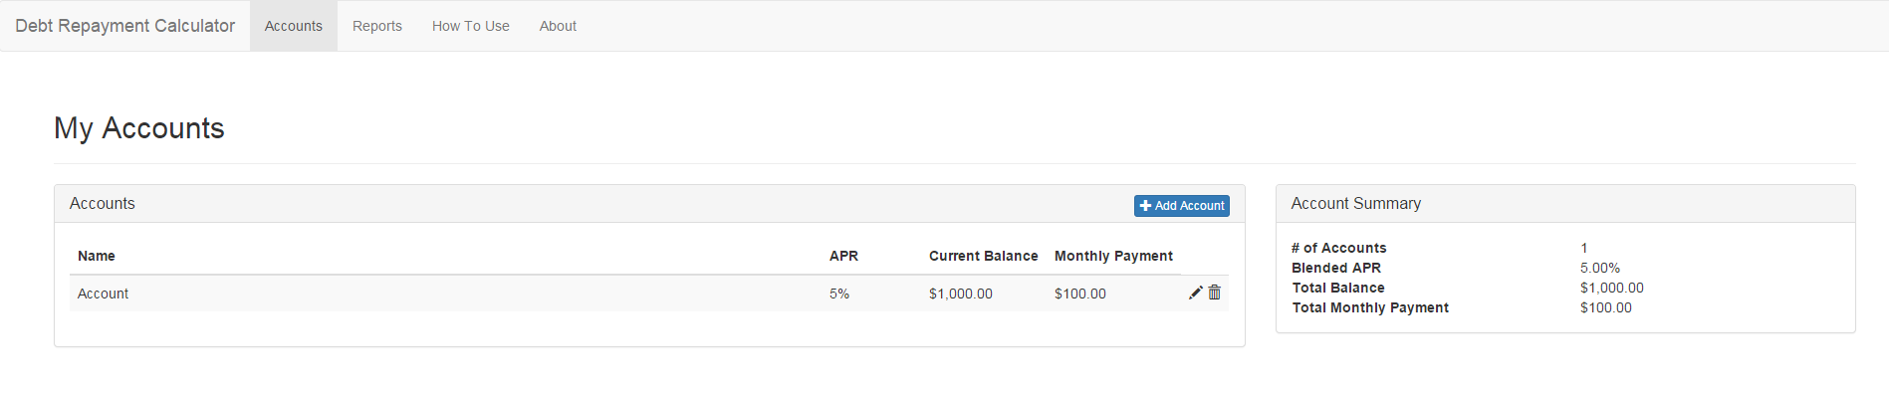
Accounts page – Editing and deleting accounts
To edit an account, click the pencil icon next to the account. When done editing the account, click the check mark again to confirm the account.
To delete an account, click the trash can icon next to the account. This will remove it from the list of accounts.

Slide 6
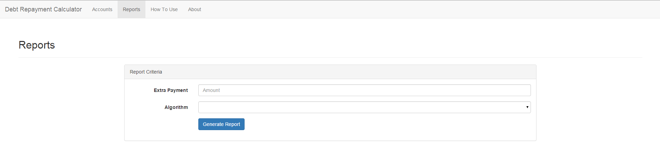
Reports page
The Reports page is made up of all the information relevant to the accounts listed on the previous page. The Initial view of the reports page will consist of two fields to be filled out before generating the report.

Slide 7
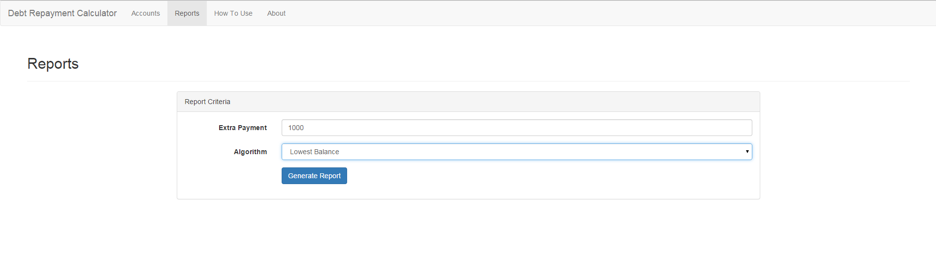
Reports page – Extra payment and algorithm style
The extra payment is the total amount of money to be applied above the accounts' minimum payments on a monthly basis.
The algorithm is how the extra payment is distributed. It can be set to lowest balance, highest interest, or a mix of the two.

Slide 8
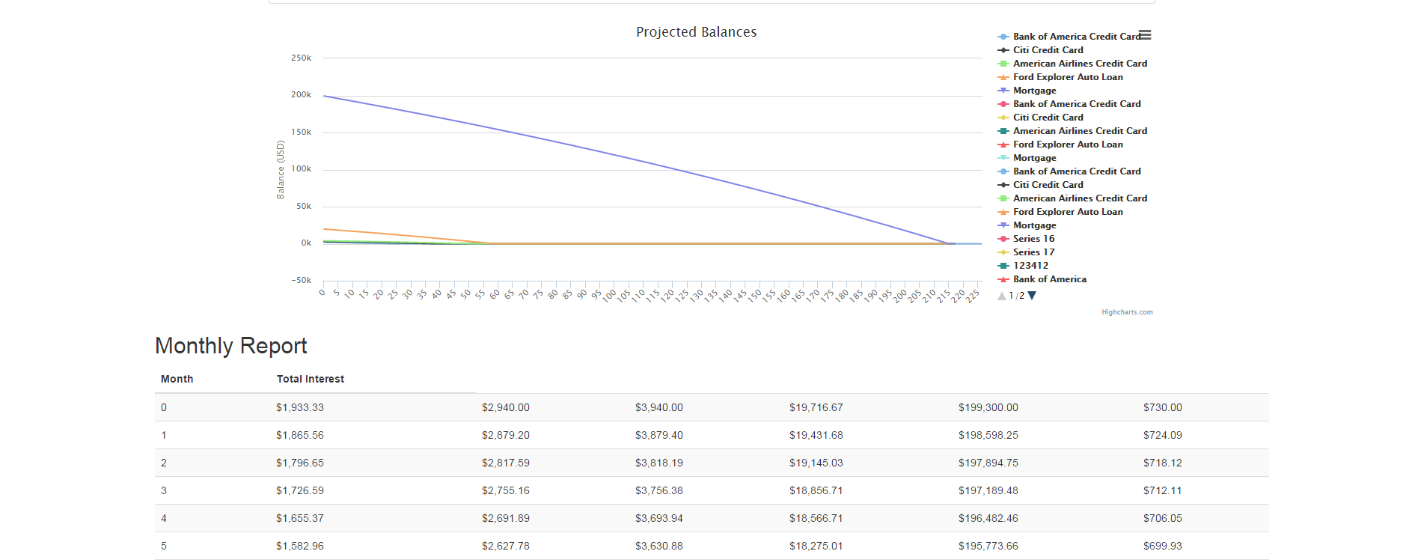
Reports page – Report
The report is made up of two parts, a graph showing the projected balances over a period from start to when all balances are paid off and a month by month table showing the total interest as well as each account’s amount at that month.

