Slide 1
Instructions
The Basics

Slide 2
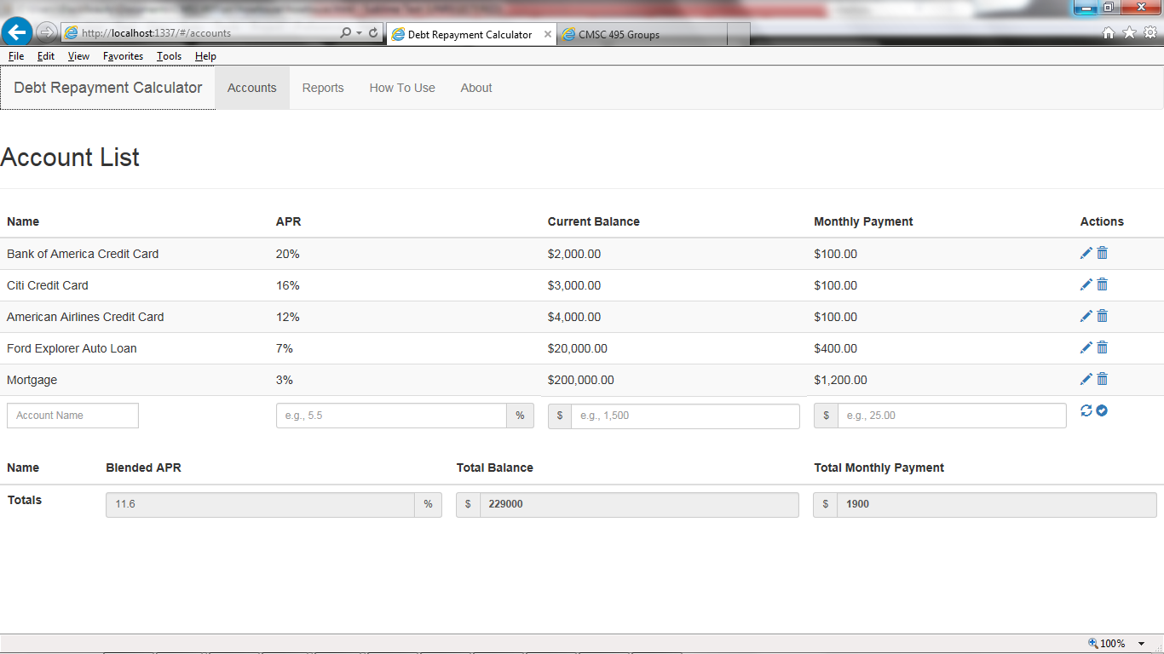
Accounts Overview

Slide 3
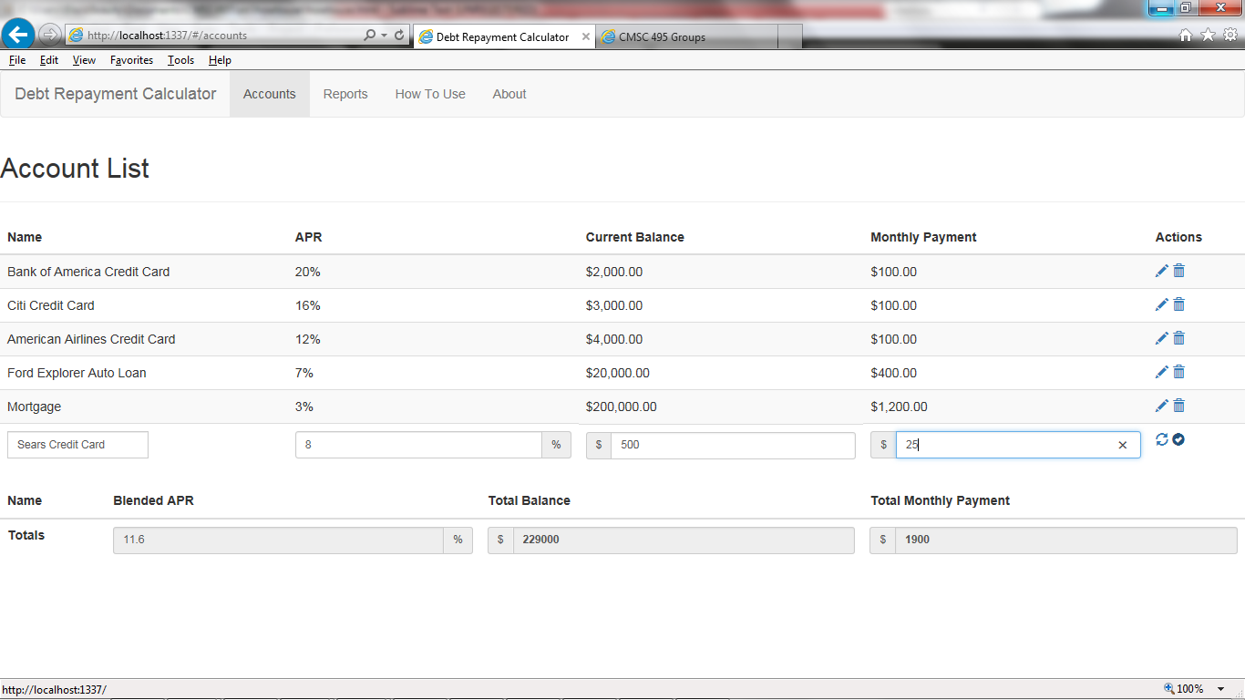
Add New Account

Slide 4
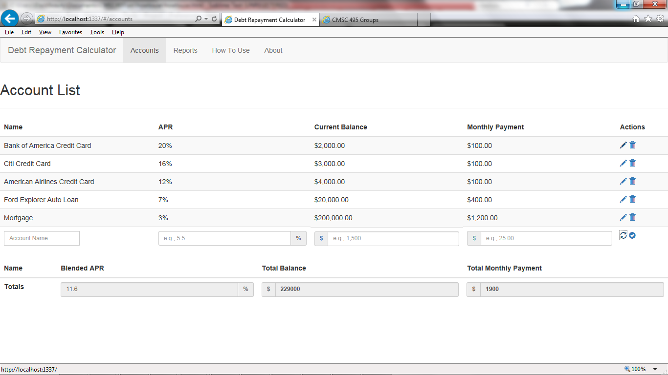

Slide 5
