Slide 1

Hello
CSS – why are we so bad at it?

Slide 2
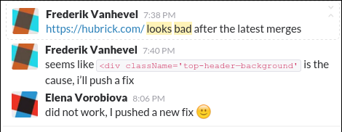
Problems

Slide 3
Why?
CSS is global
Globals are bad

Slide 4
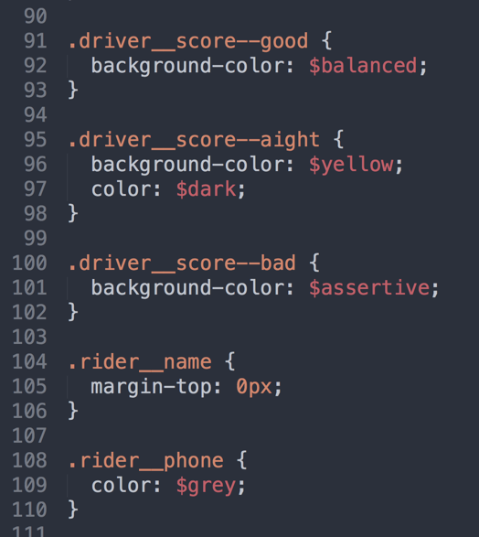
Solution: BEM (Wooh!)
You know what this is:

Slide 5
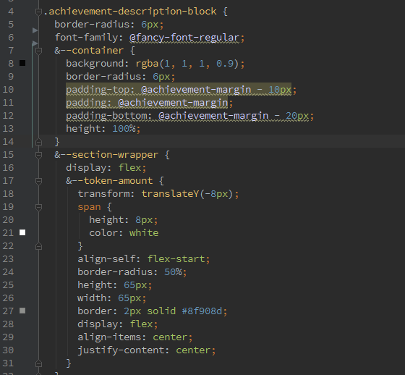
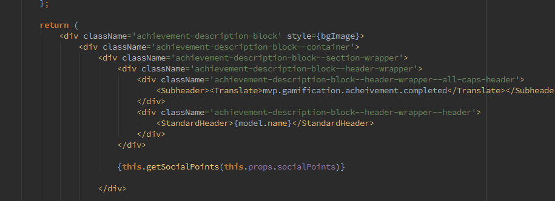
Hubrick-flavoured BEM

Slide 6
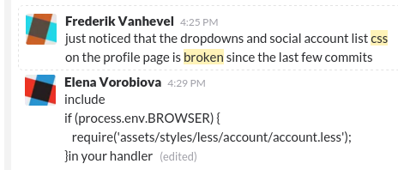

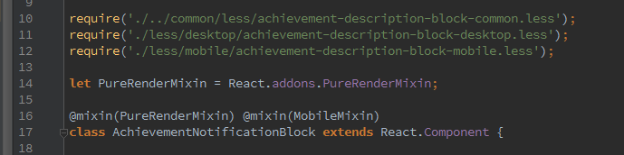
Problems
Side effects

Slide 7
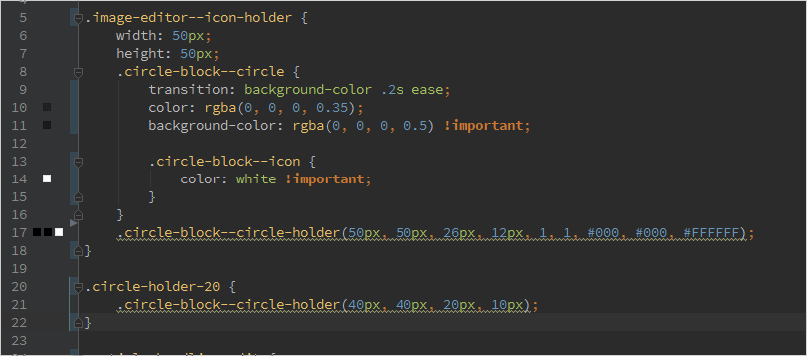
Problems
Components within components
Notes:
Too much specificity

Slide 8
Problems
Silly naming

Slide 9
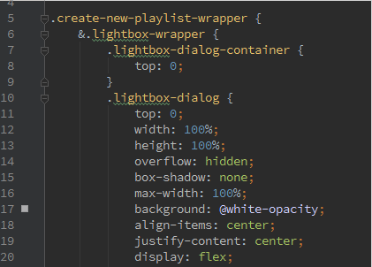
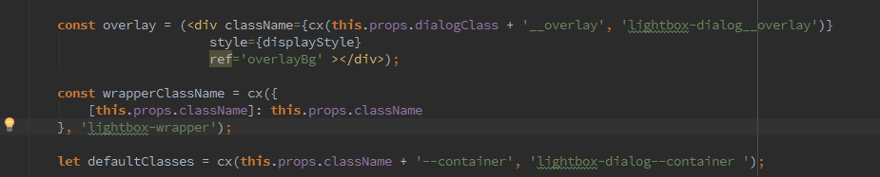
Components within components
Hard to refactor CSS
Notes:
//Case for CSS modules
// documents / vs webapps
// don't have to worry about variable naming, just like in JS
// optimisation style reuse
// reactCSSTransitionGroup
//transitionName

Slide 10
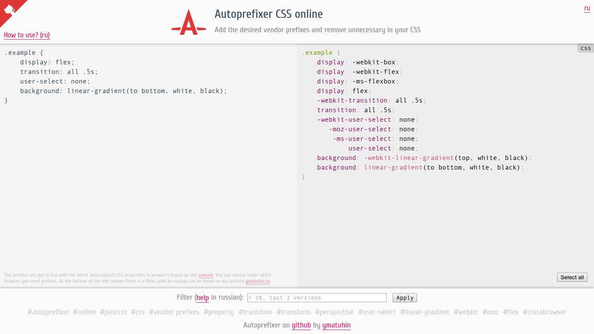

Slide 11

Solution!

Slide 12


