Slide 1
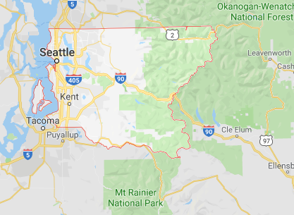
King County Washington
Home Price Evaluation

Slide 2
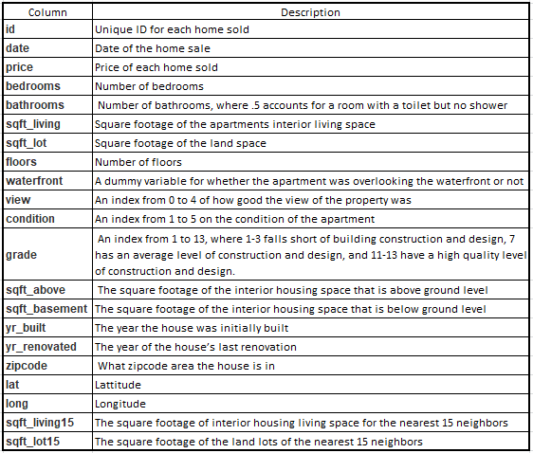
King County Property Dataset

Slide 3
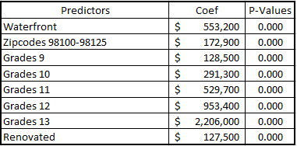
Market Trends
Predictors – variables used to determine affects on home prices.
Coef – amount increase in expected price if these are true
P-Values – statistical acceptance of the Coef

Slide 4
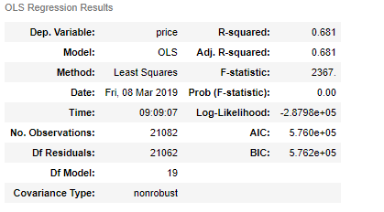
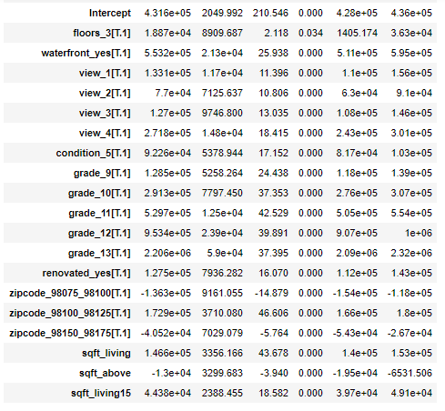
Appendix: Data Analysis

