Slide 1
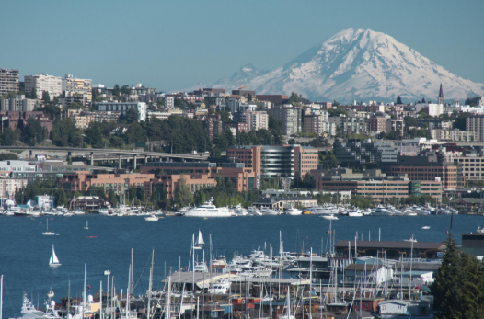
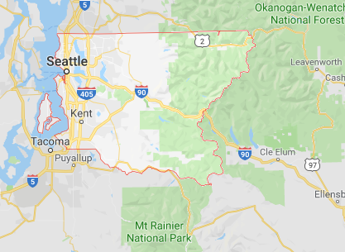

King County Washington
Home Sales Breakdown

Slide 2
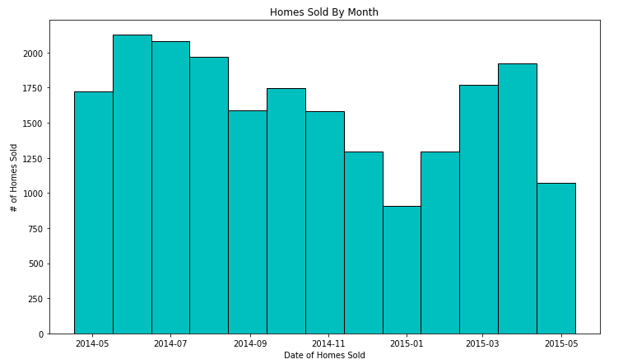
If you are looking to purchase or sell a home in King County, the best time of year is in the months of June and July, when the temperature starts to rise above 70 degrees Fahrenheit. Home sales dip in the winter months, but show an uptick in April.

Slide 3
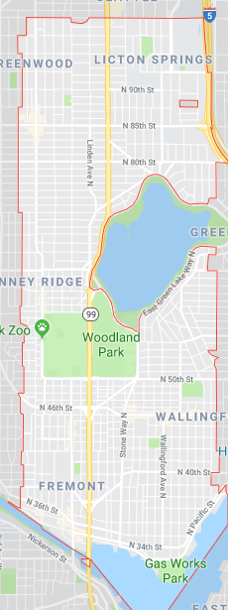
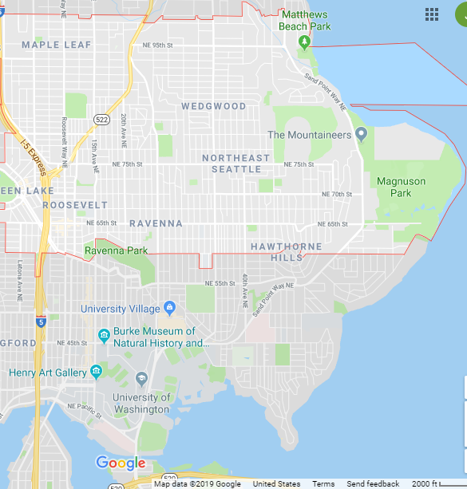
Two of the top three hottest areas for home sales in King County are outlined below. These areas are the neighborhoods located in zip codes 98103 and 98115. By average, a home sold in one of these areas adds $172,900 to the home value.

Slide 4
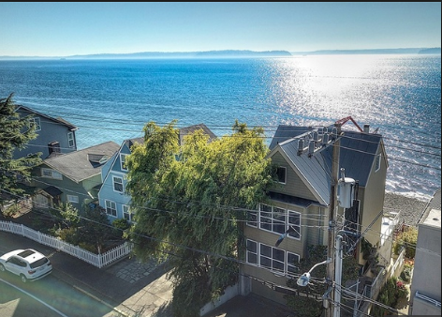
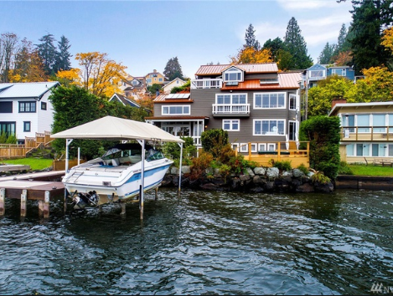
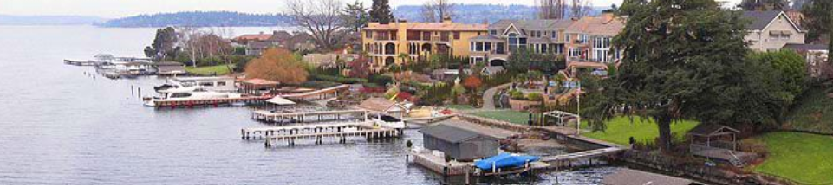
The largest city in King County, Seattle, has a total of 200 miles of freshwater and saltwater shoreline.
On average, having a home on the waterfront can boost the value of your property $553,200.

Slide 5
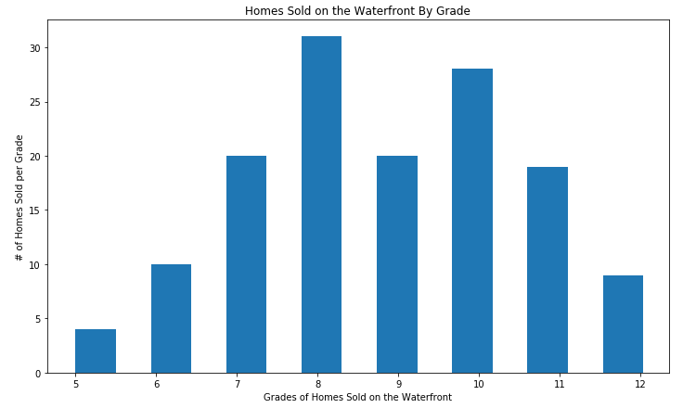
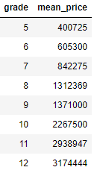
Here is the breakdown of waterfront homes by grade. The grading system devised by King County uses an index of 1-14. The county will grade a property 1-3 if it falls short of building construction and design, an average grade is 7, and a grade of 11-13 shows a high level of building quality and design.
The graph below shows how many waterfront homes were sold between 05/14 – 05/15 by grade. The table to the bottom right shows the average, or mean, price of the waterfront homes by grade. There are a wide range of prices if you are considering purchasing a home on the waterfront.

