Slide 1
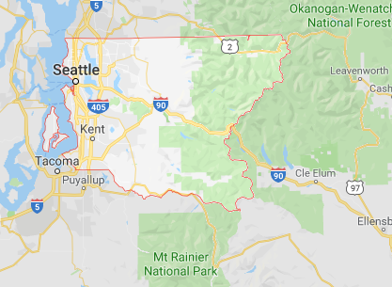
King County Washington
Home Price Evaluation

Slide 2
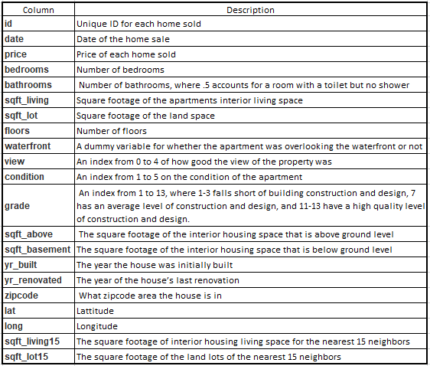
King County Property Dataset

Slide 3
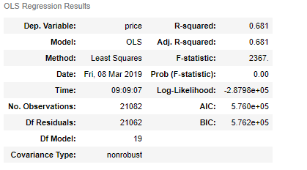
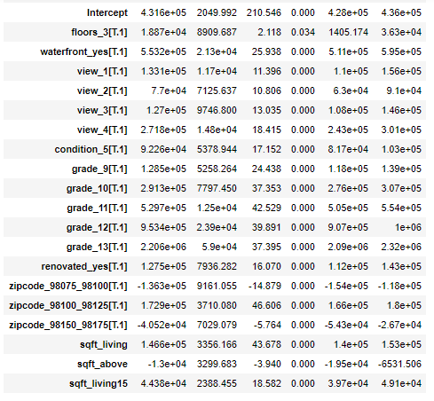
Data Analysis
This is the analysis of the dataset showing the property features that will most accurately affect price.
The model will explain 68% of the variance between price and each feature.
For each

Slide 4
Data Analysis
R-squared = __% variance of the property price affected by ____ feature.
The Intercept: A "unit" increase in TV spending is associated with a 0.0475 "unit" increase in Sales. OR An additional 1,000 spent on TV is associated with an increase in sales of 47.5

Slide 5

Selling Your Home
For every dollar

Slide 6
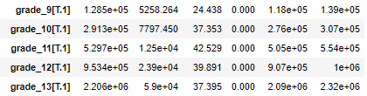
Buying A Home

