Slide 1
Software Carpentry
Joseph Hardin
Computational Scientist, Perennial critic of others code
Notes:
Stock image of cloud formations

Slide 2

What is even the purpose of this talk?
I was asked to come give some advice on how you can improve your code, how you write code, and just general development practices.
Most of this advice broadly falls under the heading of software carpentry.
My goal here is not for you to learn everything (or even much of ) what I have to say here today. There is far too much information to remember at once.
I just want to put together a roadmap for how you can start to improve your skills as a developer, and thus as a scientist.
Hopefully looking back at these slides is helpful!

Slide 3

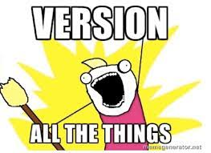
Version control all the things
If you’re not using version control (git) then do that before anything else in this presentation
Seriously, it’s 2021 and there is no excuse not to be using version control
No really, It is that important
If the sad decreasing text size isn’t making you feel guilty and anxious about not using the single most important thing you can use then I guess I’ll have to sell you on its benefits.
But really, if you don’t use git this cute puppy will be depressed.

Slide 4

Version Control: Git
Version control (here: git) is used to
Track changes in code
Back up to historical versions
Merge code with others
Recover from the inevitable dumb mistake
Multiple ways to use it but a common method is git flow (right)
Even if you’re not collaborating with others, trust me when I say git will save your bacon at least once.
It’s standard to use git + github nowadays to share code with other scientists.

Slide 5
Unit/Regression/Functional Tests
How do we ensure the code we write is correct?
Generally we try to implement unit test (also functional and regression tests)
The general idea is you write a test that your code should pass, and when developing you regularly run this set of tests.
In python look up and read the documentation for “pytest”. Other languages: xunit
Similarly when you fix a bug, you write a test to make sure you don’t reintroduce it
Example:bad_math.py

Slide 6
Continuous Integration
How do you ensure others don’t break your tests or you don’t?
Generally we set our repositories up to auto-run all of our tests before any code can be committed
This is generally called continuous integration/Continuous Deployment (CI/CD).
There is a little bit more to it than this, but we don’t want to get into the weeds here
Example: Pydsd Travis CI Integration

Slide 7
Sharpen your tools!
“If I only had an hour to chop down a tree, I would spend the first 45 minutes sharpening my axe.” – Abraham Lincoln.
Don’t waste all your time on it, but sharpen the tools you use everyday:
Editors
Shell
Developing skill with these tools speeds up every othr aspect of your work.

Slide 8
Integrated Development Environment
You can speed up development by using better tools, and learning to use these well.
If using vim/emacs learn to use the built in commands
Ie. “:%s/^\(Martin\)/Mr \1 Wicks/g”
When editing larger codebases, it can be worth it to switch to a proper IDE.
On the light side this can be something like vscode.
It can be worth it to truly learn tools like pycharm however (for python) or the equivalent for your language.
Makes it easier to refactor, debug, visualize, etc.
The better understanding an IDE gives can make it faster to code and find bugs.
Especially for large projects

Slide 9
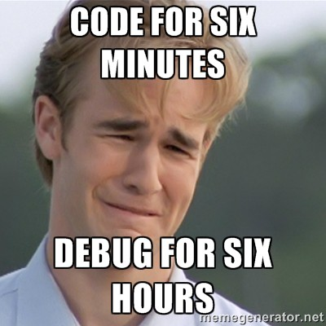
Debuggers
Many of us find bugs through “debugging by printf”
Which is to say randomly printing out values where we think errors are.
There is a much better way!

Slide 10
Debuggers
Many of us find bugs through “debugging by printf”
Which is to say randomly printing out values where we think errors are.
There is a much better way (In almost every language)!
Debuggers allow you to step through code as it runs, evaluate expressions, print values, and stop at specific conditions.
Example, pdb
Notes:
Python: https://hasil-sharma.github.io/2017-05-13-python-ipdb/, C: https://www.cs.cmu.edu/~gilpin/tutorial/, R: https://adv-r.hadley.nz/debugging.html, fortran: https://undo.io/resources/debugging-fortran-code-gdb/

Slide 11
n[ext] : n simply continues program execution to the next line in the current method
s[tep] : s steps to the very next line of executable code, whether it is inside a called method or just on the next line
w[here] : w prints a stack trace, with the most recent frame at the bottom. An arrow indicates the “current frame”, which determines the context of most commonds.
b[reak] ([filename:]lineno|function) : b ddds breakpoints to the specified locations. Example usage:
b sample-filename.py:<line no>
b <function>
b <lineno> (for the current file)
c[ontinue] : c continues program execution until another breakpoint is hit or the program execution completes
a[rgs] : a prints out all the arguments the current function received
r[eturn] : r continues execution until the current function returns

Slide 12
Refactoring
Refactoring: Restructuring existing code without changing its external behavior
Essentially rewriting code to make it cleaner, better, easier to work with, etc.
We all do this but again, there are better tools and an entire body of knowledge on it.
Two good places to start with refactoring:
Standard refactorings
Design patterns
Why do these matter? IDEs tend to implement these techniques for you.
Really helpful if you have unit tests before this.

Slide 13
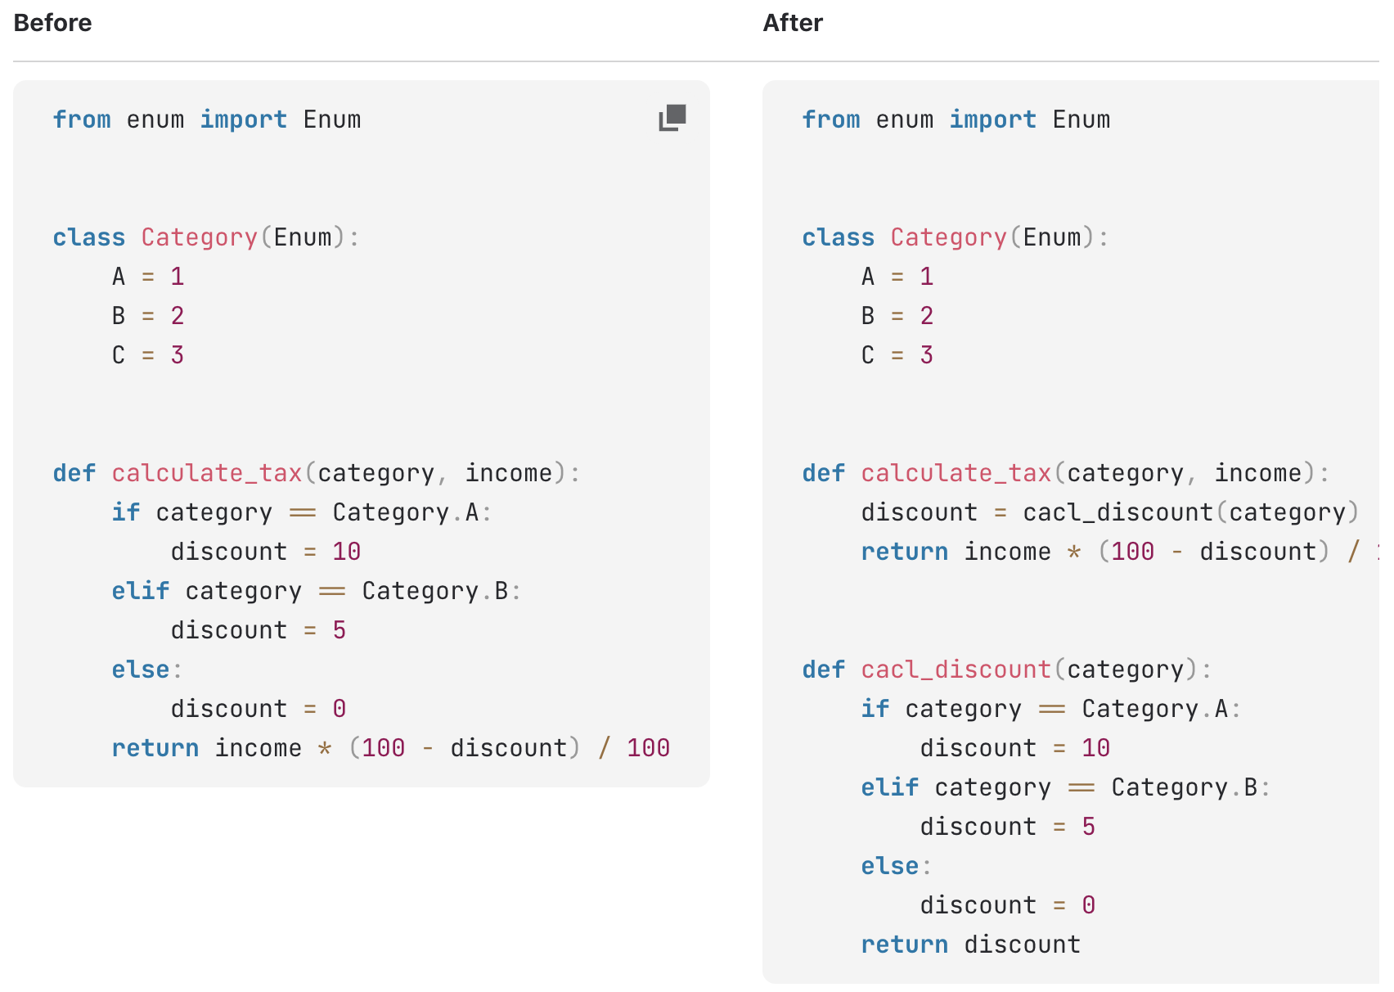
Example: Extract Function
Notes:
https://martinfowler.com/books/refactoring.html, https://refactoring.com/catalog/, https://www.jetbrains.com/help/pycharm/refactoring-source-code.html

Slide 14
Design Patterns
Mostly based around object oriented programming
Standard techniques for accomplishing a task with pros/cons known already.
These end up with names like strategy, observer, factory, etc
Also because these are well known, it makes it easier to communicate with other developers.
Also be careful about overuse. It can be a bit tempting to over design pattern everything (see late 90’s java)
Notes:
https://medium.com/educative/the-7-most-important-software-design-patterns-d60e546afb0e, https://www.amazon.com/Design-Patterns-Elements-Reusable-Object-Oriented/dp/0201633612

Slide 15

Docker
Does your code need a particular environment?
Tired of setting that environment up on other machines?
Docker allows you to ship an entire virtualized machine so that everyone is running exact same environment.
It is light weight compared to a full VM though so you can run many of these.
Use cases:
Isolation, container apps, ship dependencies with app, legacy software, cloud, HPC, swarms(kubernetes)
Composites of other containers, interactions between containers
!Example: docker hello world
Notes:
https://www.docker.com/use-cases
See also the amazing and utterly PITA kubernetes

Slide 16
Vagrant
Vagrant is like docker, but for setting up a full heavy weight VM
Most commonly used for setting up developer VMs
A lot more limitations, but allows for more comprehensive boxes.

Slide 17
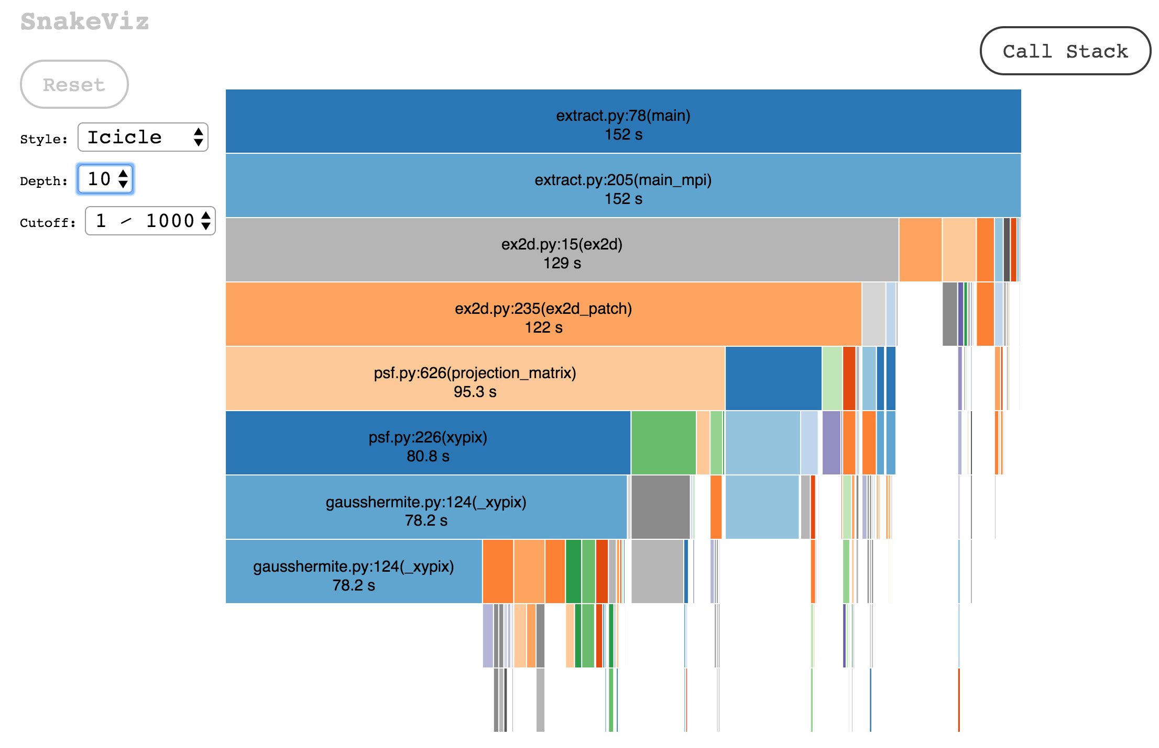
Profiling
Why is your code so slow?
How do you figure it out?
Generally we run the code, and figure out how long each line took.
This is called profiling
Most languages have profiling tools
Allows you to decide where bottlenecks in code are before you prematurely optimize
Simplest version can be timing functions (%%timeit in jupyter for instance)
More complex is line by line and function by function timings.
!Example: snakeviz profile.txt
Notes:
snakeviz

Slide 18
Documentation: Sphinx
Learn to use an appropriate documentation engine
Readmes are great, but being able to generate function signatures is crucial
Each language has their own recommended documentation engine:
Python: Sphinx, C: sphinx/doxygen, java:javadoc, etc.
These can read your code, combined with the comments and extra resources and generate rich documentation that stays up to date with your code.
Ideally automate this so you’re not running it by hand.
Example: http://josephhardinee.github.io/PyDSD/

Slide 19
Linting/Autoformatting
For sanity sake, use a linter and auto-formatter.
These look at your code and detect early errors
And autoformatters do what they say, they enforce code style automatically.
For Python I prefer black
“You can have it any color you want, as long as its black”

Slide 20
Sharing Code
So how do you let someone demo your code as fast as possible?
There are a few options:
Make it installable and easy to use (PyPI or conda-forge for instance)
Release it inside a docker container
Host it in AWS/GCP
Jupyter Notebooks on mybinder (Create a docker repo and run it in the cloud)
AWS Lambda
Shifter (docker for NERSC)

Slide 21
Books:
Books are still a great resource. I recommend the following:
Pragmatic Programmer
Code 2
Code Complete
Clean Code
The mythical man month
Working effectively with legacy code
Refactoring (fowler)
Head first design patterns
Python testing with pytest

Slide 22
Online Resources
Software Carpentry (https://software-carpentry.org/lessons/)
Leetcode (Test your actual programming skills, learn new structures/algorithms)
Stackoverflow (Let’s be honest, most of us couldn’t code without this)

Slide 23
Did we really make it this far in time?
Overall advice:
USE GIT
Learn the tools that are standard for developers
Implement testing and automation where you can
USE version control
Spend some time improving your toolbox, but not all of your time.
There is a balance between being more effective at working, and actually getting work done.
If you find yourself doing something laborious, ask yourself if there is a better way.
Better yet ask someone else
USE GIT
Spend some time at the beginning of projects thinking through how you’d set things up right.
Don’t be afraid to build a proof of concept and throw it away to understand the space better.
USE GIT

