Slide 1
Git and Github
A Very short primer for the CMDV team.

Slide 2
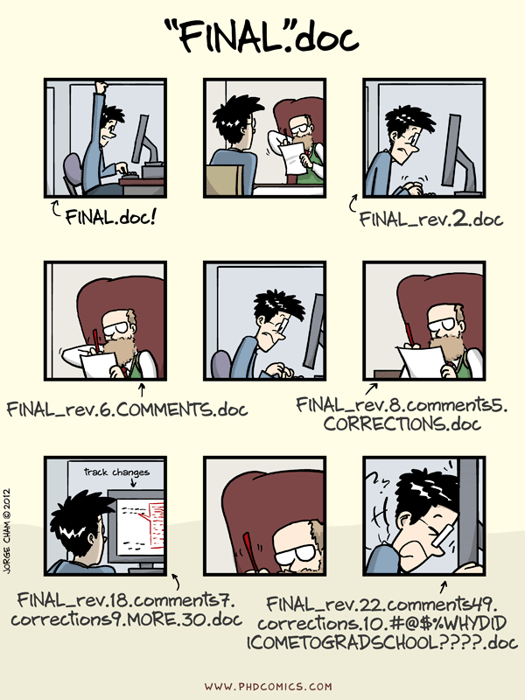
What is git?

Slide 3
Git
Git is a distributed version control system.
Think CVS, RCS, or SVN without a central server.
It’s a way of tracking changes (commits) to a document, whether that document be a latex file, a code file, or any other text file.
If two people change the same file (and there are no conflicts between their changes), git can apply both changes together (merging)
You can track code changes through time, and backup to old versions
You can also have multiple simultaneous versions going at one time (Branches) and automate merging of these
Code is stored in repositories. One repository might be a set of code for processing disdrometer data, while another may be a set of model analysis and visualization routines.

Slide 4
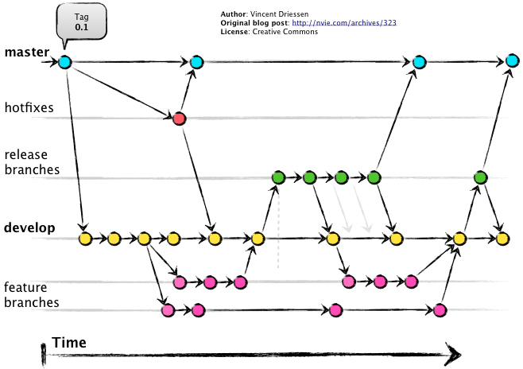
An example of a complex git workflow.

Slide 5
What does this mean for CMDV?
We will use git as our official version control system for code.
Not data.
We felt it was necessary to have a brief primer on git.
This will not be enough to teach you everything. Merely an introduction. Normally an introduction is ~3 hours.
The goal is to give you the “flavor” of git.
See references at end
Git is a software program
We will use Github as our central server.

Slide 6
Github
Github is a website that hosts git repositories.
Kai will present more on this later.

Slide 7
Let’s get started – Initializing a repository
Let’s create a hypothetical project that tells us hello world
First we initialize a repository in our project directory
“mkdir cmdv_hello ; cd cmdv_hello”
“git init .”
Git stores everything in a hidden directory .git

Slide 8
Adding files
Let’s create a file to track
“touch test.py; vim test.py”
Insert into this file “print(‘Hello World’)”
Now let’s look at the status of our repository
“git status”
We see we have one untracked file.
Let’s add this file to be tracked.
“git add test.py”
Let’s check status again
“git status”

Slide 9
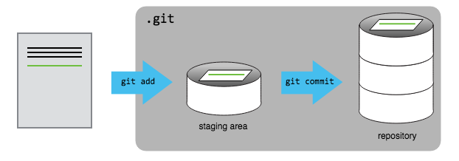
What did we just do?
Git has three “areas” for files.
The first is the working directory. These are the files in the directory being tracked.
The second is staging. These files have had a changeset “staged” for checking in.
The third is committed. These are changes that have now been added for the repository.
“git add” stages a file
(https://swcarpentry.github.io/git-novice/)

Slide 10
Git commit
We want to check this change into the repository.
“git commit”
Add a commit message then save and exit
“git status” now shows nothing to commit
Let’s repeat this process with a second file, and also modify the first.
“git status” shows one change not staged, and one untracked.
Let’s stage and commit both

Slide 11
Git log and git checkout
“git log” shows you the commit history
Each commit shows a commit has(Long string of letters and numbers)
Let’s go back to our first commit.
“git checkout b9ecda804 test.py”
Nope we like the newer version better
“git checkout – test.py”

Slide 12
Git ignore
Sometimes we don’t want certain files in git (Think .swp files, or compiled object files)
You can enter wildcards into .gitignore. Let’s ignore .pyc files here.
“vim .gitignore”

Slide 13
Git branch
What if we want two parallel versions of code?
Maybe to test out a weird idea, or apply a bugfix
We create a branch. Think of it as an alternate history.
“git checkout –b a_weird_change”
Now we can work on the repository without affecting “master”
When we’re ready, we merge it back over into master.
“git checkout master; git merge a_weird_change”

Slide 14
How about branches on another computer?
We can pull code between our version of a repository and someone elses.
We will use Github as a go-between for this.
“git clone” – Copy a repository to your computer
“git pull” – Pull a new version of a remote repository to your computer
“git push” – Push a new version of your repository to a remote
Terminology: Pull request. On github you can request someone pulls your changes into their projects. Better etiquette than just doing it yourself on shared projects.

Slide 15
Merge Conflicts
When merging, if two people change the same line you can get a merge conflcit.
Work through the software carpentry material to cover this, we won’t have time here.
https://help.github.com/articles/resolving-a-merge-conflict-from-the-command-line/

Slide 16
GUI clients
The commandline is more powerful but…
GUI’s might be easier.
If your OS is Mac or Windows
Sourcetree (https://www.sourcetreeapp.com/ )
If your OS is Linux
Smartgit, tig, gitk, gitcola, take your choice
If your OS is emacs :
Magit

Slide 17
A few other neat git tricks
Git is very powerful. Spend some time looking up the following commands.
Git diff (Create difference sets between two revisions)
Git blame (See who wrote a particular line of code)
Git bisect (Automate finding of bugs)
Git help (help)
Git stash (temporarily store changes)
Git rebase (Rewrite history)

Slide 18
Resources
Software Carpentry – Version Control with Git
https://swcarpentry.github.io/git-novice/
Git cheat sheet
https://www.git-tower.com/blog/git-cheat-sheet/
Installing git:
https://git-scm.com/downloads
Master Resource List:
https://help.github.com/articles/good-resources-for-learning-git-and-github/
Interactive tutorial (highly recommended)
https://try.github.io/levels/1/challenges/1

