Slide 1




HW3 · AI ASSISTED DEVELOPMENT OF PRODUCTS AND SERVICES
Gmail
10 test items
Third-Party Data Dashboard
GitHub
10 test items
Claude Code + MCP: download test data from four services and search it all in one local website
Notion
10 test items
Supabase
10 test items
Joseph Benzaquen
Prof. Rosenthal · Yeshiva University · Fall 2026
Notes:
HW3 for AI Assisted Development of Products and Services (Prof. Rosenthal). I connected Claude Code to Gmail, GitHub, Notion and Supabase through MCP servers, downloaded the test data into local files with a reusable skill, and built a local dashboard that searches all four at once. Everything is fake test data for an invented motorcycle dealership. Repo: github.com/josephhomeworksai-hash/third-party-dashboard

Slide 2





From four cloud services to one local search
OVERVIEW
1. Test data
2. MCP servers
3. Export skill
4. dataExports/
5. Dashboard
10 fake items in each service
Claude Code connects to all four
export-services repeats the download
One folder per service, with metadata
One search box over every file
4
40
1
0
services connected
test items exported
reusable Claude Code skill
secrets in the public repo
Notes:
The pipeline: I filled each service with 10 fake items, connected Claude Code to all four through MCP servers, wrote the export-services skill that downloads everything into dataExports/, and built a local dashboard that searches those files. 4 services, 40 items, 1 skill, and no secrets in the public repo.

Slide 3




One fake dealership, same customers everywhere
TEST ACCOUNTS AND DATA
“Dealership-test” is an invented motorcycle dealership in Caracas (brands Forza, Vento, HJM). Every account is a new test account, never a personal or school one, because the repo is public.
Gmail josephhomeworksai@gmail.com
10 customer emails: prices, financing, stock, trade-ins
GitHub josephhomeworksai-hash
The same 10 fake customers appear in all four services, so one search for a name finds them everywhere:
10 issues in repo dealership-test-tasks (daily to-dos)
Carlos Test
Maria Prueba
Notion Notion test workspace
Jose Ejemplo
Ana Demo
10 lead follow-up pages in the “Dealership Test” database
Luis Falso
Sofia Muestra
Pedro Ficticio
Laura Inventada
Supabase Project “Dealership-test”
10 rows in table clients_sales (client + motorcycle)
Diego Simulado
Valeria Imaginaria
Notes:
All four accounts are new test accounts. The data is a fake motorcycle dealership. The key design choice: the same 10 fake customer names appear in every service, so a single search such as 'Maria Prueba' returns one result from each service. The test data was created in a separate Claude Code conversation, then /clear before downloading.

Slide 4
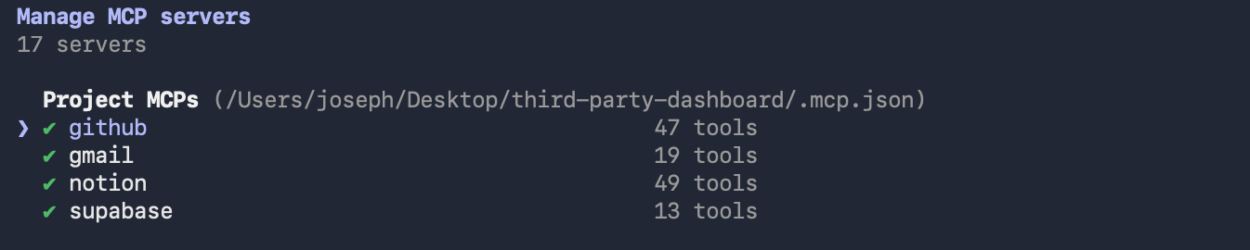
Claude Code connected to all four services
MCP SERVERS
Official GitHub server
Personal access token (env variable)
Official
Claude Code /mcp: all four project servers show connected (from .mcp.json)
Official Notion server
OAuth in the browser
Official
.mcp.json (excerpt, no secrets)
"github": api.githubcopilot.com/mcp/
Bearer ${GITHUB_PERSONAL_ACCESS_TOKEN}
"notion": mcp.notion.com/mcp
"supabase": mcp.supabase.com/mcp
?project_ref=...&read_only=true
"gmail": claude.ai Gmail connector
(account-level, not in .mcp.json)
Official Supabase server
OAuth, read-only mode
Official
Anthropic's official Gmail connector
OAuth (claude.ai Settings → Connectors)
Official
Notes:
The four MCP servers are defined in .mcp.json. GitHub, Notion and Supabase use the vendors' official servers. Supabase runs with read_only=true so the export cannot change data. Tokens and passwords never go in the file: .mcp.json only has ${...} placeholders that Claude Code fills from environment variables. Gmail uses the community server gmail-mcp-imap with an app password, because Google's official Gmail MCP server needs a Google Cloud project, the Gmail API and an OAuth client (see Challenges).

Slide 5
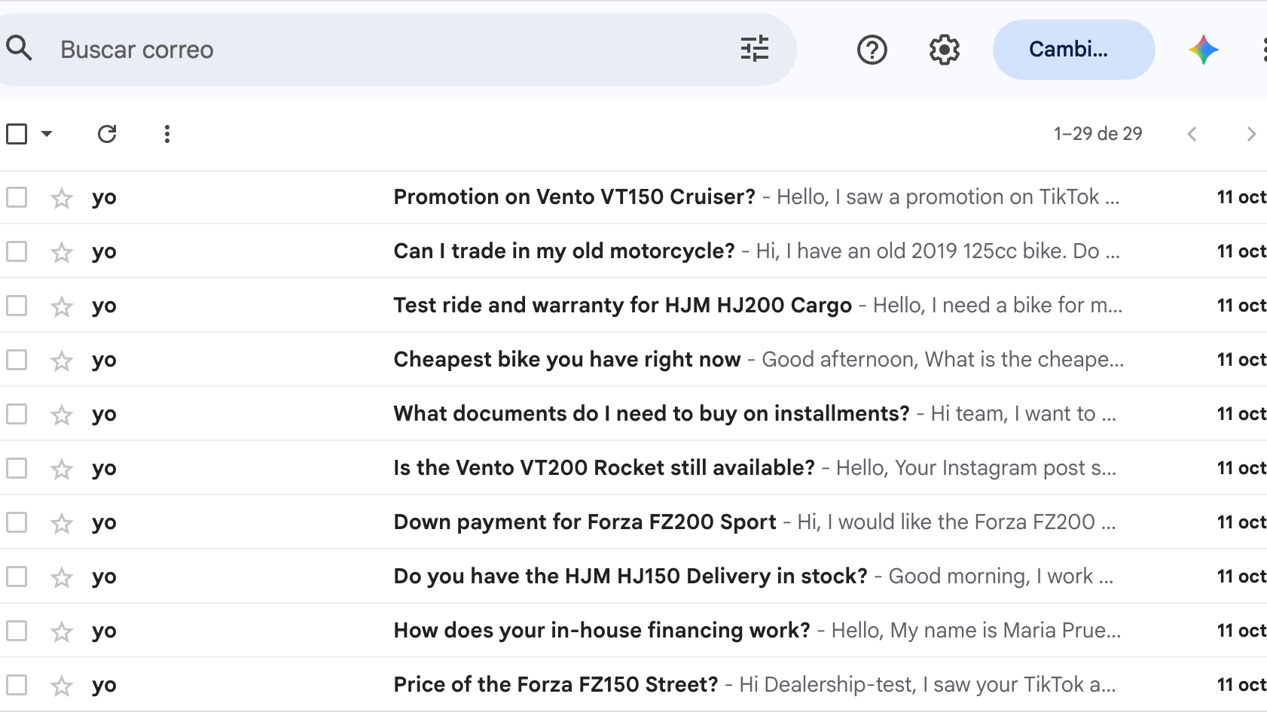
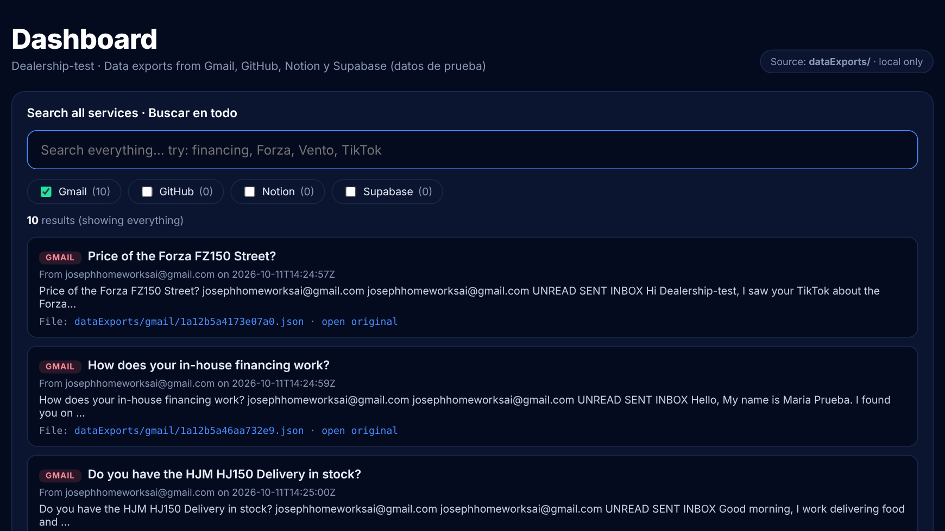
Gmail: original data vs. dashboard
SERVICE 1 OF 4
ORIGINAL Gmail test inbox
IN THE DASHBOARD Dashboard, only Gmail selected (10 results)
10 fake customer emails about prices, financing, stock and trade-ins
Connected with Anthropic's official claude.ai Gmail connector, signing in with OAuth
Each email saved as a JSON file with from, to, date, subject and labels
Notes:
Gmail: on the left, the test inbox; on the right, the same 10 emails in the dashboard with only Gmail selected. Each email is one JSON file named by its message id, with from, to, cc, subject, date, labels, snippet, body and viewUrl.

Slide 6
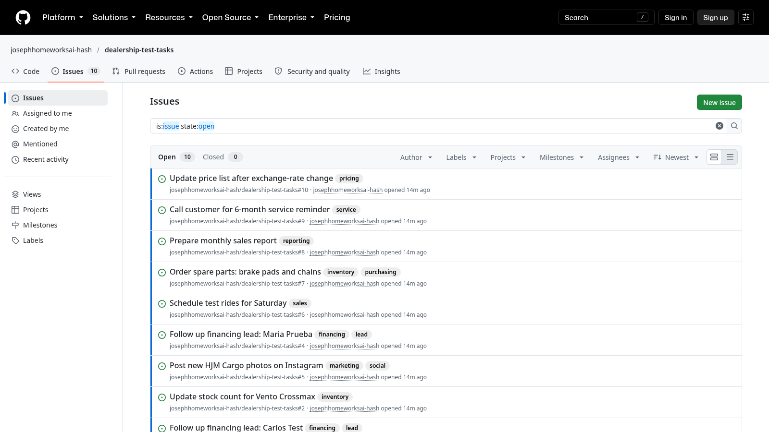
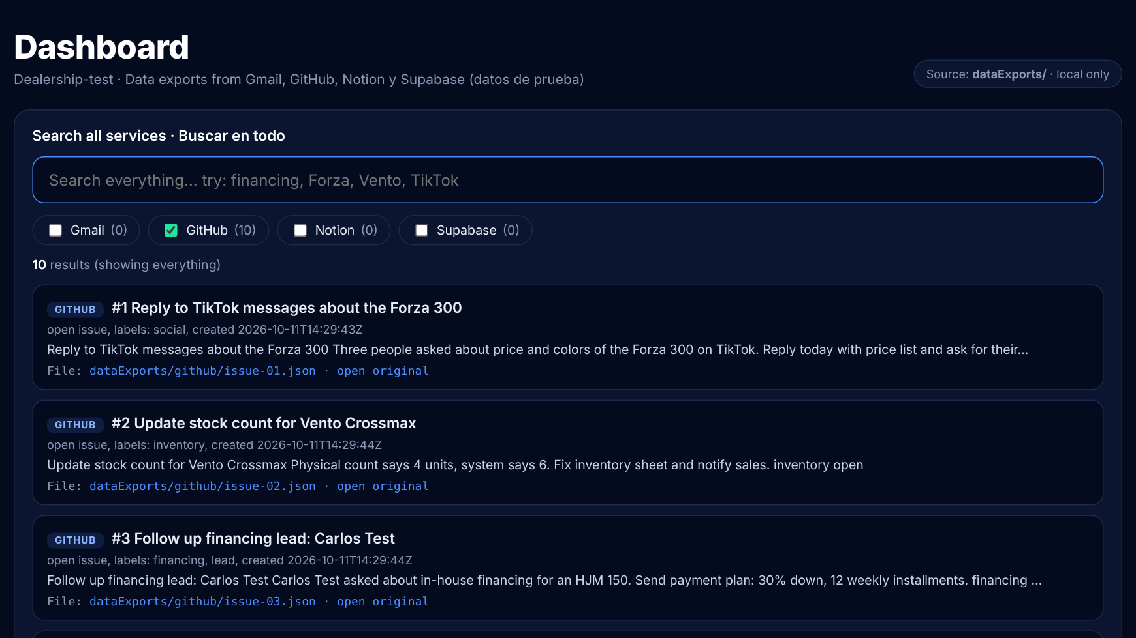
GitHub: original data vs. dashboard
SERVICE 2 OF 4
ORIGINAL Issues in repo dealership-test-tasks
IN THE DASHBOARD Dashboard, only GitHub selected (10 results)
10 issues with daily dealership tasks and labels
Connected with GitHub's official MCP server and a personal access token
Each issue saved as a JSON file with title, state, labels, author and dates
Notes:
GitHub: the test repo dealership-test-tasks has 10 open issues. Each one is saved as issue-NN.json with number, title, state, labels, assignees, author, created and updated dates, url, comment count and body.

Slide 7
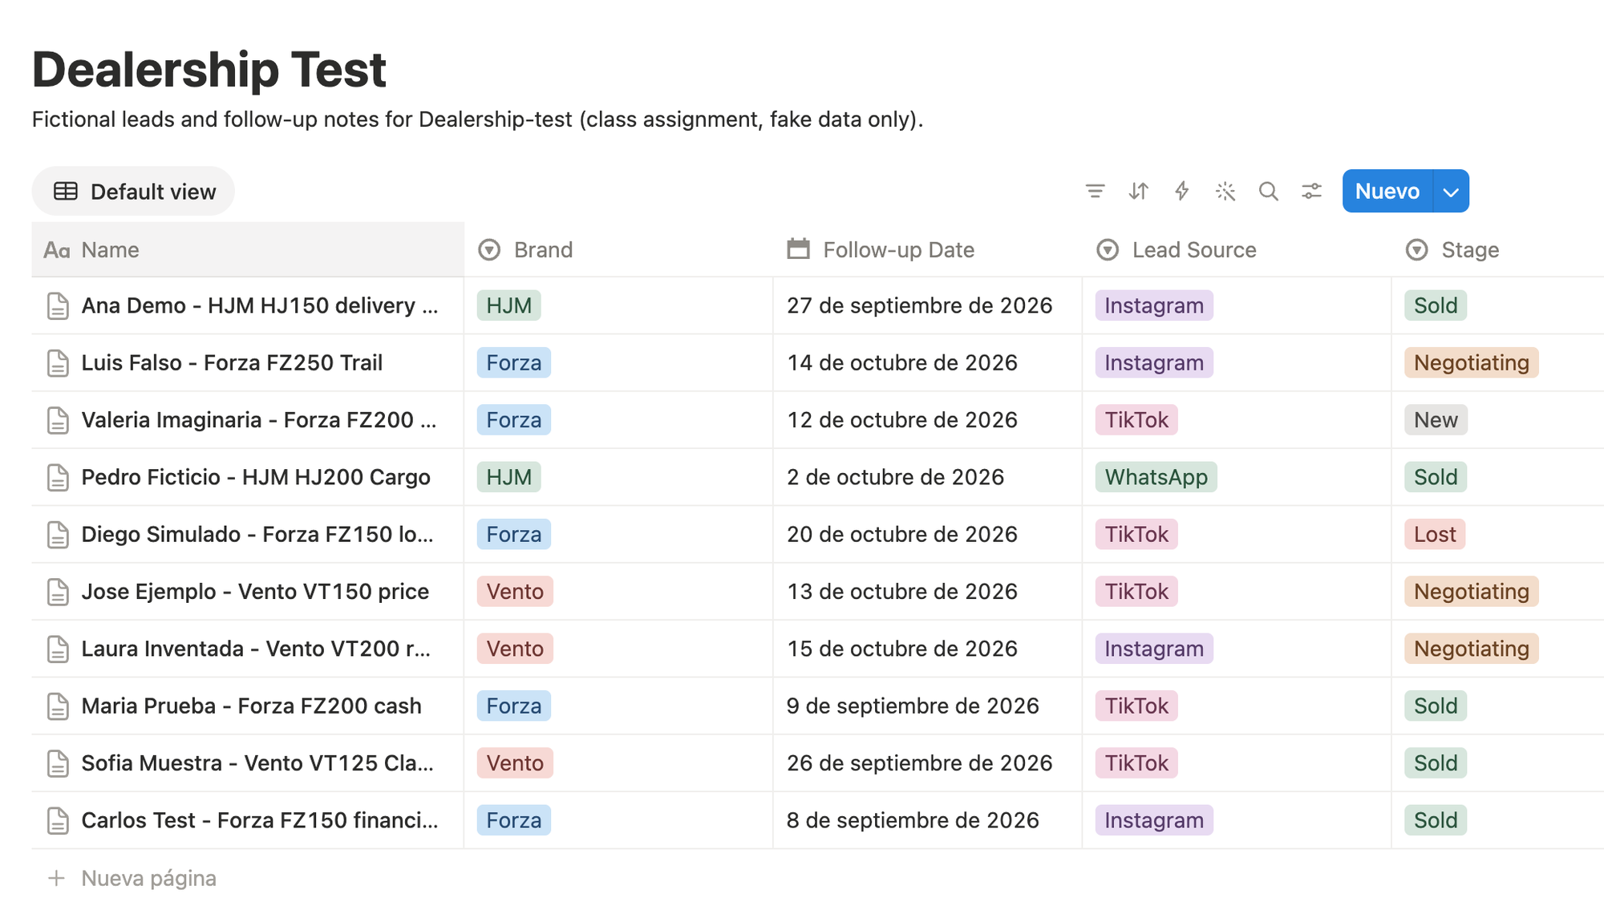
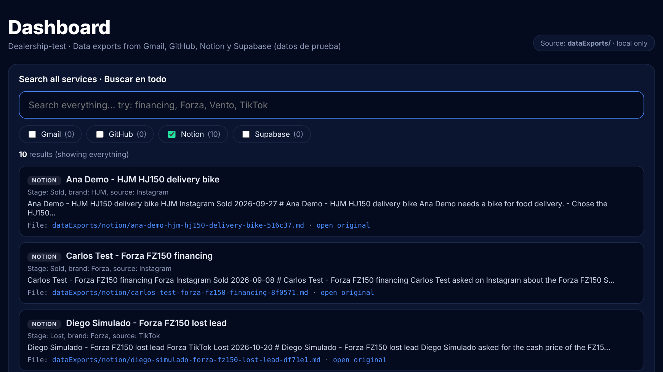
Notion: original data vs. dashboard
SERVICE 3 OF 4
ORIGINAL “Dealership Test” database
IN THE DASHBOARD Dashboard, only Notion selected (10 results)
10 lead follow-up pages: brand, lead source, stage, follow-up date
Connected with Notion's official MCP server, signing in with OAuth
Each page saved as Markdown, with its metadata in a YAML header
Notes:
Notion: the Dealership Test database has 10 lead follow-up pages. Each page is saved as Markdown with a YAML front matter block: page id, url, title, database, created and edited times and the four database properties.

Slide 8
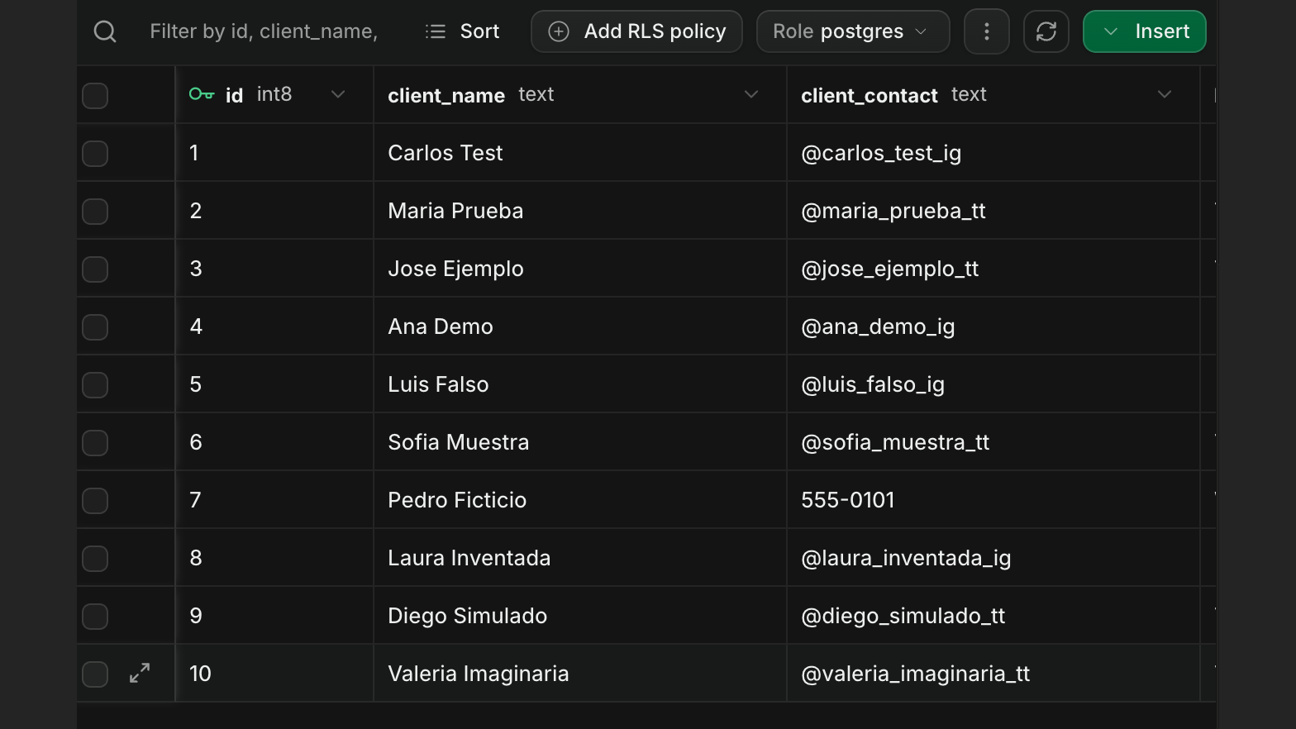
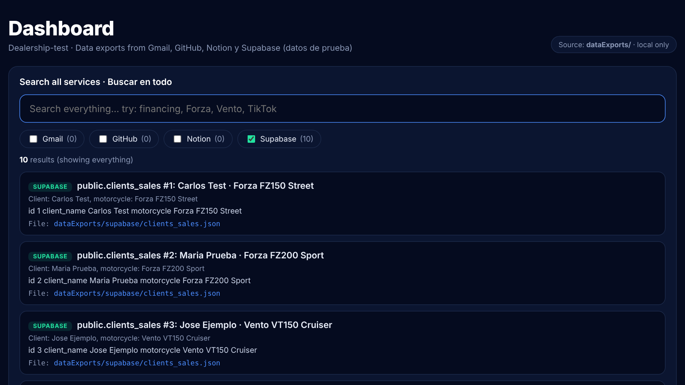
Supabase: original data vs. dashboard
SERVICE 4 OF 4
ORIGINAL Table Editor: clients_sales, 10 rows
IN THE DASHBOARD Dashboard, only Supabase selected (10 results)
10 rows: id, client name and motorcycle (joined from the catalog)
Connected with Supabase's official MCP server via OAuth, in read-only mode
The table saved as JSON and CSV, plus schema.json with the column types
Notes:
Supabase: the export joins clients_sales with the motorcycles catalog into one table of 10 rows (id, client_name, motorcycle). It is saved as JSON (with project, table, row count and export date) and CSV (opens in Excel), plus schema.json with column types.

Slide 9
Each service gets the format that fits its data
LOCAL STORAGE FORMATS
Service | Format | File | Why this format
Gmail | JSON | one file per email | Short fields plus one long body; lists stay lists (to, labels)
GitHub | JSON | one file per issue | The GitHub API already speaks JSON, so nothing is lost
Notion | Markdown + YAML | one file per page | Pages are mostly text; the YAML header keeps the metadata
Supabase | JSON + CSV + schema | one table (10 rows) | CSV opens in Excel; JSON adds project, table, row count and date
Rules for every service: data lives in dataExports/<service>/, each item is its own file with a unique name, and every file keeps its metadata plus a source field. Full details and reasons are in localStorageFormats.md.
Notes:
Formats are explained in localStorageFormats.md. Gmail and GitHub are records with a few short fields and one long text, so JSON. Notion pages are mostly text, so Markdown with YAML front matter, a common convention that editors like Obsidian understand. Supabase is a table, so CSV for spreadsheets and JSON for the table-level metadata, plus schema.json with the column types.

Slide 10
What a saved file looks like
LOCAL STORAGE FORMATS
dataExports/gmail/1a12b5a46aa732e9.json
dataExports/notion/maria-prueba-forza-fz200-cash-7693d9.md
{
"id": "1a12b5a46aa732e9",
"from": "josephhomeworksai@gmail.com",
"to": ["josephhomeworksai@gmail.com"],
"cc": [],
"subject": "How does your in-house
financing work?",
"date": "2026-10-11T14:24:59Z",
"labels": ["UNREAD", "SENT", "INBOX"],
"snippet": "Hello, My name is Maria
Prueba. I found you on...",
"body": "...",
"viewUrl": "https://mail.google.com/...",
"source": "gmail"
}
---
source: notion
id: 3f6e7bb8-8d4a-81cb-b2d1-c717397693d9
title: "Maria Prueba - Forza FZ200 cash"
database: "Dealership Test"
created_time: "2026-10-11T14:24:51Z"
properties:
Brand: "Forza"
Lead Source: "TikTok"
Stage: "Sold"
Follow-up Date: "2026-09-09"
---
# Maria Prueba - Forza FZ200 cash
Maria Prueba saw our TikTok video of
the FZ200 Sport and paid cash.
Notes:
Two real files from the repo. Left: one Gmail message as JSON, every field separate and typed. Right: one Notion page as Markdown with a YAML header; the metadata sits on top and the page text stays readable below it. Both belong to the same fake customer, Maria Prueba.

Slide 11
export-services makes the download repeatable
CLAUDE CODE SKILL
1
Check
All 4 MCP servers connected, test accounts only, no secrets written
.claude/skills/export-services/SKILL.md
---
name: export-services
description: Download test items from Gmail,
GitHub, Notion and Supabase into dataExports/
---
2
Read
Gmail search, GitHub list_issues, Notion query, Supabase read-only SQL
3
Save
Each item in dataExports/<service>/ in the documented format
Test after /clear: new chat, same format
> Use the export-services skill to
download everything
$ python3 dashboard/server.py --search ""
gmail 10 github 10 notion 10 supabase 10
4
Verify
Count files per service, run a test search, scan git status for secrets
Notes:
The project-level skill lives in .claude/skills/export-services/SKILL.md. It tells Claude Code exactly which MCP tools to call for each service and which file to write, so the result is the same every time. I tested it by running /clear and asking for the download in a fresh conversation: the files came out in the same format and the dashboard still finds 10 items per service.

Slide 12
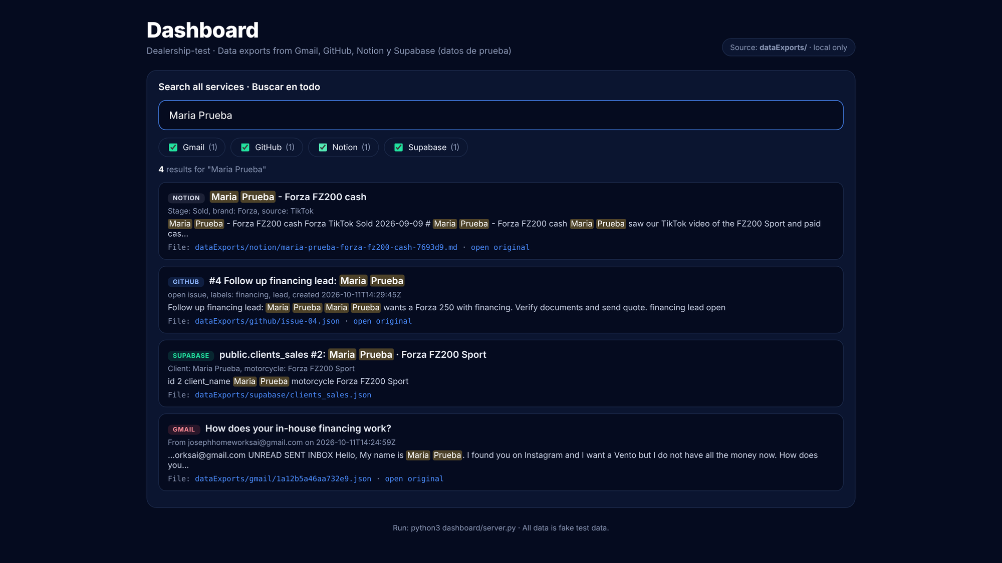
One search, four services
LOCAL DASHBOARD
4
results, one per service, from a single search
Search box runs over all dataExports/ folders at once
Checkboxes turn each service on or off
Colored badge shows which service each result comes from
Click a file name to see the saved file
Runs locally: python3 dashboard/server.py
Search for “Maria Prueba”: one result from each service
Notes:
The dashboard is dashboard/server.py, Python standard library only, so nothing to install. It reads the local files on every search. Searching 'Maria Prueba' returns 4 results: her Notion page, her GitHub follow-up issue, her Supabase row and her Gmail inquiry, each with its service badge. Open http://localhost:8000 after running python3 dashboard/server.py.

Slide 13



A public repo with zero secrets in it
SECURITY
Test accounts only
New Gmail, GitHub, Notion and Supabase accounts; no personal or school data
Secrets stay in the shell
GitHub token is an environment variable; .mcp.json only has a ${...} placeholder. Gmail needs no secret at all: it's an OAuth connector tied to the account
Read-only where possible
Supabase MCP runs with read_only=true; the skill only uses read tools
Checked before every commit
The skill scans exported files and git status for tokens; .gitignore blocks .env
Notes:
The repo is public, so: only test accounts, no secrets in any file (tokens are environment variables and .mcp.json uses placeholders), read-only access where possible, and a secret check before committing. After grading I delete the GitHub token and revoke the Gmail app password.

Slide 14


Challenges and lessons learned
WRAP-UP
Challenges
Lessons
Google's own Gmail MCP server needs a Google Cloud project enrolled in Google's Developer Preview Program, so I used Anthropic's own official Gmail connector instead (OAuth, no Google Cloud setup needed)
Separate test accounts keep real data out of a public repo
Each service logs in a different way: OAuth or a personal access token
A skill turns a one-time download into a repeatable workflow
Supabase had two related tables; I joined them into one clean 10-row export
Shared customer names make one search work across different formats
Notes:
Main challenge: Gmail. The official Google server needs a Google Cloud project, the Gmail API and an OAuth client, so I used the community IMAP server gmail-mcp-imap with an app password. The README documents the official alternative. Lessons: test accounts, a skill for repeatable downloads, and shared names so one search works across JSON, Markdown and CSV.

Slide 15
TRY IT
Everything is in one public repo
github.com/josephhomeworksai-hash/third-party-dashboard
Run the dashboard
dataExports/ with the data
$ git clone <repo>
$ cd third-party-dashboard
$ python3 dashboard/server.py
# open http://localhost:8000
# search: Maria Prueba, Forza, financing
.claude/ with the skill
.mcp.json (no secrets)
Dashboard code + README
localStorageFormats.md
This deck and the demo video
Notes:
The repo has every deliverable: dataExports, the .claude skill, .mcp.json, the dashboard with its README, localStorageFormats.md, this presentation and the demo video. To try it: clone, run python3 dashboard/server.py and open localhost:8000.

