Slide 1

The Importance of Industry Links in Merger Waves
Kenneth R. Ahern and Jarrad Harford
The Journal of Finance, Vol LXIX, April 2014
Presentation by Joseph P. Janko
Mays Business School, Texas A&M University
Presented on November 17, 2020

Slide 2
Overview
How do real economic transactions explain the formation and propagation of merger waves
Authors use graph theory techniques to form a network of industry pairs connected by trade flows
The Model has 3 implications
Stronger product network connections lead to greater frequency of cross industry mergers
Mergers propagate in waves through both customer and supplier links
Merger activity aggregates into economy wide merger waves due to merger activity in central nodes
How does this relate to the previous literature
holdup problems, valuation motivated mergers, complementary assets

Slide 3
Data
Customer-Supplier Trade Network Data
IO data obtained from BEA to form links between industries based on customer and supplier relations
Merger Network Data
Obtained from SDC Thomson Platinum Database
Other Industry Characteristics
Proxies for holdup problems, complementary assets, valuation-driven mergers
Networks
Use graph theory to link industries based of node and link relationship

Slide 4
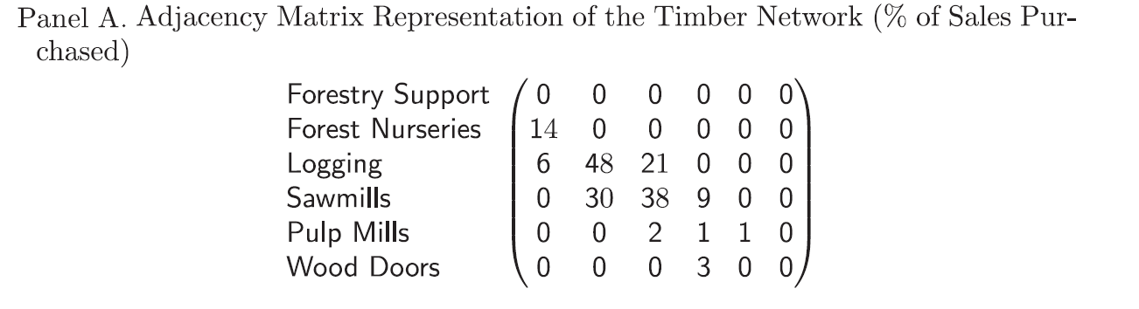
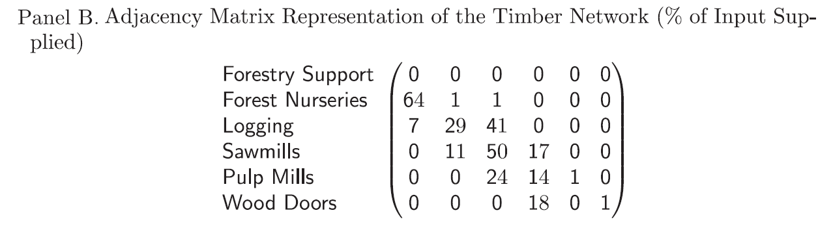
Figure 1

Slide 5
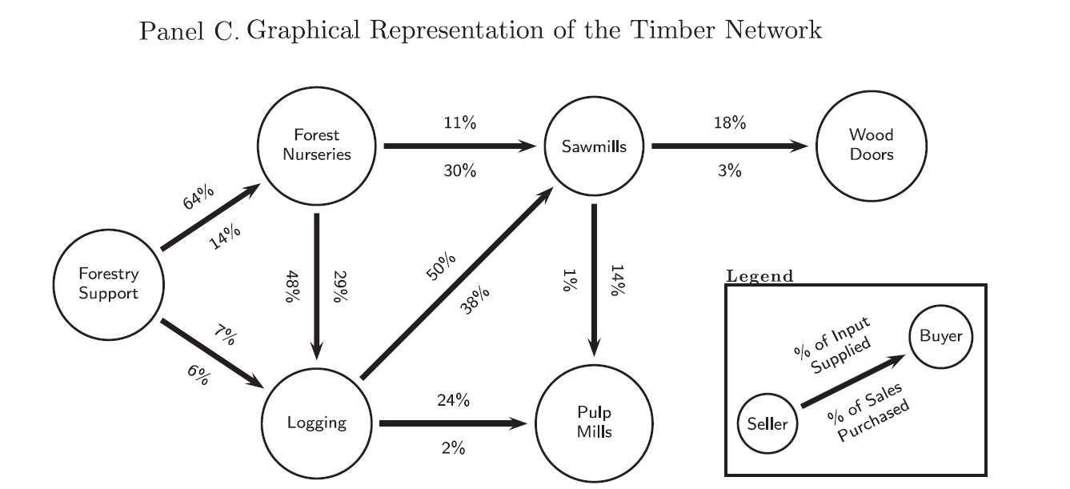
Figure 1 Cont.

Slide 6
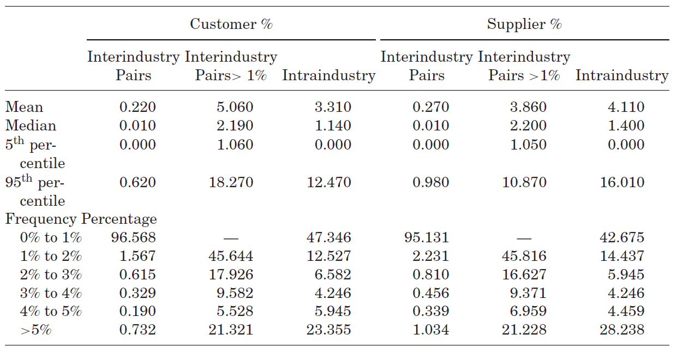
Input-Output Summary Statistics

Slide 7
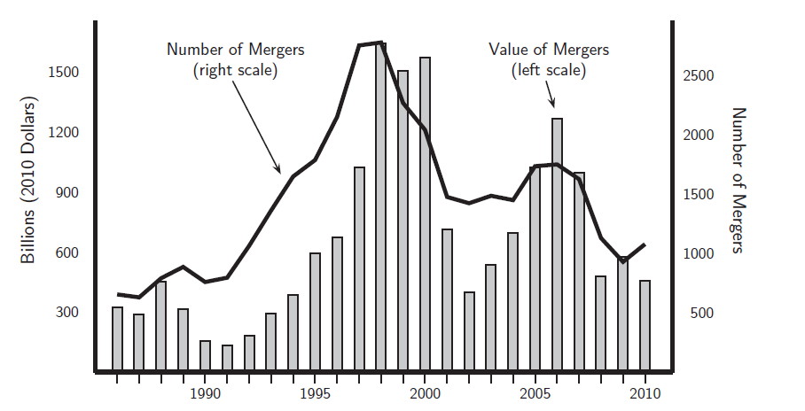
Aggregate Merger Activity
Dollar Value and Number of Mergers- Data in terms of 2010-adjusted US dollars

Slide 8
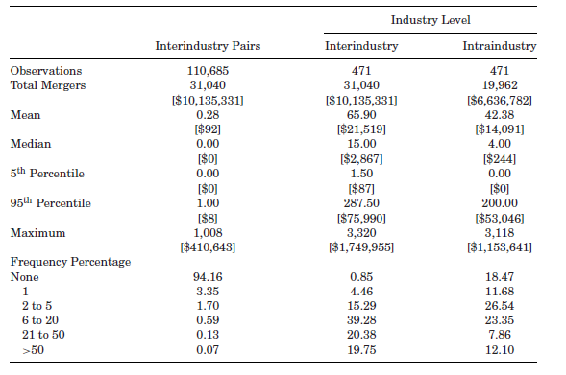
Merger Summary Statistics

Slide 9
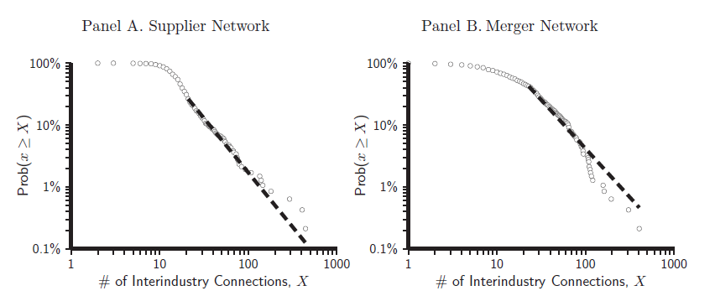
Degree Distribution of Merger and IO Networks
Figures show distribution of degree centrality in log-log scale
Clustering may indicate that the distribution follows a power law,
P(k) = ck^{-α}
Both mergers and IO connections have few connections
Clustering in small set of industries

Slide 10
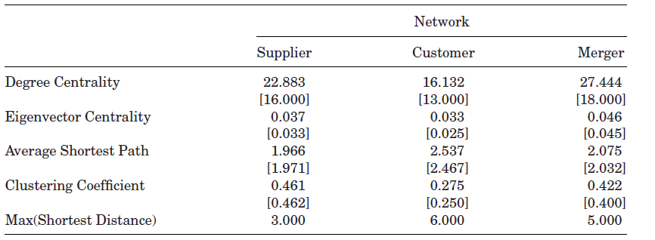
Mean and Median Network Statistics
Networks are sparse and highly connected through central hub industries!!!

Slide 11
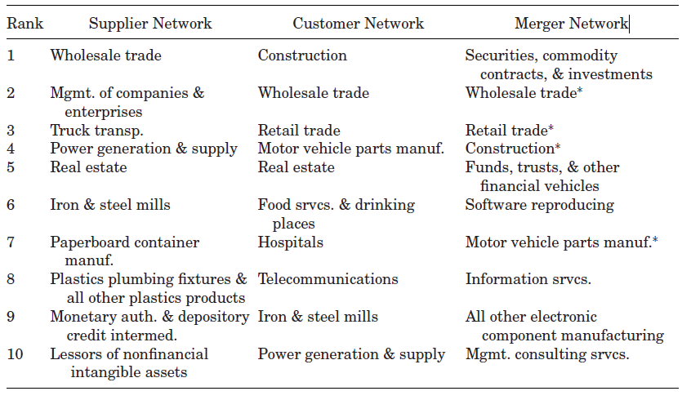
The Most Central Industries in the IO and Merger Networks

Slide 12
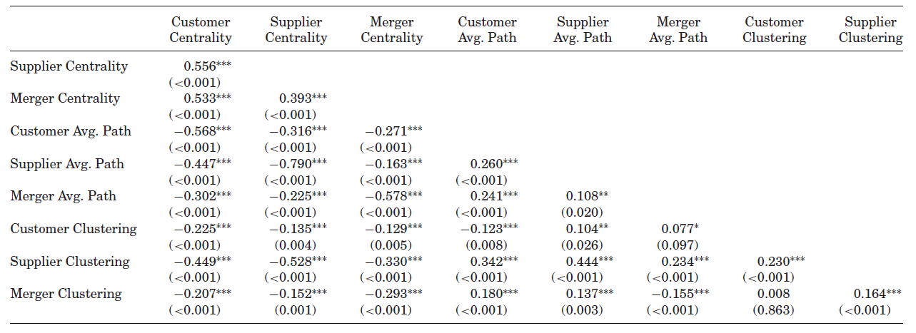
Correlations between Industry Characteristics across Networks

Slide 13
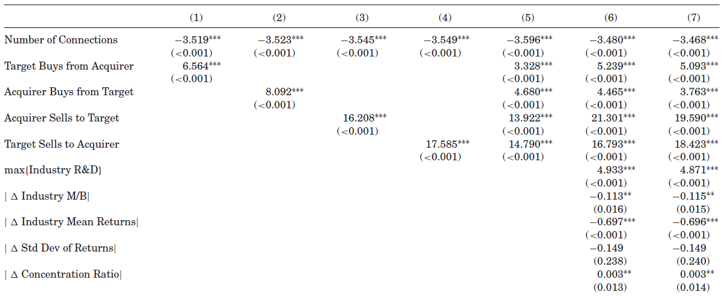
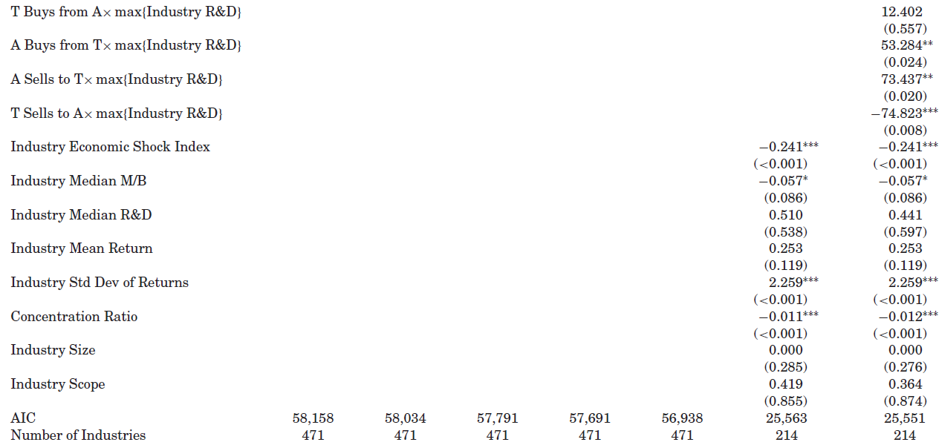
Exponential Random Graph Model to Explain the M&A Network
ERGM produces MLE estimates of an entire network
Coefficient values are the marginal effect of a variable on the conditional log-odds that two industries will have additional interindustry merger
Columns 1 through 4 show that the four IO network connections increase likelihood of merger connections
Column 5 is a joint test
Column 6 adds industry characteristics to account for holdup problems, overvaluation and economic characteristics
Column 7 is an interaction variable between IO connections and R&D
Cross-industry merger activity is related to the strength of the customer-supplier relationship

Slide 14
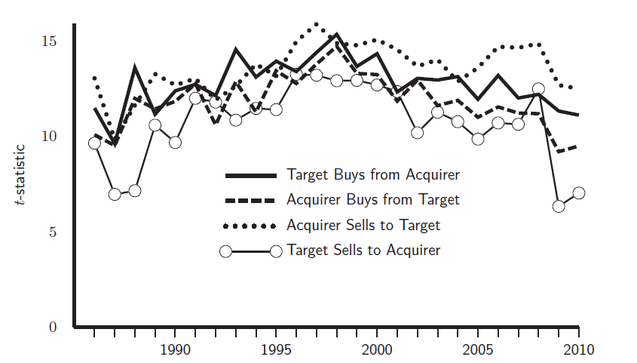
T-statistics from yearly ERGM tests

Slide 15
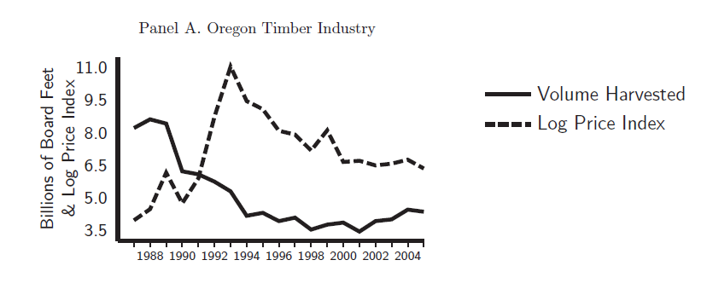
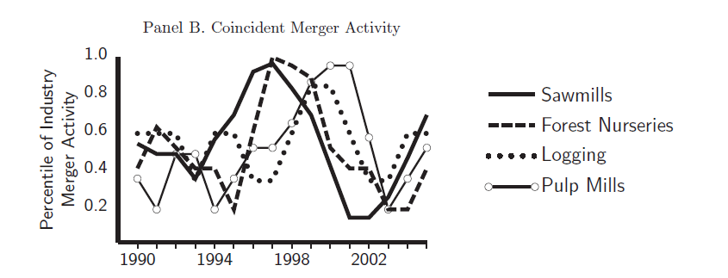
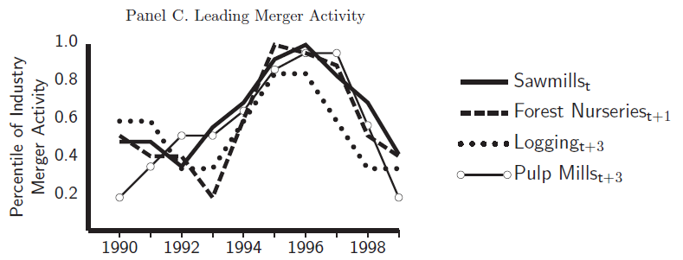
Diffusion of Merger Activity in Timber

Slide 16


Closeness-Weighted M&A Activity in Connected Industries
where dist_{ij} is the shortest path between industries i and j, and v_{jkt} is a measure of M&As between industries j and k in year t.
Shortest path calculated for both customer and supplier links > 1%
This measure accounts for an industry’s exposure to higher merger activity in more closely connected industries
Aggregate merger activity may also be caused by macroeconomic and technological shocks. Distance between industries matter, thus we need controls
where v_{i,t} = ∑_{j} v_{ijt} is the number of industry pairs involving industry i that experience high merger activity in year t, as above. The industry fixed effects, γ_{i} , control for all time-invariant industry characteristics. Year fixed effects, τ_{t}, capture any macroeconomic shock.

Slide 17
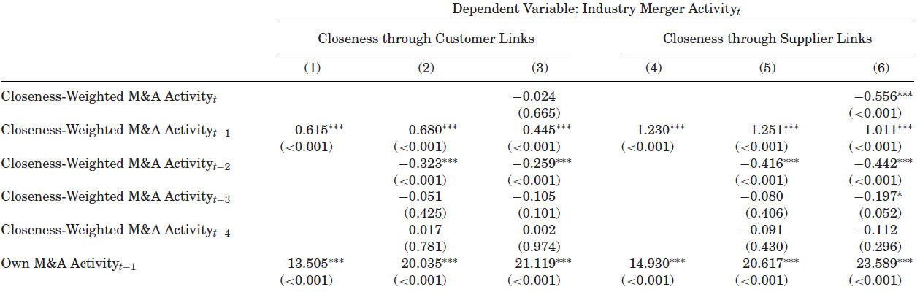
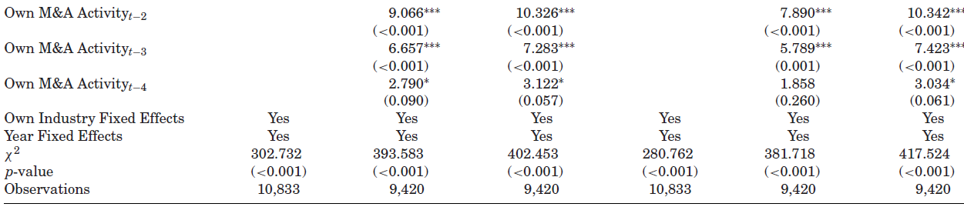
The Dynamic of Impact of Mergers in Close Industries

Slide 18
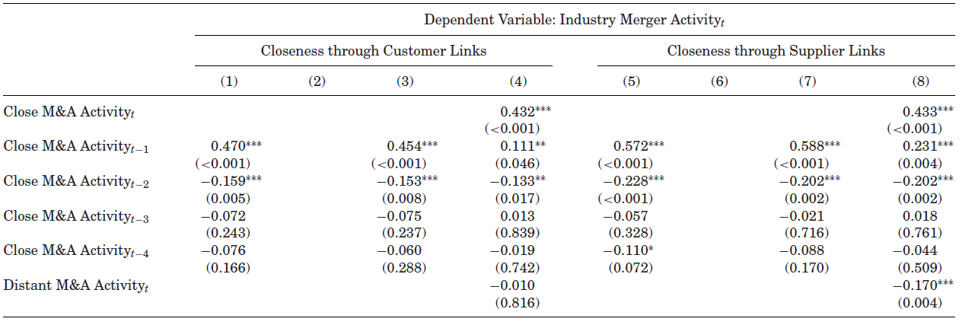
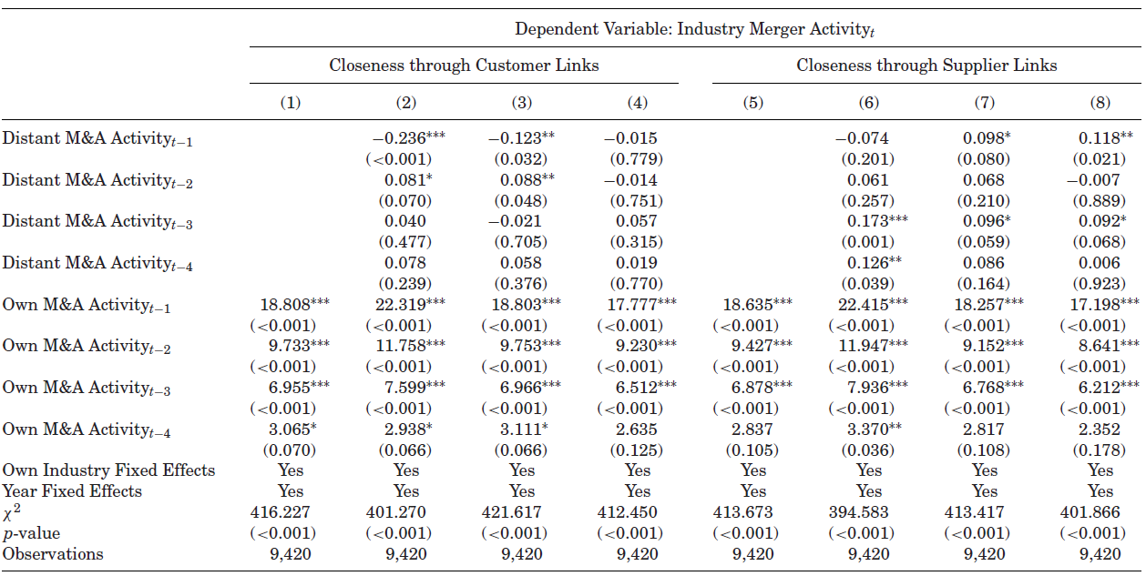

The Diffusion of Merger Activity across Close and Distant Industries
How does distance between two industries across the network affect diffusion across time??
Does merger activity in closely connected industries have greater impact in the near future than periphery industries??
Author’s test hypothesis with the following equation:

Slide 19
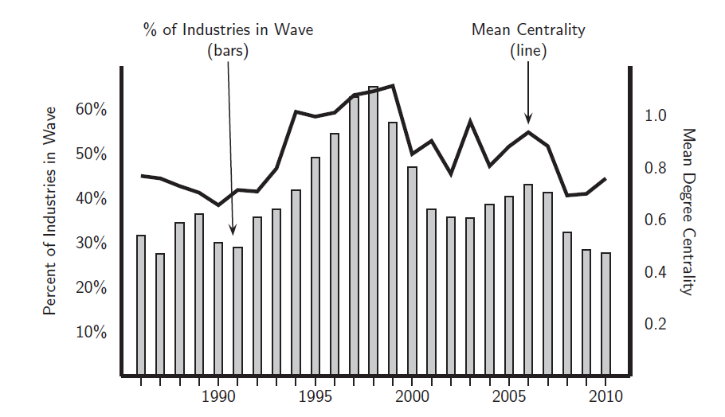
Network Centrality and Industry Merger Waves
High ρ between Centrality and Merger Waves

Slide 20
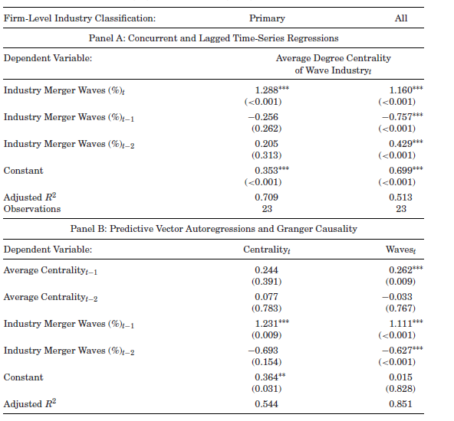
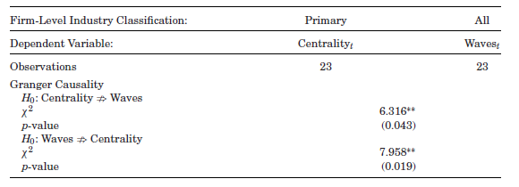
Aggregate Merger Activity and Centrality

Slide 21
Conclusion
Customer-supplier trade flows were used to model the US economy as a network from BEA data
Larger trade flows mean stronger interindustry connections
3 potential questions were tested
interindustry mergers cluster in industry pairs with strong trade flows
merger waves propagate across industries through customer-supplier links
the structure of the customer supplier network influences which industries are involved in economy-wide merger waves.
3 Main Results
cross-industry mergers are highly clustered in a small number of industry pairs
Industry merger activity travels in wave-like pattern. There is less delay and stronger effects for supplier links when compared to customer links due to the density of the supplier network
More central industries experience merger waves at the same time as economy-wide merger waves

Slide 22
Questions ???

Slide 23
References
Acemoglu, Daron, Simon Johnson, and Todd Mitton, 2009, Determinants of vertical integration: Financial development and contracting costs, Journal of Finance 64, 1251–1290.
Ahern, Kenneth R., 2012, Bargaining power and industry dependence in mergers, Journal of Financial Economics 103, 530–550.
Ahern, K.R. and Harford, J. (2014), The Importance of Industry Links in Merger Waves. The Journal of Finance, 69: 527-576.
Albert, Reka, and Albert-Laszlo Barabasi, 2002, Statistical mechanics of complex networks, Review of Moden Physics 74, 47–97.
Bhattacharyya, Sugato, and Amrita Nain, 2011, Horizontal acquisitions and buying power: A product market analysis, Journal of Financial Economics 99, 97–115.
Bonacich, Philip, 1972, Factoring and weighting approaches to status scores and clique identification, Journal of Mathematical Sociology 2, 113120.
Borgatti, Stephen P., 2005, Centrality and network flow, Social Networks 27, 55–71.
Clauset, Aaron, Cosma R. Shalizi, and M. E. J. Newman, 2009, Power-law distributions in empirical data, SIAM Review 51, 661–703.
Coase, R. H.,1937, The nature of the firm, Economica 4, 386–405.
Dijkstra, E. W., 1959, A note on two problems in connexion with graphs, Numerishce Mathematik 1, 269–271.
Garfinkel, Jon A., and Kristine Watson Hankins, 2011, The role of risk management in mergers and merger waves, Journal of Financial Economics 101, 515–532.a
Hoberg, Gerard, and Gordon Phillips, 2010a, Dynamic text-based industry classifications and endogenous product differentiation, Working paper, University of Maryland and University of Southern California.
Hoberg, Gerard, and Gordon Phillips, 2010b, Product market synergies and competition in mergers and acquisitions: A text-based analysis, Review of Financial Studies 23, 3773–3811.
Ohanian, Nancy Kane, 1994, Vertical integration in the U.S. pulp and paper industry, 1900-1940, Review of Economics and Statistics 76, 202–207.
Rhodes-Kropf, Matthew, David T. Robinson, and S. Viswanathan, 2005, Valuation waves and merger activity: The empirical evidence, Journal of Financial Economics 77, 561–603.

