Slide 1


HOUSING DATA ANALYSIS
GROUP 9
1. Daphine Lucas
2. Joseph Karumba
3. Wachuka Kinyanjui
4. Winny Chemusian
5. Wambui Githinji
6. Allan Mataen
Exploring influential factors in house pricing.

Slide 2
Overview
Delve into the King County House sales dataset, a comprehensive repository of housing sales information in King County, USA.
Our aim is to provide precise insights to assist homeowners and real estate agencies in making informed decisions regarding property valuation and understanding market trends.

Slide 3
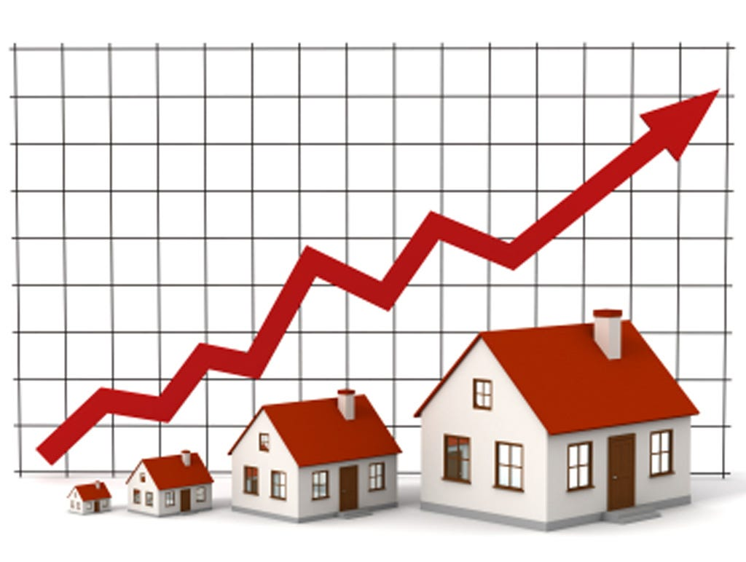
Business understanding
We are tasked with developing a predictive model to provide insights for homeowners and real estate companies.
By analyzing property features such as year built , living space and number of bedrooms our model aims to offer accurate predictions, aiding decisions on property valuation and market trends.

Slide 4
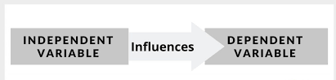
Data understanding
In our analysis, the variable we aim to predict is property price.
We utilize predictive variables such as the number of bedrooms, year built and living space to estimate this target variable.

Slide 5


Slide 6
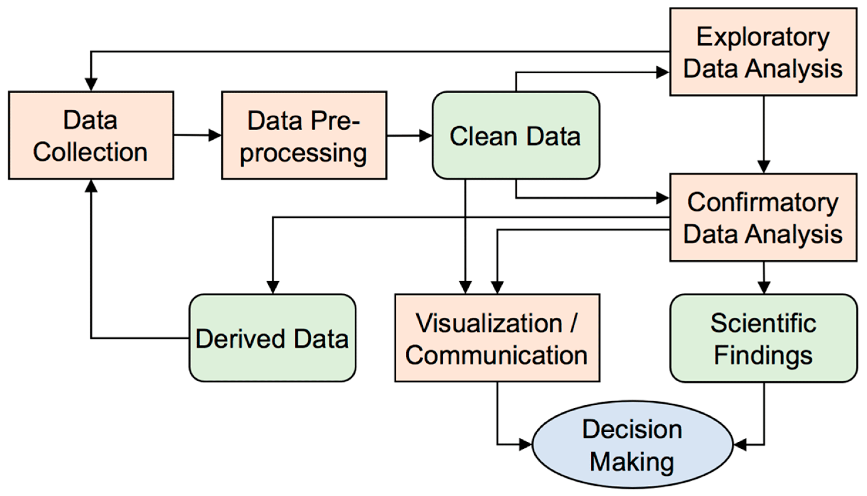

Slide 7
Regression Results
The following provide insights into how various features are related to the price of the house:
Larger living spaces, both above ground and in the basement, contribute positively to housing prices.
Properties with a waterfront view command higher prices compared to those without.
Newer properties tend to have lower prices compared to older properties. Newer isn't always pricier
Larger lot sizes are associated with lower housing prices, indicating that buyers may value space differently based on their preferences and needs.

Slide 8
Recommendations
Priority should be given to properties with waterfront views or larger living spaces.
Newer properties could be considered for affordability and investment opportunities compared to older ones.
Renovation of older houses could increase the prices of houses.
Real estate agents and homeowners should factor in living space, basement, and views when pricing properties.

Slide 9
Next steps
Stay informed on market trends to make informed decisions regarding property purchases or sales.
Further data collection to provide a more comprehensive understanding of the housing market dynamics.

Slide 10


THANK YOU!

