Slide 1
Tasks
Slide on SHG Calculations
SHG Buildup Diagram
Continuance towards further setup
Current data with annotations on potential PMT voltage, frequencies swept using MOGLabs wavemeter. – might not be possible, but maybe with new readings this is attainable
Plan on how to comm with both moglabs & oscope – maybe Labjack helps
Document photos on SHG setup.

Slide 2
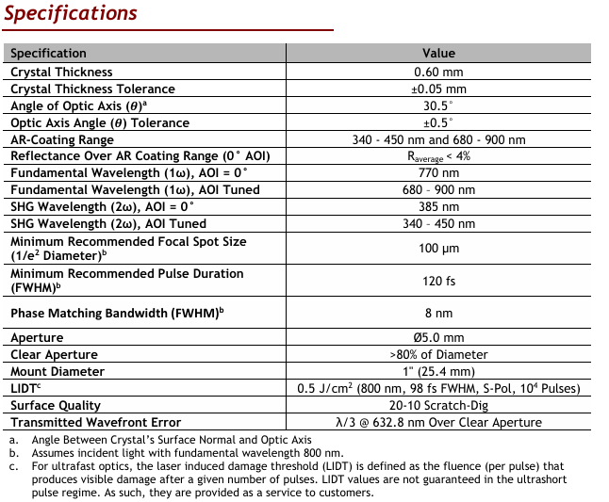
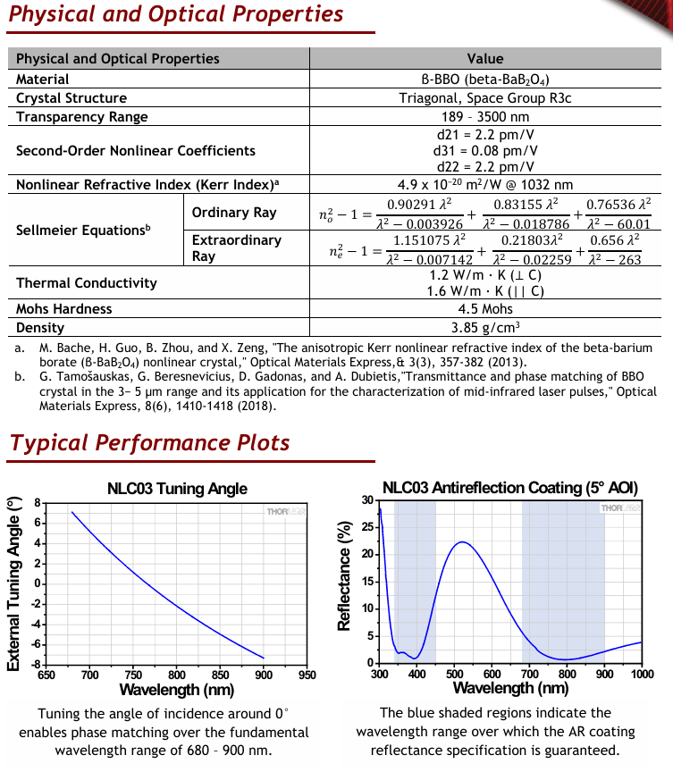





SHG Calculations: Known Parameters

Slide 3
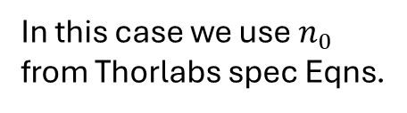

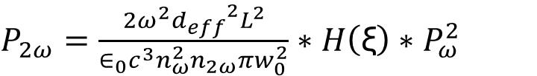
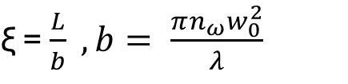


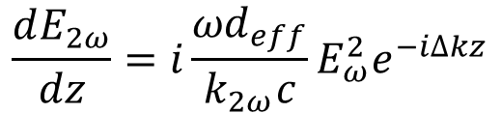

Calculations
Fundamental Power
Generated SHG Power
$P_{2ω}=\frac{2ω^{2}{d_{eff}}^{2}L^{2}}{∈_{0}c^{3}n_{ω}^{2}n_{2ω}πw_{0}^{2}}∗H\left(\text{ξ}\right)∗P_{ω}^{2}$
$$η= \frac{P_{2ω}}{P_{ω}}$$
Conversion Efficiency
Derived by integration along the length (L) of the crystal, using the following relation(s):
$$\frac{dE_{2ω}}{dz}=i\frac{{ωd}_{eff}}{k_{2ω}c}E_{ω}^{2}e^{−i∆kz}$$
In this case we use $n_{0}$ from Thorlabs spec Eqns.
$\text{ξ}$ = $\frac{L}{b} , b= \frac{πn_{ω}w_{0}^{2}}{λ}$
$$d_{eff}= d_{22}∗sin⁡(2θ)$$
$$∆k=k_{2ω}−2k_{ω}$$
Relevant for this Type-I SHG process
$$H\left(\text{ξ}\right)$$
See: Parametric Interaction of Focused Gaussian Light Beams | Journal of Applied Physics | AIP Publishing
&
R. W. Boyd, Nonlinear Optics, 3rd edition, Academic Press, Sec. 2.3 (especially eqns. 2.3.22–2.3.24)

Slide 4
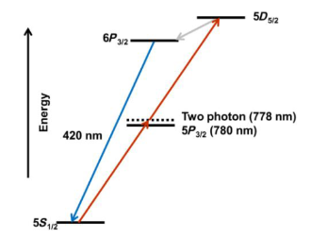
Plans today / this week
Finish laser alignment / build up SHG Setup.
Follow up with Vescent on final quote for 780 box
Retake data with MOGLabs meter hooked up to oscope for frequency capture.

