Slide 1
 | 1 | 2 | 3 | 4
A | FICTION | NON-FICTION | FICTION | FANTASY
B | RETURN CART (starting pt) | LABEL DESK | FANTASY
C | RECYCLE | PREP BIN
Color code:
Return cart = blue
Fiction = green
Non-fiction = orange
Fantasy = purple
Label desk = yellow
Recycle = red
Prep bin = gray
Coordinates:
A1 = (1,1), A2 = (2,1), etc.
B1 = (1,2), B2 = (2,2), etc.
C1 = (1,3), C2 = (2,3), etc.

Slide 2
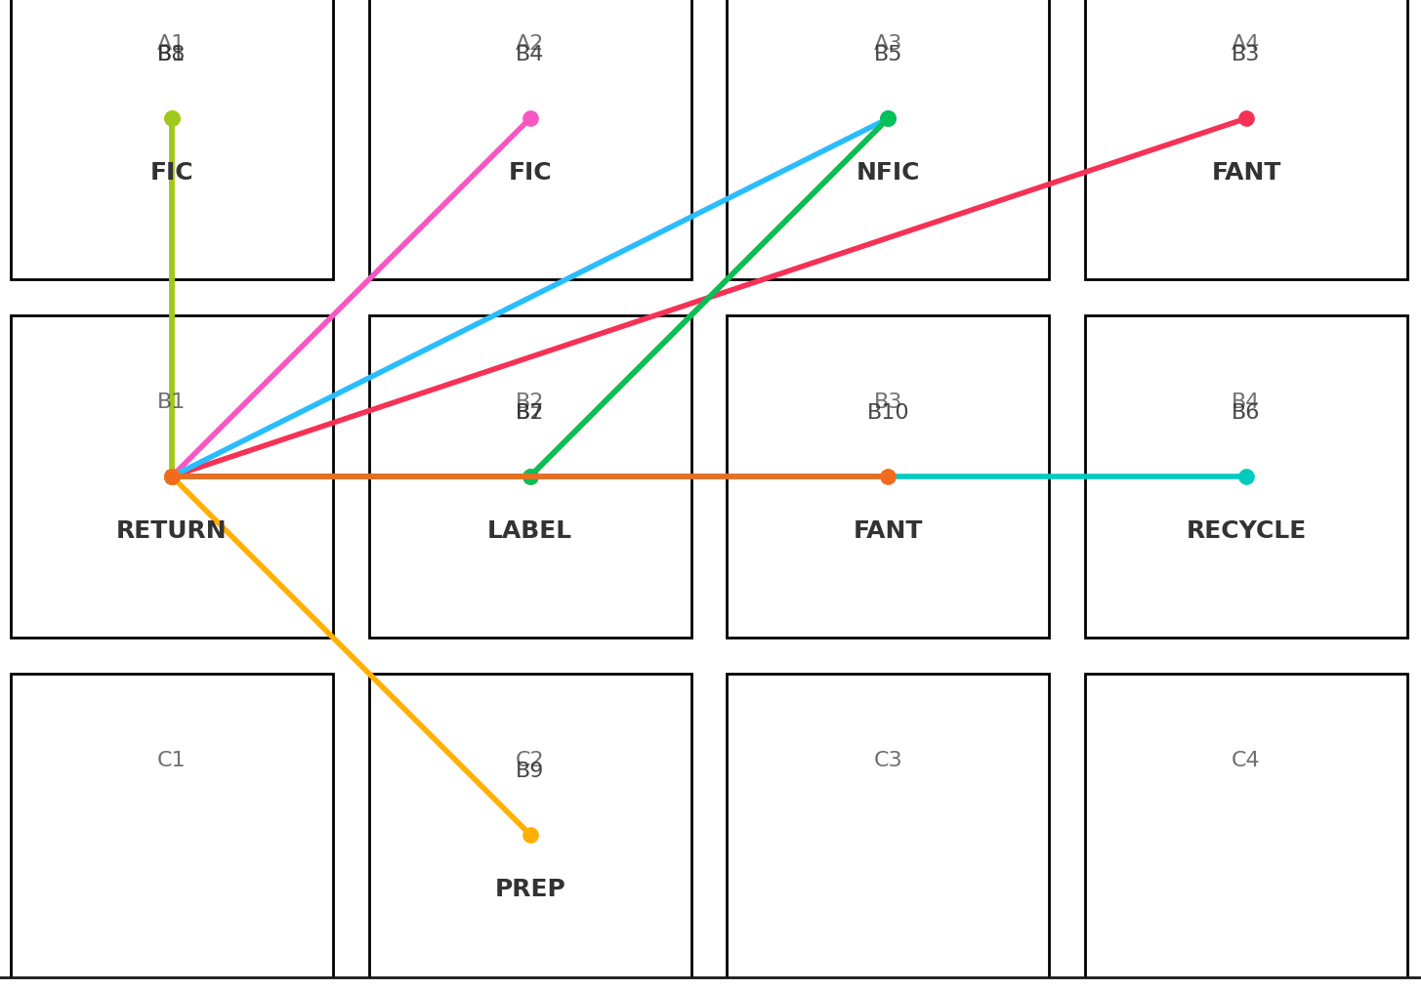

Slide 3
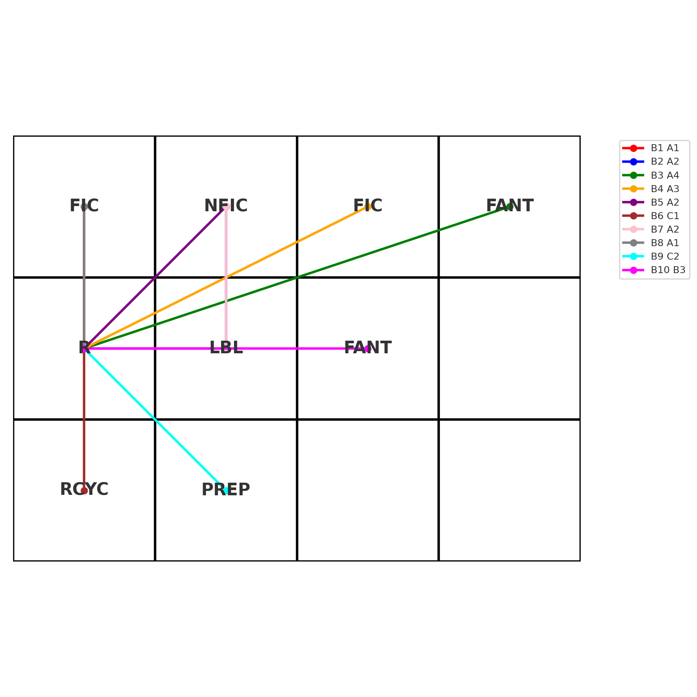

Slide 4
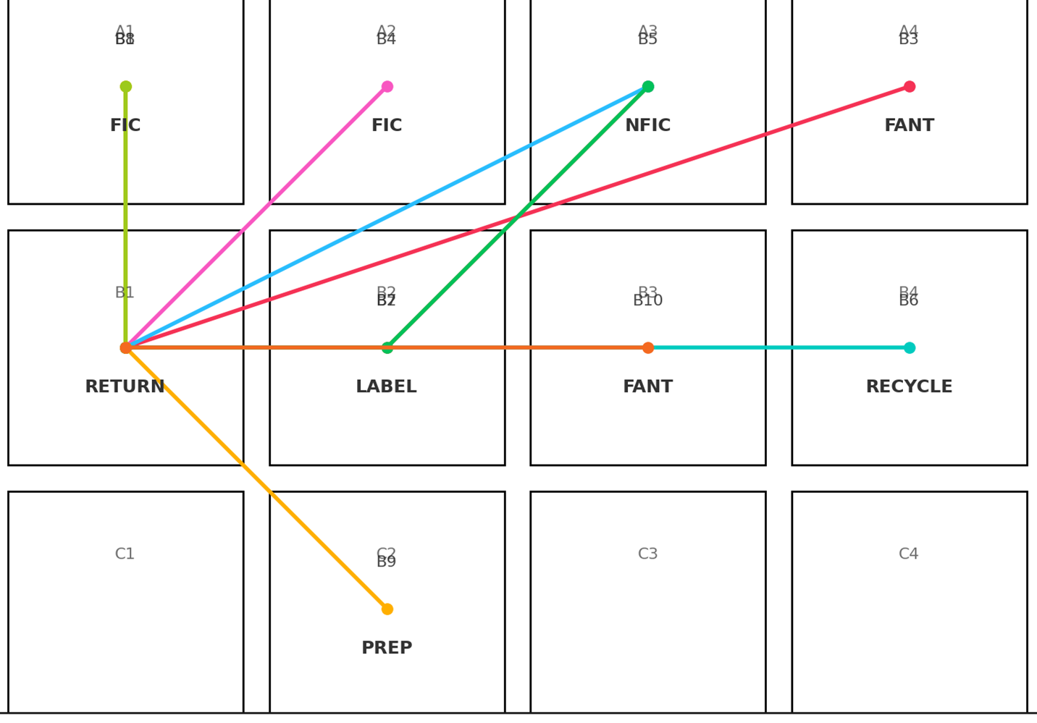
BEFORE
AFTER
I reconfigured the returns station with a category swap (NFIC ↔ closer shelf), moved Recycle to C1, and preserved a straight Return→Label→Shelf path. On the same 10‑book set, I fixed routes to drop total distance from 24 to 20 grid steps (–16.7% motion). My new layout reduces long aisle travel (A4/A3 runs) and eliminates a 3‑step Recycle detour by utilizing row C.
Motion waste decreased, simpler flow from Return → Label → Shelf, reduced over‑processing

