Slide 1
MACHINE LEARNING CASE STUDY
Classifying the Cosmos
Predicting whether a sky object is a galaxy, star, or quasar
from telescope light measurements
SDSS photometric dataset • End-to-end analytics workflow
Notes:
Title slide. This project walks through a full analytics workflow — from framing the business problem, through exploratory and descriptive analytics, feature engineering, and predictive modelling — using an astronomy dataset as the substrate.

Slide 2
THE BUSINESS PROBLEM
Why does this problem exist?
Modern sky surveys photograph millions of objects every night. There are not enough astronomers alive to classify them by hand. The question is operational, not just scientific:
THREE POSSIBLE ANSWERS
Galaxy
Can we automatically sort each observed object into galaxy, star, or quasar using only the measurements a telescope already captures?
Billions of stars bound together
Star
Scale
Automate what humans cannot do by hand across millions of objects
A single nearby sun-like body
Triage
Flag the interesting objects worth expensive follow-up observation
Quasar
Consistency
Apply the same criteria every time, without fatigue or bias
A black hole devouring matter
Notes:
The business problem is framed operationally: surveys generate more data than humans can label. The goal is an automated classifier that triages objects into three types using only cheap photometric measurements.

Slide 3
HOW WE'LL GET THERE
The analytics workflow
01
02
03
04
05
Exploratory
Descriptive
Feature Engineering
Predictive
Evaluate
Understand the raw data
Summarise what's there
Build smarter inputs
Train & compare models
Test honestly for traps
Each stage answers a different question — and each one guards against a different way of fooling yourself.
Notes:
Roadmap slide. The five stages mirror a standard analytics progression: exploratory, descriptive, feature engineering, predictive, evaluation. Each stage has its own purpose and its own pitfall to avoid.

Slide 4
KNOW YOUR INPUTS
What the telescope gives us
Each row is one observed object. Its measurements fall into four groups:
Five brightness bands
Redshift
u g r i z
how far it is
The same object photographed through five colour filters, ultraviolet to infrared. The core signal.
How stretched the object's light is by cosmic expansion. Extremely predictive — and a trap we'll return to.
Sky position
Identifiers
alpha delta
IDs & run info
Where the object sits on the celestial sphere. Should not matter for classification.
Bookkeeping about which telescope run captured it. No predictive value — dropped.
Notes:
The dataset has ~100k rows. Four feature groups: photometric bands (the signal), redshift (predictive but leaky), sky position (should be irrelevant), and identifiers (dropped). Framing which columns are honest and useful is the first analytic act.

Slide 5
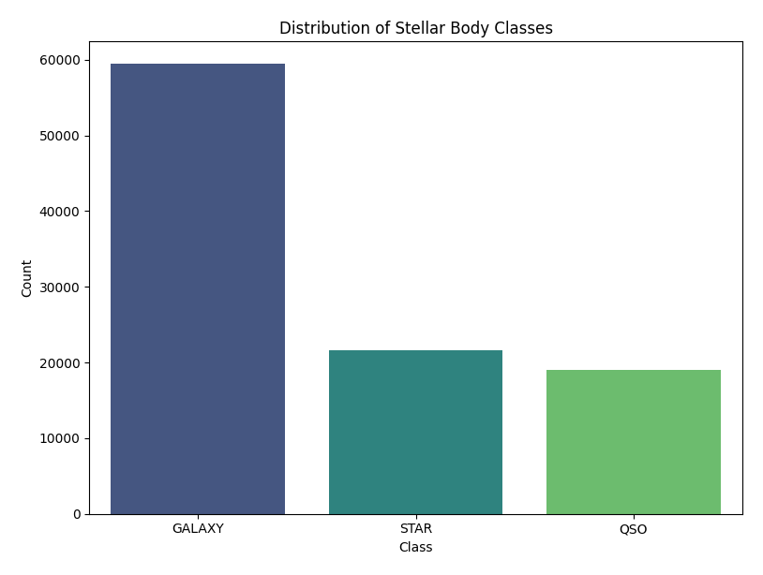
STAGE 01 — EXPLORATORY ANALYTICS
Turning the lights on
Before modelling anything, interrogate the data. Exploratory analysis asks four blunt questions:
1
Is the data even okay?
Shape, missing values, duplicates, silly outliers like -9999 error codes
2
What am I predicting?
Check class balance — galaxies dominate (~60%), so that's the baseline to beat
3
Are any features cheating?
Redshift almost gives the answer away — flagged early
4
Are inputs redundant?
Galaxies dominate at ~60% — the baseline any model must beat.
The five bands are all highly correlated with one another
Notes:
Exploratory analytics is about building intuition and catching problems early: data quality, class balance (the 60% baseline), leakage risk from redshift, and redundancy among the bands. The chart shows the real class counts — galaxies ~59.5k, stars ~21.5k, quasars ~19k.

Slide 6
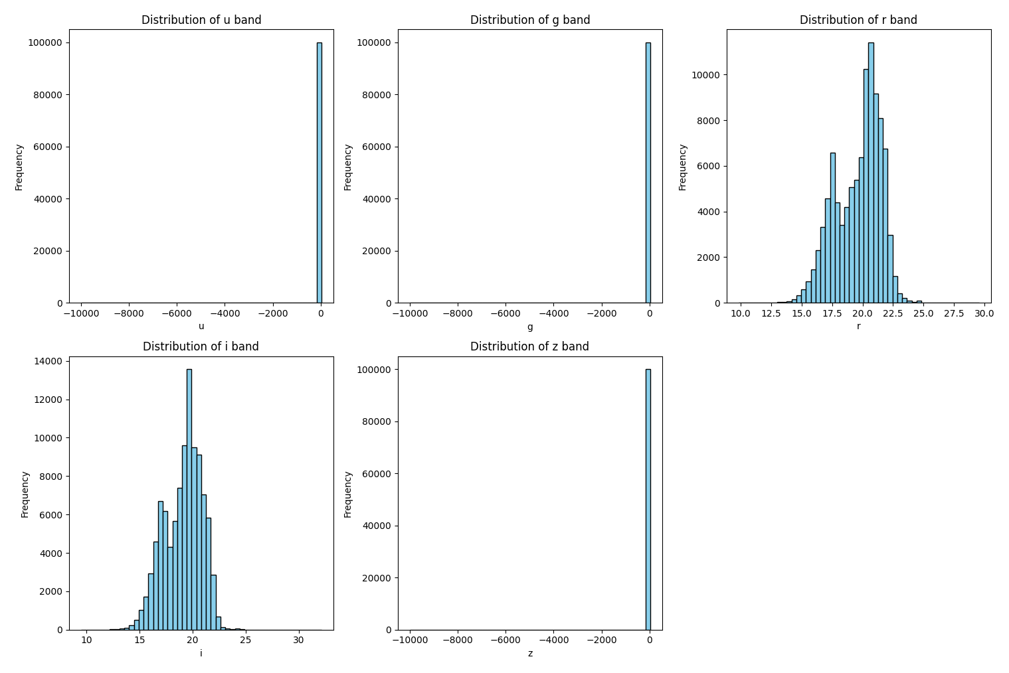
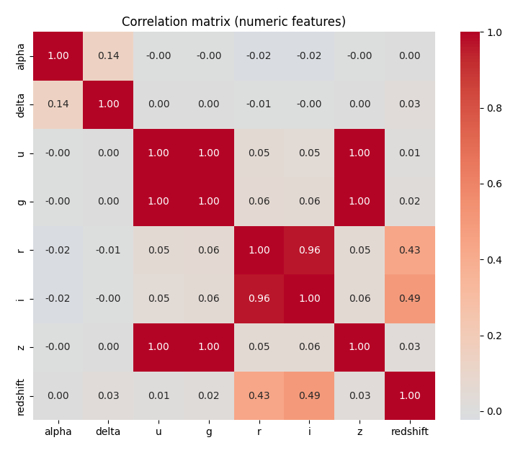
STAGE 02 — DESCRIPTIVE ANALYTICS
What the numbers actually say
Descriptive analytics summarises the data with charts — no prediction yet, just an honest portrait. Two views mattered most:
Raw band distributions
Correlation matrix
Note the huge spike near −9999 in u, g, z — SDSS's "bad measurement" sentinel, caught and handled.
u, g, z are near-perfectly correlated (1.00) — the redundancy that motivated feature engineering.
Notes:
Descriptive analytics: the histograms reveal the -9999 sentinel spike in three bands; the correlation heatmap shows u/g/z are almost perfectly correlated. That redundancy is what motivated the feature engineering stage that follows.

Slide 7
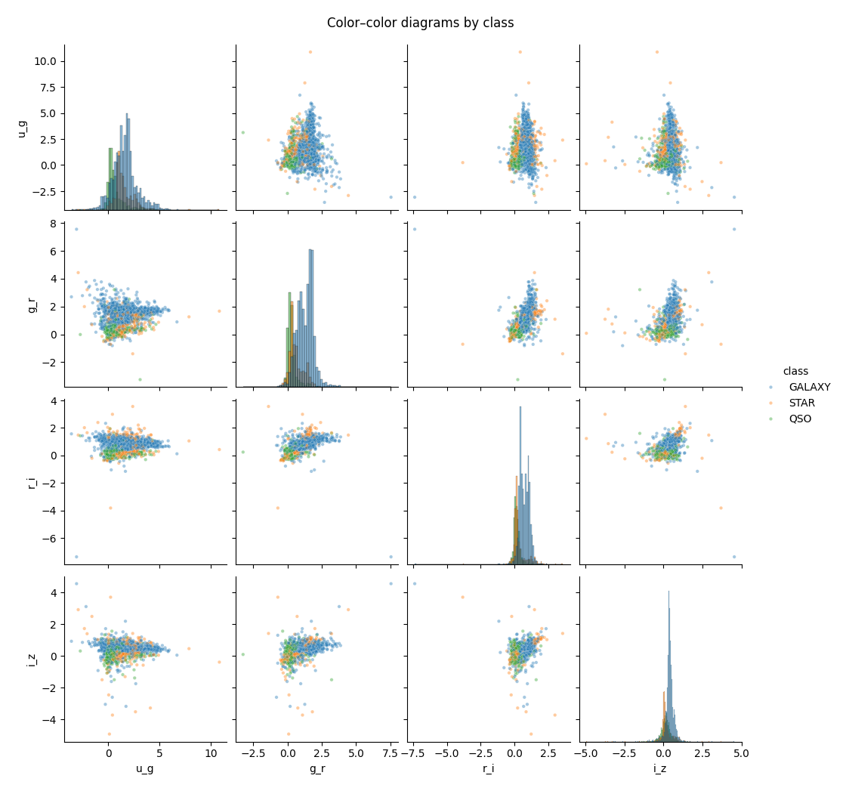
STAGE 03 — FEATURE ENGINEERING
Building smarter inputs: colour
Raw brightness confuses distance with type. The fix — used by astronomers for a century — is to take differences between bands, called colour indices.
u_g = u − g
g_r = g − r
r_i = r − i
i_z = i − z
Why it works: a colour index captures the shape of an object's light, independent of how far or bright it is. Two stars of the same type share a colour even at different distances.
Sourced, not invented. You don't need to be a physicist — you notice the redundancy in the data, then look up how the field handles it, then confirm it empirically.
Colour–colour diagrams: the classes begin to separate in engineered feature space.
Notes:
Feature engineering: colour indices are differences between adjacent bands. They capture intrinsic type independent of distance. The colour-colour scatter shows the classes beginning to separate. Key teaching point: domain knowledge is sourced and empirically validated, not invented.

Slide 8
STAGE 04 — PREDICTIVE ANALYTICS
Two models, on purpose
We trained a simple linear model and a flexible ensemble — not to crown a winner, but to diagnose the shape of the problem.
Logistic Regression
Random Forest
The honest baseline
The flexible workhorse
Draws straight-line boundaries between classes
A committee of hundreds of decision trees that vote
Simple, fast, and fully interpretable
Captures curves and feature interactions naturally
You can read exactly what it learned from its coefficients
Ignores feature scale — no scaling headaches
Fails visibly when relationships are curved — which is useful
Reports which features it relied on most
Notes:
Predictive analytics: logistic regression as an interpretable linear baseline, random forest as a flexible nonlinear alternative. Running both diagnoses whether the problem is linear or nonlinear.

Slide 9
STAGE 05 — EVALUATE HONESTLY
The result — and the trap
Each model was trained twice: without redshift, then with it. Redshift only comes from expensive spectroscopy, so a real image-only classifier can't use it. Including it is proxy data leakage.
Without redshift (honest)
With redshift (leaky)
Logistic Regression
88%
95%
Random Forest
88%
97%
The 7–9 point jump is the leakage, quantified. For a real image-only pipeline the honest ceiling is ~88% — and a simple linear model reaches it. Feature quality mattered more than model choice.
Notes:
The core result. Redshift adds 7-9 points but wouldn't be available in a real image-only deployment. The honest ceiling is ~88%, reachable even by logistic regression. The headline lesson: feature legitimacy and quality dominate model sophistication.

Slide 10
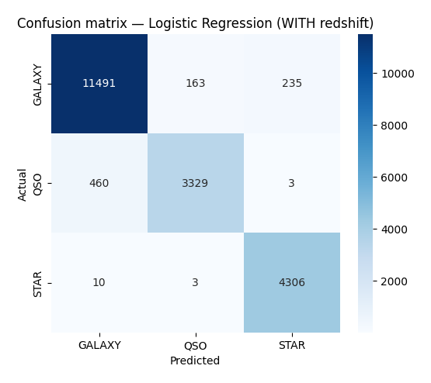
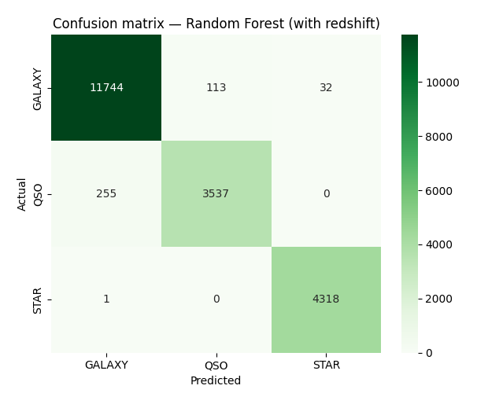
WHERE THE MODELS GET IT WRONG
Reading the mistakes
A confusion matrix shows not just how often each model is right, but which classes it confuses. The diagonal is correct; off-diagonal cells are errors.
Logistic Regression
Random Forest
The pattern is physically sensible: stars are almost never confused (redshift ≈ 0 makes them distinct), while nearly all remaining errors sit in the galaxy↔quasar cells — the genuinely hard cases. Random Forest tightens the diagonal further.
Notes:
Confusion matrices with redshift. Both models nail stars. Errors concentrate in galaxy-quasar confusion, which is physically expected since a quasar is a bright core inside a distant galaxy. Random Forest reduces the off-diagonal counts versus Logistic Regression.

Slide 11
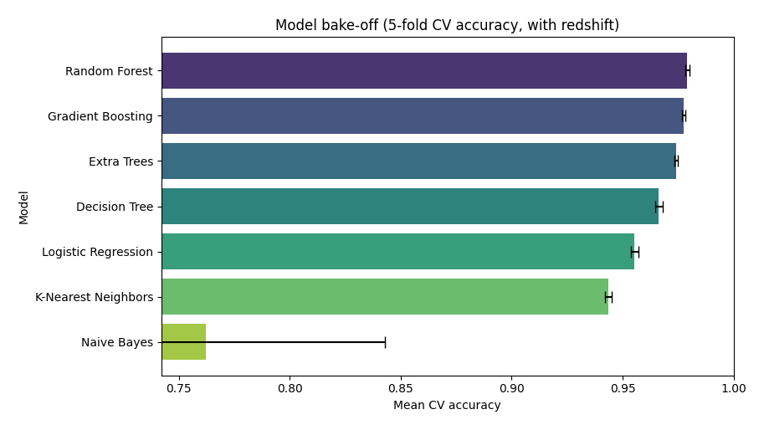
CROSS-VALIDATED COMPARISON
Does a fancier model help?
Seven classifiers, 5-fold cross-validation, redshift included. The tree ensembles cluster at the top; Naive Bayes collapses because its independence assumption is violated by the correlated features.
Once features are good, top ensembles converge — algorithm choice matters far less than beginners expect. Note Naive Bayes' wide error bar: unstable as well as inaccurate.
Notes:
Bake-off: RF, Gradient Boosting, Extra Trees tie at ~97-98%. Naive Bayes fails at ~76% with a wide error bar due to violated independence assumptions. Lesson: with good features, ensemble choice barely matters.

Slide 12
WHAT THE MODEL RELIED ON
The leakage, seen a second way
Random Forest reports how much it leaned on each feature. Redshift alone is over half the total — the same leakage story in a different picture.
redshift
51%
r_i (colour)
14%
g_r (colour)
9%
i_z (colour)
6%
u_g (colour)
5%
raw bands (z,g,i,u,r)
12%
alpha, delta (position)
2%
Sanity check passed: colours outrank the raw bands they came from, and sky position is ~0. The model independently recovered a century of astronomy.
Notes:
Feature importance: redshift ~51%, colours next (outranking raw bands), position ~0. Confirms leakage and validates that the model found physically sensible structure.

Slide 13
WHAT THIS PROJECT DEMONSTRATES
Takeaways that travel
Frame the real problem
Interrogate every feature
The valuable task is classifying before spectroscopy — which changes which features are legitimate.
Ask of each column: would I actually have this at prediction time? If not, its accuracy is a fiction.
Feature quality beats model choice
Report honestly
Engineered colours + honest inputs mattered more than which algorithm we picked.
88% stated plainly is worth more than a leaky 97% dressed up as success.
Notes:
Four portable takeaways: frame the real problem, interrogate every feature for availability, feature quality over model choice, honest reporting. These generalise well beyond astronomy.

Slide 14
From raw light to a labelled sky
Exploratory → Descriptive → Feature Engineering → Predictive → Evaluation
The algorithm is the small part. The discipline — honest features, honest reporting — is the whole game.
Notes:
Closing slide restating the workflow and the central discipline: the model is a small part; honest feature selection and honest reporting are what matter.

