Slide 1
Meteorological Service Singapore (MSS)
Forecast Weather Data
National Environment Agency (NEA)
PUB Flood Management System
Real-Time Water Level Monitoring
Rainfall Monitoring
CCTV Monitoring
NEA Weather API integration
Flood Forecasting
Public Warning System
IoT devices
Water level sensors
Rain gauges
Flow sensors
CCTVs
Weather Data API
Public Utilities Board (PUB)
Manages
Manages
Operations Coordination
Singapore Civil Defence Force (SCDF)
Certis CISCO under Singapore Police Force (SPF)
Land Transport Authority (LTA)
Town Councils
Rescue and Evacuate
Traffic Support
Traffic Control
Drainage Maintenance

Slide 2
Monitor with IoT sensors and weather data
Start
No
Heavy Rainfall Detected?
Yes
Flood Detected?
No
Yes
Issue public warning
Activate Emergency Response
End

Slide 3
Monitor with IoT sensors and weather data
Start
AI Prediction Engine
AI powered Drainage and Pump Health Monitoring
Flood Probability?
Low
Issue public warning
Activate Emergency Response
High
End
Risk analysis and assessment
Execute Stormwater Storage Optimisation
Coordinate Post-Flood Recovery

Slide 4
Monitor with IoT sensors and weather data
Start
AI Prediction Engine
AI powered Drainage and Pump Health Monitoring
Auto-Escalate Emergency Alert
Flood Probability?
Low
No
Acknowledged within Window?
Disseminate Multi-Channel Alerts
Yes
High
Risk analysis and assessment
Activate Coordinated Emergency Response (SCDF, Police, LTA, QRT)
Execute Stormwater Storage Optimisation
Coordinate Post-Flood Recovery
End
Generate Real-Time Flood-Free Navigation & Route Feeds
Coordinate Dynamic Road Cordons & Inter-Agency Deployments

Slide 5
IoT Sensors
Weather Forecast API
NoSQL Databases
Stream Process Engine
AI Prediction Service
GIS Engine
Downstream Agencies
Store Sensor Data
Store Weather Forecast API Data
Stream Data
Preprocess Data
Run ML Models to
- Predict Flood Probability
- Flood Severity
GIS Map
GIS Mapping
- High Risk Areas
- Impact Analysis
- Recommendations
Generate Notifications and Alerts

Slide 6
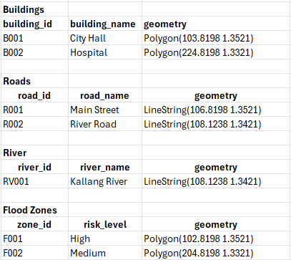
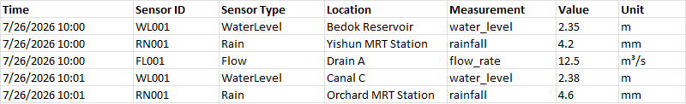
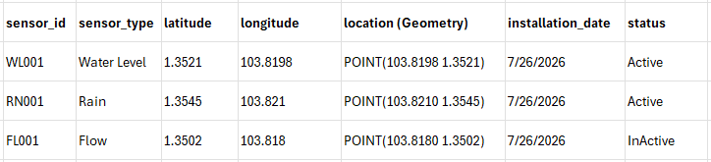
08:00 API → Redis (update) + PostgreSQL (insert)
08:30 API → Redis (update) + PostgreSQL (insert)
09:00 API → Redis (update) + PostgreSQL (insert)
09:30 API → Redis (update) + PostgreSQL (insert)

Slide 7
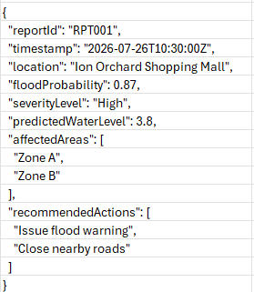
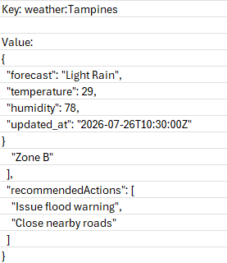

Slide 8











Serverless Layered Architecture (AI-Based Flood Prediction & Risk Analysis)
Application Layer
Database Layer (Multi AZ)
External Data Source
VPC
Spatial Data
Processing Layer
Historical Data
2-Hour Weather Forecast Data
Request GIS Map Overlay Lambda
AWS IoT
TwinMaker
REST API
Req/Res
AWS RDS
Postgresql + PostGIS
HTTPS
NEA Weather
Forecast Lambda
Prediction and Impact Analysis
Latest Data
AWS
Sagemaker
AWS Elasticache (Redis)
Read Data
IoT Rule
Invoke AI Inference Lambda
AWS IoT Core
Real-Time Sensor Processing Lambda
Real-time Data
Flood Prediction and Impact Analysis Report Lambda
AWS Timestream
NB-IoT
Document Data
- Water Level Sensor
- Rain Gauge Sensor
- Flow Sensor
Send Reports to Downstream Agencies Lambda
AWS DynamoDb
IoT Devices

Slide 9
Input - Current water level
- Predicted water level (from LSTM)
- Rainfall
- Water flow
Dataset
Dataset
Random Feature
Selection
Random Feature
Selection
Decision
Tree 1
Decision
Tree 2
Decision
Tree 3
Decision
Tree 1
Decision
Tree 2
Decision
Tree 3
Prediction C
Prediction A
Prediction B
Prediction A
Prediction B
Prediction C
Majority Voting
Majority Voting
Final Classification
Final Classification
Output - Flood Risk: Low, Moderate, High

Slide 10



Data:
Flood Risk: High
Location: Newton MRT Station
Client
Server
Real-Time Sensor Readings
NEA Weather Forecast Data
Reads Data
Encrypted Data:
x8f#K!92...@*&
Client
Server
Invoke AI Inference Lambda
Spatial Information
flood polygons
drainage networks
Request Mapping Overlay
LSTM
Random Forest
AWS
Sagemaker
Request GIS Map Overlay Lambda
AWS IoT
TwinMaker
Retrieve Mapping Objects
AWS RDS
Postgresql + PostGIS

Slide 11
Sensor A
LoRaWAN Gateway
Internet
LoRaWAN Network Server
Sensor B
Sensor C
LoRaWAN
Data
Model
Software

Slide 12
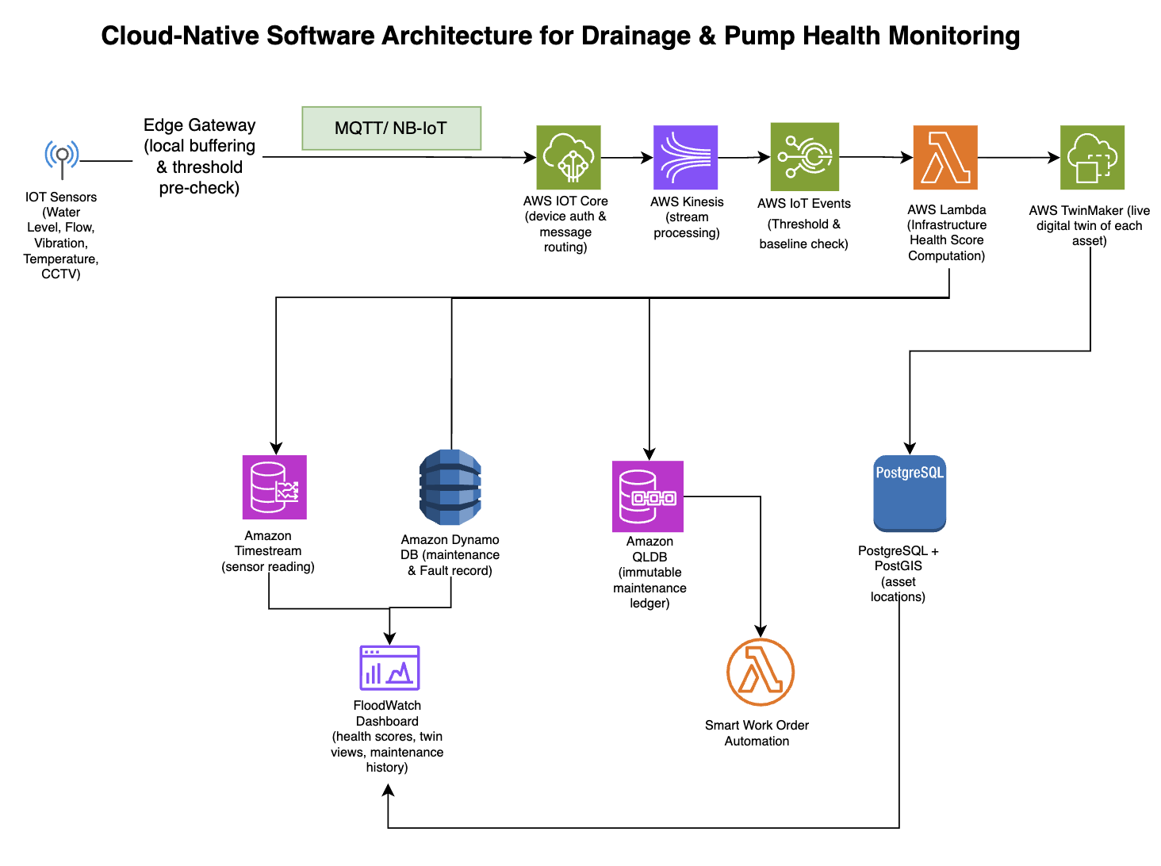

Slide 13
Serverless Layered Architecture (AI-Based Flood Prediction & Risk Analysis)
Application Layer
Database Layer (Multi AZ)
External Data Source
VPC
Spatial Data
REST API
Req/Res
Processing Layer
Historical Data
CCTV Streams and IoT Devices (Sensors & Motorized Gates)
HTTPS
Request GIS Map Overlay Lambda
AWS IoT
TwinMaker
AWS RDS
Postgresql + PostGIS
NEA Weather
Forecast Lambda
Prediction and Impact Analysis
Latest Data
AWS
Sagemaker
AWS Elasticache (Redis)
Read Data
IoT Rule
Invoke AI Inference Lambda
MQTT over TLS
AWS IoT Core
Real-Time Sensor Processing Lambda
Real-time Data
Flood Prediction and Impact Analysis Report Lambda
AWS Timestream
- Water Level Sensor
- Rain Gauge Sensor
- Flow Sensor
Document Data
IoT Devices
AWS DynamoDb
Send Reports to Downstream Agencies Lambda

Slide 14










Tactical Ground Situational Awareness & Operational Feeds
Data Sources
AWS Cloud Infrastructure
HTTPS
(TLS)
IoT Devices
API Gateway
Vision Processing Lambda
(Container)
CCTV
Sensors
HTTPS
EventBridge
Trigger
Citizen App
Incident Ingestion Lambda
Function 3 : Early Warning & Alert Dissemination System
Amazon S3
(Frame Artifacts)
Amazon DynamoDB
(Incident Logs)
Shared Data (Function 1 & 3)
REST /
WebSocket
Amazon Neptune
(Dynamic Tactical
Routing Engine)
PostGIS Operational Map Feed Service
Operational Response Dashboards
(PUB QRT / SCDF / LTA / SPF)
Amazon Timestream

