Slide 1
GOSPEL CHURCH OF CHICAGO
Website Project Brief
English-first, with a short Korean section — simple enough for volunteers to maintain
Current site: http://gospelchurch1.com/index.php
For freelance web designers · August 2026
Notes:
Thank you for your interest. This brief covers the goal, platform, pages, design direction, handoff, and budget. Questions welcome at the end.

Slide 2



The goal
One sentence to anchor every decision
Church owns everything
A warm, Christ-centered, clean, professional website — without being complicated.
Account, domain, and subscription are ours.
Volunteers can update it
Non-technical staff edit text, photos, events.
Simplicity and ease of maintenance come first.
Simple beats clever
No custom code, no complex features.
Notes:
The most important requirement: after handoff, church staff and volunteers must be able to update the site themselves. Every other choice should serve that.

Slide 3



Where we are today
gospelchurch1.com — custom-built, Korean-first, no HTTPS
Keep
Retire
Decide
YouTube playlists
Address & phone
Pastor's greeting
Prayer requests
Missions news
Korean school
Community board
Legacy banners
Bulletins (주보)
Photo gallery
Church email (not personal)
Notes:
The current site is a custom PHP site on plain HTTP. It has good YouTube content and contact info we can reuse. Korean school pages are no longer needed. Missions stays as its own page.

Slide 4
Platform & theme
Either platform is fine — recommend one and say why
Squarespace
Wix
Cove (church template)
Safe Haven (church template)
Any clean nonprofit template
Trinity Urban Church
Any Religion-section template
Built-in Events and donation tools
Easiest editor for volunteers; templates can be switched later.
Note: a Wix template cannot be changed later without rebuilding.
No custom-coded website.
Notes:
We are open to Squarespace or Wix. Please propose the one you recommend for a volunteer-maintained church site and name the template you would start from. No custom code.

Slide 5








Site map
Eight pages in English, plus a short Korean section
Home
About Us
Visit
Ministries
Missions
Sermons
Events
Give
한국어 section: one or two Korean pages — service times, pastor's greeting, prayer requests, directions. Contact info in the footer of every page.
Notes:
Keep navigation flat and simple. Contact can live in the footer and on the Visit page rather than as its own nav item.

Slide 6

Homepage must-haves
Everything a first-time visitor needs, above the scroll
Welcoming hero with church name
Upcoming events
Sunday service time
Latest sermon
Church address
Ministries overview
“Plan Your Visit” button
Giving
“Watch a Sermon” button
Contact and location
Short introduction to the church
Mobile-friendly throughout
Notes:
The two buttons — Plan Your Visit and Watch a Sermon — are the main calls to action. Service time and address should be visible without scrolling.

Slide 7
What the homepage could look like
A simple sketch — the freelancer will match this to the template
GCC
Home · About · Visit · Ministries · Missions · Sermons · Events
Give
Welcome home.
Sundays · [time] · Des Plaines, IL
[ hero photo of the congregation ]
Plan Your Visit
Watch a Sermon
Latest sermon
Upcoming events
Ministries
Footer: address · phone · church email · map · social · 한국어
Notes:
This is a sketch, not a design. Big welcoming photo, service time and address visible immediately, two buttons, then the latest sermon, events, and ministries. Korean link in the footer and header.

Slide 8
On a phone, and in Korean
Most first-time visitors will find us on a phone
GCC
≡
한국어 section
Welcome home.
A “한국어” link in the header and footer
One landing page, Korean only: 예배시간, 목사님 인사, 교회 기도제목, 오시는 길
Same YouTube playlists — no duplicate uploads
Kept short on purpose so it stays easy to update
Sundays · [time]
Des Plaines, IL
Plan Your Visit
Latest sermon
Events
Give
Notes:
Mobile first: service time, address, and Plan Your Visit within one thumb-scroll. The Korean section is intentionally small — one page the Korean congregation actually uses, not a full mirror site.

Slide 9
Real examples to match
Browse these live demos — we like the warm, clean, photo-led style
Squarespace church templates
squarespace.com/website-templates/church
Cove and other church-specific layouts
Wix religion templates
wix.com/website/templates/html/communities/religion
Trinity Urban Church and similar
Safe Haven (Squarespace)
websitesbyelise.com/squarespace-designer-blog/squarespace-church-templates
Warm, modern church template review
Paste 1–2 screenshots of your favorite demo here before presenting.
Notes:
Open one or two of these live demos during the meeting so the freelancer sees the style we want. Ask them which template they would start from.

Slide 10
Core pages
About Us · Visit · Ministries · Missions
About Us
Visit
Ministries
Missions
Who we are
What we believe
Our story
Leadership
Service time
Directions
Parking & transit
Kids ministry
What to expect
Children
Youth
Young Adults
Adults
Easy to add/remove
Where we serve
Our missionaries
News & updates
Get involved
Notes:
Visit page should include a Plan Your Visit button. Ministries must be an easy-to-edit section so the church can add or remove items without help.

Slide 11

Core pages
Sermons · Events · Give · Contact
Sermons
Events
Embed the church YouTube channel so new sermons appear automatically.
Name, date, time, location, description, image, optional registration link.
Give
Contact
Simple page with a button to our existing giving platform. No custom payments.
Address, phone, email, contact form, Google Map, and social media links.
Notes:
Sermons: integrate YouTube so the site does not need rebuilding each week. Give: link out, do not build a payment system.

Slide 12
Design direction
Professional but not corporate
Modern
Clean
Welcoming
Christ-centered
Mobile-friendly
Easy to navigate
Attractive
Uncomplicated
Please avoid: excessive animations, complicated features, and anything a volunteer could not safely edit. Simplicity and ease of maintenance beat visual flourish every time.
Notes:
Warm and welcoming, not flashy. Think of a first-time visitor on a phone: can they find the service time and address in five seconds?

Slide 13
Scope & handoff
Setup only — the church supplies all content
Freelancer delivers
Video walkthrough covers
Set up template, 8 pages + Korean page
YouTube, Events, Give, contact form
Transfer admin, domain, logins
30–60 min video walkthrough
Written upkeep instructions
Edit text
Change photos
Add and edit events
Add and remove ministries
Update service information
Add sermons
Make basic website changes
Notes:
The church should never need to hire the freelancer for routine updates. The video walkthrough and written guide are part of the deliverable, not extras.

Slide 14




What the church provides
Ready before work begins, so setup stays fast and cheap
All page text
Photos and logo
English pages, missions info, and the Korean page text
Service, people, building — high resolution
Accounts and links
Service details
YouTube channel, giving platform link, social links
Time, address, parking, transit, children's ministry
Notes:
Content is the biggest cost driver. If the church hands over finished text, photos, and links up front, the freelancer only has to set things up.

Slide 15
Budget & your proposal
$300–$600
Please include in your proposal
Examples of church or nonprofit sites you built
Platform and template recommendation
Fixed price and timeline
What is and is not included
Setup only — 8 English pages + 1 Korean page
Thank you — we look forward to your proposal.
Notes:
Budget is $500 to $1,000. Ask for examples of similar church or nonprofit sites, a platform recommendation, timeline, and a clear scope.

Slide 16
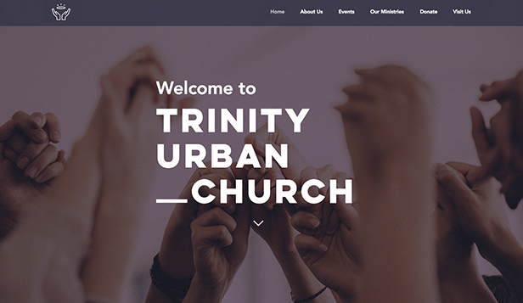
Examples

Slide 17
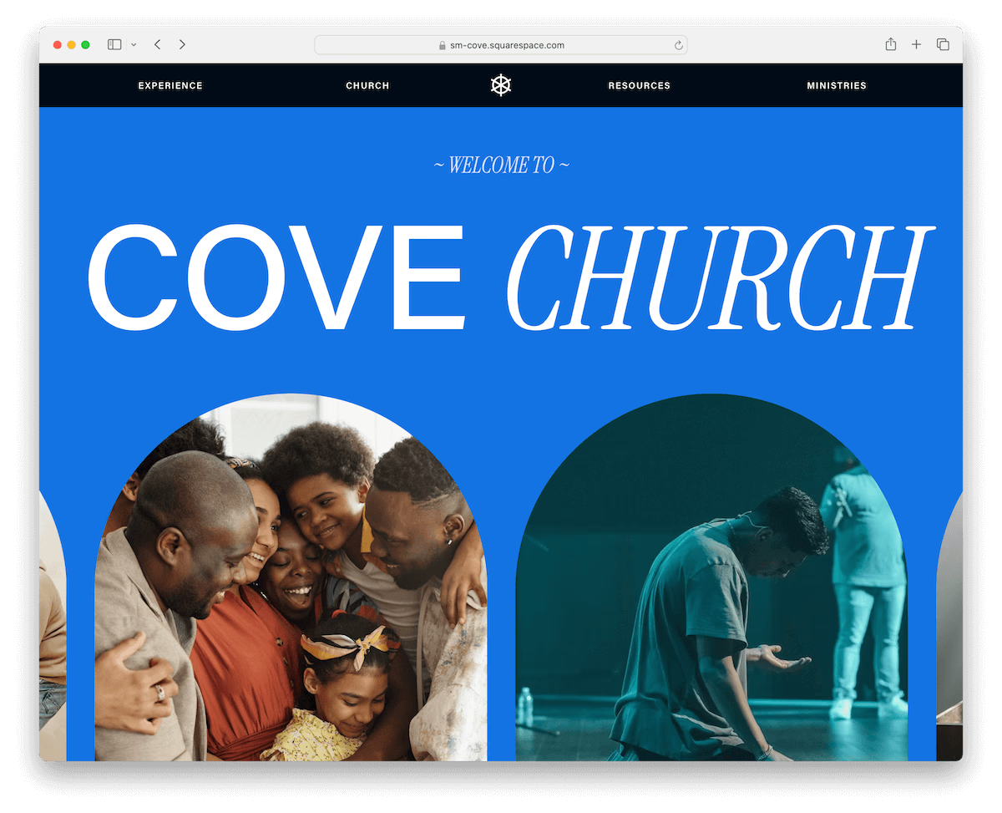
Examples

