Slide 1
Team ΔΣβ (DSB) presents
Sacramento County
Flu Shot Text Notifier
To easily inform and engage the public to reduce high risk influenza scenarios

Slide 2
Improve Public Health by immunizing more people against influenza
Goal

Slide 3
People forget or get busy
Clinics change time/location without notice
Info not easy to find, or not readily available
Challenges

Slide 4
Solution?
Text Messages! :-)

Slide 5
Text
“flu shot”
to
31996

Slide 6
Estimated 98% open rate
No smart phone required!
No app download, no additional push notifications
Advantages

Slide 7
Automated, scheduled texts
Retention of interested contacts
Easy to share with friends
Easy to sign up
Easy to market
Advantages continued..

Slide 8
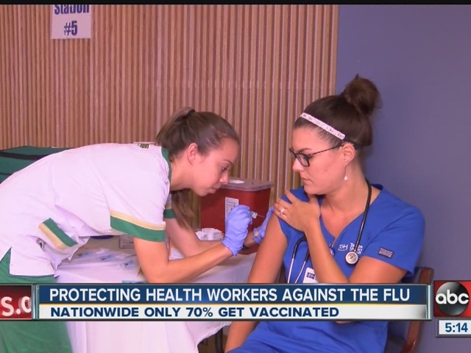
Text “flu shot” to 31996

Slide 9
Demo

Slide 10
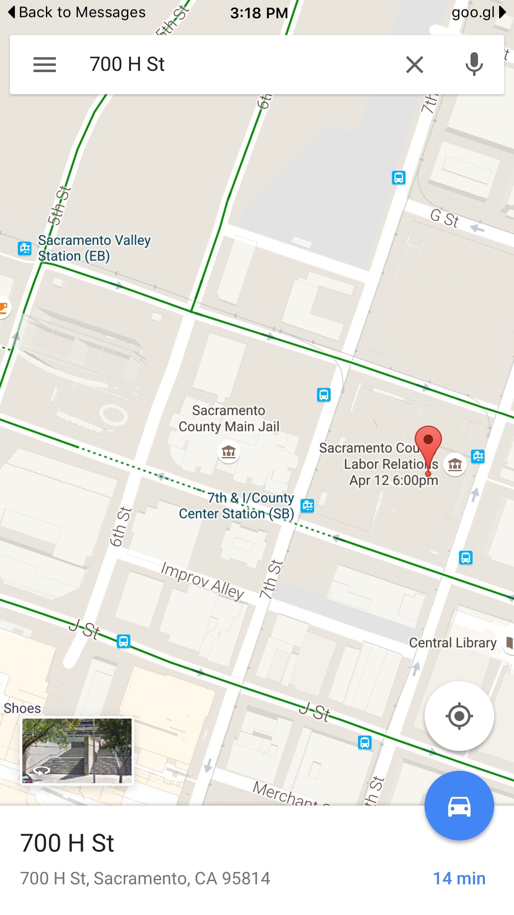
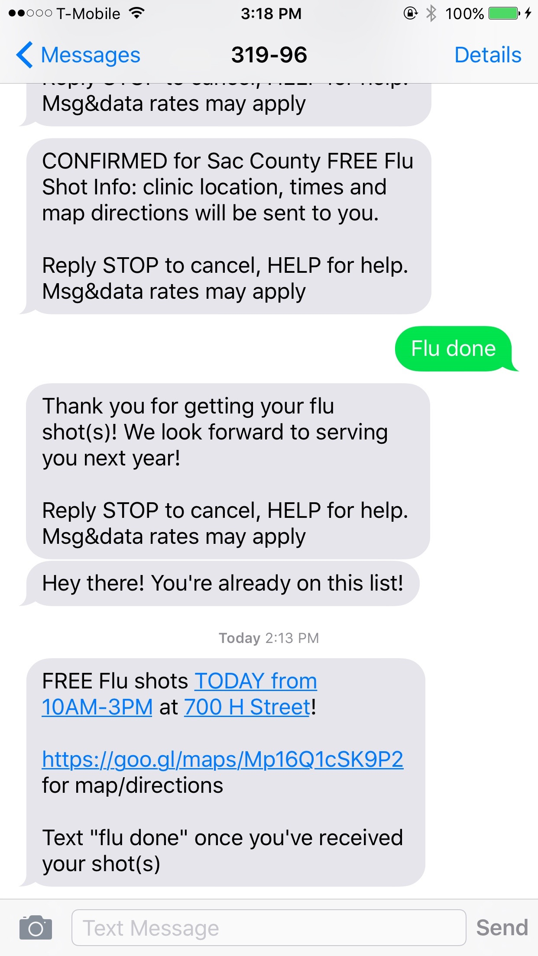

Slide 11
FAQs
When can it going live?
Currently live (feasible)
What does it cost?
$0.95 - $2.60/day (sustainable)
That’s nice, is it useful for anything else?
Emergency outbreak response, feedback gathering

Slide 12
Our solution is the fastest iteration to a working solution
A ultra low cost tool that engages citizens with flu clinics where they are
TL;DR

Slide 13
Team ΔΣβ (DSB)
Joseph Lei
joseph.lei@gmail.com
josephlei.com
github.com/josephlei
Special Thanks
Laura McCasland Sacramento DHHS
Megan Kregor Sacramento D-Tech

