Slide 1

PROJECT PRESENTATION
E-Commerce Sales Analytics
& Customer-Churn MLOps Pipeline
PROJECT SNAPSHOT
1,067,371
raw transaction rows
An end-to-end pipeline that predicts which customers stop buying
768,873
validated transactions
PRESENTED BY
0.782
Rachit Joseph
Dr Swastisudha Punyatoya
USN 1CR23CI041
Guide | Dept. of AI & ML
held-out test ROC-AUC
CMR Institute of Technology, Bengaluru

Slide 2
CMRIT | MLOPS
PROJECT PRESENTATION
Project Objectives & Pipeline
1,067,371
768,873
62,607
0.782
raw transaction rows
rows passed validation
labelled customer snapshots
held-out test ROC-AUC
Why does customer churn matter?
How the pipeline helps
Keeping a customer costs far less than winning a new one, so knowing who is about to stop buying is directly valuable to the business.
Step 1: Build the warehouse
PHASE 1
Airflow ingests 25 monthly extracts, validates them against four explicit rules, and loads a PostgreSQL star schema.
A deployed model decays quietly as the data it scores drifts away from its training data.
Retraining on a fixed schedule can replace a working model with a worse one.
PHASE 2
Step 2: Model and operate
Train three candidates on a chronological split, register the winner in MLflow, serve it through an API, and monitor it for drift.
Our goal is to predict churn and keep the deployed model trustworthy over time.
Goal: retrain on measured evidence of decay, never on a fixed schedule.
Rachit Joseph | USN: 1CR23CI041
CMRIT
2

Slide 3
CMRIT | MLOPS
PROJECT PRESENTATION
Dataset & Data Quality
2009-2011
25
1,067,371
period covered by the source data
monthly landing files extracted
raw transaction rows ingested
Where does the data come from?
How we guarantee data quality
UCI Online Retail II dataset (Dec 2009 - Dec 2011)
Landing CSVs
›
Validation
›
Star schema
25 monthly extracts
four explicit rules
facts + dimensions
1,067,371 transaction rows across 25 monthly landing files.
A one-time script slices the public workbook into monthly CSV extracts.
Rows are checked against four rules before they reach the warehouse.
meta.ingestion_log records every file load, so a re-run skips it.
261,822 rows (24.5%) were rejected, each stored with its reason.
No final analytical table is ever edited by hand.
The fact load deduplicates, so re-running never doubles the data.
Rachit Joseph | USN: 1CR23CI041
CMRIT
3

Slide 4
CMRIT | MLOPS
PROJECT PRESENTATION
Pipeline Architecture & Orchestration
Automated path from the monthly extracts to the warehouse, dashboard and prediction API
UCI source
Extract
Validate
Warehouse
Consumers
Online Retail II workbook
Landing CSVs to raw.sales_raw
Four rules to staging tables
PostgreSQL star schema
Dashboard + churn API
AUTOMATION
ONE-CLICK RUNNER
Airflow orchestrates retail_etl and churn_ml, with retries.
demo.bat / demo.ps1 brings the whole stack up.
Validation funnel, in rows
Raw rows ingested
Passed validation
Rejected with reason
Fact rows loaded
1,067,371
768,873
261,822
768,865
HELD-OUT TEST ROC-AUC
0.782
Every task is idempotent: a second run changes no row counts.
Rachit Joseph | USN: 1CR23CI041
CMRIT
4

Slide 5
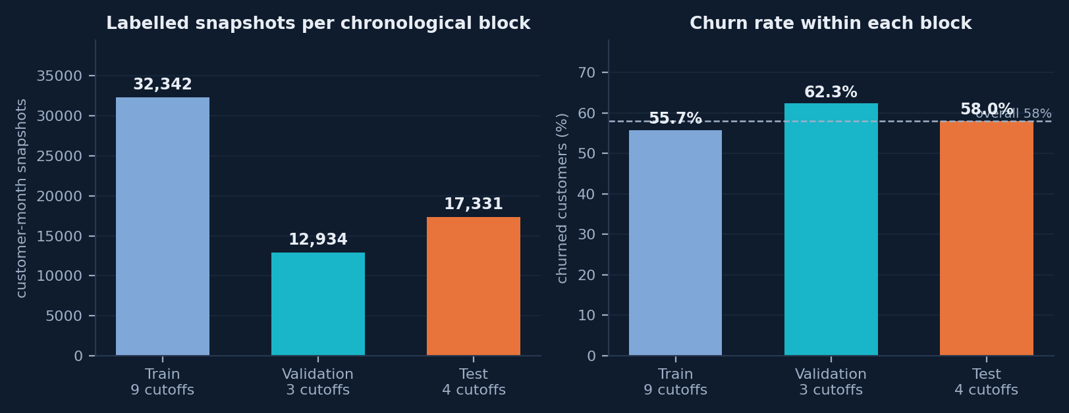
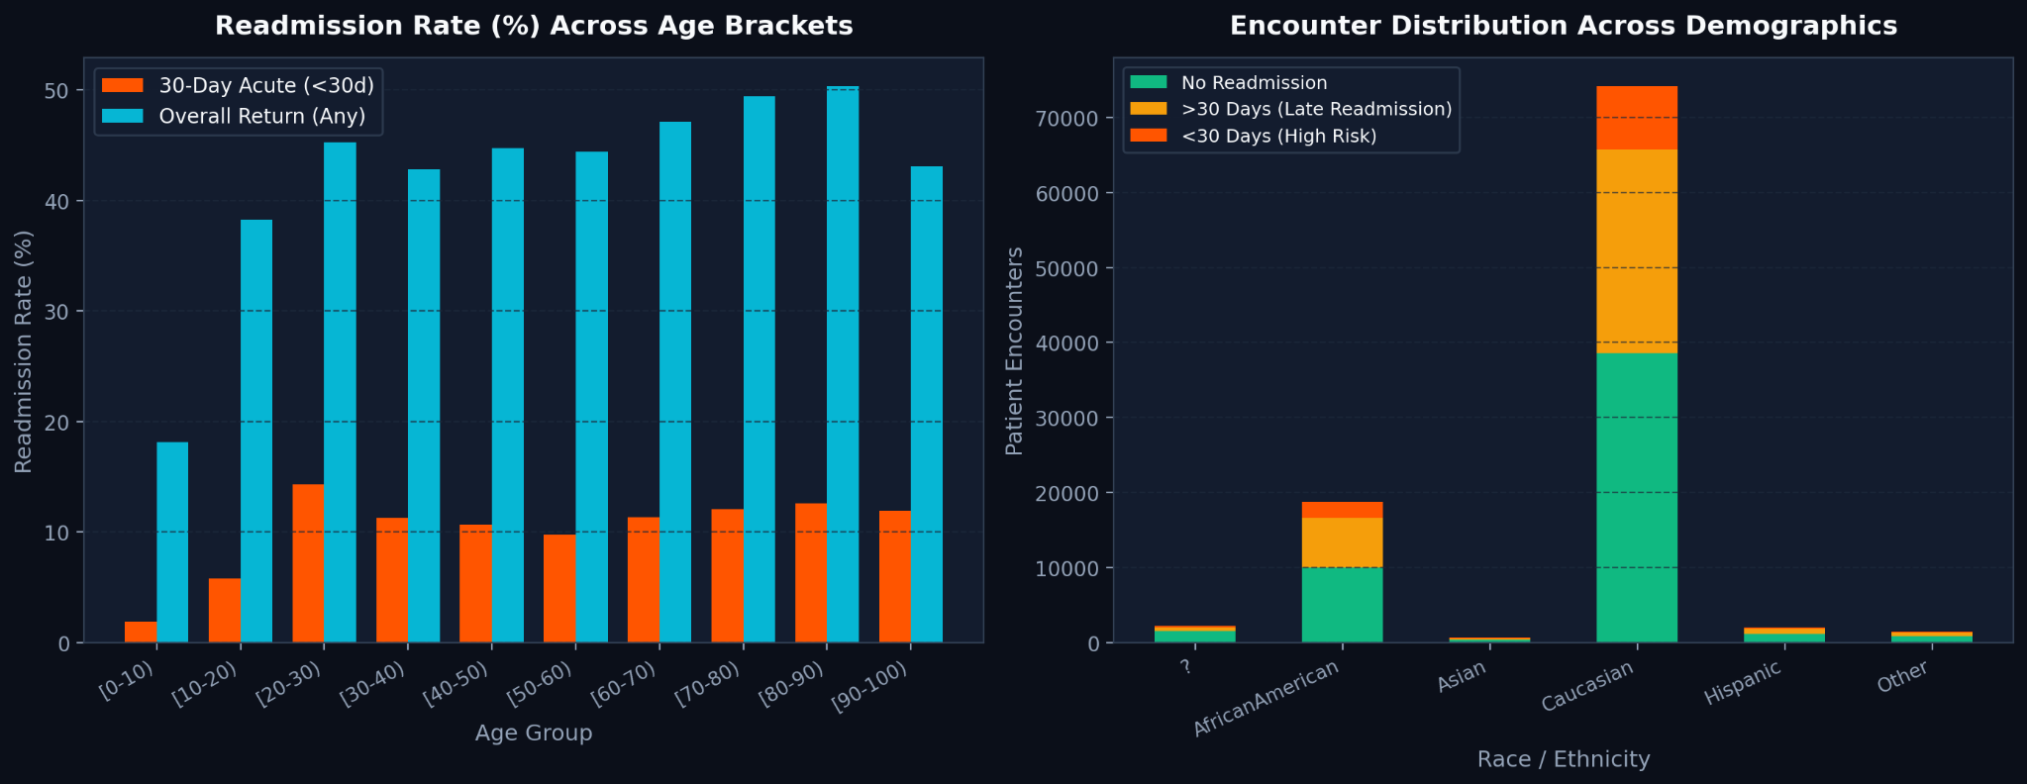
CMRIT | MLOPS
PROJECT PRESENTATION
Churn Definition & Snapshot Design
KEY INSIGHTS
• Definition: a customer is churned at a cutoff if they place no order in the next 90 days.
• Eligibility: only customers who bought in the previous 365 days are scored at all.
• Volume: 62,607 labelled snapshots across 16 month-end cutoffs.
• Split: 9 / 3 / 4 cutoffs, cut in time so no customer's future can leak.
Rachit Joseph | USN: 1CR23CI041
CMRIT
5

Slide 6
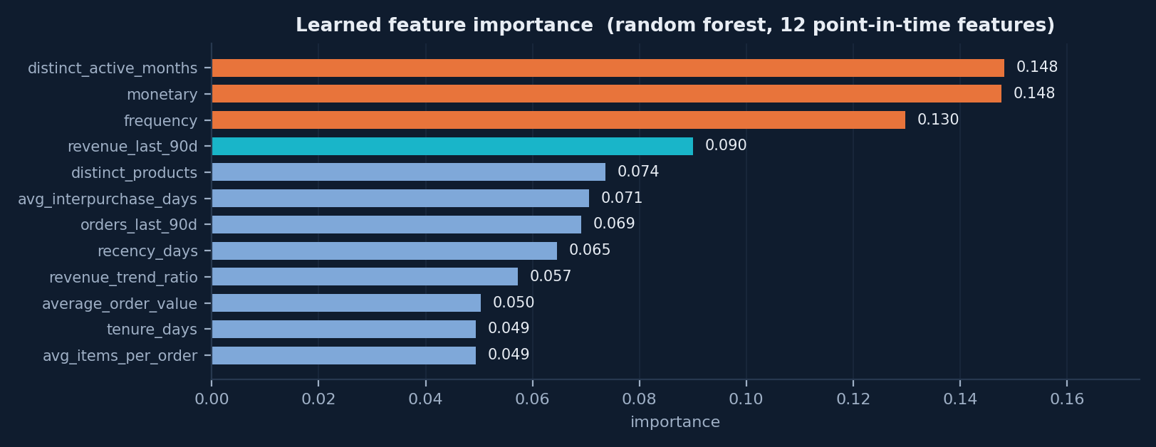
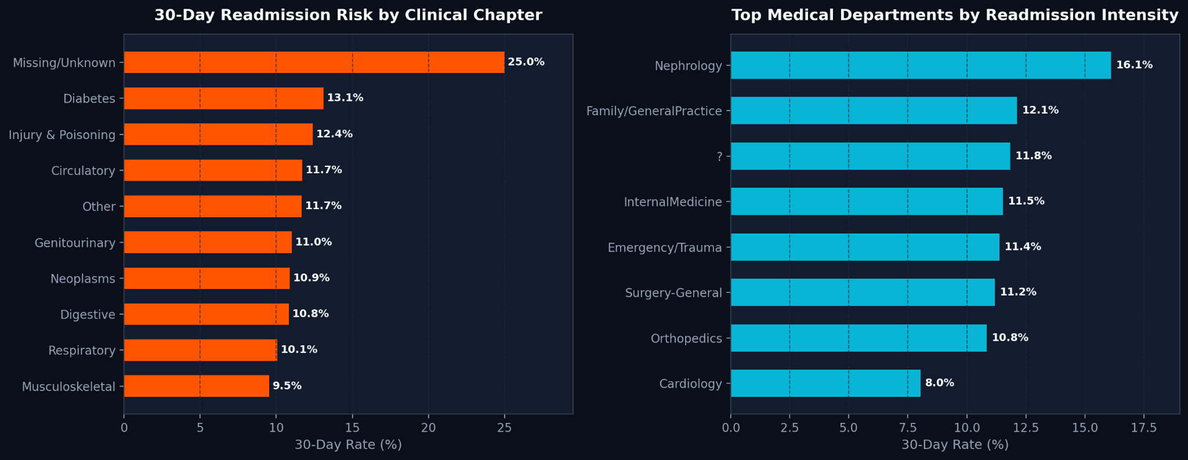
CMRIT | MLOPS
PROJECT PRESENTATION
Feature Engineering & Leakage Control
KEY INSIGHTS
• Point-in-time: all 12 features use only data on or before the cutoff.
• Strongest signals: engagement breadth and monetary value outrank recency alone.
• Reading it: the model separates a weakening habit from a customer simply between orders.
• Leakage test: appending a year of future data changes no feature value.
Rachit Joseph | USN: 1CR23CI041
CMRIT
6

Slide 7
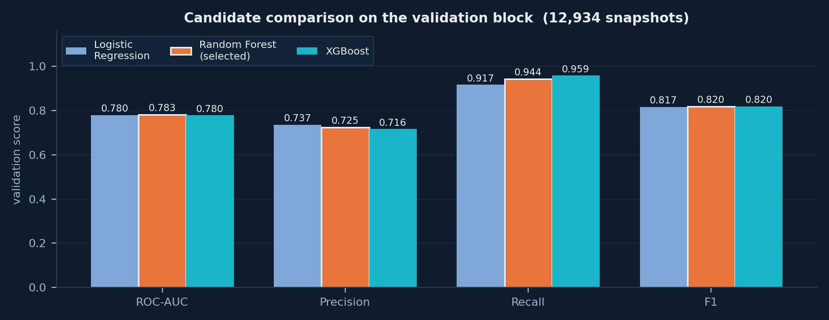
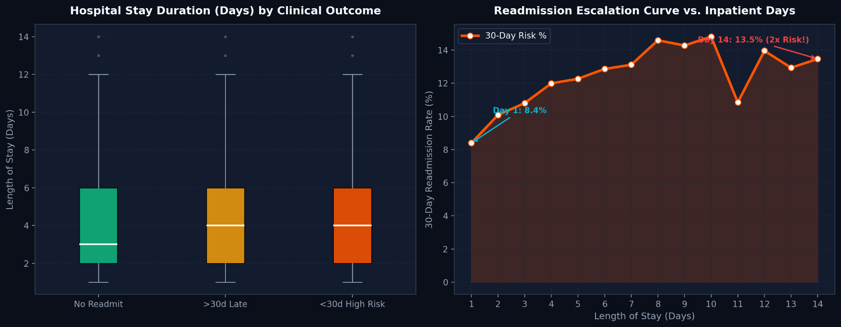
CMRIT | MLOPS
PROJECT PRESENTATION
Model Comparison & Selection
KEY INSIGHTS
• Three candidates: logistic regression, random forest and gradient-boosted trees.
• Selection rule: highest validation ROC-AUC, judged before any threshold is set.
• Winner: random forest at 0.783, registered as retail-churn-classifier.
• Threshold: tuned on validation only to 0.34, deliberately biased to recall.
Rachit Joseph | USN: 1CR23CI041
CMRIT
7

Slide 8
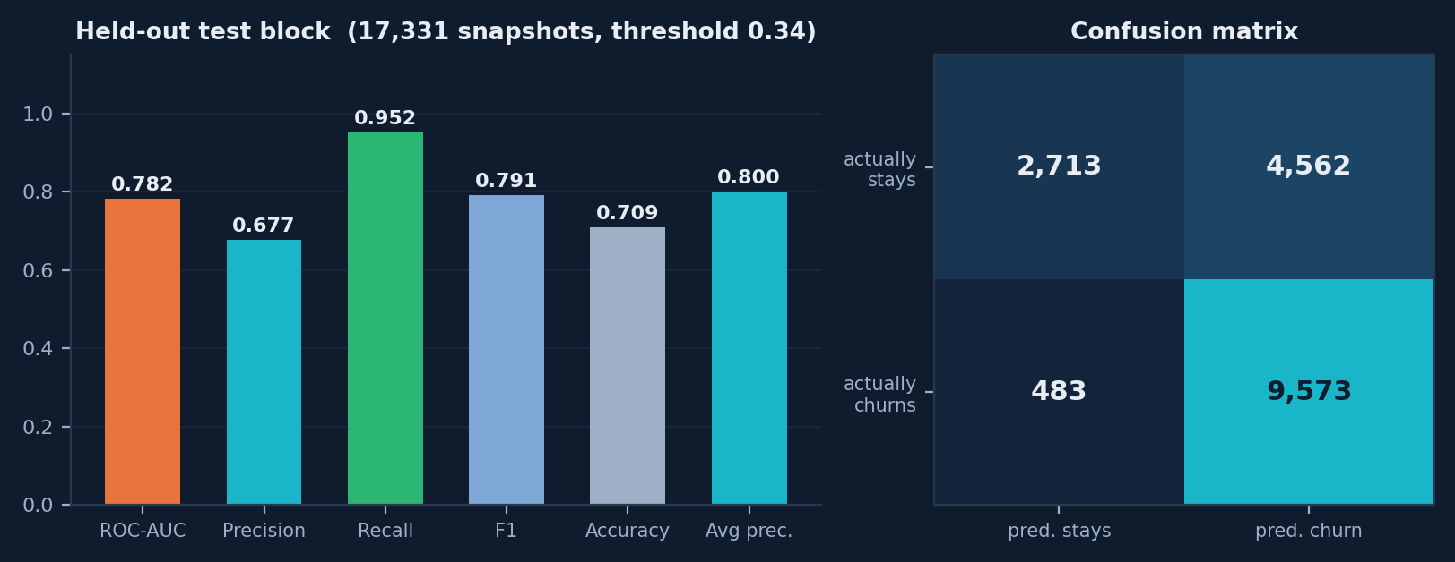
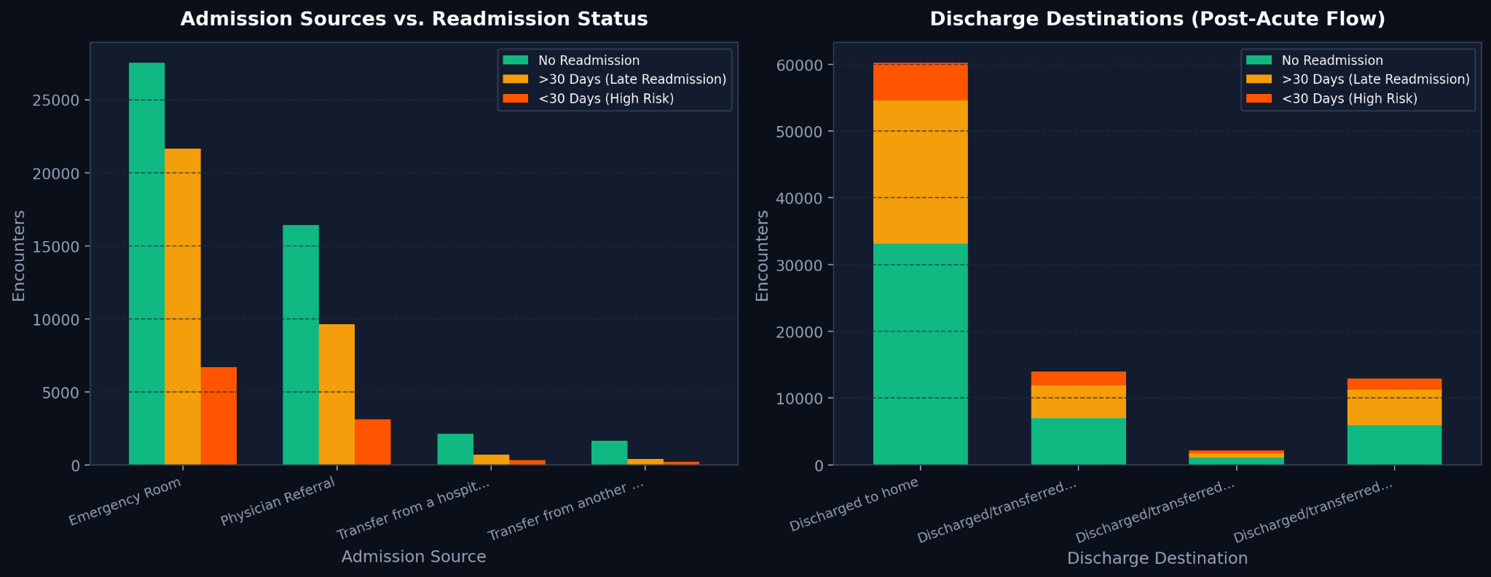
CMRIT | MLOPS
PROJECT PRESENTATION
Held-Out Test Performance
KEY INSIGHTS
• Evaluated once: 17,331 snapshots, strictly later than every training cutoff.
• Result: ROC-AUC 0.782, precision 0.677, recall 0.952, F1 0.791.
• Generalises: test 0.782 against validation 0.783 indicates no overfitting.
• Trade-off: 483 missed churners against 4,562 false alarms, by design.
Rachit Joseph | USN: 1CR23CI041
CMRIT
8

Slide 9
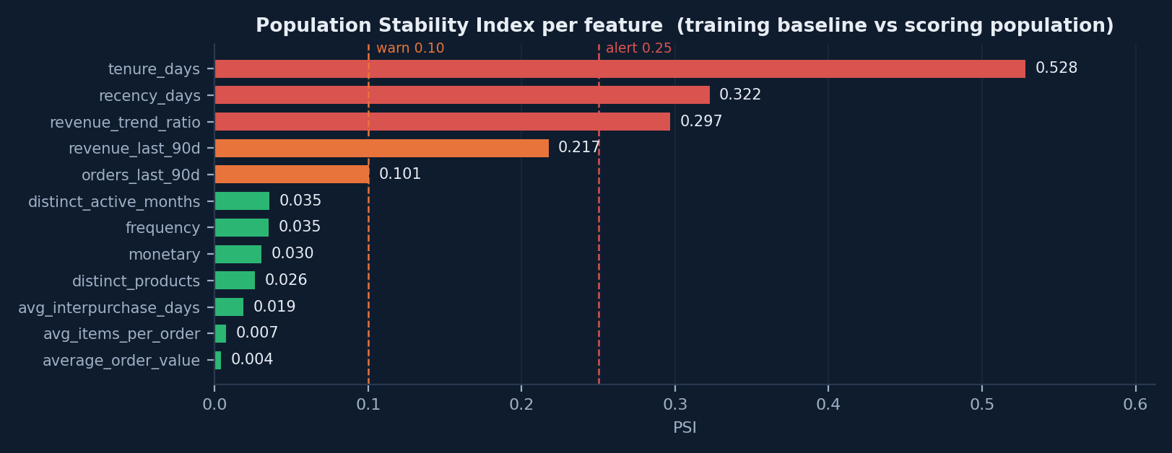
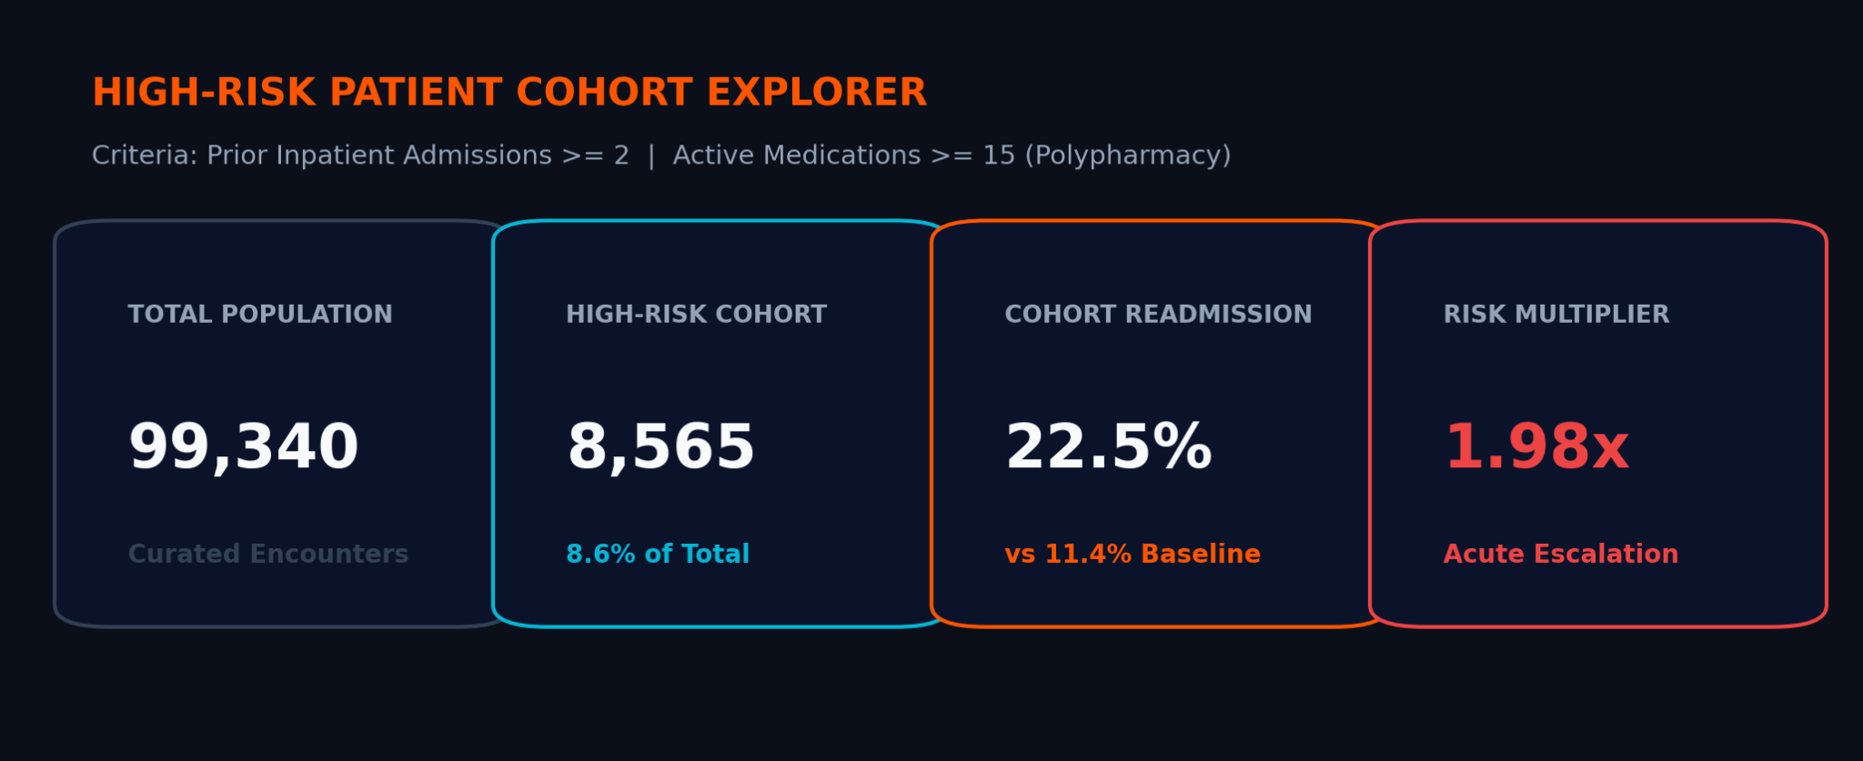
CMRIT | MLOPS
PROJECT PRESENTATION
Drift Monitoring with PSI
KEY INSIGHTS
• What drifted: tenure_days 0.528, recency_days 0.322, revenue_trend_ratio 0.297.
• Why: the scoring cutoff sits three months after the last training cutoff.
• Stable: nine of the twelve features stayed below the warning threshold.
• Outcome: status action_required, so a retrain was recommended on evidence.
Rachit Joseph | USN: 1CR23CI041
CMRIT
9

Slide 10
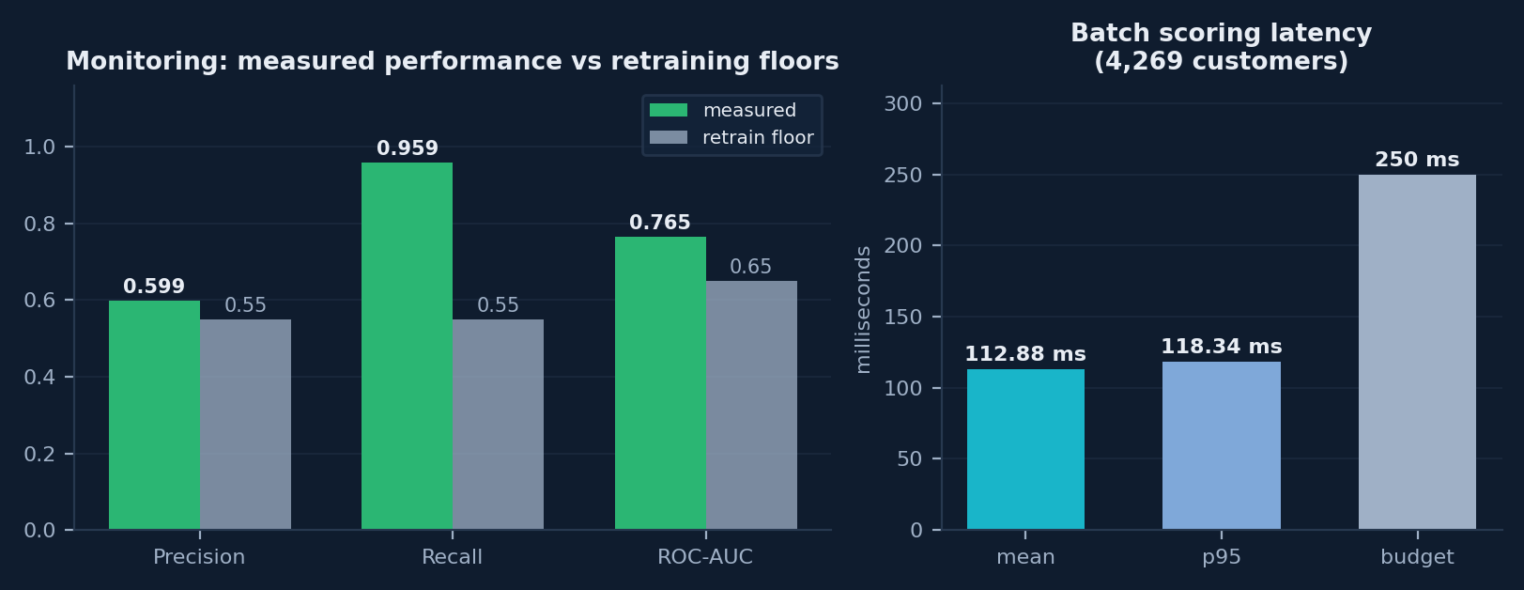
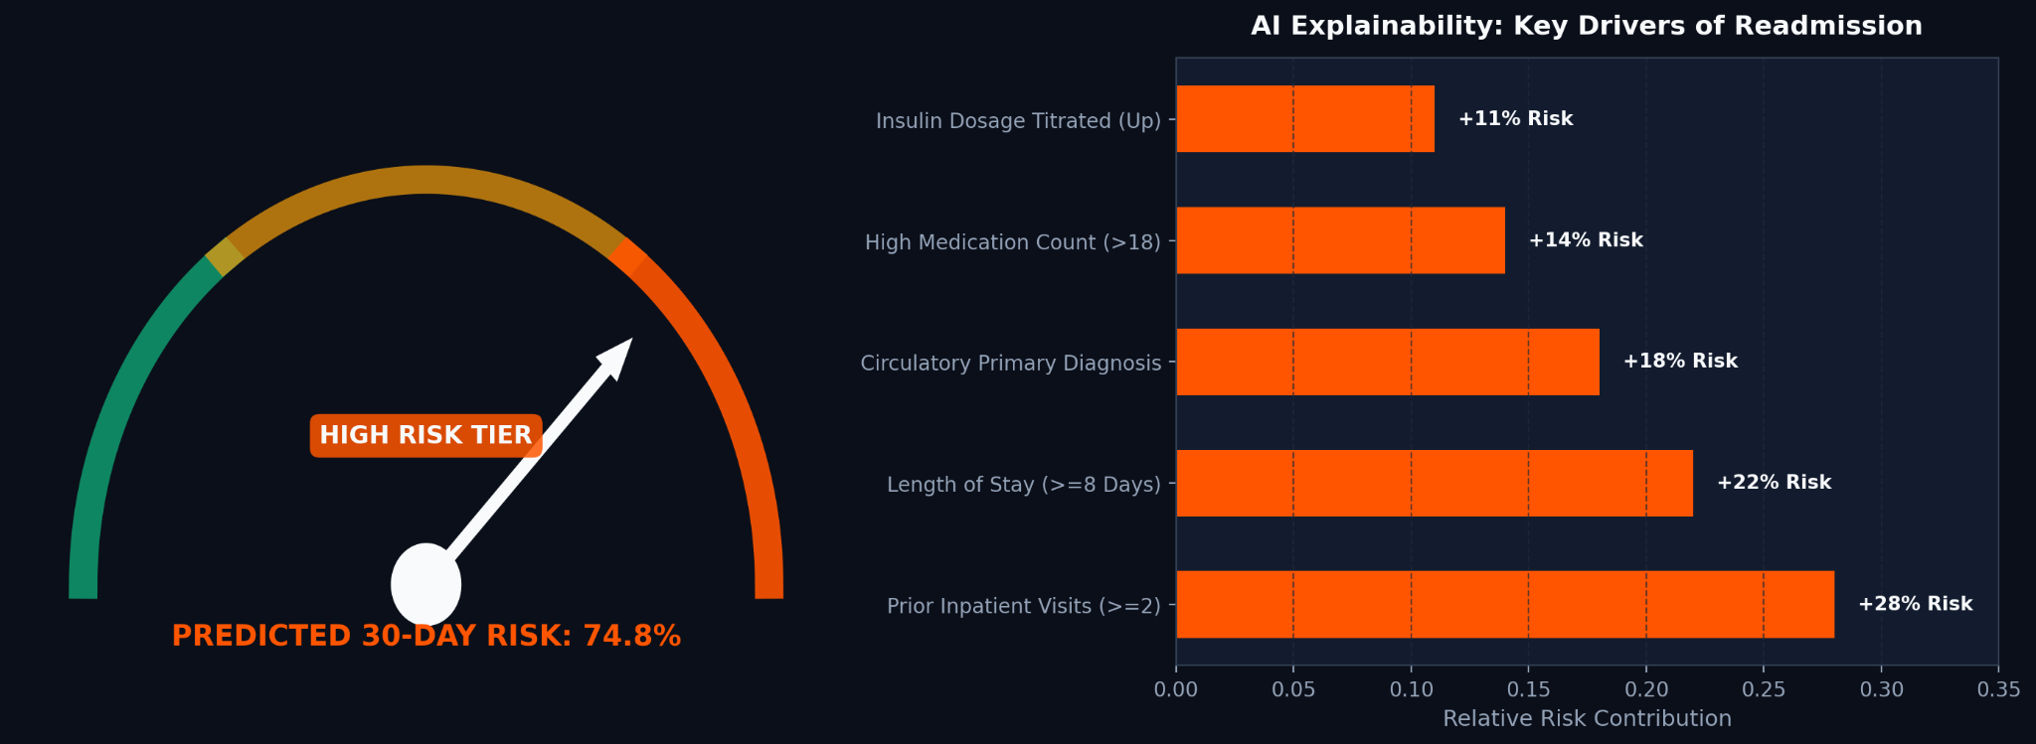
CMRIT | MLOPS
PROJECT PRESENTATION
Serving, Monitoring & Retraining
HOW THE PREDICTOR WORKS
• Floors passed: precision 0.599, recall 0.959 and ROC-AUC 0.765 all clear their limits.
• Latency: 4,269 customers scored at a p95 of 118 ms against a 250 ms budget.
• Short-circuit: the weekly DAG skips retraining unless a criterion actually fires.
• Registry: retail-churn-classifier sits at v2, produced by the DAG's own retrain.
• Example shown: The supplied chart displays a predicted 30-day risk of 74.8%.
Rachit Joseph | USN: 1CR23CI041
CMRIT
10

Slide 11
CMRIT | MLOPS
PROJECT PRESENTATION
Summary & Project Highlights
What the project does, from raw retail transactions to an operated churn model
01
Data Source
05
Model Selection
UCI Online Retail II
LR, Random Forest and XGBoost compared
Dec 2009 - Dec 2011, 25 files
Random forest won on validation
02
Validated Warehouse
06
Test Performance
261,822 rows rejected with reasons
ROC-AUC 0.782, recall 0.952
768,865 fact rows loaded
Evaluated once on a later block
03
Leakage-Free Features
07
Serving + Dashboard
12 point-in-time features
FastAPI service and Streamlit views
Verified by an automated test
p95 scoring latency 118 ms
04
Chronological Split
08
Monitoring + Retraining
9 / 3 / 4 month-end cutoffs
PSI drift, performance and latency
No customer's future can leak
Retrains only when a criterion fires
Scores prioritise retention outreach; they do not set prices or replace judgement.
Rachit Joseph | USN: 1CR23CI041
CMRIT
11

Slide 12
CMRIT | MLOPS
PROJECT PRESENTATION
Thank You
Questions & Discussion
E-Commerce Sales Analytics & Customer-Churn MLOps Pipeline
Rachit Joseph | USN: 1CR23CI041
CMRIT
12

