Slide 1
EASEMENTS IN COLORADO
Mark Cohen, J.D. LL.M.
Boulder, Colorado
(303) 638-3410
mark@cohenslaw.com
www.cohenslaw.com

Slide 2
EASEMENT
TERMINOLOGY
Notes:
Words with different meanings are sometimes used interchangeably.

Slide 3
Easement Terminology
Lawyers that don’t use proper terminology put themselves and their clients at risk.
“In the event the Real Estate purchase is closed, Seller grants to Buyer an easement and/or license to use the fields and wooded areas of Seller's remaining property for horse related activities including trail riding.”
Holding: Ambiguity construed against the drafter, so the document was a license. Christiansen v. Schuhart, 951 N.E.2d 107(Ohio. App. 2011)
Notes:
An easement is not the same as a license.

Slide 4
Easement Defined
Colorado law defines an easement as “an interest in property which, though distinct from an ownership interest in the land itself, nevertheless confers on the holder an enforceable right to use the property of another for a specific purpose.”
Wright v. Horse Creek Ranches, 697 P.2d 384, 387-388 (Colo. 1985).

Slide 5
Easement Defined
An easement is a right conferred by (1) grant, (2) prescription, or (3) necessity authorizing one to do or maintain something on the land of another “which, although a benefit to the land of the former, may be a burden on the land of the latter.”
Barnard v. Gaumer, 361 P.2d 778, 780 (Colo. 1961).
Case law suggests an easement can also be created by (4) implication from preexisting use, or (5) estoppel.

Slide 6
Types of Easements
EXPRESS EASEMENTS:
Express Easements (created by grant or reservation in a deed, easement agreement, covenants, or plat)
OTHER EASEMENTS (will require a court decree to establish)
Easements by Necessity
Easements Implied by Pre-existing use
Prescriptive Easements
Easement by Estoppel
R.S. 2477
Condemnation of a Way of Necessity pursuant to the Colorado Constitution
Notes:
There is a reason I listed condemnation last.

Slide 7
Easement v. License
A license is merely a personal privilege to do some particular act or series of acts on land without possessing any estate or interest therein. Condry v. Laurie, 184 Md. 317, 41 A.2d 66. See, Eastman v. Piper, 68 Cal.App. 554, 229 P. 1002. See also, American Coin Meter v. Poole, 503 P.2d 626 (Colo. App. 1972).
A license is, ordinarily, revocable at the will of the licensor and is not assignable. Radke v. Union Pacific R.R., 334 P.2d 1077 (Colo. 1959).

Slide 8
Easement v. License
A license is sufficient to establish access under a title policy. Fid. Nat'l Title Ins. Co. v. Woody Creek Ventures, LLC, 830 F.3d 1209 (10th Cir. 2016). The court held that a 30 year revocable right of way was sufficient to constitute “access” under a title policy, so the owner’s claim against the title company based on an alleged lack of access as dismissed. The court noted a claim might arise if the owner ever lost that access, but that was “a question for another day.”
But will a license be sufficient access for a county to issue a building permit? Counties generally require “legal access” 24/7/365. A revocable license may not satisfy this requirement.

Slide 9
Easement v. License
Courts consider five factors in determining whether the parties intended to create an easement or a license.
1. Manner of creation of right (oral or written). The existence or absence of words that are ordinarily used in the conveyances of real estate is an important factor.
2. Nature of right created. The creation of a right to be used in a particular portion of the servient estate indicates that an easement was intended. Likewise, the existence of authority in the holder of the right to maintain or improve the burdened property suggests an easement.
.
3. Duration of right. A set duration indicates an easement. A grant in perpetuity also indicates an easement. Further, an express provision that the right benefits its holder's successors and assigns supports the conclusion that an easement was intended.
4. Amount of consideration, if any, given for right. Substantial consideration indicates an easement. In this regard, it is necessary to distinguish consideration given for the right from money expended in reliance upon the right.
5. Reservation of power to revoke right. An express reservation of the power to cancel, revoke, or terminate the right may be considered to indicate a license.
Bruce & Ely, The Law of Easements & Licenses in Land § 1:5, pp. 1–12 to 1–17.

Slide 10
Easement v. Right of Way
Problems arise because of inconsistent use of “right of way.” Lawyers will sometimes see, “An easement for a right of way” or a grant of a “right of way” that does not use the word “easement.”
In some instances, the terms may be synonymous:
Deeds which in the granting clause convey a right-of-way over, across, or upon certain lands devolve a right only, and are generally construed as creating an easement. See, Board of County Commissioners v. Morris, 362 P.2d 202 (Colo. 1961); Farmers Reservoir & Irrigation Company v. Sun Production Company, 721 P.2d 1198 (Colo. App. 986)

Slide 11
Easement v. Right of Way
In some instances, the terms may not be synonymous. Many statutes refer to specific rights of way:
Right of way fences. 35-46-111, C.R.S.
Railroad Right of Way. 43-1-1302, C.R.S.
RS 2477 was adopted in 1866. It states, in its entirety, that, “The right of way for the construction of highways over public lands, not reserved for public uses, is hereby granted.“

Slide 12
Easement v. Right of Way
Practice Tips:
1. If the intent is to convey an easement, use the word “easement.”
2. Avoid “right of way” to avoid confusion.

Slide 13
Easement v. a Profit
A profit à prendre -- in modern parlance, a profit -- “is an easement that confers the right to enter and remove timber, minerals, oil, gas, game, or other substances from land in the possession of another.” Restatement (Third) of Property: Servitudes § 1.2(2)(1998) Thus, a profit is a type of easement. Lobato v. Taylor, 271 P.3d 938 (Colo. 2002)

Slide 14
Affirmative and Negative Easements
An affirmative easement is the right to use another property for a specific purpose.
A negative easement is the right to prevent another from performing an otherwise lawful activity on their own property. (For example, an easement restricting a property owner from construction an addition that would block an adjacent owner’s view).

Slide 15
Easement Appurtenant and Easements in Gross
An easement in gross does not belong to an individual by virtue of her ownership of land, but rather is a personal right to use another's property. Lewitz v. Porath Family Trust, 36 P.3d 120, 122 (Colo. App. 2001).
An easement appurtenant, on the other hand, runs with the land. It is meant to benefit the property, or an owner by virtue of her property ownership. Lazy Dog Ranch v. Telluray Ranch Corp., 965 P.2d 1229, 1234 (Colo.1998).
An easement is presumed to be appurtenant, rather than in gross. Lewitz v Porath Family Trust, 36 P.3d at 120 (Colo. App. 2001); Restatement (Third) of Property: Servitudes § 4.5(2).

Slide 16
Dominant and Servient Estates
The property burdened by the easement is customarily known as the “servient estate,” while the property benefited by the easement is called the “dominant estate.” Bijou Irrig. Dist. v. Empire Club, 804 P.2d 175, 183 (Colo. 1991).
The owner of the servient estate enjoys all the rights and benefits of proprietorship consistent with the burden of the easement; while the rights of the owner of the dominant estate are limited to those connected with use of the easement. Id.
An easement in gross does not have a dominant estate, only a servient estate. Sinclair Transportation Co. v. Sandberg, 350 P.3d 924 (Colo. App. 2014).

Slide 17
Locating Existing Easements
Title policies will list all recorded easements in the Schedule B(II) exceptions. Most title companies now provide hyperlinks to the actual documents.
Recorded covenants, e.g., HOA covenants, etc. These should also be listed in the Schedule B(II).
Subdivision plats, PUD’s, etc. Easements in a plat are often listed in the Schedule B(II).
An Ownership and Encumbrances Report (O&E) will not reveal existing easements.

Slide 18
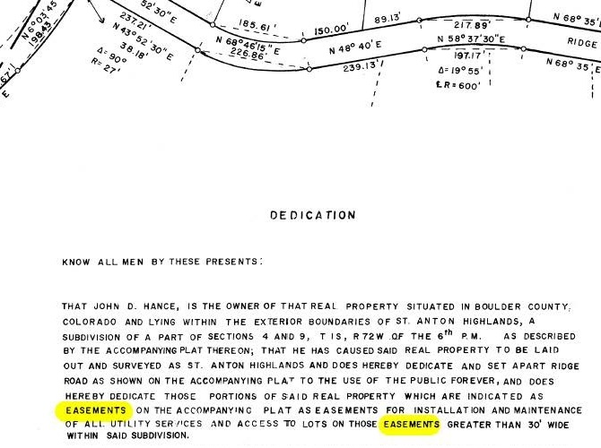
Locating Existing Easements

Slide 19
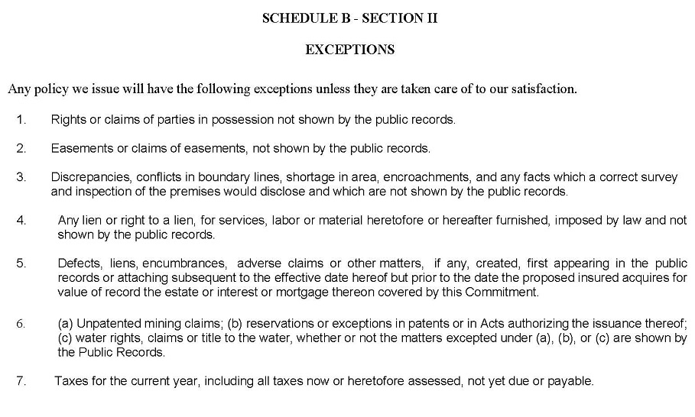
Standard Title Policy Exceptions

Slide 20
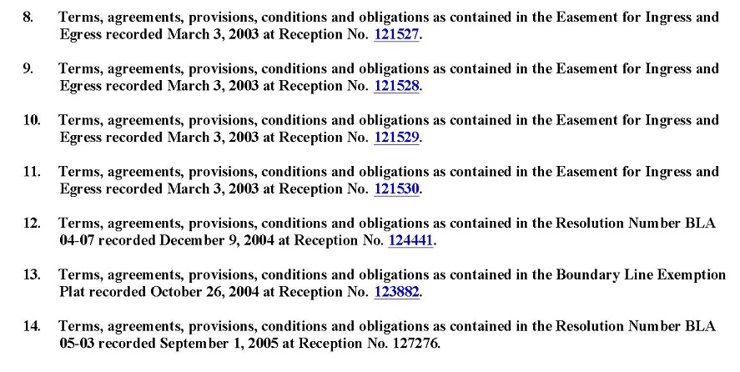
Other Exceptions

Slide 21
Easement
Purposes

Slide 22
Purposes of Easements
Some Common Purposes of Easements:
Access (ingress and egress)
Allow existing encroachments, e.g., structures, fences, retaining walls, trees, etc.
Utility easements
Easements for construction (usually for a fixed term)
Drainage easements
Easements for common areas (contained in covenants)
Negative easements (to preserve a view, for example)

Slide 23
The Importance
of Access

Slide 24
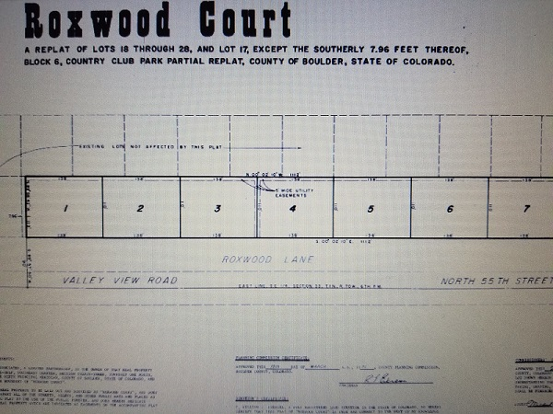
Typical Plat in a Municipal Subdivision Lot owners have direct access from a public road, so access is not an issue.

Slide 25
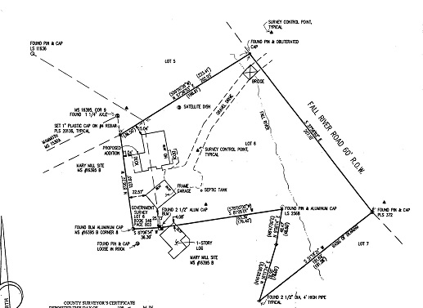
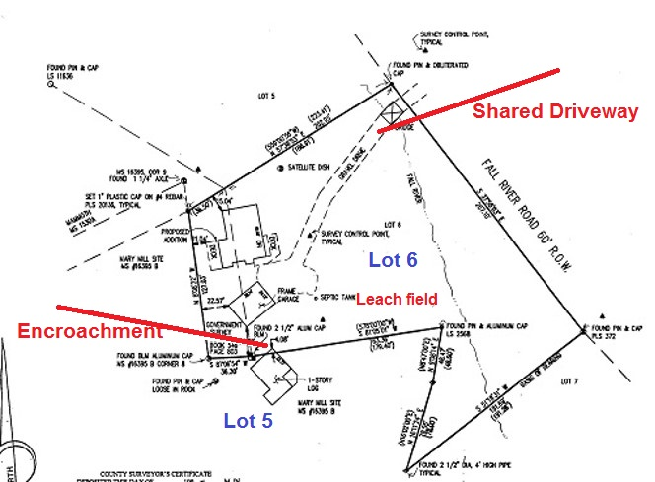
Mountain Property
Easement for bridge
Notes:
Great case. I want to set it up because it provides a great example of a lot of issues I will talk about. Common owner wanted to sell Lot 6, but granted easements over Lot 6 for benefit of Lot 5 before selling Lot 6. Talk about it. Easements for illegal purpose. Shared driveway standards. River access. Shared well and septic. Dog poop.

Slide 26
Property May Not Be Accessible by Public Road
Access is important for three reasons:
There is no point in owning a parcel if you can’t access it.
Trespass is a crime (18-4-502 et. seq. C.R.S.) and is also actionable.
The county or municipality will not issue a building permit if the owner does not have “legal access.”
Notes:
And it’s not good enough to tell county you have a prescriptive easement, they will want to see a court order or decree.

Slide 27
Ways to Establish Access
The property fronts a public road ( municipal street, county road, or state highway).
The property is in a platted subdivision accepted by the county or municipality that dedicates an easement or right of way to owners over a road that leads to a public road.
There is a recorded easement over a private road that leads to a public road. (An express easement).
The owner or buyer purchases an express easement.
Prescriptive easements and similar creatures (requires a lawsuit to obtain a decree that establishes the right).
A license. (May not be sufficient to obtain a building permit).
Notes:
This is not in a statute, it’s just my list.

Slide 28
Easements (other than express easements)
Easements by Necessity
Easements Implied by Pre-existing use
Prescriptive Easements
Easement by Estoppel
R.S. 2477
Condemnation of a Way of Necessity Pursuant to the Colorado Constitution

Slide 29
Easement by Way of Necessity
An implied way of necessity arises when the owner of a parcel of land conveys and grants part thereof to another, which leaves the remainder of the land without ingress or egress, except over the part conveyed. There are three requirements:
The first requires that the original ownership of the entire tract be held by a single grantor prior to a division thereof.
The second requires that the necessity existed at the time of the severance.
The third requirement is that the necessity for the particular right-of-way be great.
Wagner v. Fairlamb, 379 P.2d 165 (Colo. 1963).
Notes:
Note use of the word “implied” even though this is not an easement implied by preexisting use.

Slide 30
Here, the owner of Lot 5 claimed an easement by necessity over the shared driveway, but there was no necessity since she also had an easement allowing her to building a bridge to access her property.
Easement for bridge
Notes:
No necessity for shared driveway easement since the common owner granted herself an easement for the bridge before conveying Lot 6.

Slide 31
Easements by Pre-existing Use Sometimes called “Easements Implied from Prior Use”
Four requirements must be met to establish an implied easement by pre-existing use: (1) unity and subsequent separation of title; (2) obvious benefit to the dominant tenement and a burden to the servient tenement which existed at the time of the conveyance; (3) evidence that the common owner used the premises in an altered condition long enough before the conveyance to show that the change was intended to be permanent; and (4) necessity for the easement.
Lee v. School District, 435 P.2d 232 (Colo. 1967)

Slide 32
Easements by Pre-existing Use Sometimes called “Easements Implied from Prior Use”
While absolute physical impossibility of reaching the alleged dominant estate is not a requisite, an easement by implication is not sanctioned if available alternatives offering reasonable means of ingress and egress exist. Strict necessity has been interpreted to mean the absence of a reasonably practical way to and from plaintiff's land that the plaintiff has a legally enforceable right to use. Thompson v. Whinnery, 895 P.2d 537 (Colo. 1995).

Slide 33
Easements by Pre-existing Use v. Easement by Necessity
An easement by necessity does not require proof of the use of the premises by the common owner in their altered condition long enough before the conveyance to show that the change was intended to be permanent. Wagner v. Fairlamb, 379 P.2d 165 (Colo. 1963).
An easement implied by preexisting use does not require proof that the necessity existed at the time of the severance, but only that that there was an obvious benefit to the dominant tenement and a burden to the servient tenement which existed at the time of the conveyance.
Practice Tip: Though these two doctrines appear similar, a Complaint should plead them as separate causes of action. Wagner v. Fairlamb makes clear that they are different.

Slide 34
Prescriptive Easements
An easement by prescription is established when the prescriptive use is: (1) open or notorious; (2) continued without effective interruption for the prescriptive period; and (3) the use was either (a) adverse or (b) pursuant to an attempted, but ineffective grant.
Lobato v. Taylor, 71 P.3d 938 (2002).
Notes:
There is case law that if you put up a gate, that is actually evidence that you are giving others permission to use the road.

Slide 35
Prescriptive Easements
Section 38-41-101, C.R.S. establishes a prescriptive period of eighteen years.
Under the statute, there is a difference between seeking a prescriptive easement and seeking fee title by prescription.
A litigant seeking a fee title by adverse possession must prove each element of the claim by clear and convincing evidence, AND also prove a good faith belief that the person in possession of the other property was the actual owner of the property.
Notes:
In many cases you will be better off claiming a prescriptive easement than attempting to claim fee title by adverse possession.

Slide 36
Prescriptive Easements
Permissive use is not adverse. Brown v. Faatz, 197 P.3d 245 (Colo. App. 2008).
A fence may show permissive use. “By constructing a gate across a road, a landowner conveys the clear message that any public use of that road is with the landowner's permission only; and the public's use is not adverse."). Brown v. Faatz, 197 P.3d 245 (Colo. App. 2008).

Slide 37
Prescriptive Easements
A sign may also indicate permissive use. Aaron v. Dunham, 41 Cal.Rptr.3d 32 (Calif. App. 2006)(Sign stating "Right to pass by permission, and subject to control, of owner" was sufficient to show use was permissive). (But California has a statute).
Notes:
But California has a statute.

Slide 38
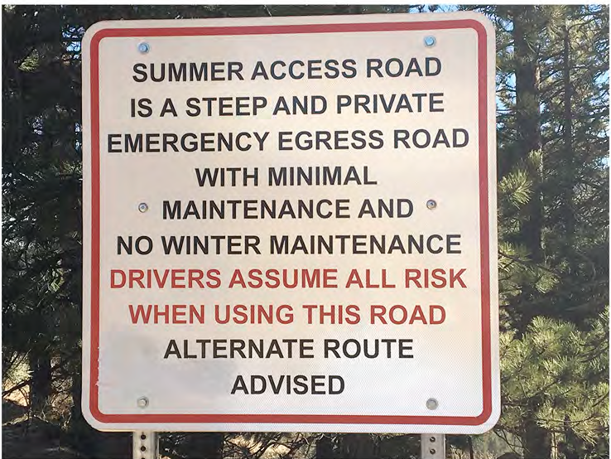
Prescriptive Easements

Slide 39
Prescriptive Easements
There is no rule of law requiring that to secure a right-of-way by prescription one must be in continuous possession in the sense that claimant must physically possess it every moment of every day. The right that matures, and the one here claimed, is the right to passage whenever desired. Rivera v. Queree, 358 P.2d 40 (Colo. 1960).
An owner may interrupt the running of the statutory period by physically limiting access to the property. McKenzie v. Pope, 33 P.3d 1277 (Colo.App.2001). See also, Trask v. Nozisko, 134 P.3d 544 (Colo. App. 2006)(No easement by prescription where owner's construction of an earthen berm limited claimant's access for three days).
Notes:
But California has a statute.

Slide 40
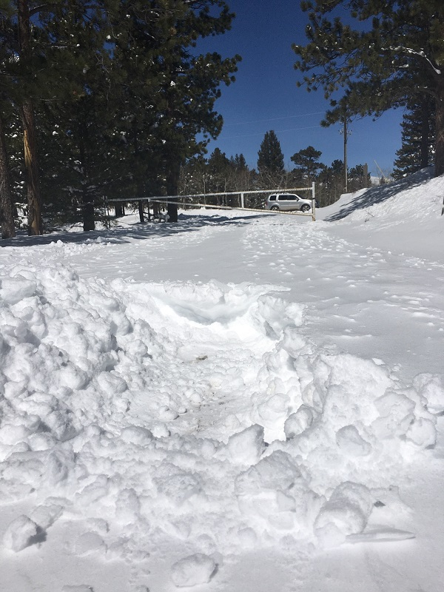
Prescriptive Easements
Notes:
But California has a statute.

Slide 41
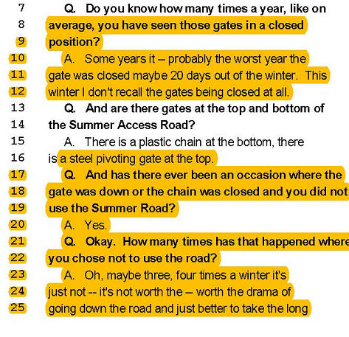
Prescriptive Easements
Notes:
But California has a statute.

Slide 42
Easements by Estoppel
Colorado courts have recognized that easements by estoppel exist. Lobato v. Taylor, Supra.
“At best, these decisions dispense instructions to make the following inquiries: (1) whether the party to be estopped acted so as to falsely represent or conceal material facts, or at least conveyed the impression that the facts were different than those which this party later tries to assert; (2) whether the party to be estopped acted with an intention, or expectation, that his or her conduct would be acted on by the other party; and (3) whether the party to be estopped had knowledge (actual or constructive) of the real facts.”
David L. Masters, A Survey of Colorado Easement Law – Part 1, The Colorado Lawyer, May 1993.

Slide 43
R.S. 2477
Revised Statute 2477 is a federal statute adopted in 1866. It states, in its entirety, that "the right of way for the construction of highways over public lands, not reserved for public uses, is hereby granted.“
RS 2477 was repealed in 1976 by the Federal Land Management and Policy Act, FLPMA. However, FLPMA provided that all existing RS 2477 rights of way were not affected by the repeal of RS 2477 and remained valid.
The use necessary to establish the road can be very limited, and “if the use be by only one, still it suffices.” Leach v. Manhart, 77 P.2d 652 (Colo. 1938) However, the road must be established before the government land is withdrawn from the public domain. Korf v. Itten, 169 P. 148 (Colo. 1917).
Notes:
This is common when someone owns a mining claim and there is a road or path historically used to get to the claim. You may need to get a court decree to establish the existence of the right.

Slide 44
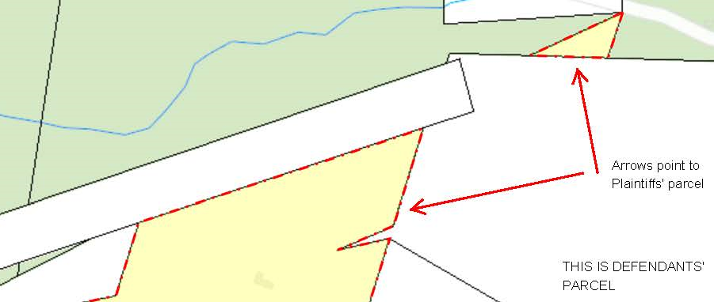
R.S. 2477

Slide 45
Condemnation of an Easement
Article II, Section 14 of the Colorado Constitution provides:
Private property shall not be taken for private use unless by consent of the owner, except for private ways of necessity, and except for reservoirs, drains, flumes or ditches on or across the lands of others, for agricultural, mining, milling, domestic or sanitary purposes.
The right to condemn a private “way of necessity” is a remedy of last resort when common law principles would otherwise not provide legal access to landlocked parcels. The process is governed by statute at Section 38-1-102(3), C.R.S. For an example, see Bear Creek Development Corp. v. Genesee Foundation, 919 P.2d 948 (Colo. App. 1996).
Don’t confuse the “way of necessity” referred to in the Colorado Constitution with an Easement by Necessity.

Slide 46
EASEMENT
LITIGATION

Slide 47
Filing Suit to Establish an Easement
C.R.C.P. 105(a):
(a) Complete Adjudication of Rights. An action may be brought for the purpose of obtaining a complete adjudication of the rights of all parties thereto, with respect to any real property and for damages, if any, for the withholding of possession. The court in its decree shall grant full and adequate relief so as to completely determine the controversy and enforce the rights of the parties…

Slide 48
Filing Suit to Establish an Easement Venue
C.R.C.P. 98(a):
All actions affecting real property, franchises, or utilities shall be tried in the county in which the subject of the action, or a substantial part thereof, is situated.

Slide 49
Filing Suit to Establish an Easement Provide Legal Descriptions of Relevant Parcels
C.R.C.P. 105(g):
(g) Description of Real Property. In any proceeding for the recovery of real property or an interest therein, such property shall be designated by legal description.
Because legal descriptions can be lengthy it is common to see Complaints with allegations like this:
X. Plaintiff’s property is commonly known as 123 Norris Weese Drive, Nederland, Colorado, and is legally described as shown on EXHIBIT A.

Slide 50
Filing Suit to Establish an Easement Defendants
Owner of the parcel in question
Lienholders with an interest in the parcel in question
Unknown persons
Servicemembers

Slide 51
Filing Suit to Establish an Easement Should You Name Lienholders as Defendants?
C.R.C.P. 19(a). A person… shall be joined as a party in the action if: (1) In his absence complete relief cannot be accorded among those already parties, or (2) he claims an interest relating to the subject of the action and is so situated that the disposition of the action in his absence may: (A) As a practical matter impair or impede his ability to protect that interest or (B) leave any of the persons already parties subject to a substantial risk of incurring double, multiple, or otherwise inconsistent obligations by reason of his claimed interest.
C.R.C.P. 105(b). No person claiming any interest under or through a person named as a defendant need be made a party unless his interest is shown of record in the office of the recorder of the county where the real property is situated, and the decree shall be as conclusive against him as if he had been made a party; provided, however, if such action be for the recovery of actual possession of the property, the party in actual possession shall be made a party.
All parties with any claim to the property, or material interests which might be affected, were considered necessary to quiet title. Keith v. Kinney, 961 P.2d 516 (Colo. App. 1997). BUT – those not named are not bound by the result. Ginsberg v. Stanley Aviation Corp., 568 P.2d 35 (Colo. 1977).

Slide 52
Filing Suit to Establish an Easement Defendants
Practice Tips:
Get a copy of the deed to the subject property and be sure the Complaint uses the owner’s name as shown on the deed.
Obtain an Ownership and Encumbrance Report (O&E) form a title company, and consider whether to name any lienholders as defendants.

Slide 53
Filing Suit to Establish an Easement Unknown Defendants
Quiet title suits frequently name “all other persons claiming an interest in the property” as defendants, and service on them is by publication. See, C.R.C.P. 4(g).
It is not mandatory to name every person that may claim an interest. A plaintiff in a quiet title action may omit an interest, or the holder of the interest, because challenging the interest would be futile, the plaintiff did not contemplate the interest, the plaintiff did not know of the interest, or the plaintiff did not care about the interest. Campbird Colorado Inc., v. Board of County Commissioners, 215 P.3d 1277 (Colo. App. 2009); G.P. Anderson, Colorado Quiet Title Actions § 3.1.7, at 68 (2008). BUT – those not named are not bound by the result. Ginsberg v. Stanley Aviation Corp., 568 P.2d 35 (Colo. 1977).

Slide 54
Filing Suit to Establish an Easement Unknown Defendants - Servicemembers
The Servicemembers Civil Relief Act, 50 U.S.C. App. § 521, provides in relevant part:
“If in an action covered by this section it appears that the defendant is in military service, the court may not enter a judgment until after the court appoints an attorney to represent the defendant.”
In some cases, the Plaintiff may want to seek appointment of an attorney for unknown servicemembers. Generally, the Plaintiff pays that attorney. Generally, the attorney’s duties are limited. See, Entitlement to Stay or Default Judgment under the Soldiers’ and Sailors’ Civil Relief Act, 35 Am.Jur. POF3d 323.

Slide 55
Filing Suit to Establish an Easement Quiet Title v. Declaratory Judgment
A declaratory judgment is NOT the proper mechanism. In Argus Real Estate, Inc. v. E-470 Public Highway Authority, 397 P.3d 215 (Colo. App.2003), the Court explained:
In a declaratory judgment, the court declares the rights of parties “under a deed, ... written contract, or other writings constituting a contract.” Section 13–51–106, C.R.S. 2003; see also, C.R.C.P. 57. While a document interpreted in a declaratory judgment may affect the title to land, the declaratory judgment does not adjudicate title. In contrast, a quiet title decree adjudicates title to property as between the parties to the action. See Dynasty, Inc. v. Winter Park Assocs., Inc., 5 P.3d 392 (Colo. App. 2000).
Notes:
But a declaratory judgment to declare an easement void would be appropriate. Or to determine the terms of an ambiguous easement.

Slide 56
Filing Suit to Establish an Easement Other Claims for Relief
Both parties also brought trespass claims and sought injunctive relief. Lot 6 owner sought declaratory relief to declare any easements void because they served an illegal purpose.
Notes:
The Lot 5 owner even sought damages allegedly incurred when the dogs belonging to the owners of Lot 6 pooped on her property.

Slide 57
Filing Suit to Declare an Easement Void for Illegal Purpose or to Obtain Injunctive Relief
Contracts that violate the law are not enforceable. Metropolitan Life Ins. Co. v. Roma, 50 P.2d 1142 (Colo. 1935). “[When] a party asserts that entire contract is illegal, the court must determine this threshold issue. Contracts in violation of statutory provisions are void…” Amedeus Corp. v. McAllister, 232 P.3d 107, 109 (Colo. App. 2009).
“[A]n easement may not authorize activity prohibited by a zoning ordinance or other pertinent laws.” Baccouche v. Blankenship, 154 Cal. App. 4th 1551, 65 Cal.Rptr.3d 659 (2007); Teachers Ins. & Annuity Ass'n. v. Furlotti, 70 Cal. App. 4th 1487, 83 Cal.Rptr.2d 455 (1999). However, an easement that does serve an illegal purpose is not automatically void. “While the owner of a dominant tenement may be enjoined from using an easement where that use is illegal, such an easement is not void for illegality.” Cottonwood Duplexes, LLC v. Barlow, 210 Cal. App. 4th 1501, 173 Cal. Rptr. 3d 433 (2012).
Notes:
The Lot 5 owner even sought damages allegedly incurred when the dogs belonging to the owners of Lot 6 pooped on her property.

Slide 58
Filing Suit to Establish an Easement Avoiding Simplified Procedure
C.R.C.P. 16.1(b). Simplified Procedure applies to all civil actions other than: (1) civil actions that are class actions, domestic relations, juvenile, mental health, probate, water law, forcible entry and detainer, C.R.C.P. 106 and 120, or other similar expedited proceedings, unless otherwise stipulated by the parties…
Generally, these cases are not well suited for Rule 16.1, which contains limits on depositions and requests for production, and allows no interrogatories or requests for admission. There are three ways to avoid simplified procedure:
Include a claim for damage that exceeds $100,000.00. (Be mindful of Rule 11).
Stipulation.
File a Motion asserting good cause within 42 days of the “at issue” date.

Slide 59
Filing Suit to Establish an Easement Lis Pendens
In most cases the person seeking to quiet title wants to prevent the property from being sold while the litigation is pending because that puts pressure on the defendant. Section 38-35-110, C.R.S, provides:
(1) After filing any pleading in an action in any court of record of this state or in any district court of the United States within this state wherein relief is claimed affecting the title to real property, any party to such action may record in the office of the county clerk and recorder in the county or counties in which the real property or any portion thereof is situated a notice of lis pendens containing the name of the court where such action is pending, the names of the parties to such action at the time of such recording, and a legal description of the real property…

Slide 60
Filing Suit to Establish an Easement Lis Pendens
Even litigation that does not seek to change ownership in any way but does ‘involve a determination of certain rights [and liabilities] incident to ownership can “affect” title. Kerns v. Kerns, 53 P.3d 1157, 1164 (Colo. 2002). This language includes:
Suits involving the extent of a property owner's rights to build on his property, see Hammersley, 610 P.2d at 95–96 (finding that a suit to enjoin construction until the construction plans comport with protective covenants affected the real property within the meaning of the lis pendens statute).
Suits seeking to set aside a conveyance of real property as fraudulent. Crown Life Ins. Co. v. April Corp., 855 P.2d 12, 14–15 (Colo. App. 1992).
Suits seeking to impose constructive trusts on real property. Kerns, 53 P.3d at 1165.
Suits litigating a promise to grant a deed of trust applying to a specific parcel of real property. Cooper v. Flagstaff Realty, 634 P.2d 1013, 1015 (Colo. App. 1981).
Courts must construe the phrase “affecting the title to real property” in the lis pendens statute broadly. Better Baked, LLC v. GJG Property, LLC, Colo.App.2020, 2020 WL 1471864.

Slide 61
Filing Suit to Establish an Easement
Practice Tip: Include all viable easement theories in the Complaint.
C.R.C.P. 8 states “Relief in the alternative or of several different types may be demanded.” The rule also states, “A party may set forth two or more statements of a claim or defense alternately or hypothetically, either in one count or defense or in separate counts or defenses.“
Additionally, "A party may also state as many separate claims or defenses as he has regardless of consistency and whether based on legal or on equitable grounds or on both.”

Slide 62
Filing Suit to Establish an Easement
Practice Tip:
Don’t simply allege the existence of an “implied easement” in the Complaint.
Assert a separate claim for relief for each theory, e.g., an easement by prescription, an easement by necessity, and an easement implied by preexisting use.

Slide 63
DRAFTING
EASEMENT
DOCUMENTS

Slide 64
Drafting Easement Documents
Deed of Easement (or reservation of easement contained in a deed) – signed by Grantor. “By their very nature, deeds do not call for the signature of the grantee.” VTRE Investments, LLC v. MontChilly, Inc., 2020 WL 5493780 (Vermont 2020).
Easement Agreement – signed by Grantor and Grantee.
If the Grantee is conveying some interest in land in return, the Grantee should sign the document to prevent a statute of frauds problem.
You might also want the Grantee to sign to avoid later claims by the Grantee alleging oral promises by the Grantor not contained in the document.

Slide 65
Easement Drafting Checklist
Names of Grantor and Grantee as shown on their deeds
Legal description of Grantor’s property as shown on the deed
Legal description of Grantee’s property as shown on the deed
Consideration
A description of the easement location (legal description, or maybe a drawing)
Statement of purpose of the easement (e.g., access, to allow an existing encroachment)
Non-Exclusive (versus Exclusive)
Appurtenant or In Gross
Duration of easement (perpetual, term of years, or until a specified event)
Grantor has no duty to maintain easement
Improvements
Indemnification by Grantee
Dispute resolution and attorney’s fees
Easement appurtenant or easement in gross
Servient owner’s right to relocate easement
Merger clause (for Easement Agreement)
Notarized signatures
Determine whether there are deeds of trust, mortgages or other liens superior to the easement; if so, obtain subordination agreements from the holders of those liens.
Recording

Slide 66
Description of the Easement
Many clients don’t want to pay a surveyor to provide an exact legal description of the easement area.
A legal description may not be necessary, but the writing must contain a description of the land that is to be subjected to the easement with sufficient clarity to locate it with reasonable certainty. Hornsilver Circle, Ltd. v Trope, 904 P.2d 1353 (Colo. App. 1995).
Isenberg v. Woitchek, 144 Colo. 394, 356 P.2d 904 (1960) (Court rejected claim that location of the easement inadequately described, stating that lack of a specific description of the location of the easement did not affect the validity of the easement, particularly when the conduct of the parties had over a period of time located it.
Practice Tip: If you don’t have a legal description of the easement area, try to describe the location, width, length, etc. Consider also attaching a map or drawing.

Slide 67
Description of the Easement
But it is possible for an easement to be void for vagueness:
As a part of this consideration the grantor also conveys to grantee, his heirs and assigns, the right to use a road which leads from this land on North side of Creek up the creek and acorss [sic] the creek to grantees [sic] land on South side of creek.
Holding: Although the law does not require legal perfection in the description of an easement, the description must be sufficiently full and definite to afford means of identification. Here, the description does not clearly identify the dimensions of the easement or where it begins, leads, or ends. Thus, the easement was void for vagueness and unenforceable. Smith v. Tolar, 636 S.E.2d 112 (Ga. App. 2006).

Slide 68
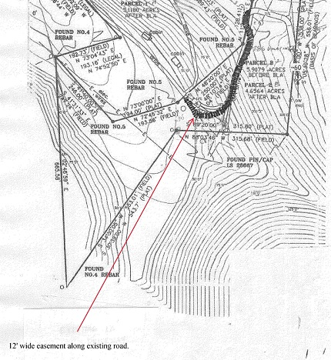
Description of the Easement A map or drawing may be sufficient

Slide 69
Purpose of the Easement
Colorado law defines an easement as “an interest in property which, though distinct from an ownership interest in the land itself, nevertheless confers on the holder an enforceable right to use the property of another for a specific purpose.” Wright v. Horse Creek Ranches, 697 P.2d 384, 387-388 (Colo. 1985).
An easement that does not specify the purpose presents two risks:
It may be held vague and unenforceable.
It may be held to give an easement for any purpose.
Examples:
“An easement for ingress and egress”
“An easement to allow the existing encroachment of a cabin that extends four feet onto Grantor’s parcel.”

Slide 70
Exclusive v. Non-Exclusive
Unless the grant conveying an easement specifically characterizes the easement as “exclusive,” the grantor of the easement retains the right to use the property in common with the grantee. Barnard v. Gaumer, 146 Colo. 409, 361 P.2d 778 (1961); Bergen Ditch & Reservoir Co. v. Barnes, 683 P.2d 365 (Colo.App.1984).
Sample clause:
GRANTEE’S use of the easement shall not be exclusive, and GRANTOR and GRANTOR’S heirs, successors, assigns, personal representatives, licensees and invitees shall have an equal right to the use of the Easement, but without interference with GRANTEE’S use of the Easement.

Slide 71
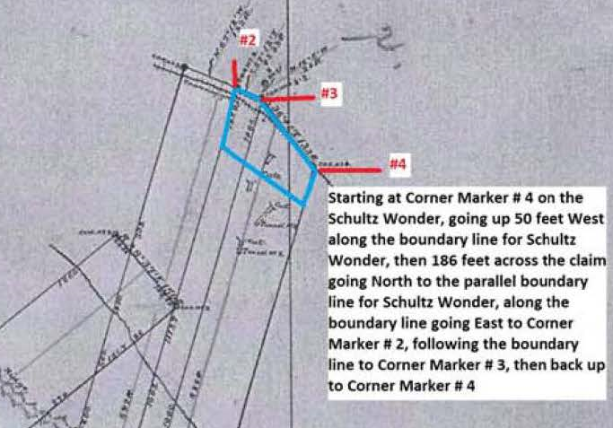
Exclusive v. Non-Exclusive
Normally, the grantor will want a non-exclusive easement, but not always. Here, the child and parent owned adjacent lots. The child lived in a mobile home on the parent’s lot and wanted an exclusive easement from the parent to maintain the mobile home on the parent’s lot.

Slide 72
Appurtenant or In Gross
Sample clause:
The Easement shall be an easement appurtenant to GRANTEE’S property, and shall inure to the benefit of GRANTEE’S heirs, successors, assigns, and personal representatives.

Slide 73
Maintenance
Sample clause:
Neither GRANTOR nor GRANTOR'S heirs, successors, assigns, personal representatives, shall have any obligation to maintain the Easement.

Slide 74
Improvements
Sample clause:
This Easement does not authorize GRANTEE or GRANTEE'S heirs, successors, assigns, and personal representatives to alter the road in any way or to alter or improve GRANTOR'S property.

Slide 75
Indemnification
Sample clause:
If GRANTEE, or any invitee or licensee of GRANTEE, brings a claim against GRANTOR arising out use of the easement, GRANTEE shall defend and indemnify GRANTOR for all expenses of any kind GRANTOR incurs because of such claim, including attorney's fees and costs. GRANTEE uses the easement at GRANTEE'S own risk.

Slide 76
Common Problems
The location actually used by the grantee differs from the location described in the easement.
The dominant owner uses his/her property in a way that interferes with the servient owner’s use of the easement.
The servient owner uses the servient property in a way that interferes with the dominant owner’s use of his/her property.
The easement failed to address maintenance.
The servient owner wants to improve the easement against the dominant owner’s wishes.
The servient owner wants to expand the easement, either in size or scope of use.
The servient owner wants to relocate the easement.

Slide 77
Changes in Use
In ascertaining whether a particular use is permissible under an easement created by prescription a comparison must be made between such use and the use by which the easement was created with respect to (a) their physical character, (b) their purpose, (c) the relative burden caused by them upon the servient tenement.
Owner that established prescriptive easement to use road for agricultural purposes could not expand scope of easement to use road for residential purposes after portions of area were subdivided. Wright v. Horse Creek Ranches, 697, P.2d 384 (Colo. 1985).

Slide 78
Relocation of Easement
Unless expressly denied by the terms of an easement, ... the owner of the servient estate is entitled to make reasonable changes in the location or dimensions of an easement, at the servient owner's expense, to permit normal use or development of the servient estate, but only if the changes do not (a) significantly lessen the utility of the easement, (b) increase the burdens on the owner of the easement in its use and enjoyment, or (c) frustrate the purpose for which the easement was created. Roaring Fork Club, L.P. v. St. Jude's Co., 36 P.3d 1229 (Colo. 2001).
At least with regard to a ditch easement, the court held the servient owner must seek court approval and not unilaterally relocate the easement.

Slide 79
Remedies for Obstruction of Easement
Trespass. The dominant owner may bring a trespass claim against the servient owner for obstructing the use of the easement. Roaring Fork Club, L.P. v. St. Jude's Co., 36 P.3d 1229 (Colo. 2001). Damages for Interference with Easement may be appropriate. Proper v. Greager, 827 P.2d 59 (Colo. App. 1992).
Breach of Contract (if both parties signed)
Injunctive Relief. See, C.R.C.P. 65.
Declaratory Relief. See, C.R.C.P. 67

Slide 80
Termination of Easements
Termination by agreement
Termination by abandonment
Termination by merger
Termination for lack of necessity
Adverse possession of easement
Termination by estoppel

Slide 81
Termination by Agreement
§ 38-10-108, C.R.S.
Every contract for the leasing for a longer period than one year or for the sale of any lands or any interest in lands is void unless the contract or some note or memorandum thereof expressing the consideration is in writing and subscribed by the party by whom the lease or sale is to be made.

Slide 82
Abandonment of an Easement
To establish common law abandonment of an easement, a party must present clear, unequivocal, and decisive evidence of affirmative acts demonstrating the easement owner's intent to abandon the easement. Westpac Aspen Invs., LLC v. Residences at Little Nell Dev., LLC, 284 P.3d 131, 137 (Colo.App.2011). The same standard has been applied in cases alleging abandonment of a prescriptive easement. Clinger v. Hartshorn, 89 P.3d 462 (Colo. App. 2003).
Mere nonuse of an easement acquired by grant, however long continued, does not constitute an abandonment. Westland Nursing Home, Inc. v. Benson, 517 P.2d 862, 866 (1974). Even if the easement was never used, mere nonuse is not abandonment. Matoush v. Lovingood, 177 P.3e 1262, 1271, (Colo. 2008).

Slide 83
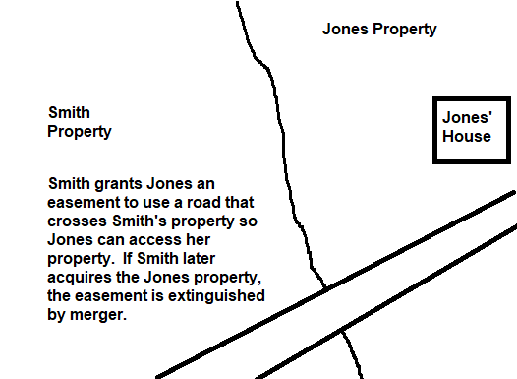
Termination by Merger
When the servient estate and dominant estate have a common owner, there is no need for the easement and it is terminated by merger. Westpac Aspen Invs., LLC v Residences at Little Nell Dev, LLC, 284 P.3d 131 (Colo. App. 2011).

Slide 84
Termination by Merger
What happens if a common owner creates easement before transferring one parcel? I would argue the merger doctrine does not apply, and there is some support for this. Shah v. Smith, 908 N.E.2d 983 (Ohio. App. 2009). (Provision in a sales contract pertaining to the conveyance of an easement was not extinguished at the time the deed was conveyed, and the “merger by deed” doctrine did not apply to preclude trial court from considering sales contract and deed together to ascertain the parties' intent.
At least one title company has disagreed with me, so one way around the issue is to find a different title company or draft the sales contract that requires the seller to execute the Deed of Easement at closing and reference the contract.

Slide 85
Termination for Lack of Necessity
A common law easement by necessity lasts only as long as the necessity continues. Proper v. Greager, 827 P.2d 591 (Colo.App.1992).
The same is true for a way of necessity obtained by condemnation. Bear Creek Development Corp. v. Genesee Foundation, 919 P.2d 948 (Colo. App. 1996).

Slide 86
Termination by Adverse Possession
Section 38-41-101(1) applies to “any right or interest of or to real property.” Thus, an easement may be terminated if the servient owner uses the easement in a manner that is adverse to the easement holder’s right of use, open or notorious, and continuous and uninterrupted for eighteen years. Matoush v. Lovingood, 177 P.3d 1626 (Colo. 2008).
To be adverse, use of an easement area must be incompatible or irreconcilable with the easement holder's right to use the easement. Id.

Slide 87
Termination by Estoppel
If the owner of the dominant estate takes some action indicating an intent to relinquish the easement, and the servient owner relies on that to his/her detriment, the dominant owner may be estopped form denying termination of the easement. Romberg v. Slemon, 778 P.2d 315 (Colo. App. 1989). (Dominant owner was estopped from denying existence of agreement to vacate the easement in return for alternative access).

Slide 88
About Mark
Mark Cohen has 37 years of experience as a lawyer, including twenty-one years in Nederland, CO (elevation 8,236 feet).
Mark earned a B.A.in Economics at Whitman College and earned his law degree at the University of Colorado in Boulder. He earned an LL.M. Agricultural and Food Law from the University of Arkansas, where he also taught advanced legal writing. His diverse legal career includes service as an Air Force JAG, a Special Assistant U.S. Attorney, a prosecutor, a municipal judge for Boulder, six years on the Advisory Board of The Colorado Lawyer (including one as chairperson), and service on the Executive Board of the Colorado Municipal League.
Mark wrote six articles in the Am.Jur. Proof of Facts series, including the seminal article on piercing the corporate veil. He has written numerous articles and book reviews for The Colorado Lawyer. His satirical article, How to Draft a Bad Contract, first published in The Colorado Lawyer, was praised by Harvard Professor Steven Pinker as “simply brilliant,” and was reprinted in several other journals.
Mark wrote two mysteries published by Time Warner, and his first mystery, The Fractal Murders, became a Book Sense ® mystery pick and was a finalist for the Colorado Book of the Year.
Mark’s practice focuses on business and real estate matters, corporate veil litigation, drafting and reviewing legal documents, and litigating disputes arising out of poorly drafted documents.
Mark holds a black belt in karate and serves on the board of directors of a non-profit that offers training in personal safety, violence prevention, and appropriate dating relationships.

