Slide 1
Is the people worried or not (about AI taking over their jobs)?
Are people using AI in work or not?
What are they using it for?
What measurements are they taking to prevent AI taking over their jobs?
Comments on Reddit
r/jobs AND “AI”
Are they worried?
Are they using AI in their jobs?
For what?
How are they adapting?

Slide 2

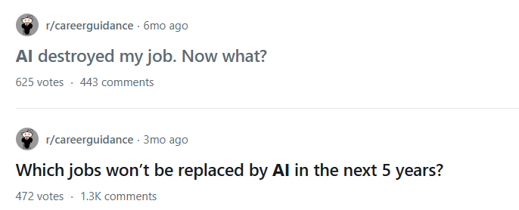
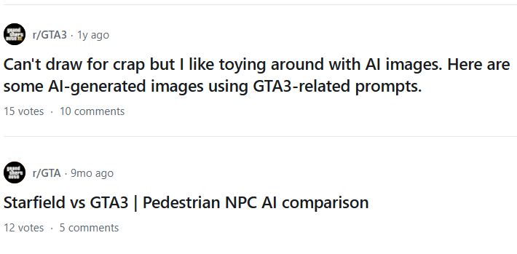
Adaptation Topics
Relevance
Concern
Usage
✓
✓
X
…
…
✓
X
✓
X
X

