Slide 1
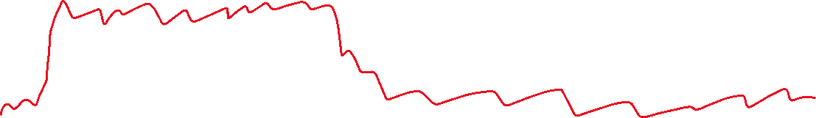


Frustration
Length of event
Tone
Variables from text
MACRO EVENT 1
MACRO EVENT 2

Slide 2

MACRO EVENT 1
MACRO EVENT 2

Slide 3
EVENT CATEGORY 1 (COVID)
EVENT CATEGORY 2 (BLACK LIVES MATTERS)
EVENT CATEGORY 3 (HURRICANE KATRINA)
Impact on system
p=.6
p=.7
p=.1
p=.8
p=.01
p=.15
p=.95
Co-occurrent shocks
p=.27
p=.3
p=.15
p=.01
p=.25
Time

Slide 4
Impact on system
System A System B
System C
Time

Slide 5


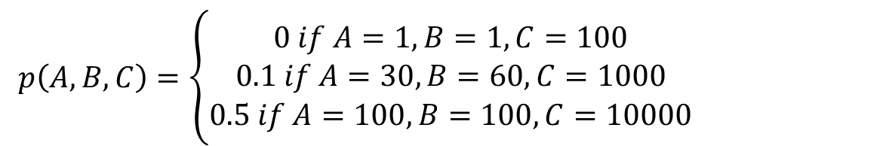





$p\left(A,B,C\right)=\left\{\begin{aligned}0 if A=1, B=1, C=100 \\ 0.1 if A=30, B=60, C=1000 \\ 0.5 if A=100, B=100, C=10000\end{aligned}\right.$
Impact variables:
A: Number of deaths (#)
B: Number of people losing homes (#)
C: Economic loss ($)
They need to be generalizable!!!
p₀ =.15
+ p(E2|E1)
2
p₀=.1
1
%
Max
Max
p₀ =.20
%
+ p(E3|E1)
%
Max
3

Slide 6
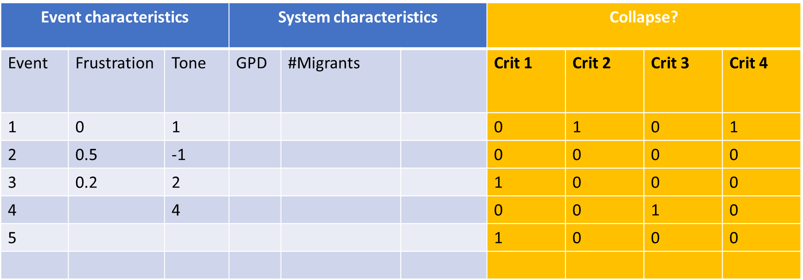
socio-ecological systems losing service or identity,
rapid loss of system identity
significant capital loss
enduring impacts
Event characteristics |  |  | System characteristics |  |  | Collapse?
Event | Frustration | Tone | GPD | #Migrants |  | Crit 1 | Crit 2 | Crit 3 | Crit 4
1 | 0 | 1 |  |  |  | 0 | 1 | 0 | 1
2 | 0.5 | -1 |  |  |  | 0 | 0 | 0 | 0
3 | 0.2 | 2 |  |  |  | 1 | 0 | 0 | 0
4 |  | 4 |  |  |  | 0 | 0 | 1 | 0
5 |  |  |  |  |  | 1 | 0 | 0 | 0

Slide 7
System
(country-level)
social
environmental
economic
ecological
political
technological

Slide 8
economic
social
political
Social capital
Cultural and social values
Quality of life
Social polarization
Trust in institutions
Economic structure & growth
Labor productivity
Safety and security
Urban-Rural Infrastructure
Energy sustainability
Water security
Environmental quality
Environmental conservation
Agricultural productivity
technological
ecological

Slide 9
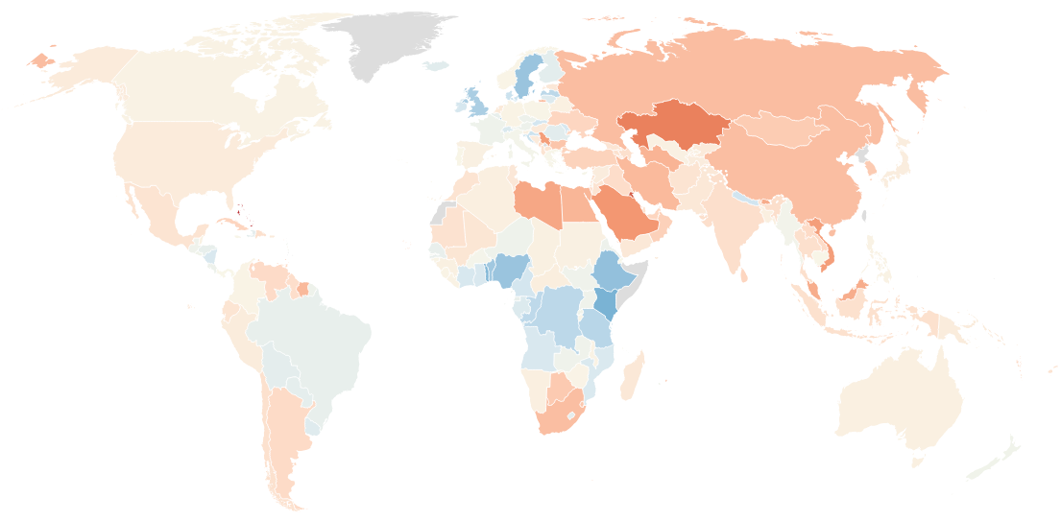
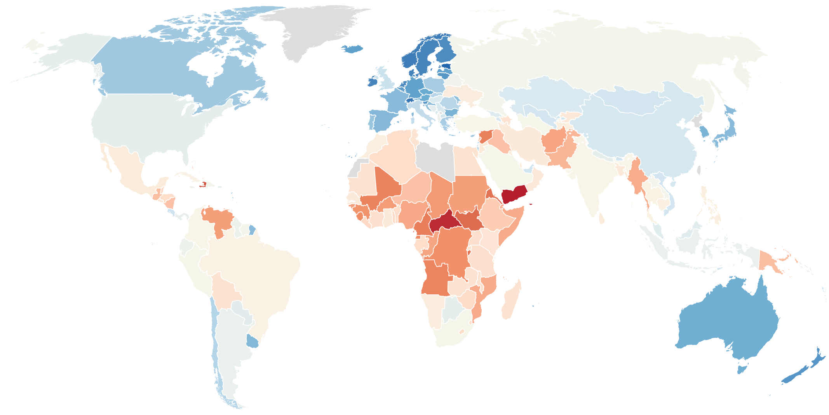
2019
2023

