Slide 1

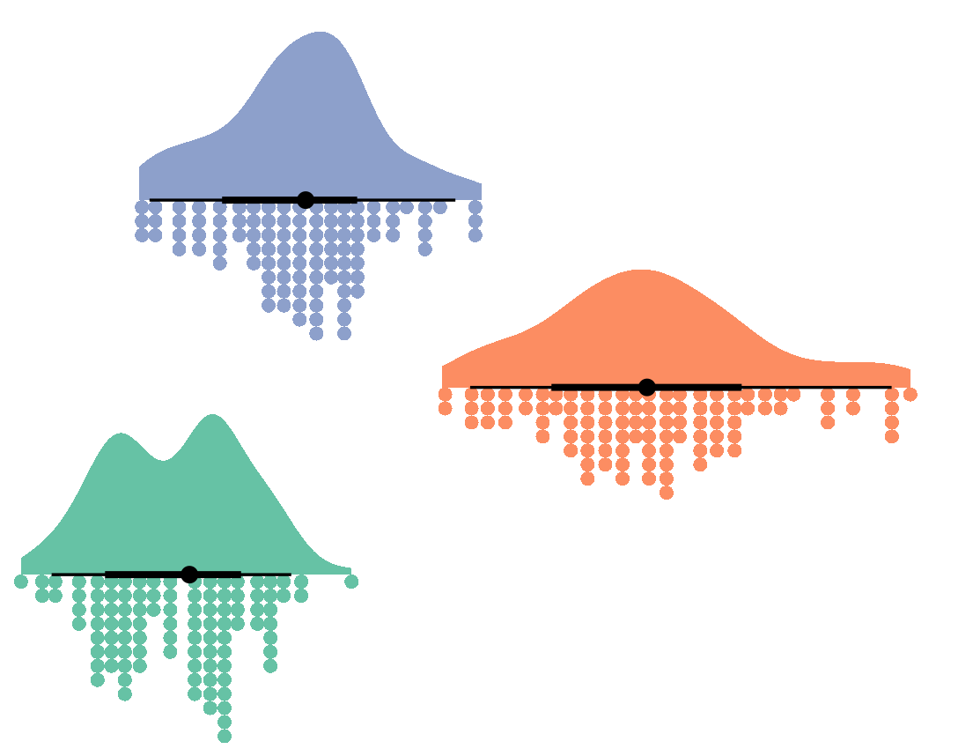

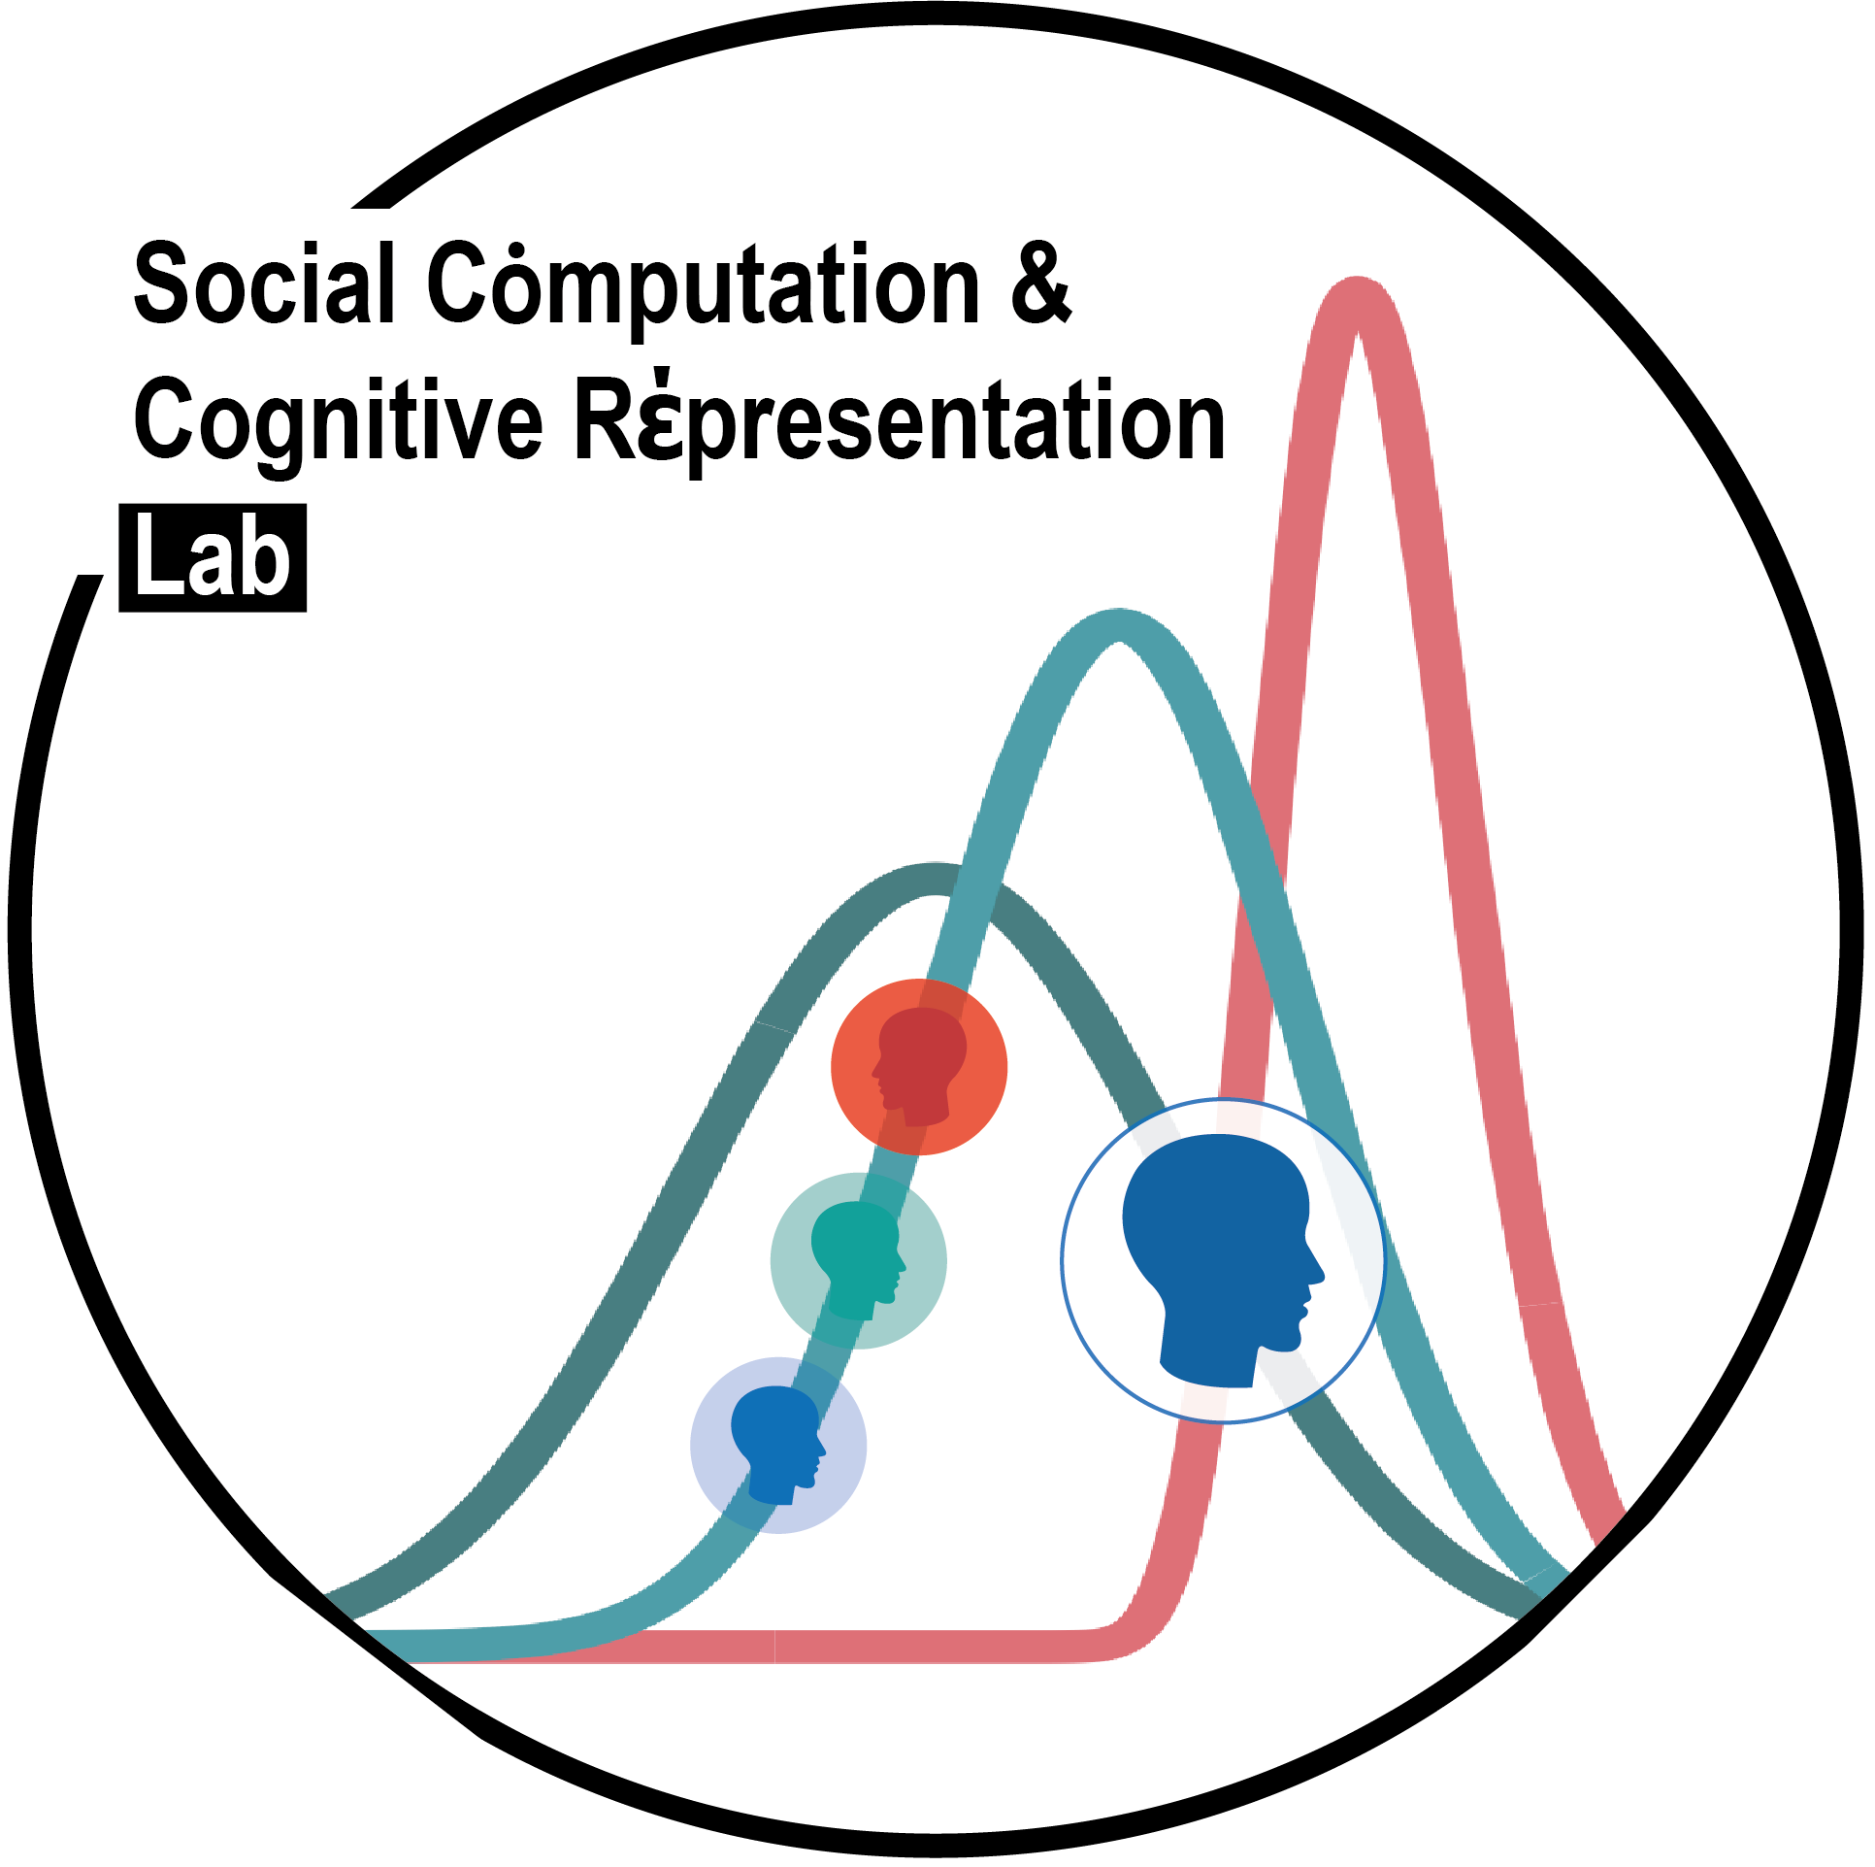
Welcome to
Background, installation, and basics
Joseph M Barnby
9/11/2022
Postgraduate Lectures
Twitter: JoeBarnby
Mastodon: @joebarnby@mastodon.online

Slide 2
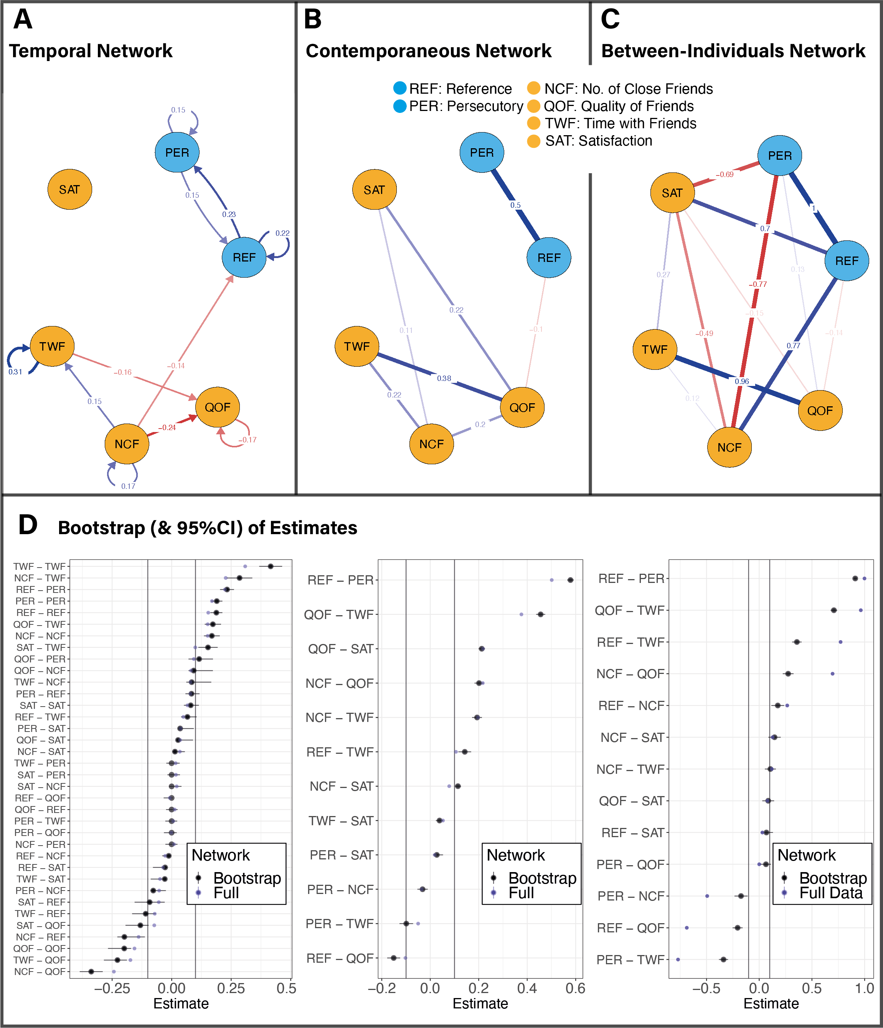
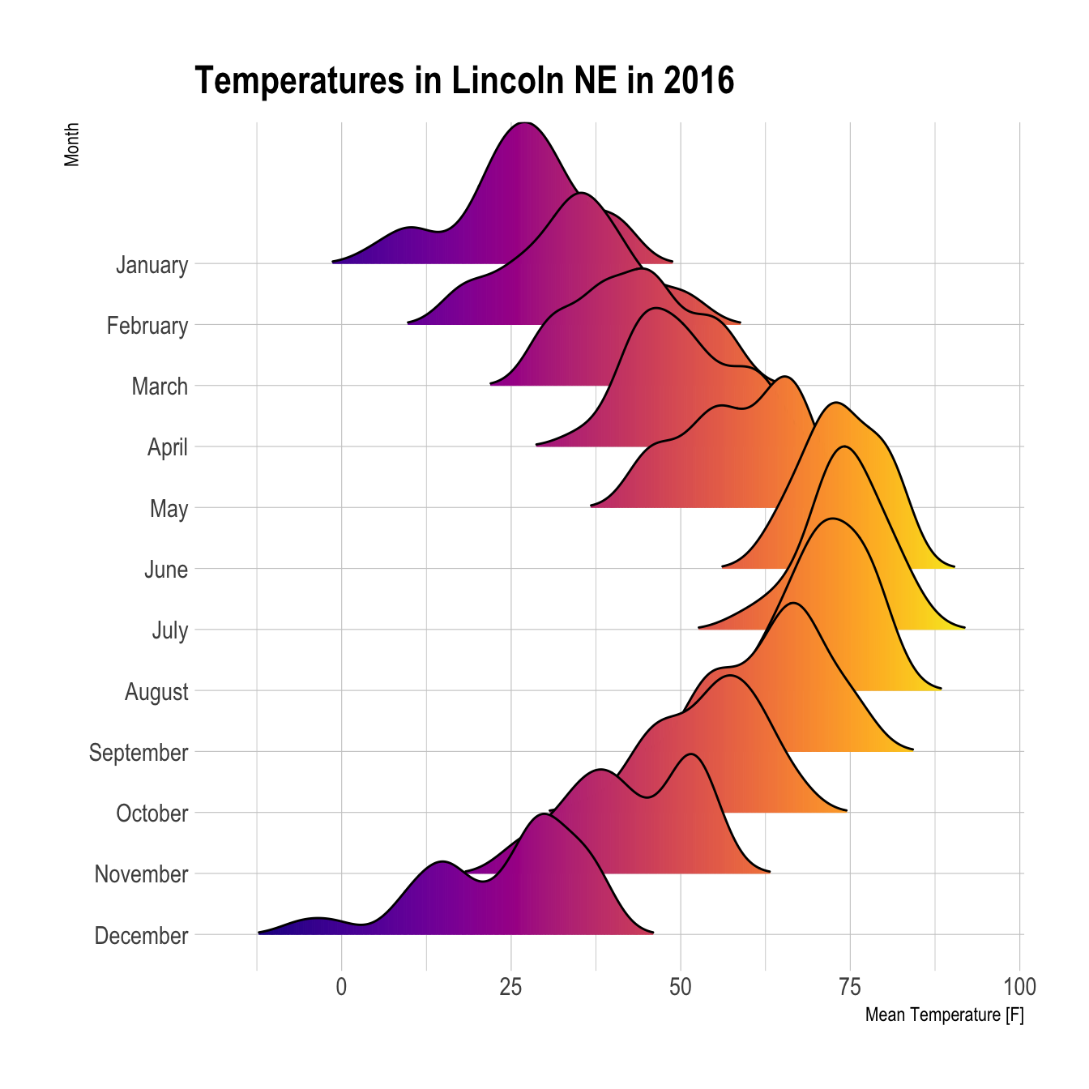


The three lectures
Getting things going (today)
Cleaning your data (11/01/2023)
Making beautiful plots and figures (25/01/2023)

Slide 3
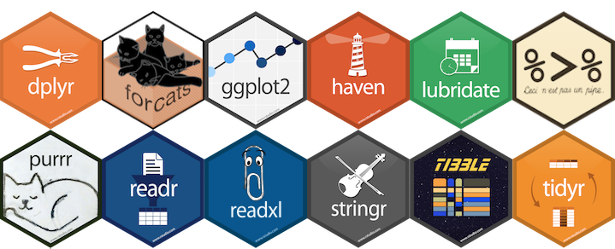
R is an open source language
Free
Mathematically sound and transparent
Excellent community driven development
Wide application in science and industry
Good statistical intuition
Creative

Slide 4
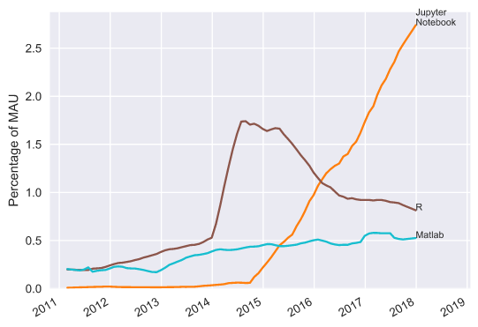
R is an open source language
https://www.benfrederickson.com/ranking-programming-languages-by-github-users/

Slide 5

R Studio is a tailored IDE for R

Slide 6

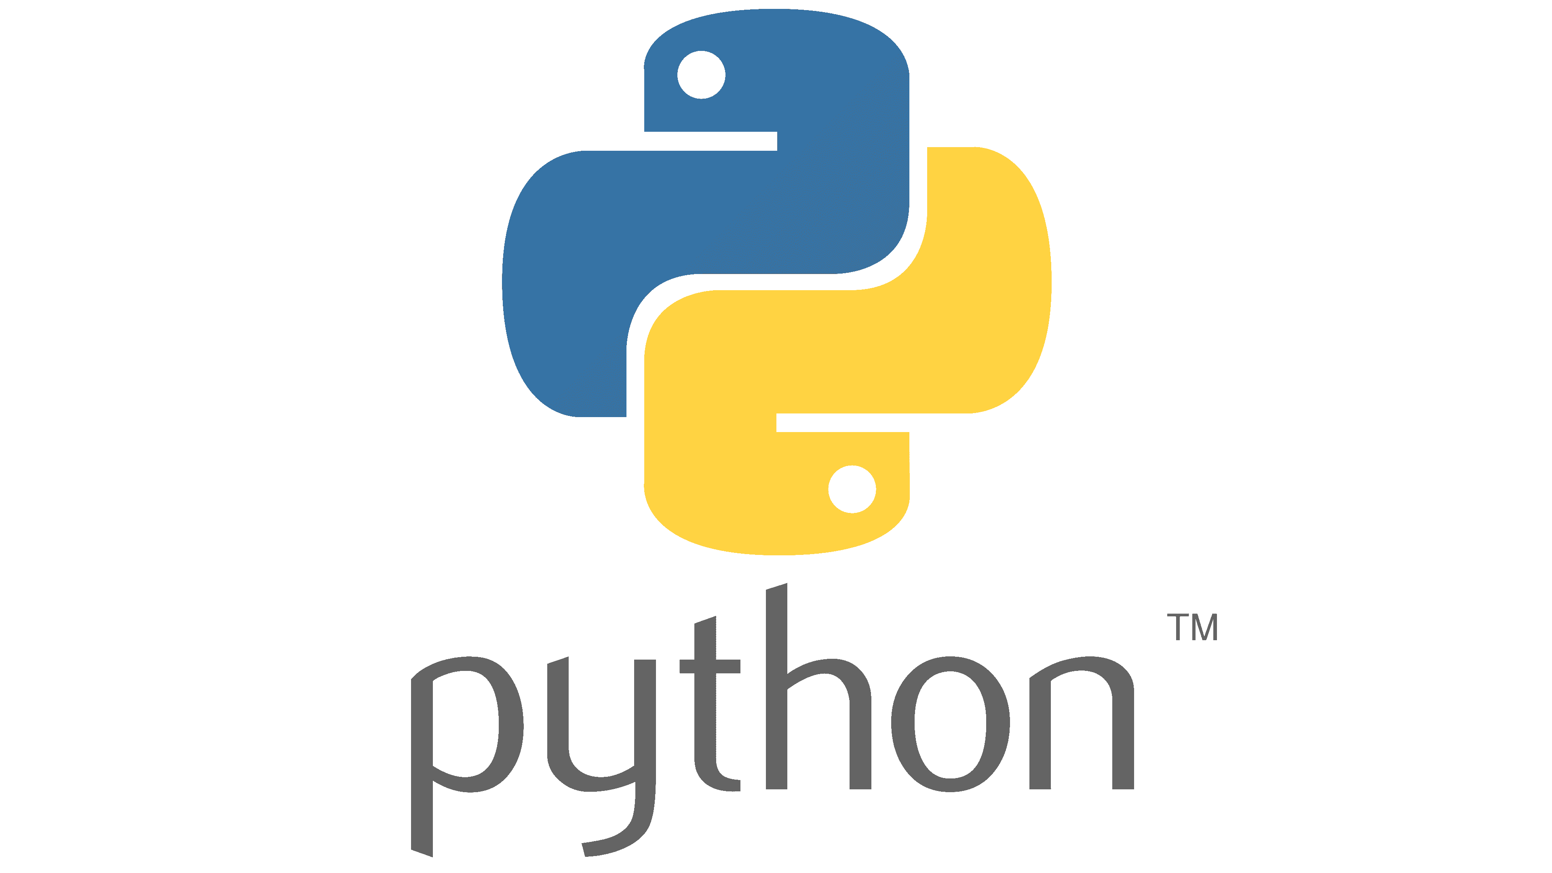
R Studio is a tailored IDE for R… & python

Slide 7

R Studio is a tailored IDE for R… & python

Slide 8
Lets first download
https://www.r-project.org/
Navigate to the CRAN link on the left
Select a UK mirror
Click download for the machine you use

Slide 9
Now lets download
https://posit.co/
Navigate to ‘download R Studio’
Click the free/Desktop version

Slide 10

Lets download some code to explore R
https://github.com/josephmbarnby
Go to the ‘BeginR’ link
Click ‘code’ and download the ZIP
Open Intro_to_script_features.R in Rstudio

Slide 11
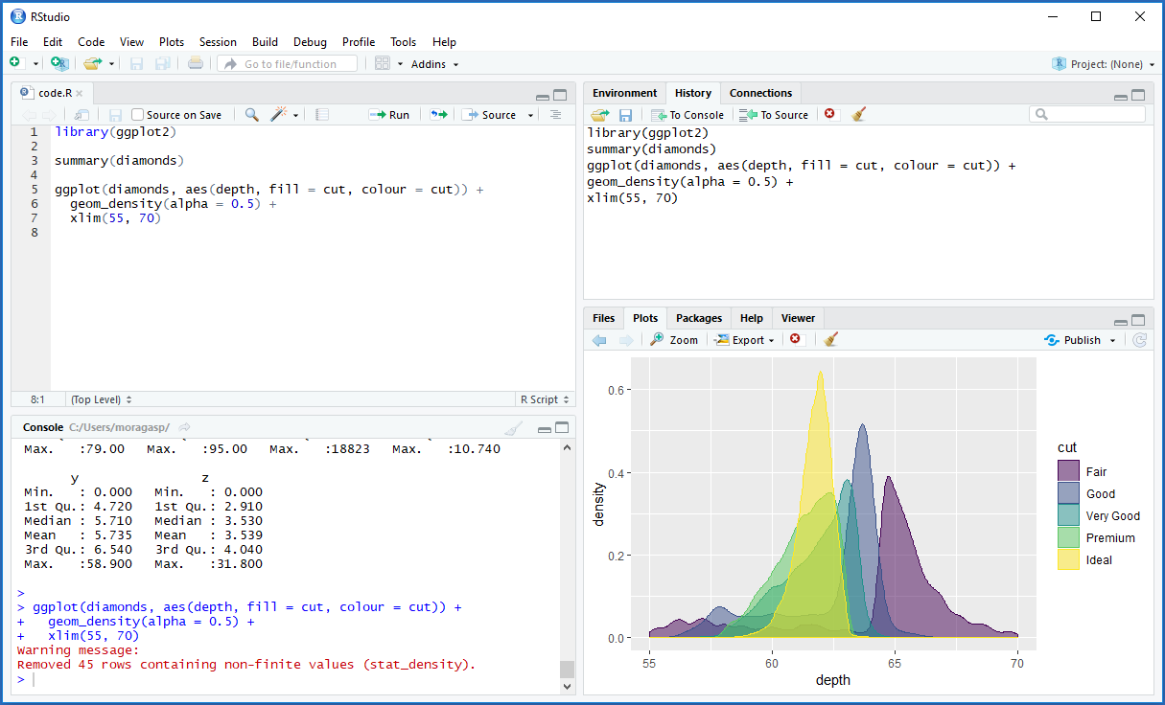
Lets take a look at the interface…

Slide 12
Lets look at the code and work through the script

