Slide 1
Data Mining Academic Emails to Model Employee Behaviors and Analyze Organizational Structure

Slide 2
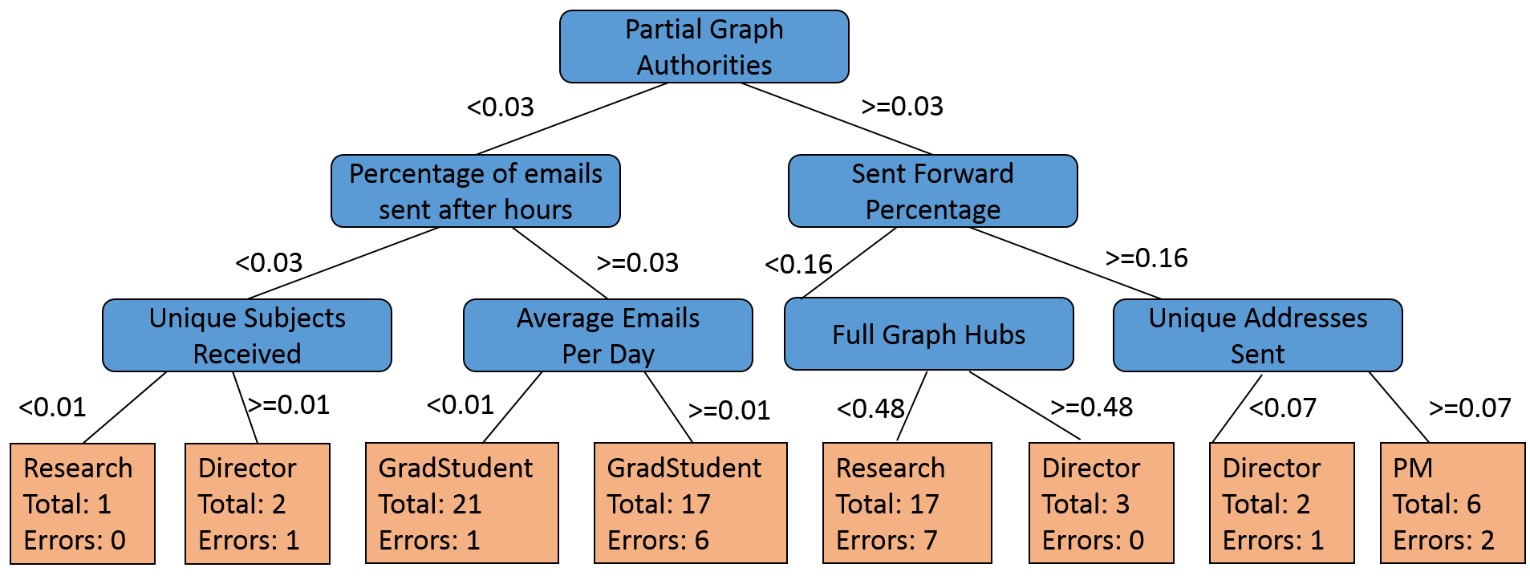
Problem
Problem
Email is everywhere!
Can a better understanding of an organization be gleaned from internal emails?
Application: business reorganization
Approach
Enron dataset has issues, so collect anonymous email metadata from volunteers
Calculate 98 different features, including traffic-based and social-based
Unique subjects received, number of forwards received, hubs
Use random forest algorithm to predict job title from features
Compare trends in data with organizational chart

Slide 3
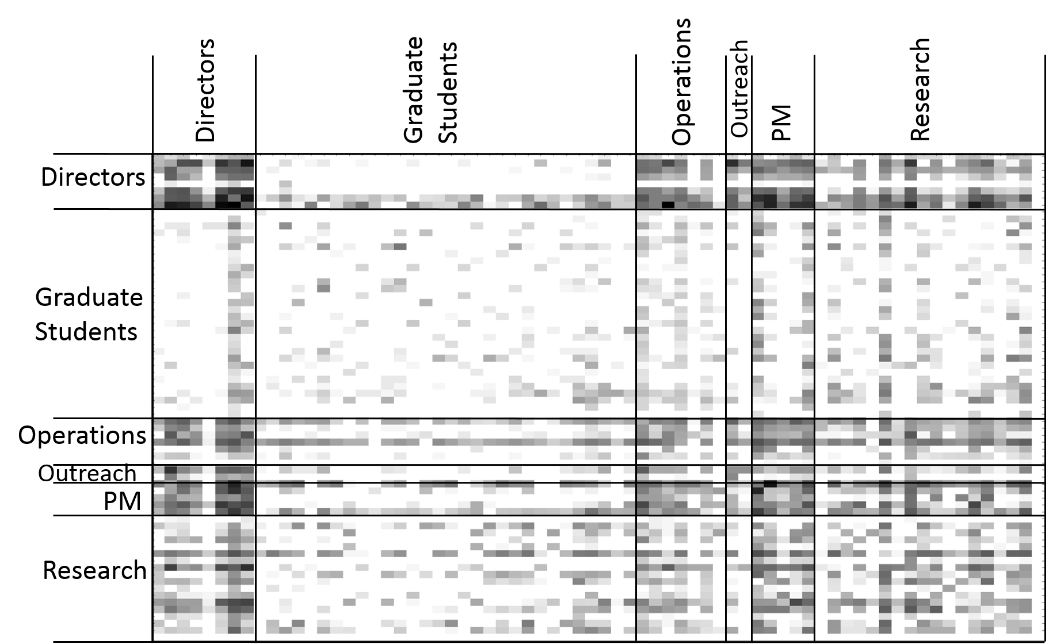
Results

Slide 4
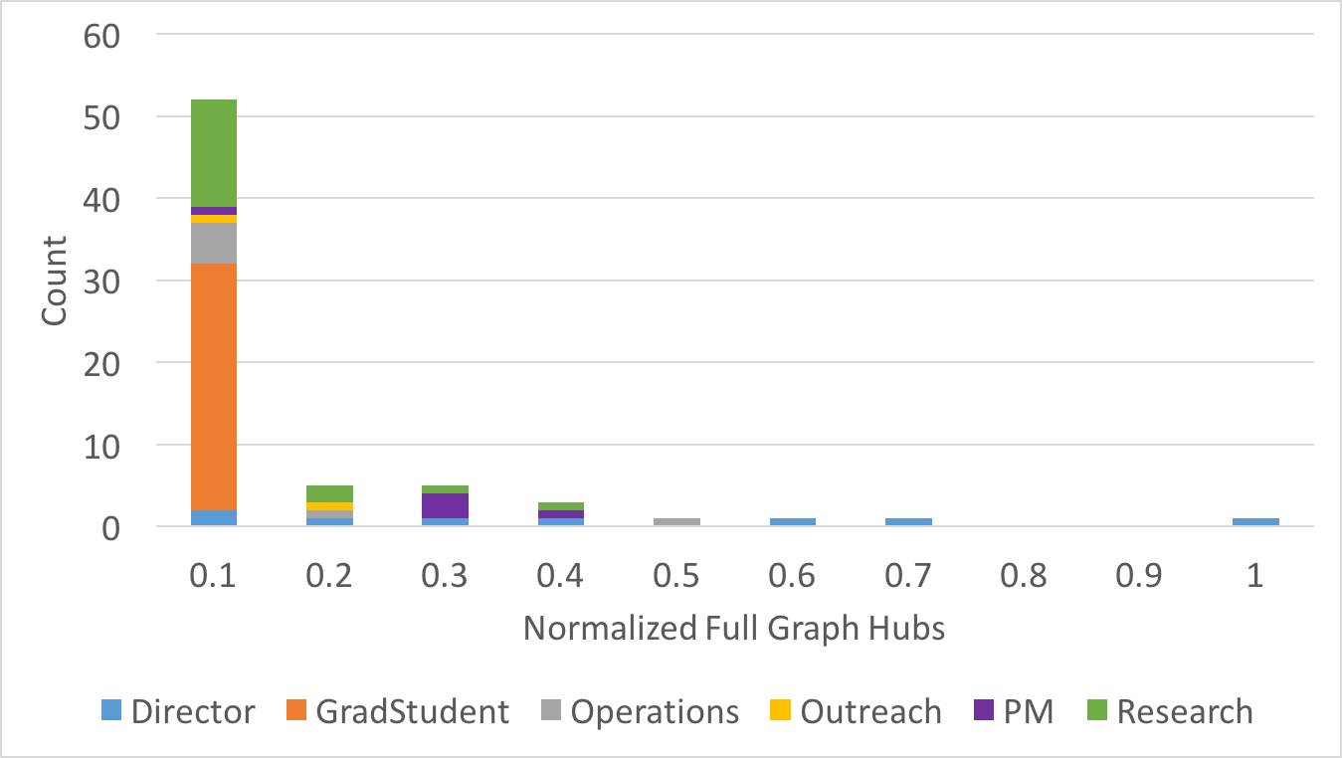

Slide 5
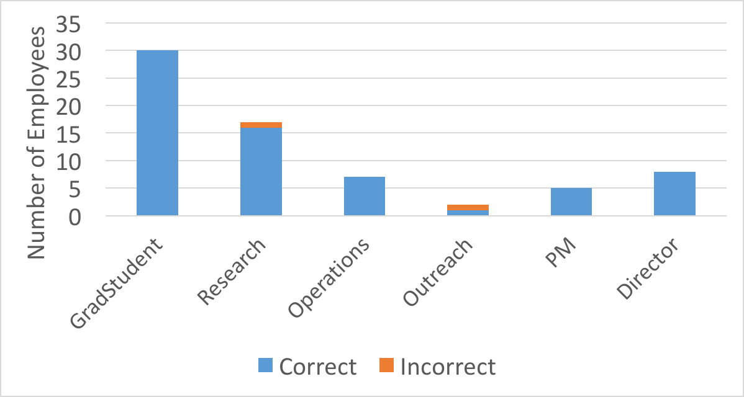
Results

Slide 6
Questions?

