Slide 2
Partial Graph
Authorities
<0.03
>=0.03
Percentage of emails sent after hours
Sent Forward Percentage
<0.03
>=0.03
<0.16
>=0.16
Unique Subjects Received
Average Emails
Per Day
Full Graph Hubs
Unique Addresses Sent
<0.01
>=0.01
<0.01
>=0.01
<0.48
>=0.48
<0.07
>=0.07
Research
Total: 1
Errors: 0
Director
Total: 2
Errors: 1
GradStudent
Total: 21
Errors: 1
GradStudent
Total: 17
Errors: 6
Research
Total: 17
Errors: 7
Director
Total: 3
Errors: 0
Director
Total: 2
Errors: 1
PM
Total: 6
Errors: 2

Slide 3
Partial Graph
Authorities
Partial Graph
Authorities
Partial Graph
Authorities
<0.03
>=0.03
Percentage of emails sent after hours
Sent Forward Percentage
Percentage of emails sent after hours
Percentage of emails sent after hours
Sent Forward Percentage
Sent Forward Percentage
<0.03
>=0.03
<0.16
>=0.16
Full Graph Hubs
Full Graph Hubs
Unique Subjects Received
Average Emails
Per Day
Full Graph Hubs
Unique Subjects Received
Unique Subjects Received
Average Emails
Per Day
Average Emails
Per Day
Unique Addresses Sent
<0.01
>=0.01
<0.01
>=0.01
<0.48
>=0.48
<0.07
>=0.07
GradStudent
Total: 21
Errors: 1
GradStudent
Total: 17
Errors: 6
Research
Total: 17
Errors: 7
Director
Total: 3
Errors: 0
GradStudent
Total: 17
Errors: 6
GradStudent
Total: 21
Errors: 1
GradStudent
Total: 17
Errors: 6
Research
Total: 17
Errors: 7
Director
Total: 3
Errors: 0
Director
Total: 2
Errors: 1
Research
Total: 1
Errors: 0
Director
Total: 2
Errors: 1
GradStudent
Total: 21
Errors: 1
Director
Total: 2
Errors: 1
PM
Total: 6
Errors: 2
Research
Total: 1
Errors: 0
Research
Total: 1
Errors: 0
Director
Total: 2
Errors: 1
Director
Total: 2
Errors: 1

Slide 4
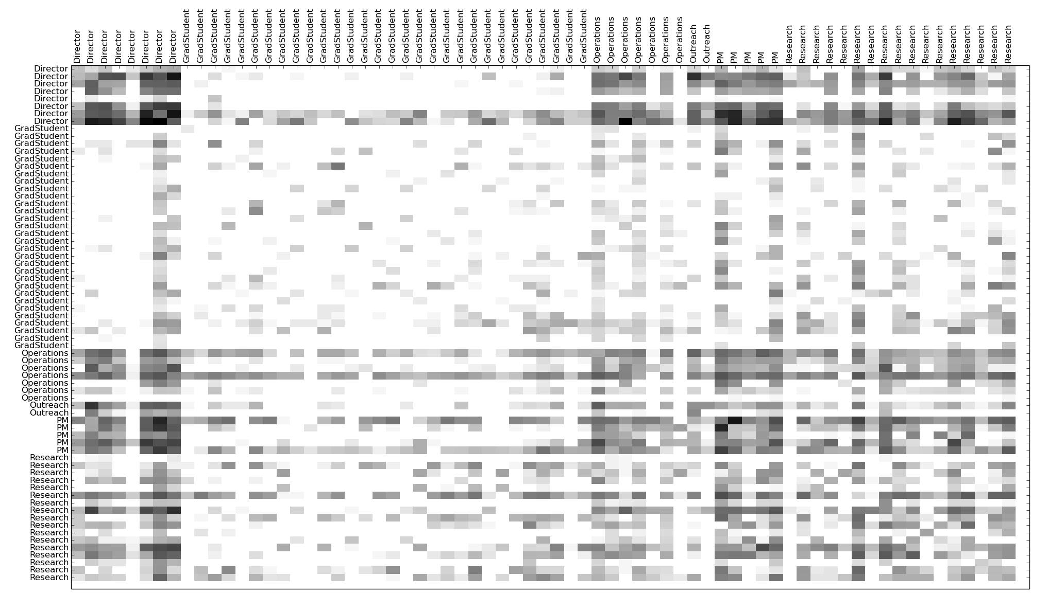
Graduate
Students
Operations
Directors
Outreach
Research
PM
Directors
Graduate
Students
Operations
Outreach
PM
Research

