Slide 2
Partial Graph
Authorities
<0.03
>=0.03
Percentage of emails sent after hours
Sent Forward Percentage
<0.03
>=0.03
<0.16
>=0.16
Unique Subjects Received
Average Emails
Per Day
Full Graph Hubs
Unique Addresses Sent
<0.01
>=0.01
<0.01
>=0.01
<0.48
>=0.48
<0.07
>=0.07
Research
Total: 1
Errors: 0
Director
Total: 2
Errors: 1
GradStudent
Total: 21
Errors: 1
GradStudent
Total: 17
Errors: 6
Research
Total: 17
Errors: 7
Director
Total: 3
Errors: 0
Director
Total: 2
Errors: 1
PM
Total: 6
Errors: 2

Slide 3
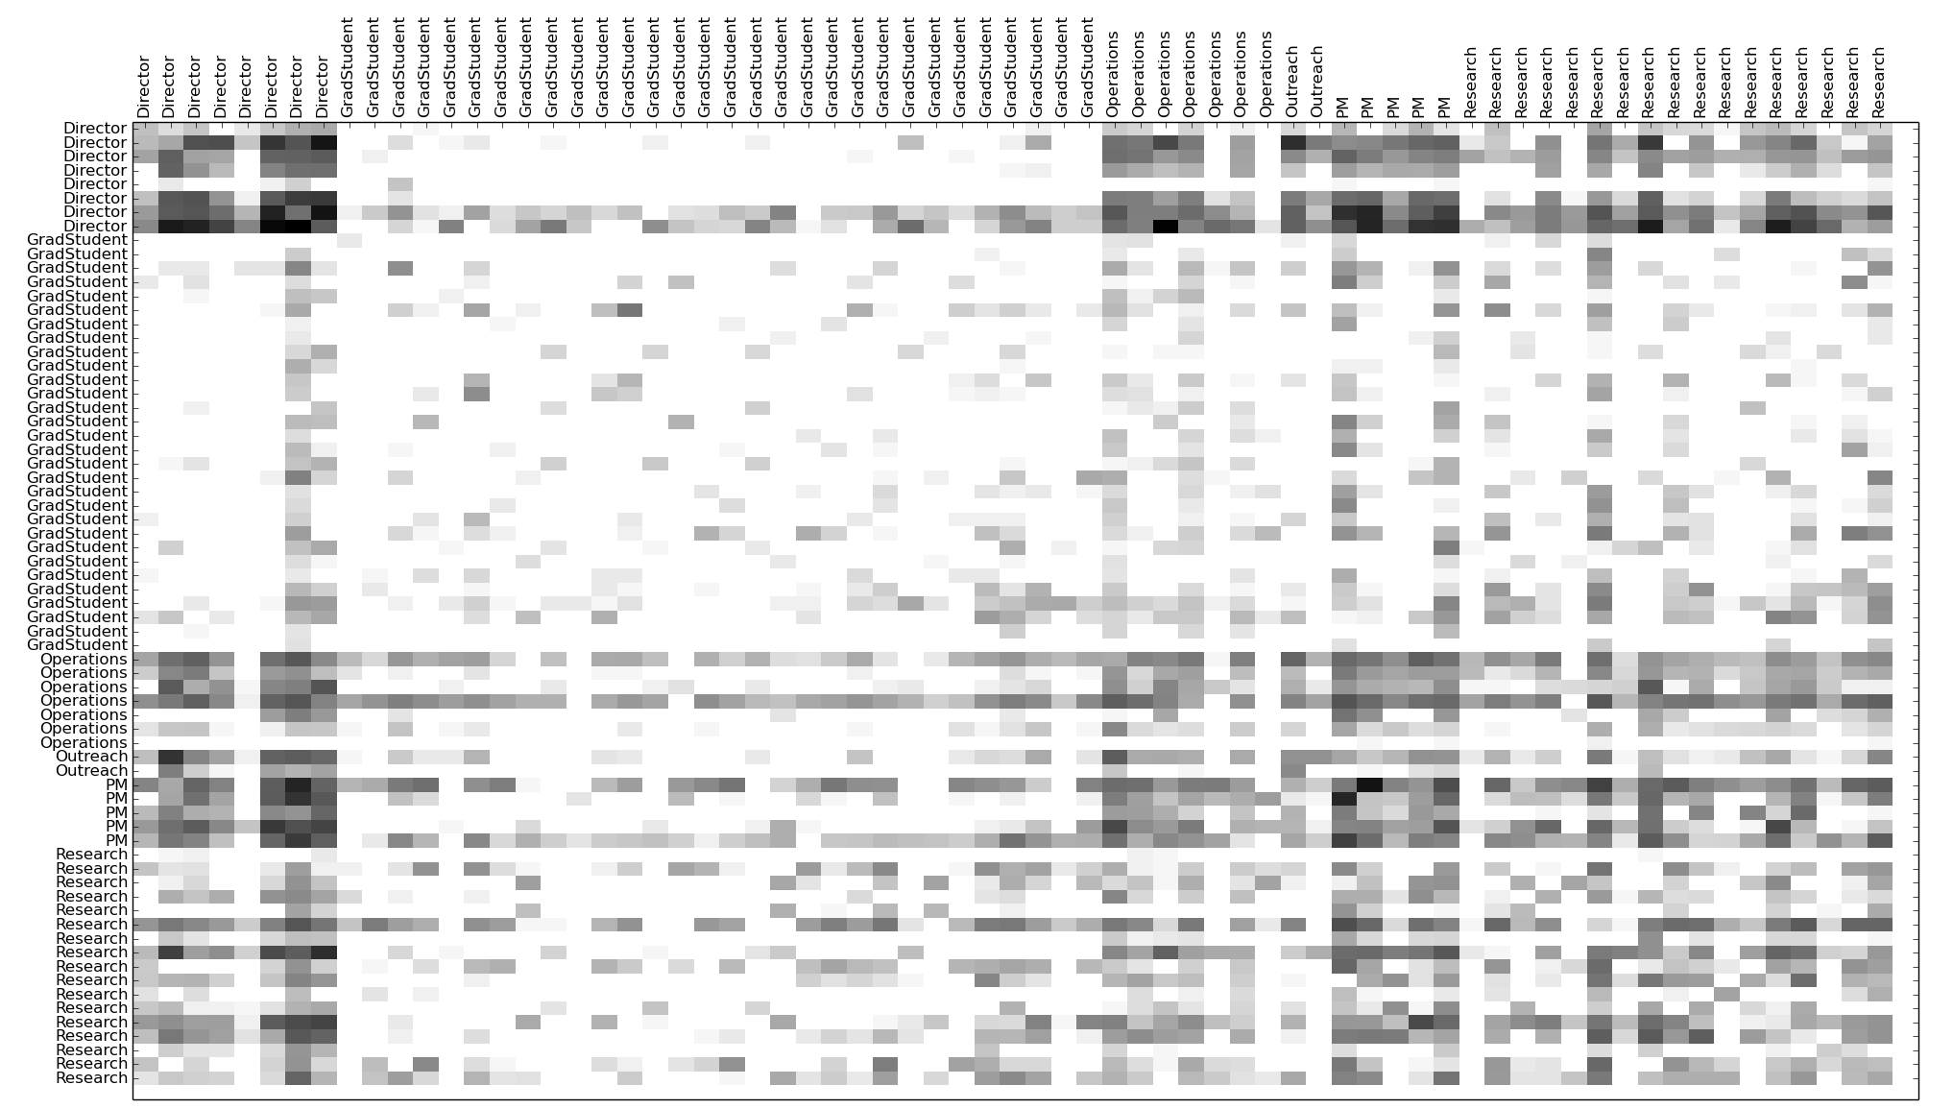
Graduate
Students
Operations
Directors
Outreach
Research
PM
Directors
Graduate
Students
Operations
Outreach
PM
Research

