Slide 1
CSE 315 –
Machine Learning
Midterm Project
Report
Student 1:
Yusuf AKIN
171805020
Student 2:
Semih AKIN
171805004
Student 3:
Mehmet VARAN
181805009
Student 4:
Mehmet Baturalp CAYLAK
181805060

Slide 2
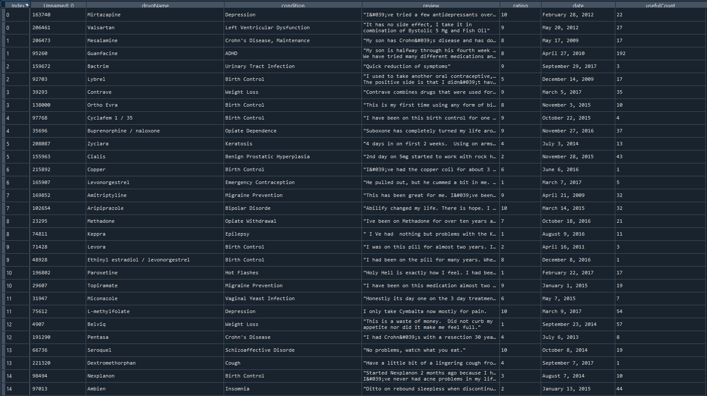
CSE 315 –
Machine Learning
Midterm Project
Report
Meet the Unique
Data Set For Classification
And Clustering
First we need to unite the train and test so we can work it in easily and we couldn’t use review data column,date and Unnamed : 0

Slide 3
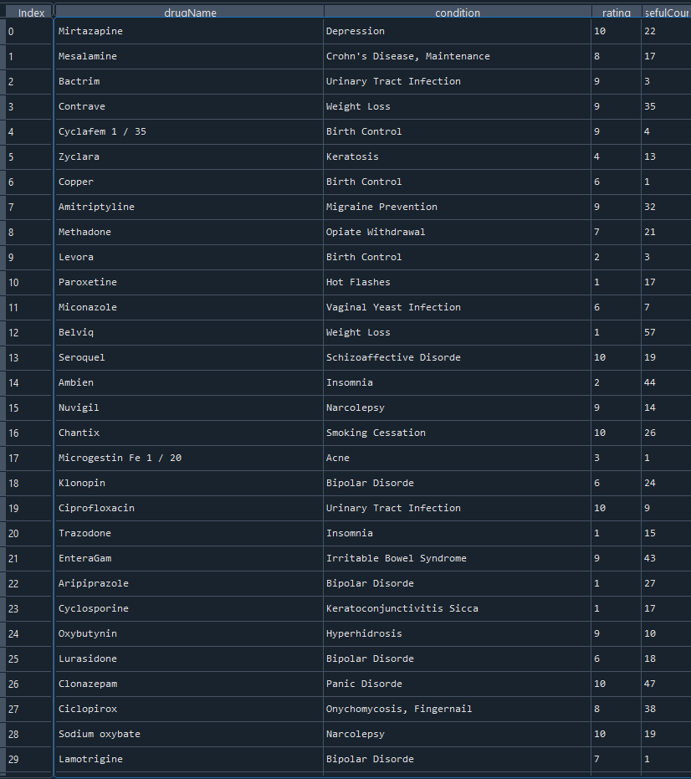
After drop operation data set will looked like this.
Attribute information:
dataDrug(Categorical): Name of drug
condition(Categorical):Name of condition
review(Text):patient review(Dropped)
date(date):date of review entry(Dropped)
usefulCount(numerical):numbers of users who found review useful

Slide 4
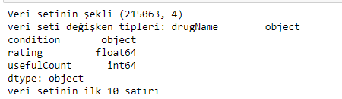
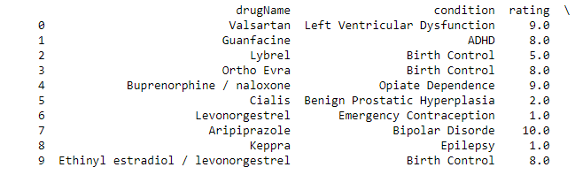
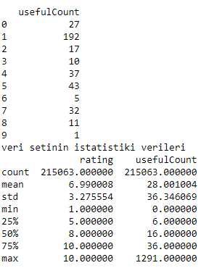
CSE 315 –
Machine Learning
Midterm Project
Report
Giving some informations about dataset(cont.)

Slide 5
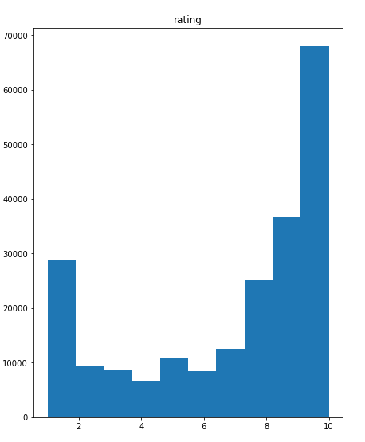
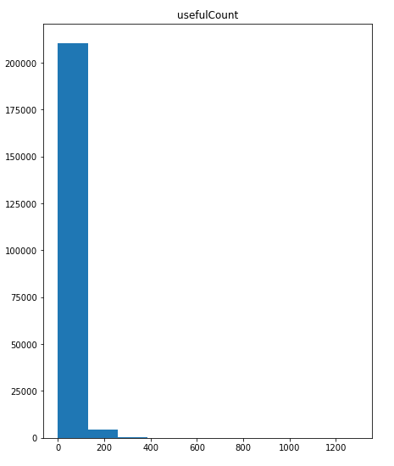
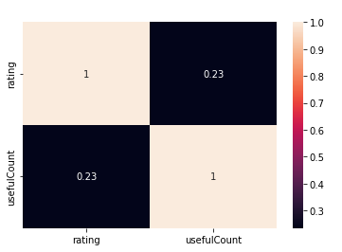
CSE 315 –
Machine Learning
Midterm Project
Report
Giving some informations about dataset(cont.)

Slide 6
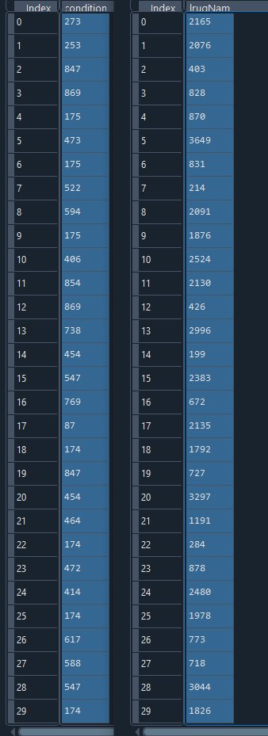
After Label encoding the categorical data it will be like this
from sklearn import preprocessing
le= preprocessing.LabelEncoder()
drug_name['drugName'] = le.fit_transform(drug.iloc[:,0])
drug_others = pd.concat([drug_name, drug.iloc[:,2:4]], axis = 1)
drug_condition = le.fit_transform(drug_condition)

Slide 7
CSE 315 –
Machine Learning
Midterm Project
Report
Classification
Basic Flowchart of Classification Model
Importing Libraries
Reading Datas
Preprocessing
Standart Scalar
Train and Test Splitting
KNN
Decision Tree

Slide 8
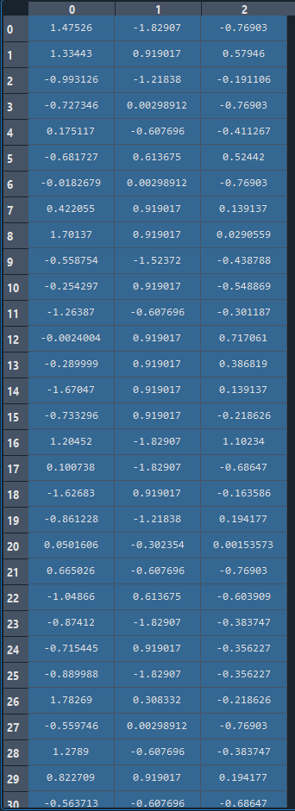
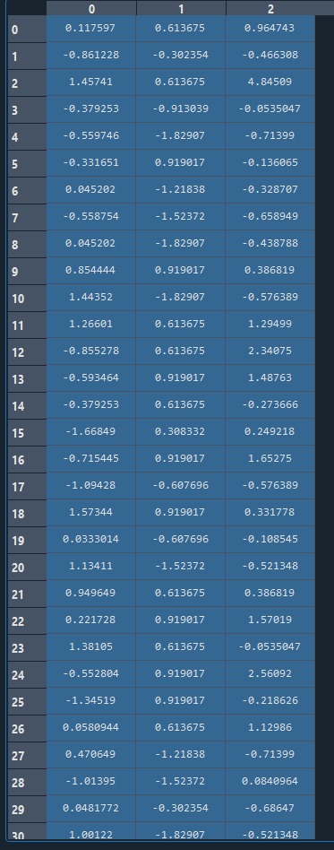
CSE 315 –
Machine Learning
Midterm Project
Report
Classification
After Standart Scalar
TRAIN
TEST
We used standart scalar to find values more reliable

Slide 9
CSE 315 –
Machine Learning
Midterm Project
Report
Classification
After Standart Scalar
TRAIN
TEST
We used standart scalar to find values more reliable

Slide 10
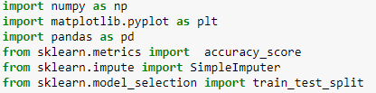
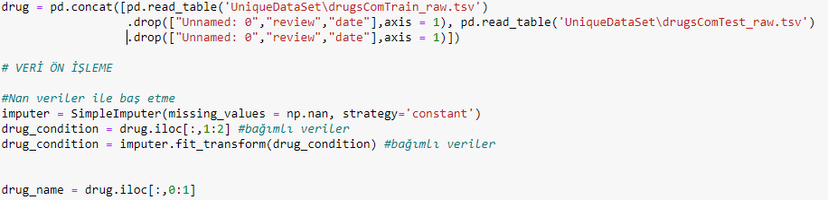
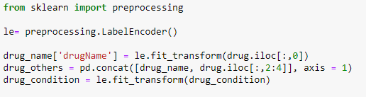
CSE 315 –
Machine Learning
Midterm Project
Report
Classification
Importing Libraries
Reading Datas
Preprocessing

Slide 11
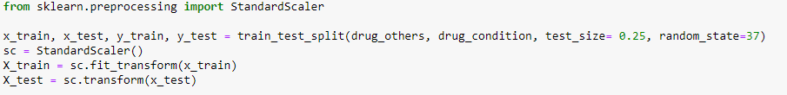
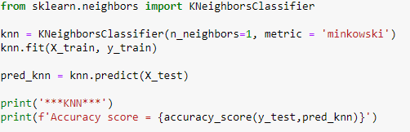
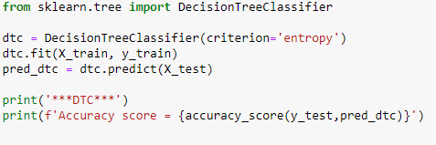
CSE 315 –
Machine Learning
Midterm Project
Report
Classification
Standart Scalar
KNN
Decision Tree

Slide 12


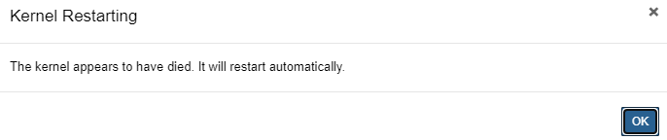
CSE 315 –
Machine Learning
Midterm Project
Report
Classification
We tried 5 different classification methods so far. 2 of them worked well
RFC gave an error like this
Logistic Regression gave an error like this
SVC made the kernel die
We have these errors cause of data’s size

Slide 13
CSE 315 –
Machine Learning
Midterm Project
Report
Clustering
Basic Flowchart of Clustering Model
Importing Libraries
Reading Datas
Preproccesing
Data Visualation
Showing WCSS of K-Means
Applying K-Means Method
Prediction of K-Means

Slide 14


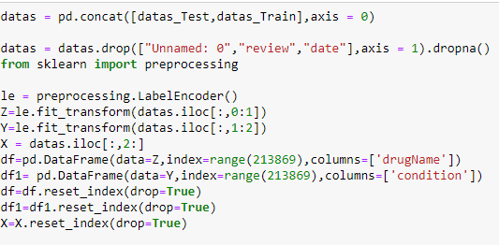

CSE 315 –
Machine Learning
Midterm Project
Report
Clustering
Importing Libraries
Reading Datas
Preproccesing

Slide 15

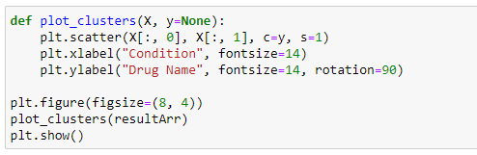

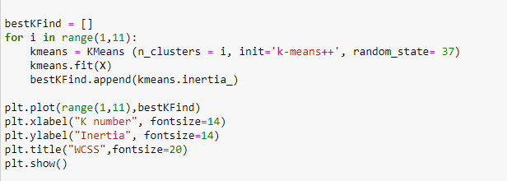
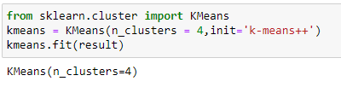
CSE 315 –
Machine Learning
Midterm Project
Report
Clustering
Applying K-Means Method

Slide 16
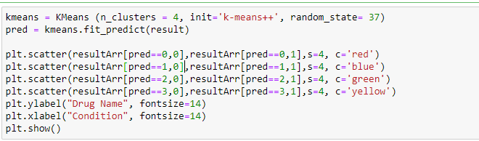
CSE 315 –
Machine Learning
Midterm Project
Report
Clustering
Prediction of K-Means

Slide 17
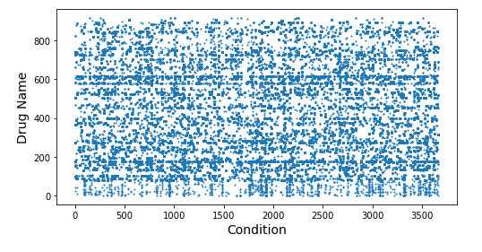
CSE 315 –
Machine Learning
Midterm Project
Report
Clustering
We tried 2 different clustering methods so far. 1 of them worked well
Data Table before clustering

Slide 18
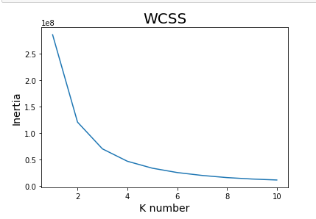
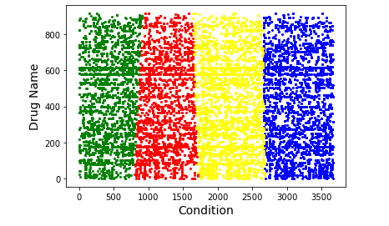
CSE 315 –
Machine Learning
Midterm Project
Report
Clustering
We tried 2 different clustering methods so far. 1 of them worked well
K-Means:
After seeing the WCSS we can see there is a clear elbow in n=4
Data’s clustering with K-Means
K-Means Centrel Points
[[1238.0432115 297.53457297 6.68750706 23.05591523] [3191.56343465 412.07453886 7.12463875 32.51734973]
[436.05787518 411.41234608 7.24509918 32.20757494] [2139.50732913 377.87101342 6.96678166 26.03924434]]

Slide 19
CSE 315 –
Machine Learning
Midterm Project
Report
Clustering
We tried 2 different clustering methods so far. 1 of them worked well
Hierarcy Clustering
After computing the Hierarcy Clustering it give us a MemmoryError
We have these errors cause of data’s size

Slide 20
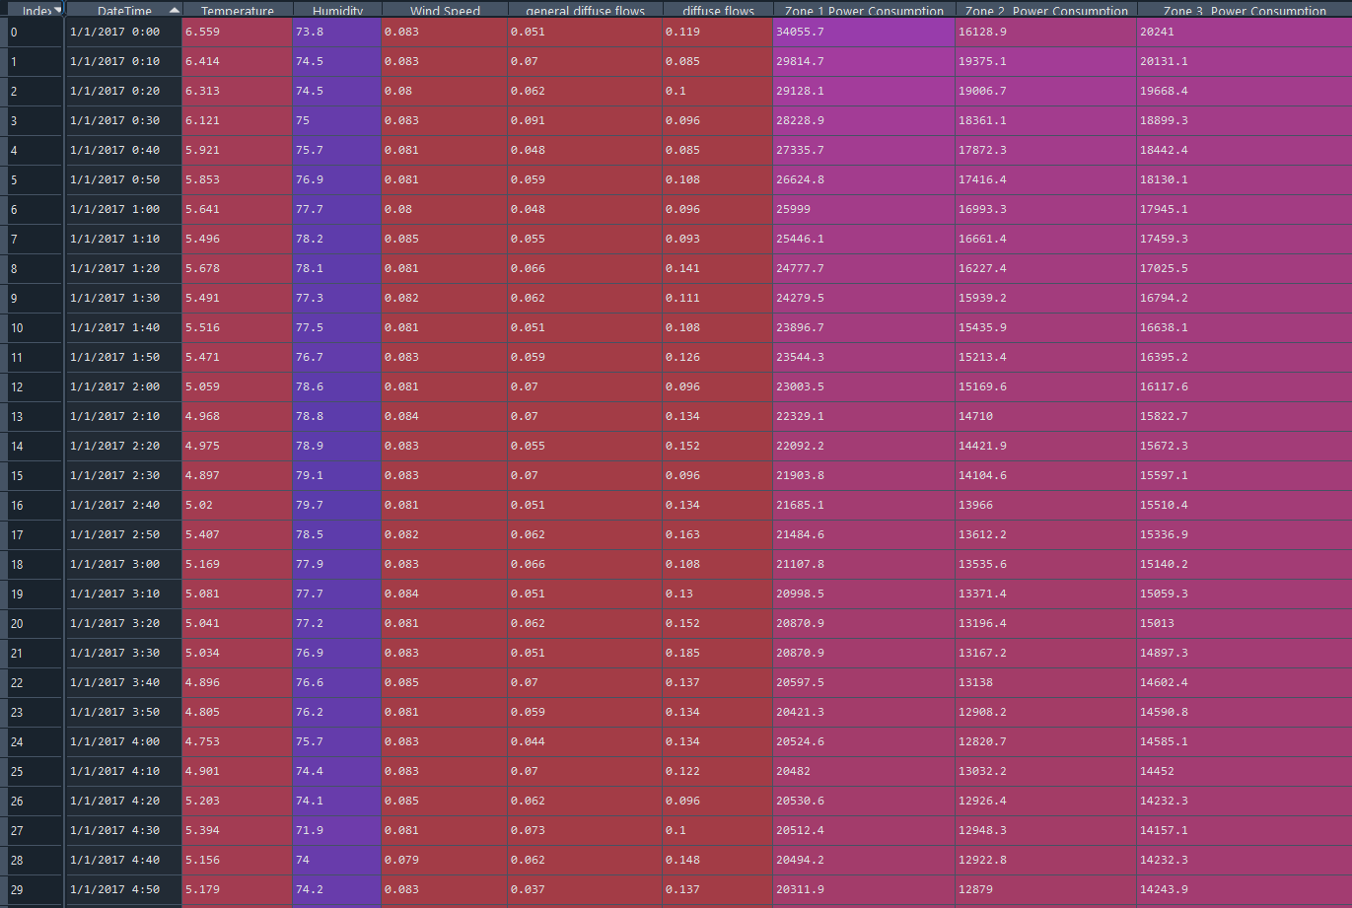
CSE 315 –
Machine Learning
Midterm Project
Report
Meet the Unique
Data Set For Regression
This dataset is related to power consumption of three different distribution networks of Tetouan city which is located in north Morocco.

Slide 21
CSE 315 –
Machine Learning
Midterm Project
Report
Attribute Information
Date Time: Each ten minutes.
Temperature: Weather Temperature of Tetouan city.
Humidity: Weather Humidity of Tetouan city.
Wind Speed of Tetouan city.
General diffuse flows.
Diffuse flows.
power consumption of zone 1 of Tetouan city.
power consumption of zone 2 of Tetouan city.
power consumption of zone 3 of Tetouan city.

Slide 22
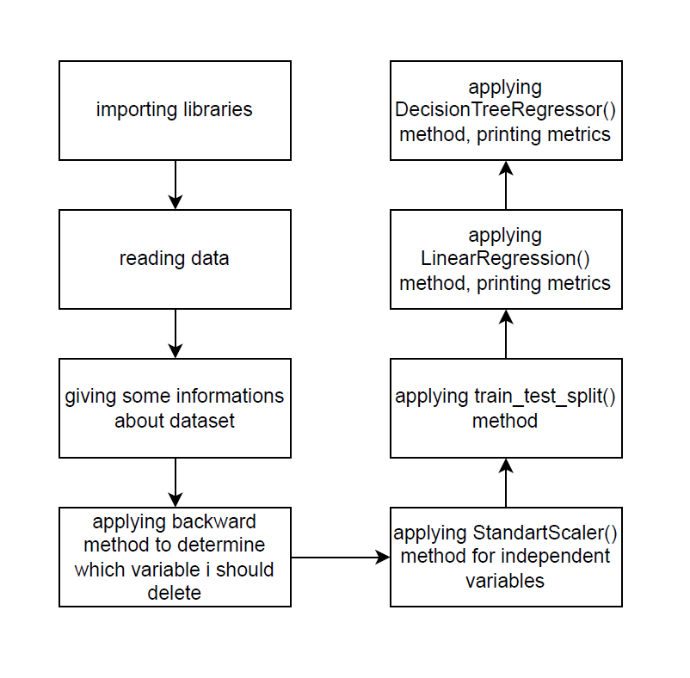
CSE 315 –
Machine Learning
Midterm Project
Report
Basic Flowchart of Regression Model

Slide 23
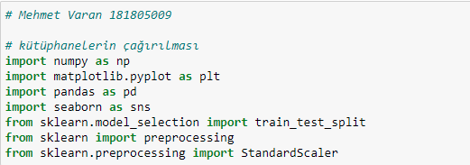
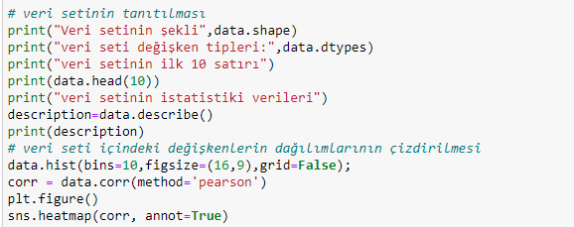
CSE 315 –
Machine Learning
Midterm Project
Report
1- Importing libraries
2- Reading data
3- Giving some informations about dataset

Slide 24
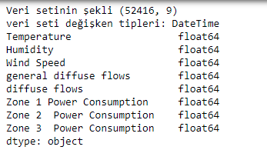
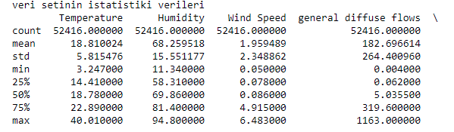
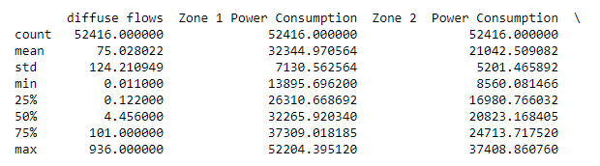
CSE 315 –
Machine Learning
Midterm Project
Report
3- Giving some informations about dataset(cont.)

Slide 25
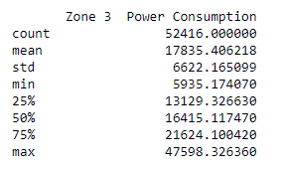
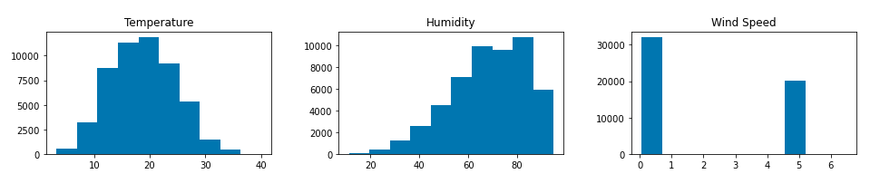
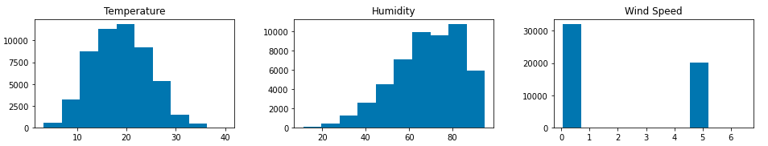
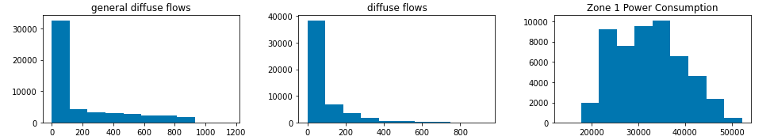
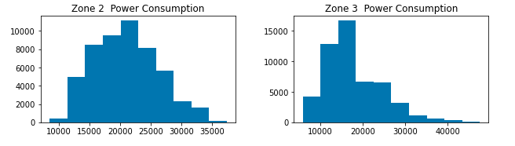
CSE 315 –
Machine Learning
Midterm Project
Report
3- Giving some informations about dataset(cont.)

Slide 26
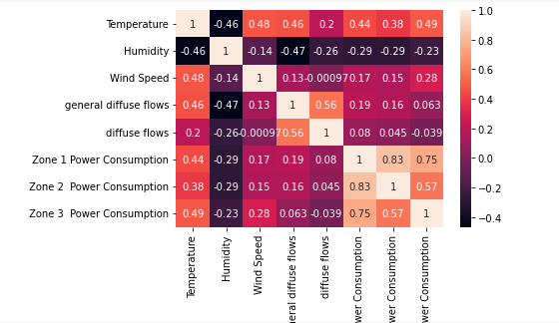
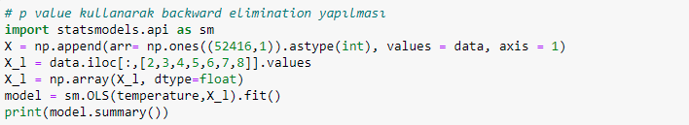
CSE 315 –
Machine Learning
Midterm Project
Report
3- Giving some informations about dataset(cont.)
4- Getting dependent variable
5- Applying backward elimination method

Slide 27
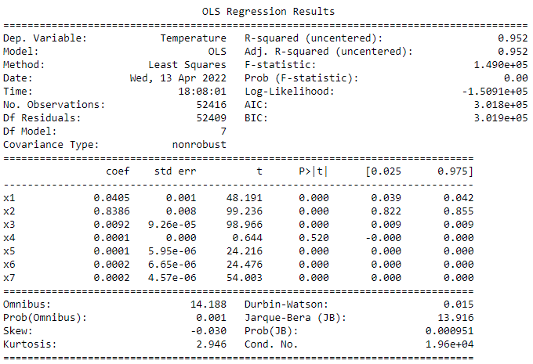
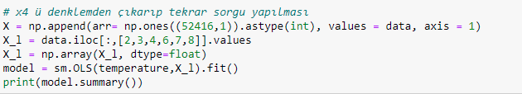
CSE 315 –
Machine Learning
Midterm Project
Report
5- Applying backward elimination method(cont.)
5- Applying backward elimination method(cont.)
X4 has highest P value. Thus, I remove it from equation.

Slide 28
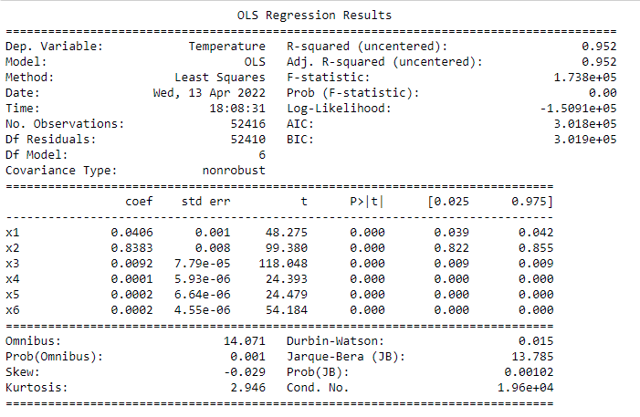

CSE 315 –
Machine Learning
Midterm Project
Report
5- Applying backward elimination method(cont.)
6-Getting independent variables and applying StandartScaler()
7- Splitting data using train_test_split()

Slide 29

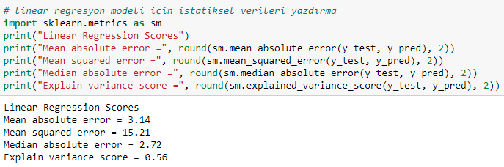

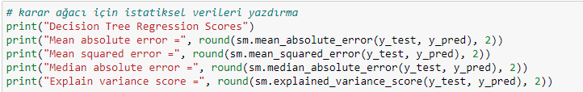
CSE 315 –
Machine Learning
Midterm Project
Report
8- Applying LinearRegression() and getting some metric values
9- Applying DecisionTreeRegressor() and getting some metric values

Slide 30

CSE 315 –
Machine Learning
Midterm Project
Report
9- Applying DecisionTreeRegressor() and getting some metric values(cont.)
The DecisionTree model is more suitable for this dataset. Because there are more then one independent variable and these variables are different from each other.Some of them are suitable for Non-Linear Regression model but some of them are not. So, I used the DecisionTree model and it predicts %80.

Slide 31
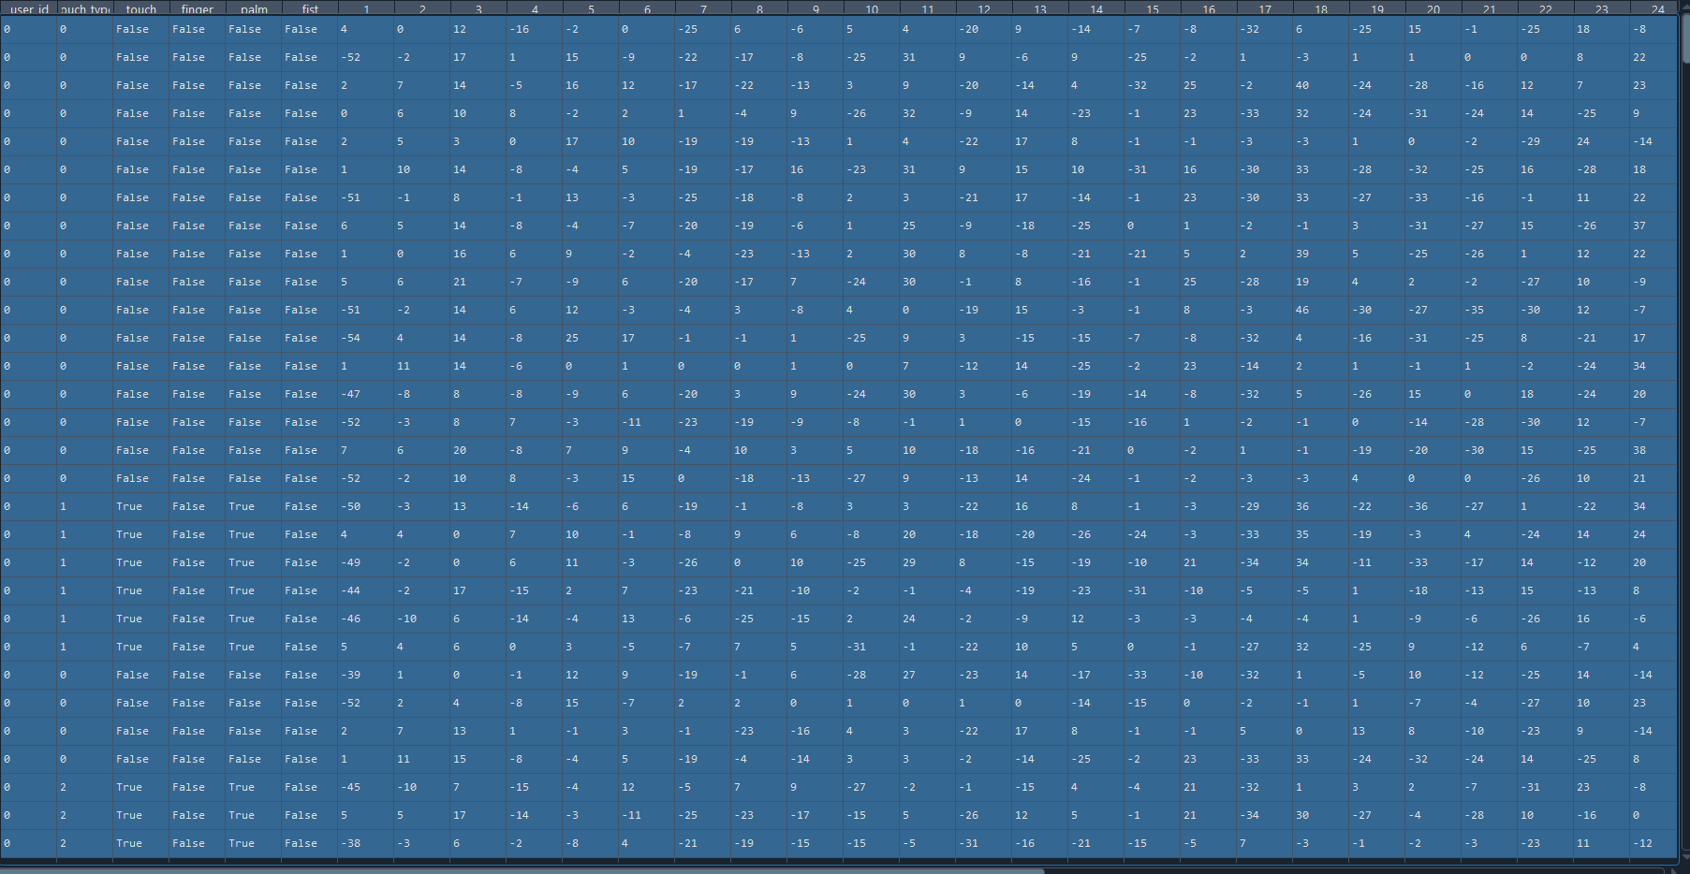
CSE 315 –
Machine Learning
Midterm Project
Report
Meet the Common
Data Set For Classification
Data Features
user_id(int): Determines the user
touch_type(int): Determines the touch type
touch(Bool): check if touched
finger(Bool): check if touch type is finger
palm(Bool): check if touch type is palm
fist(Bool): check if touch type is fist
data_measurement(2dArray): data measurement

Slide 32
CSE 315 –
Machine Learning
Midterm Project
Report
Classification
Basic Flowchart of Classification Model
Importing Libraries
Reading Datas
Preprocessing
GNB
Standart Scalar
SVC
PCA
Logistic Regression
Train and Test Splitting
RandomForestClassifier
Decision Tree
KNN

Slide 33
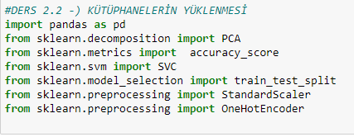
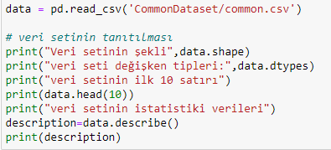
CSE 315 –
Machine Learning
Midterm Project
Report
Classification
Importing Libraries
Reading Datas

Slide 34
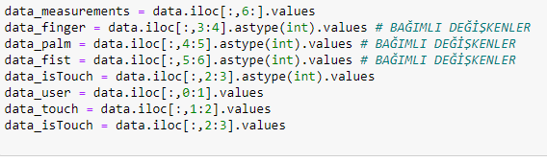


CSE 315 –
Machine Learning
Midterm Project
Report
Classification
Preprocessing
Standart Scalar
PCA

Slide 35
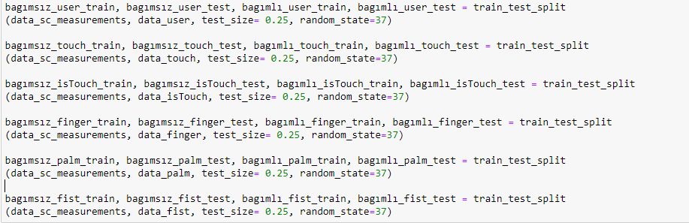

CSE 315 –
Machine Learning
Midterm Project
Report
Classification
Train and Test Splitting
Decision Tree

Slide 36

CSE 315 –
Machine Learning
Midterm Project
Report
Classification
KNN

Slide 37

CSE 315 –
Machine Learning
Midterm Project
Report
Classification
RandomForestClassifier

Slide 38

CSE 315 –
Machine Learning
Midterm Project
Report
Classification
Logistic Regression

Slide 39

CSE 315 –
Machine Learning
Midterm Project
Report
Classification
SVC

Slide 40

CSE 315 –
Machine Learning
Midterm Project
Report
Classification
GNB

Slide 41







CSE 315 –
Machine Learning
Midterm Project
Report
Classification
Decision Tree
KNN
RandomForestClassifier
Logistic Regression
SVC
GNB

Slide 42
CSE 315 –
Machine Learning
Midterm Project
Report
Classification
We tried to classify User id, Touch Type,Finger,Palm,Fist according to measurements. We don’t classify Touch feature because if any finger palm fist is touched, feature is automatically true.
First of all we read dataset after that we make data prepared for classififcation(preproccesing).we used standart scaler and principal component analysis for the data. We entried 1000 component for the principal component analysis. We held variance of principal component analisys and measurements before scaled.
We splited data to train and test(0.75 and 0.25 rate).So everything was ready for Classification. We tried to Decision tree, K-Nearest Neighbors, Random Forest, Logistic Regression, Support Vector, Gaussian Naive Bayes algorithms.
Best algorithm was Decision Tree Classifier for us. Other algorithms overfitted while learning process.

Slide 43


CSE 315 –
Machine Learning
Midterm Project
Report
Classification
Variance of PCA
Measurement before Scaled

