Slide 1
+
Display 1
Display 1: Fixation
A fixation cross will first appear in the middle of the screen.
This indicates the beginning of a new trial.
Please maintain fixation throughout the experiment.

Slide 2
+
Display 1
Display 1: Fixation
A fixation cross will first appear in the middle of the screen.
This indicates the beginning of a new trial.
Please maintain fixation throughout the experiment.

Slide 3
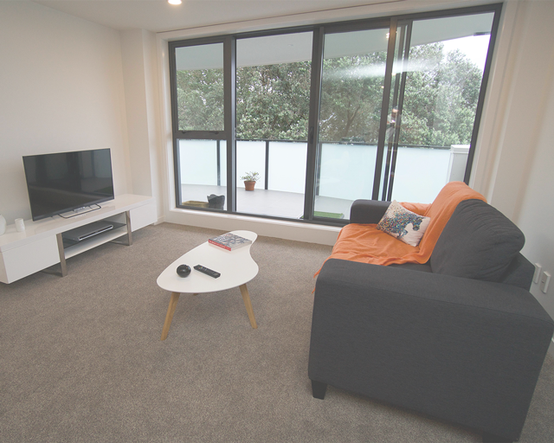
+
+
Display 1
Display 2
Display 2: Scene
An image of a scene will then appear in the middle of the screen.
No response is needed and keep maintaining fixation.

Slide 4
+
+
+
Display 1
Display 2
Display 3
Display 3: Objects
Two objects will then appear to the left and right of the fixation.
No response is needed and keep maintaining fixation.

Slide 5
+
+
+
+
Display 1
Display 2
Display 3
Display 4
Display 4: Targets
A small circle with vertical lines slanted either left or right will briefly appear on top of the fixation cross as well as one of the object. A checkerboard distractor will appear on top of the other object.
Your task is to indicate whether the two circle targets are slanted in the same direction or not.
If the two are slanted in the same direction, press the “f” key.
If the two are not slanted in the same direction, press the “j” key.

Slide 6
+
+
+
+
+
Display 1
Display 2
Display 3
Display 4
Display 4
Display 4: Targets
A small circle with vertical lines slanted either left or right will briefly appear on top of the fixation cross as well as one of the object. A checkerboard distractor will appear on top of the other object.
Your task is to indicate whether the two circle targets are slanted in the same direction or not.
If the two are slanted in the same direction, press the “f” key.
If the two are not slanted in the same direction, press the “j” key.

Slide 7
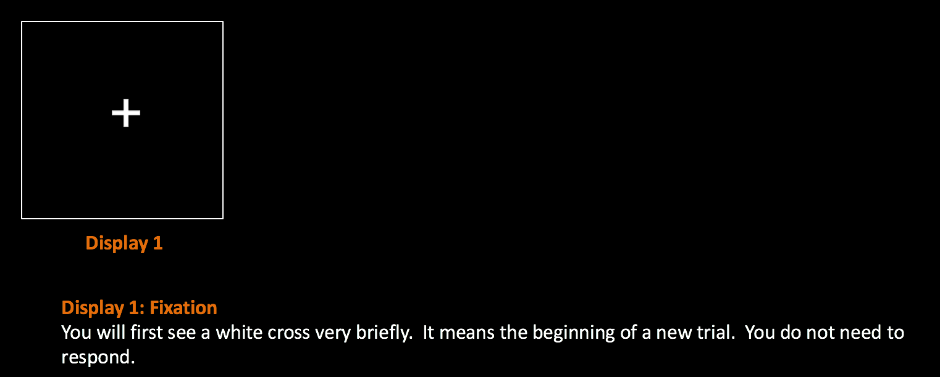

Slide 8
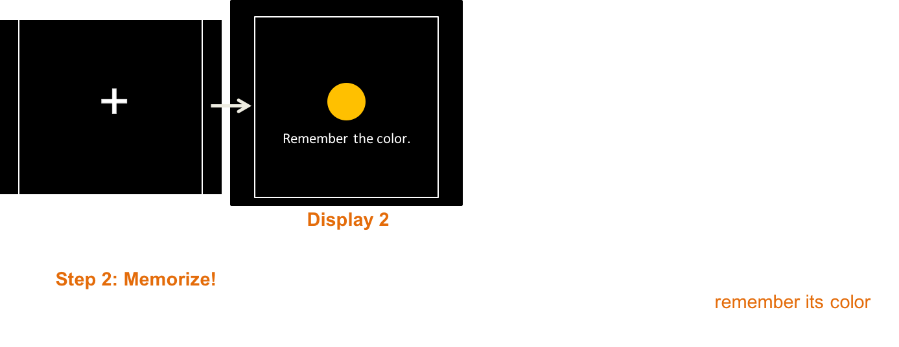

Slide 9
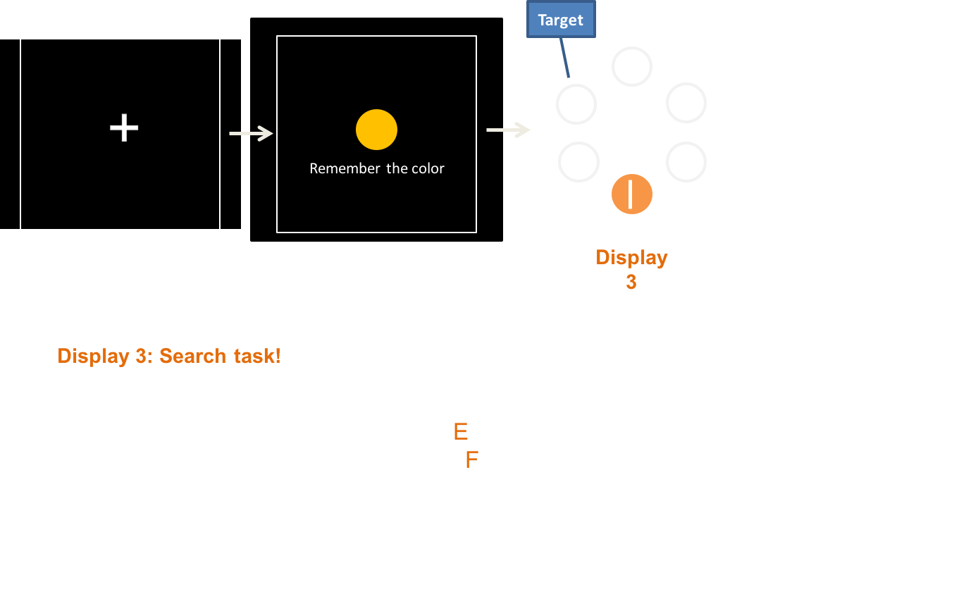

Slide 10
+
Display 1
Display 1: Fixation
A fixation cross will first appear in the middle of the screen. This indicates the beginning of a new trial. Please maintain fixation throughout the experiment.

Slide 11
+
+
Display 1
Display 2

Slide 12
+
+
+
Display 1
Display 2
Display 3

