Slide 1

Welcome!
In this experiment, you will be performing an orientation matching task. On every trial, you will be briefly presented with two patches of orientation and a checkerboard (like below) overlaid on top of two objects.
Your task is to report whether the two patches match in orientation, and to ignore the checkerboard.
There will be a total of X blocks of trials. Each block has XX trials and the experiment will last between 20 to 30 minutes. You will be able to take breaks in between blocks.

Slide 2
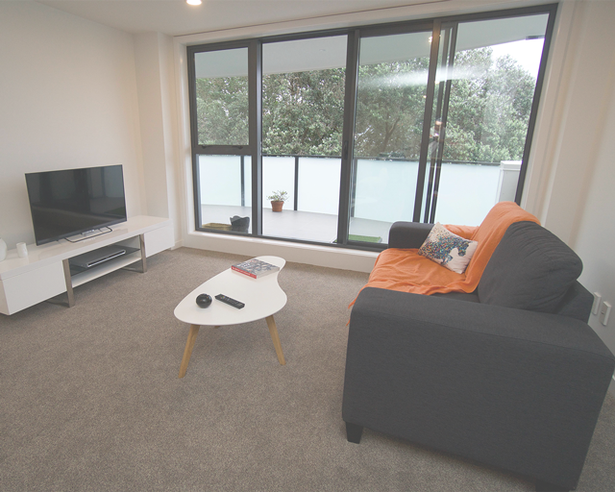
+
+
+
Display 1
Display 1: Fixation
A fixation cross will appear in the middle of the screen, indicating the start of a new trial
No response is necessary, please keep your eyes fixated on the cross

Slide 3
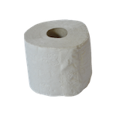
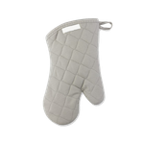
+
+
+
+
+
+
Display 1
Display 3
Display 2
Display 2: Scene
An image of a scene will then appear in the middle of the screen
Again, no response is needed and keep maintaining fixation on the cross

Slide 4
+
+
+
+
+
+
Display 2
Display 4
Display 3
Display 3: Objects
Two objects will appear on either side of the fixation
No response is needed and keep maintaining fixation

Slide 5
+
+
+
+
+
+
Display 3
Display 5
Display 4
Distractor
Two targets
Display 4: Targets
Two small target circles with vertical slanted lines will briefly appear, one in the center and the other on one of the objects
Your task is to indicate whether the two circle targets match in orientation
The above is an example when orientations match
Ignore the checkerboard circle
The circles are only flashed for a very short time, so pay attention

Slide 6
+
+
+
+
Display 4
Display 5
Display 5: Objects & Scene
Since the circles orientations only appear briefly, try to remember whether orientations matched or not
If the two match in orientation, press the f key
If the two are in different orientation, press the j key
If you did not see the orientations, take your best guess

Slide 7
+
+
+
+
+
+
+
+
+
Display 1
Display 2
Display 3
Display 4
Display 5
Experiment Sequence
A quick recap. This is the experiment sequence. Maintain fixation on the cross throughout the experiment and report whether the two circle targets are slanted in the same direction or not.
If the two are slanted in the same direction, press the f key.
If the two are not slanted in the same direction, press the j key.

Slide 8
Good Job! You finished practice.
Now, get ready for the real experiment.
Note: There will be no instructions and the targets will be presented for only a brief period of time.
Press Spacebar to begin the experiment

Slide 9
You completed the experiment. Thank you!
Press Spacebar to continue

