Slide 1
Flight management And Booking
professor Joe bruen
Group Saigonese:
bon nguyen
Nghia nguyen
hiep nguyen

Slide 2
contents
Introduction
Main Use Cases
Static Model
Technologies Used
Future Extension
Demo

Slide 3
introduction
Flight Information System is to manage and present all flight info and related info: airplane, airline and airport.
The team decided to selected a type of project that we could practice the studied topics as many as possible.
Ability to extend business domain and technologies.

Slide 4
Main Use cases
 | Use Case | Description | Onwer
1 | Airport | Add/modify an Airport | Nghia Nguyen
2 | Airline | Add/modify an Airline | Hiep Nguyen
3 | Airplane | Add/modify an Airplane | Bon Nguyen
4 | Flight | Add/modify a flight | Nghia Nguyen
5 | Flight Booking | Book ticket for a flight | Hiep Nguyen
6 | Online Support | Online chat support | Bon Nguyen
7 | Login / Logout | Log user in/out | Hiep Nguyen

Slide 5
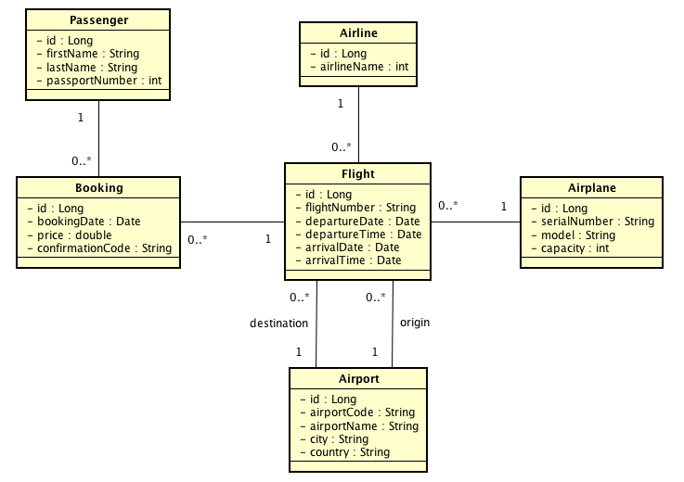
Static model

Slide 6
Technologies used
Annotation
Data binding
Validation; Custom Validation
Custom Formatter
Uploading files -> Chua lam
Internationalization
Exception Handling
REST/Ajax two way; error handling → Chua lam
Security ; Login, Authorization
Web Sockets
Web Flow
Tiles
Persistence in database [JPA]
DB: MySQL

Slide 7
Future Extension
Business Domain:
Customer register
Email booking
Payment
Technologies:
Advanced Search, Mobile app
Spring Cloud and Microservices: distributed config, service discovery, routing & load balancing, etc

Slide 8
SCI
“Do less and accomplish more”
What we studied in this course is the same as the above quote.

Slide 9
Demo
Q&A

