Slide 1
Flight management And Booking
professor Joe bruen
Team Saigonese:
bon nguyen
Nghia nguyen
hiep nguyen

Slide 2
contents
About
Introduction
Technologies Used
Main Use Cases
Static Model
Future Extension
Demo

Slide 3
About
Flight Management and Booking project
An engineering proof of concept
Not a planned marketable project
The goal is to exercise the Spring MVC technology according to the Web Application Architecture (WAA) course guidelines to validate its use in future projects.
The team decided to select a type of project that we could practice the studied topics as many as possible.

Slide 4
introduction
An online web application which provides ability
To view flights and make a booking for a flight.
To view booking
Back-office features - provided for authorized person for system administration purpose

Slide 5
Technologies used
Annotation
Data binding
Validation; Custom Validation
Custom Formatter, Interceptor
Internationalization
Exception Handling
REST/Ajax two way; error handling
Security; Authentication & Authorization
Web Sockets
Web Flow
Tiles
Persistence in database [JPA]
DB: MySQL

Slide 6
Main Use cases
 | Use Case | Description | Onwer
1 | Airport | Add/modify an Airport | Nghia Nguyen
2 | Airline | Add/modify an Airline | Hiep Nguyen
3 | Airplane | Add/modify an Airplane | Bon Nguyen
4 | Flight | Add/modify a flight | Nghia Nguyen
5 | Flight Booking | Create/View flight booking | Hiep Nguyen
6 | Online Support | Online customer chat support | Bon Nguyen
7 | Login / Logout | Log in/out for back-end portal (admin) | Hiep Nguyen

Slide 7
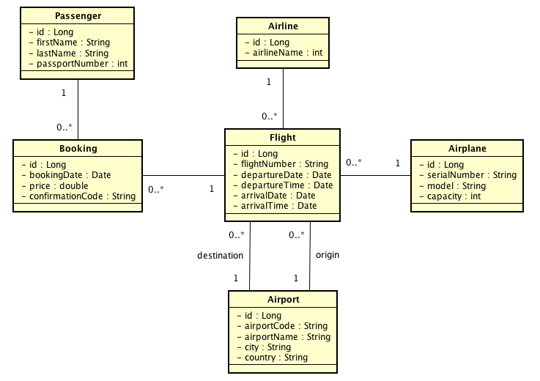
Static model

Slide 8
Future Extension
Business Domain:
Customer registration
Promotion
Multiple customer online support
Online checking
Payment
Technologies:
Search and Advanced Search
Mobile app
Spring Cloud and Microservices: distributed config, service discovery, routing & load balancing, etc

Slide 9
SCI
“Do less and accomplish more”
What we studied in this course is the same as the above quote.

Slide 10
Demo
Q&A

