Slide 1
login
Using form-based authentication
Web request authorization using interceptors

Slide 2
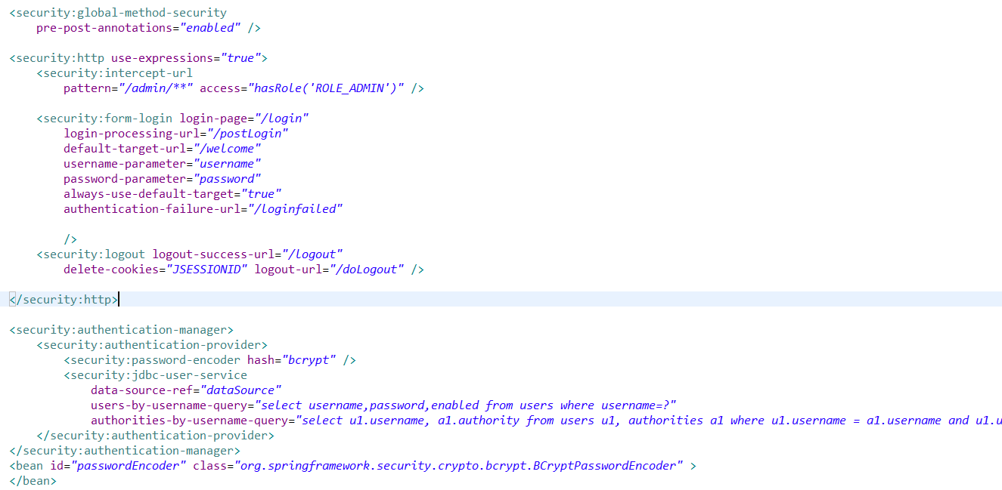
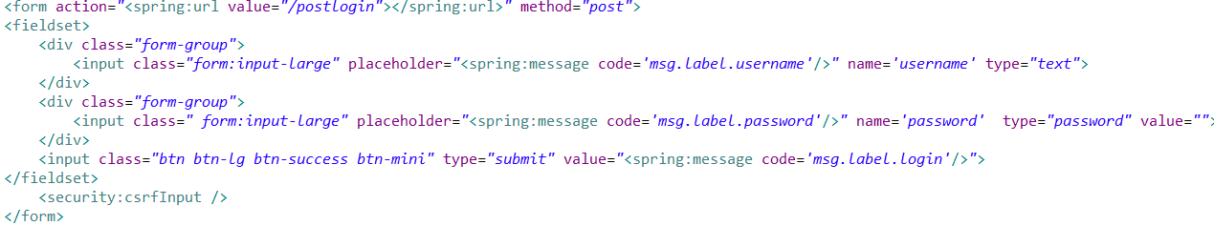

Slide 3
Template for View
Using Tile Resolver to create template
Reuse code header and footer
Just render content
Separating UI between Guest and Admin

Slide 4
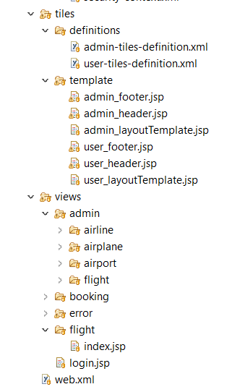
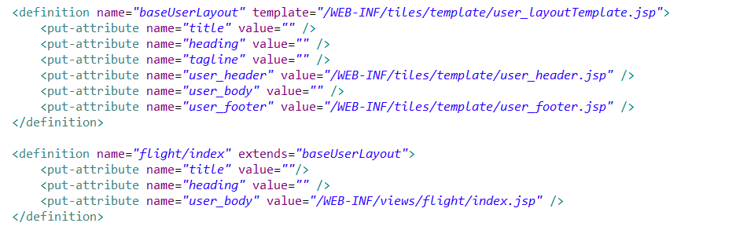

Slide 5
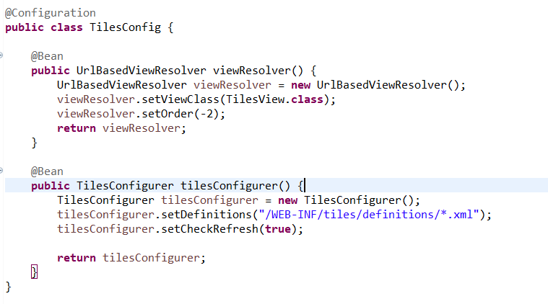
Configuration

Slide 6
Demo login and template view

Slide 7
Booking Flight
Using Spring Web Flow

Slide 8
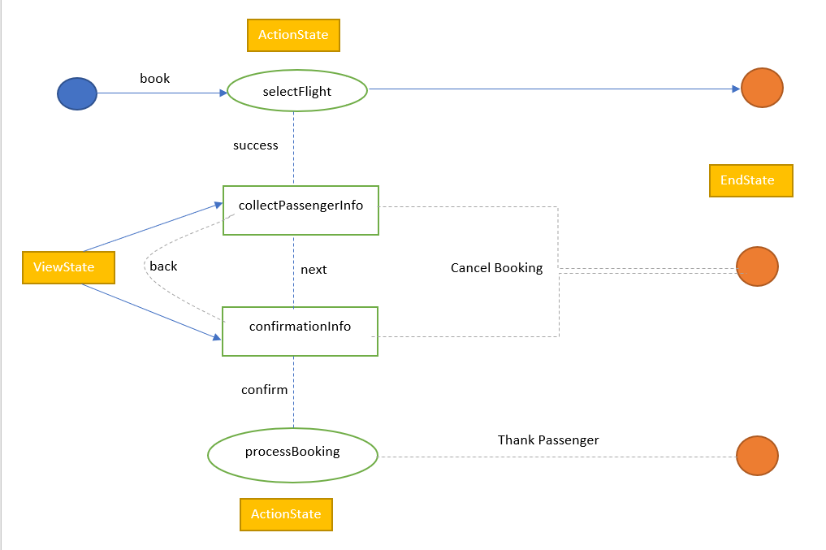

Slide 9
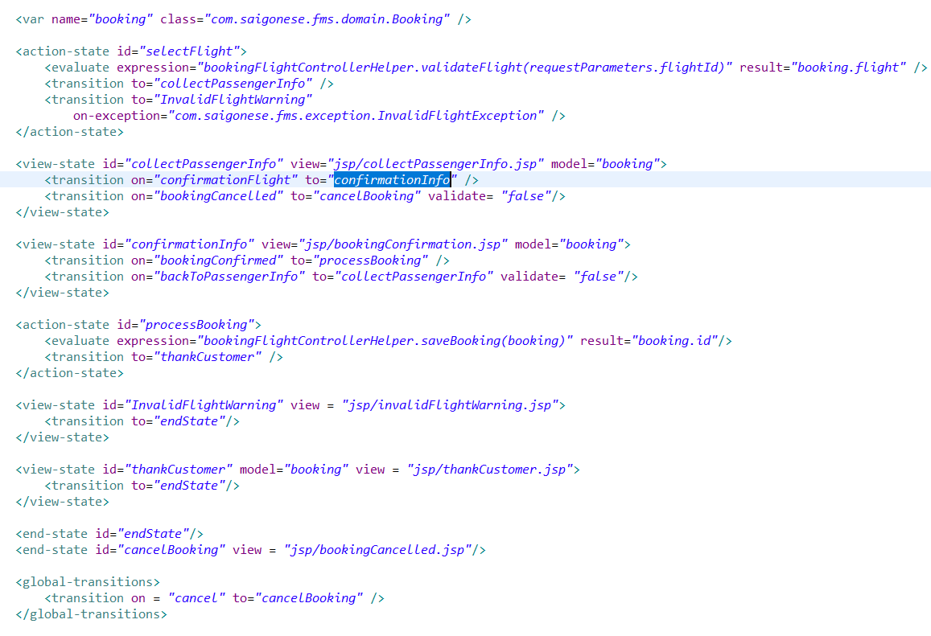
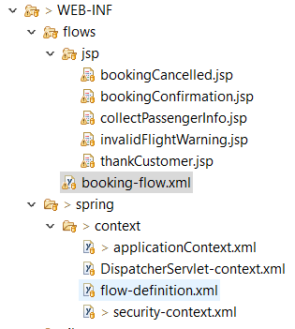
Configuration

Slide 10
View Booking Flight
Using ConfirmationCode to search booked flight
Add new function to interface BookingRepository that extends CrudRepository
Using @Query to get data from database

Slide 11
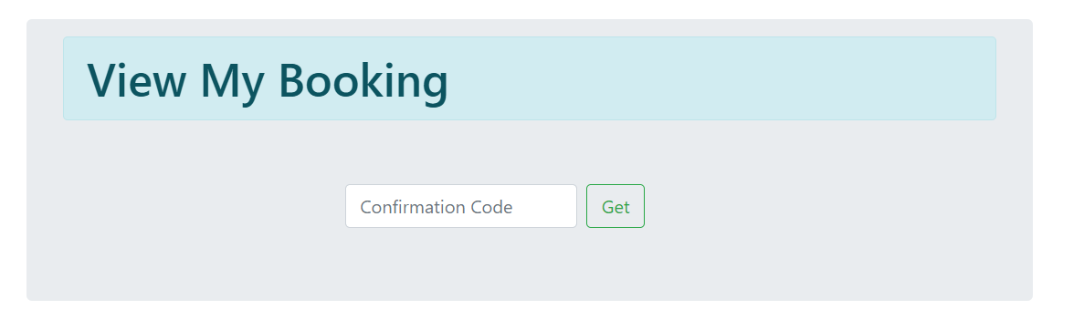
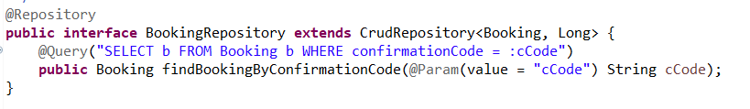
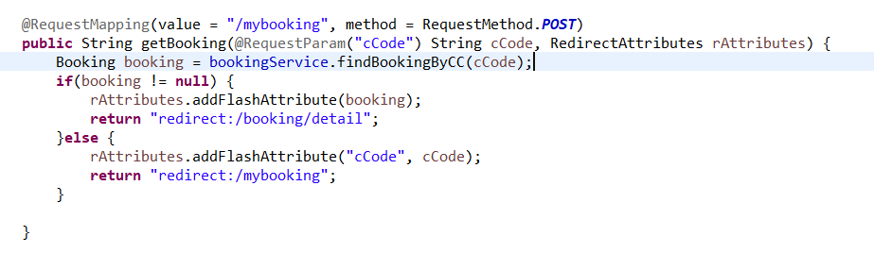

Slide 12
Demo Book and view my booking

