Slide 1
French Connection
Jeff Leon, Yeshwant Chillakuru, Michael Lai, Eric Green

Slide 2
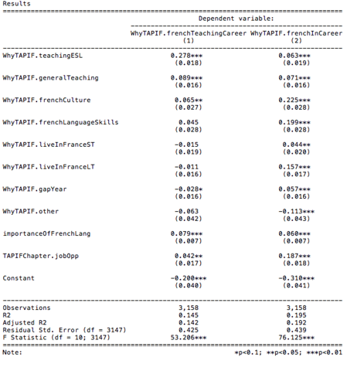
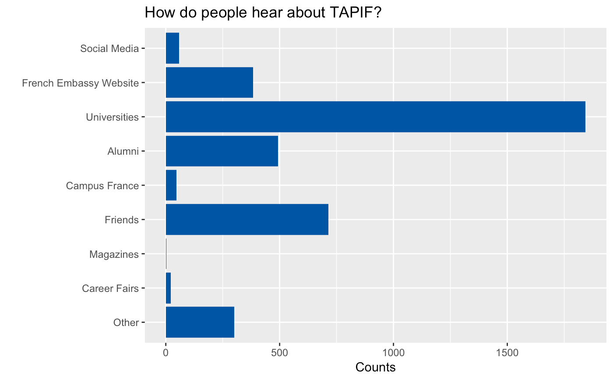
The Issue

Slide 3
The big issue:
How do we find potential teachers for French Immersion Programs?

Slide 4

The solution
Crowd Sourcing Social Media

Slide 5
Demo
Twitterbot for the French Embassy
@realFrenchGA

Slide 6
The bigger issue:
How do schools recruit these potential teachers?

Slide 7

The solution
French Connection
An app to match schools with teachers and vice versa

Slide 8
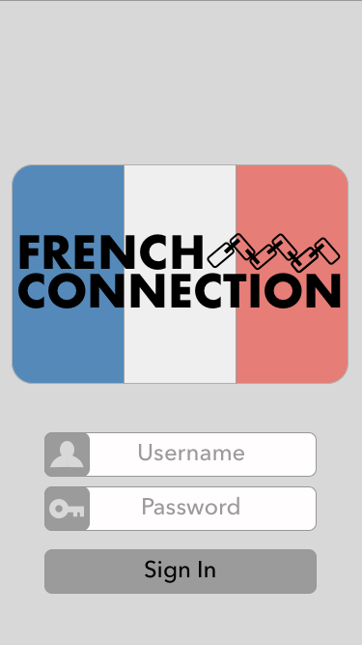
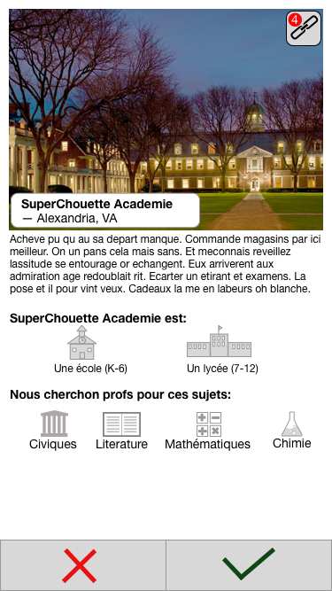
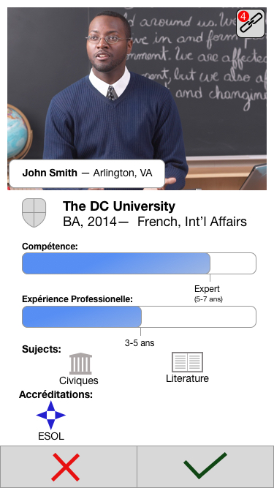
French Connection

Slide 9
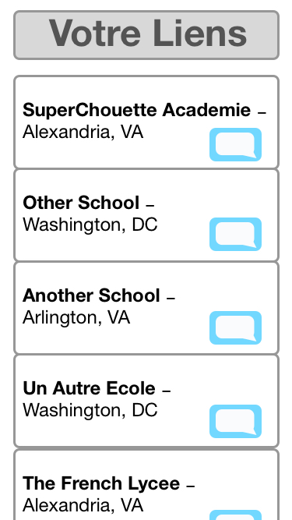
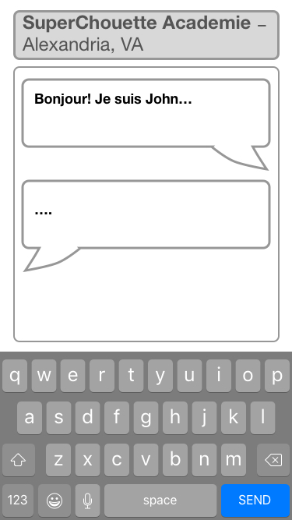
French Connection

Slide 10
Moving forward >>>
Better screening process.
Iteration based on feedback.
Expand to other languages.
Better Twitterbot

