Slide 1
Comparison Report of SMLib Versions
SMLib 8.11 vs SMLib 8.12

Slide 3
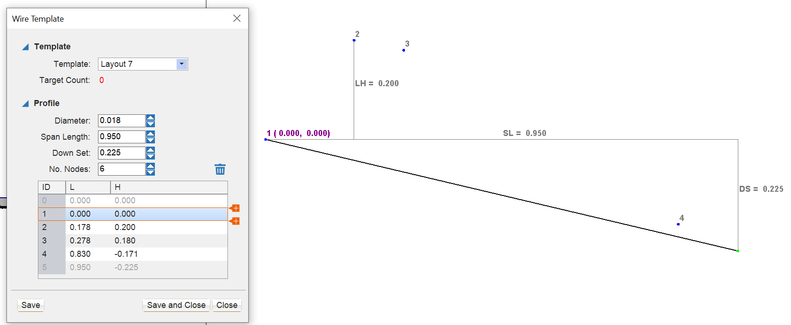
Comparison #1
 | SMLib 8.11 | SMLib 8.12
Srfm Free Edge
Srfm T-connect
Srfm Overlap

