Slide 1

Lecture 6 User-Device Interactions

Slide 2
Recap
What’s the difference between keystroke and touch?
How might we obtain touch data from smartphones?
Is touch data dependent on the application?

Slide 3
User-Device Interactions
Data Collection
Screen/power on and off
Battery consumption
Installing / removing applications
Launching applications
Text messages
To who (de-identified, but may indicate area code) and content
Calls
Incoming or outgoing? Missed call?
Networking activity
What networks are seen by the device?
Location
Longitude / latitude

Slide 4
User-Device Interactions
Challenges in feature generation:
Usually, the distribution of the data is heavily skewed – many people tend to “do the same thing”
Data is nominal, so avoiding scarcity is hard
Categories
Frequencies
Sequences
No standard way to extract or match features
The data is not permanent

Slide 5

Let’s Talk About Data Analysis Because this is the only modality that we’ll discuss that does not care about the physical make-up of a person

Slide 6
The Big 7
Universality
Uniqueness
Permanence
Measurability
Performance
Acceptability
Circumvention
Everybody needs a face!
Everybody needs their OWN face!
Your face shouldn’t change so easily or quickly!
Need a device to capture the trait and a means to digitize it!
Accurate and reasonable
Everybody needs to play along!
Hard to trick the system!

Slide 7
The Big 7
Universality
Uniqueness
Permanence
Measurability
Performance
Acceptability
Circumvention
Everybody needs a face!
We will focus on inter-person and intra-person similarity
We will focus on how stable the data is over time; this helps to establish an appropriate template size
We will focus on categorical and numerical representations of the data
Accurate and reasonable
Everybody needs to play along!
Hard to trick the system!

Slide 8
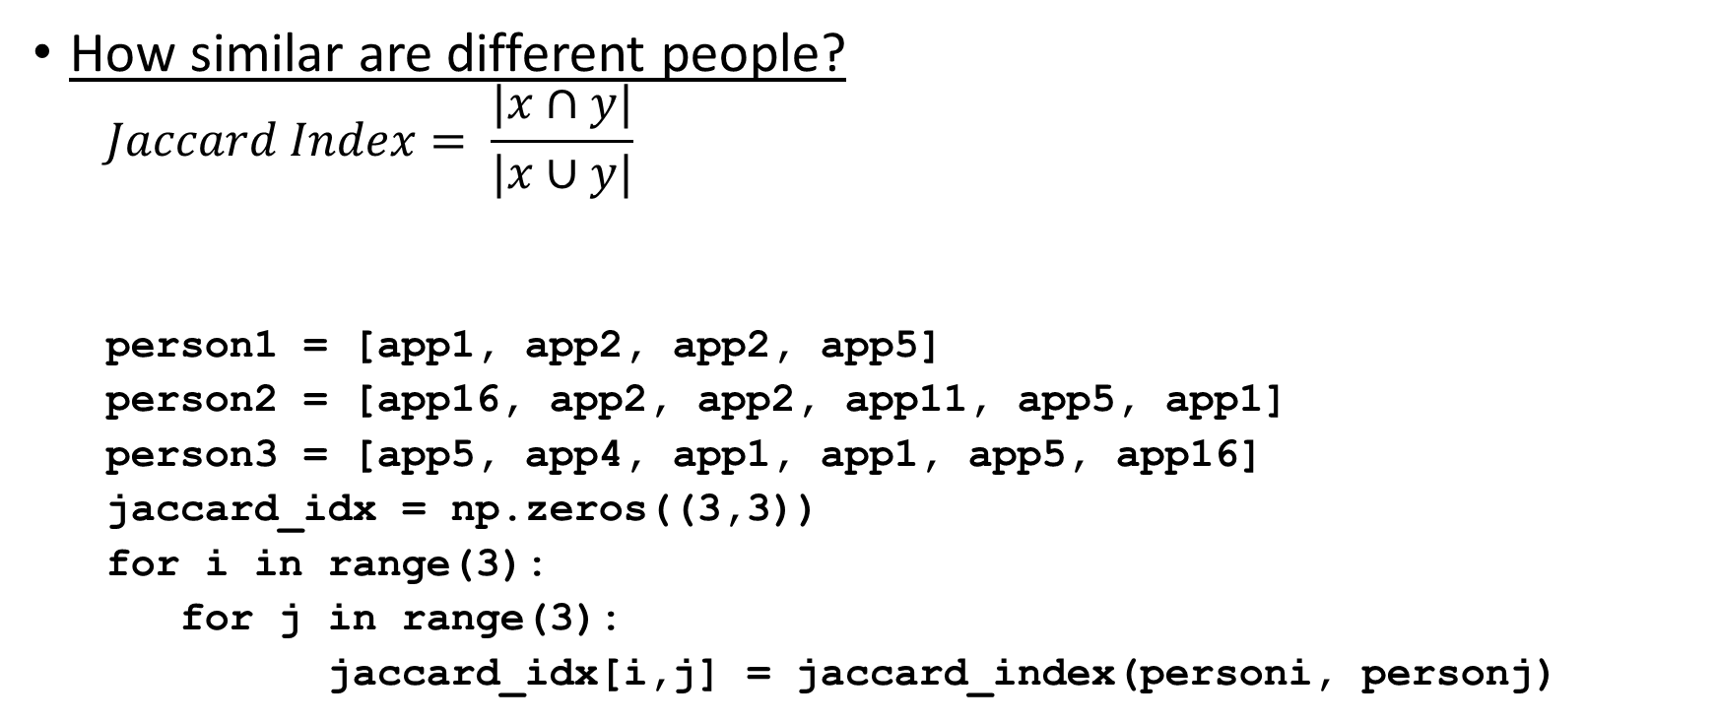
Inter-person Similarity
How similar are different people?
$$Jaccard Index= \frac{|x∩y|}{|x∪y|}$$
person1 = [app1, app2, app2, app5]
person2 = [app16, app2, app2, app11, app5, app1]
person3 = [app5, app4, app1, app1, app5, app16]
jaccard_idx = np.zeros((3,3))
for i in range(3):
for j in range(3):
jaccard_idx[i,j] = jaccard_index(personi, personj)
def jaccard_index(x, y):
a = set(x)
b = set(y)
return len(a.intersection(b)) / len(a.union(b))

Slide 9
Inter-person Similarity
person1 = [app1, app2, app5]
person2 = [app16, app2, app11, app5, app1]
person3 = [app5, app4, app1, app16]
 | Person1 | Person2 | Person3
Person1 | 1.0 | 1, 2, 5 1, 2, 5, 11, 16 3 / 5 = 0.6 | 1, 5 1, 2, 4, 5, 16 2 / 5 = 0.4
Person2 | 1, 2, 5 1, 2, 5, 11, 16 3 / 5 = 0.6 | 1.0 | 16, 5, 1 16, 2, 11, 5, 1, 4 3 / 6 = 0.5
Person3 | 1, 5 1, 2, 4, 5, 16 2 / 5 = 0.4 | 16, 5, 1 16, 2, 11, 5, 1, 4 3 / 6 = 0.5 | 1.0

Slide 10
Inter-person Similarity using the Jaccard Index
def jaccard_index(x, y):
a = set(x)
b = set(y)
return len(a.intersection(b)) / len(a.union(b))
def compute_intersimilarity(data, num_subjects):
interperson_similarity = np.zeros((num_subjects,num_subjects))
for i in range(num_subjects):
for j in range(num_subjects):
interperson_similarity[i,j] = jaccard_index(data[i], data[j])
plt.figure()
plt.imshow(interperson_similarity, cmap="Reds")
plt.title('Inter-person similarity')
for i in range(3):
for j in range(3):
plt.text(j, i, '%.2f‘ % interperson_similarity[i, j],
ha="center", va="center", fontsize=10)
return
Goal: Select features that minimize
the values in the off-diagonal if using a
similarity metric
Goal: Select features that maximize the
Values in the off-diagonal if using a
Distance metric

Slide 11
Intra-person Similarity
How similar are you with yourself?
Goal: Select features that maximize the values in the off-diagonal if using a similarity metric / minimize the values if using a distance metric
def compute_intrasimilarity(data, n):
intraperson_similarity = np.zeros((n,n))
chunksize = int(len(data) / float(n))
u = 0
v = 0
for i in range(0, len(data)-chunksize, chunksize):
for j in range(0, len(data)-chunksize, chunksize):
intraperson_similarity[u,v] = jaccard_index(data[i:i+chunksize],data[j:j+chunksize])
v += 1
u += 1
v = 0
plt.figure()
plt.imshow(intraperson_similarity, cmap="Reds")
plt.title('Intra-person similarity')
return

Slide 12
Recap
Provide some examples of user-device interactions.
How do they differ from gait and touch biometrics?
Why is data analysis important?
What are some common feature representations for user-device interactions?

Slide 13
The Big 7
Universality
Uniqueness
Permanence
Measurability
Performance
Acceptability
Circumvention
Everybody needs a face!
We will focus on inter-person and intra-person similarity
We will focus on how stable the data is over time; this helps to establish an appropriate template size
We will focus on categorical and numerical representations of the data
Accurate and reasonable
Everybody needs to play along!
Hard to trick the system!

Slide 14
Measuring Permanence
Usually, user-device data is matched using a sliding window approach; if the red blocks represent template data and green represent query data, it’s important to know an appropriate window size.
Is a person’s data stable within the time covering the template and the query?

Slide 15
Measuring Permanence
import numpy as np
def compute_permanence(data, n):
permanence = np.zeros(n)
chunksize = int(len(data) / float(n))
u = 0
for i in range(0, len(data)-chunksize-chunksize, chunksize):
permanence[u] = jaccard_index(data[i:i+chunksize],data[i+chunksize:i+chunksize+chunksize])
u += 1
return permanence
files = ['1.csv', '2.csv', '3.csv']
data = []
for file in files:
temp = open(file)
temp = temp.readlines()
data.append( [t.split(',')[1] for t in temp] )
num_chunks = [5, 10, 20, 50, 100, 200]
permanence_scores = np.zeros((len(data), len(num_chunks)))
for i in range(len(data)):
for j in range(len(num_chunks)):
vector = compute_permanence(data[i], num_chunks[j])
permanence_scores[i,j] = np.mean(vector)

Slide 16

Categorical to Numerical
One-Hot Encoding
Method for transforming a categorical feature value$x$into the binary representation $is_x$.
Most Used App
Facebook
ESPN
Checkers
Facebook
is_facebook | is_ESPN | is_Checkers | is_facebook
1 | 0 | 0 | 0
0 | 1 | 0 | 0
0 | 0 | 1 | 0
1 | 0 | 0 | 0

Slide 17
Categorical to Numerical
One-Hot Encoding
Many machine learning algorithms cannot work with categories
Using a simple numerical encoding could make a classifier think order matters, but Facebook is not better than ESPN
Most Used App
Facebook
ESPN
Checkers
Facebook
is_facebook | is_ESPN | is_Checkers | is_facebook
1 | 0 | 0 | 0
0 | 1 | 0 | 0
0 | 0 | 1 | 0
1 | 0 | 0 | 0

Slide 18
Categorical to Numerical
sklearn.preprocessing.OneHotEncoder
Encode categorical integer features using a one-hot aka one-of-K scheme.
The input to this transformer should be a matrix of integers, denoting the values taken on by categorical (discrete) features. The output will be a sparse matrix where each column corresponds to one possible value of one feature. It is assumed that input features take on values in the range [0, n_values).
This encoding is needed for feeding categorical data to many scikit-learn estimators, notably linear models and SVMs with the standard kernels.
http://scikit-learn.org/stable/modules/generated/sklearn.preprocessing.OneHotEncoder.html#examples-using-sklearn-preprocessing-onehotencoder

Slide 19
Categorical to Numerical
from sklearn.preprocessing import LabelEncoder
from sklearn.preprocessing import OneHotEncoder
import numpy as np
data = np.array(['facebook', 'espn', 'checkers', 'facebook'])
le = LabelEncoder()
data = le.fit_transform(data)
data = data.reshape((len(data),1))
ohe = OneHotEncoder(sparse=False)
data = ohe.fit_transform(data)

Slide 20
THINGS TO REMEMBER
Perform all data analysis only using your training data!
Be able to support your decisions
Why did you choose a certain window size?
How did you determine your feature representation?
Use graphs / statistics when appropriate
You can use a validation set to confirm / tweak your parameters before testing with your test set
You are not confined to the data as given; features can be derived from the raw data, such as the mean and standard deviation of the number of applications accessed at night
 | TR | TR | VA | TE | TE

